Slide 1

2023 NATO BILC STANAG 6001
Testing Workshop
Riga, Latvia
BILC Update and Info
Irena Prpic Djuric, BILC Chair

Slide 2
What is BILC?
Bureau for
International
Language
Co-ordination
a consultative and advisory body for language training and language testing matters in NATO

Slide 3
Bureau for International
Language Co-ordination
1966 – DEU, FRA, GBR, ITA, USA
1978 – 2011 – the Joint Services Sub-Group within NATO Training Group (NTG)
2011 – onwards – under the auspices of the Supreme Allied Commander Transformation (HQ SACT); the HQ SACT Joint Force Development, Human Capital Enhancement & Individual Training Branch (HCEIT Branch) → MEMORANDUM OF COOPERATION between SACT and BILC (2019)

Slide 4

BILC Steering Committee
GBR (1966-1981)
DEU (1982-1996)
USA (1997-2008)
CAN (2008-2014)
USA (2014-2016)
BGR (2016-2019)
SVN (2019-2022)
HRV (2022-2025)
Chair
Irena Prpić Đurić
Senior Advisor
Dr. Ray Clifford
Secretaries
Suzana Horvat
Borjana Soldo
Associate Secretaries
Peggy Garza
Julie Dubeau
Jana Vasilj-Begovic

Slide 5
Bureau for International
Language Co-ordination
Mission:
To promote and foster interoperability among NATO and Partner nations by furthering standardization of language training and testing.
To support the Alliance's operations through the exchange of knowledge and best practices, IAW established procedures and agreements.
Vision:
To achieve levels of excellence where progress made by one is shared by all.

Slide 6
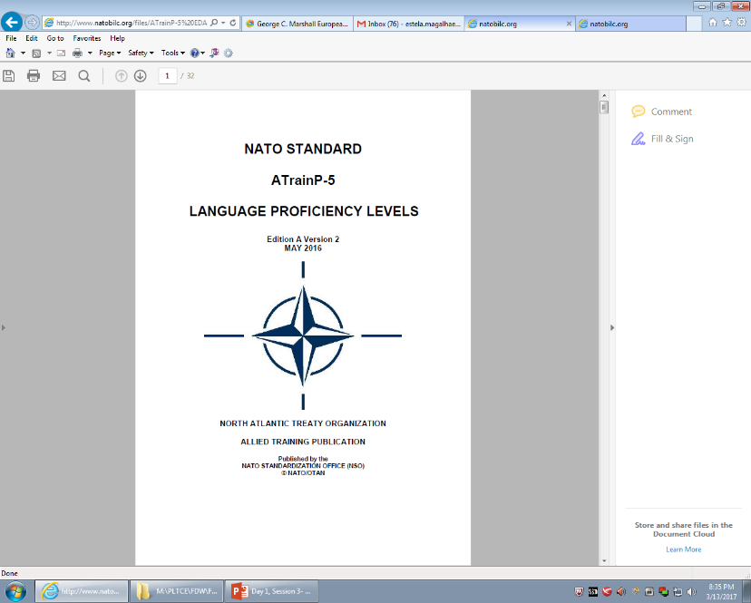
STANAG 6001
Key to Interoperability
Main responsibility: custodian of STANAG 6001
Language proficiency descriptions developed by BILC
Adopted by NATO in 1976
  SLP (Standardized Language Profile) SLP 3232
  Four numbers for Listening, Speaking, Reading, and Writing
  0-5 scale (0: No Ability; L1: Survival: L2: Functional; L3: Professional; L4: Expert; L5: equivalent to a highly-articulate, well–educated native speaker)
  SLPs in job descriptions, prerequisites for training, Language Capability Goals, Partnership Goals, etc.
BILC is responsible for periodically updating STANAG 6001

Slide 7
NATO Language Context
Each nation is responsible for own training / testing program
No common tests - only a common standard - STANAG 6001
Varying interpretations of standard? Nations certify their own military and give their members Standardized Language Profiles (SLPs) based on their own STANAG – based tests.
Language is viewed as a critical factor in the interoperability shortfall

Slide 8
Major BILC Events
  1) NATO BILC Conference
  May 2023 was CANCELLED (Istanbul, Turkey)
  SC Meeting – held virtually
  2) NATO BILC Professional Development Seminar
  October 2022, hosted by Provo, Utah, U.S.A.
  Theme: “Applied Research and Practical Experience in Teaching and Learning Languages”

Slide 9
  3) NATO BILC STANAG 6001 Testing Workshop
  September 2022, hosted by Bonn, Germany
  Theme: “Increasing Standardization and Efficiency of STANAG 6001 Testing in the Digital Age”
  4) NATO BILC Military Terminology Conference
  bi-annual event, 2024

Slide 10
BILC Professional Development
Programme in Partnership Cooperation Menu
(PCM. i. e. ACT-sponsored BILC courses)
  1. Language Testing Seminars (conducted at PLTCE):
  Language Testing Seminar, ACT.647, 2 weeks;
  Advanced Language Testing Seminar, ACT.658, 3 weeks;
  Language Standards and Assessment Seminar, ACT.648, 2 weeks.
  2. BILC Methodology Workshops
  English Teaching Faculty Development Workshop “Teaching Speaking and Writing for Military Purposes”, ACT.659, 2 weeks. Conducted at 3 PTECs PLTCE, Bulgaria and Slovenia.
  Facilitators: BILC teaching & testing experts from 24 nations.

Slide 11
Other BILC activities
Standardization efforts and support:
- Non-resident activities (in person and online - DEEP, DCB TF, cooperative visits)
DEEP – Defence Education Enhancement Programme
BILC PoCs for DEEP

Slide 12
BILC WGs & Projects
Shared Item Bank Project
Project launched in February 2020 to:
further standardization of language testing,
help testing organizations in the test development process.
Participating nations:
Canada, Croatia, Estonia, Latvia, Romania, Slovakia, Slovenia
pre-testing reading test items
JTAC WG
STANAG 6001 Update – Focus Group

Slide 13
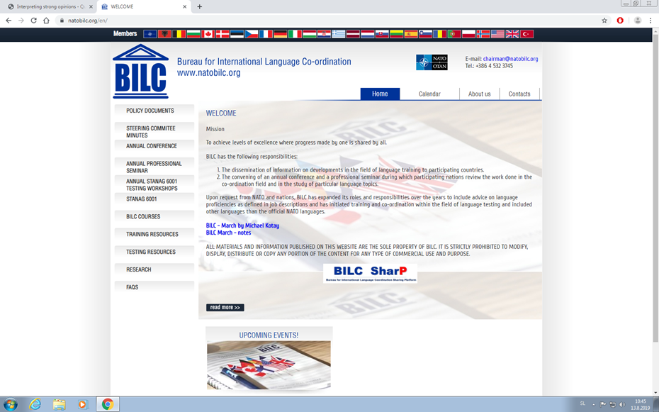
BILC site – www.natobilc.org

Slide 14
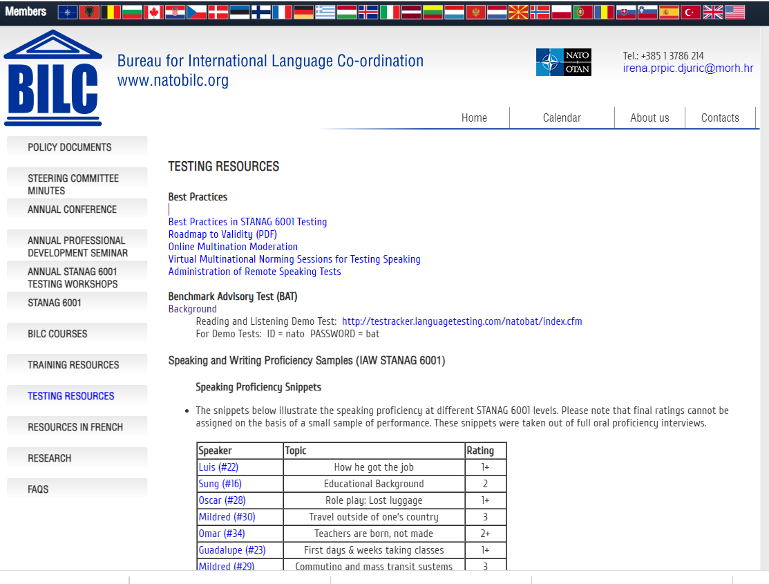
BILC site – www.natobilc.org

Slide 15
BILC site – www.natobilc.org
New:
Presentations from events
Testing Resources
Materials on Level 4
Resources in French
Updated version of the calendar 2023 and 2024

Slide 16
Contacts:
BILC site https://natobilc.org
Email: irena.prpic.djuric@morh.hr
BILCteam.hrv@gmail.com

Slide 17
THANK YOU FOR YOUR ATTENTION!
Questions???

