Slide 1




2022 NATO BILC STANAG 6001
Testing Workshop
September 6 – 8, 2022
Bonn, Germany
BILC Update
Irena Prpic Djuric

Slide 2
Bureau for International
Language Co-ordination
1966 – DEU, FRA, GBR, ITA, USA
NATO’s consultative and advisory body for language training and testing issues.
Main responsibility: custodian of STANAG 6001
Community of language teaching/testing professionals from MoDs and defense-sponsored organizations.

Slide 3
Bureau for International
Language Co-ordination
Mission:
To promote and foster interoperability among NATO and Partner nations by furthering standardization of language training and testing.
To support the Alliance's operations through the exchange of knowledge and best practices, IAW established procedures and agreements.
Vision:
To achieve levels of excellence where progress made by one is shared by all.

Slide 4
Bureau for International
Language Co-ordination
Purpose: To foster cooperative professional support among BILC member nations and to extend support to NATO within the field of language training and education and language assessment.
Active participation in BILC activities from 27 NATO nations and more than 25 partner nations.

Slide 5

BILC Steering Committee
GBR (1966-1981)
DEU (1982-1996)
USA (1997-2008)
CAN (2008-2014)
USA (2014-2016)
BGR (2016-2019)
SVN (2019-2022)
HRV (2022-2025)
Chair
Irena Prpić Djurić
Senior Advisor
Dr. Ray Clifford
Secretaries
Suzana Horvat
Borjana Soldo
Associate Secretaries
Keith Wert
Peggy Garza
Julie Dubeau
Jana Vasilj-Begovic

Slide 6
Major BILC Events
BILC Annual Conference in May;
BILC STANAG 6001 Testing Workshop in September;
BILC Professional Development Seminar in October.

Slide 7

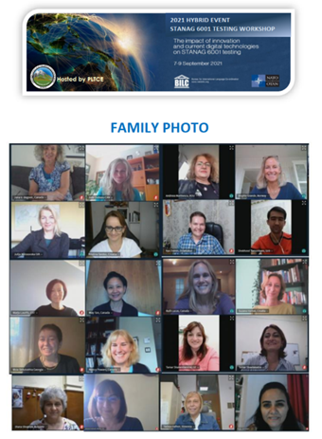
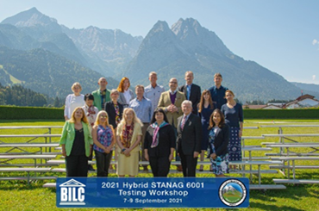
2021 BILC STANAG 6001 Hybrid Testing Workshop hosted by PLTCE in Garmisch-Partenkirchen and online
7 – 9 September, 2021
The Impact of Innovation and Current Digital Technologies on STANAG 6001 Testing
Topics:
•The impact of innovation and current digital technologies on test development practices
•The impact of innovation and current digital technologies on test administration procedures
•Changing expectations of the testing population
•Online multinational moderation practices
•Online multinational norming practices
•Tools for evaluating computer-based testing platforms
•Remote vs in-person speaking tests
•Digital item banking
•Effectiveness of remote proctoring
•New security concerns with online testing
Activities:
7 presentations
3 workshops
3 hot topics discussions
+ other activities

Slide 8

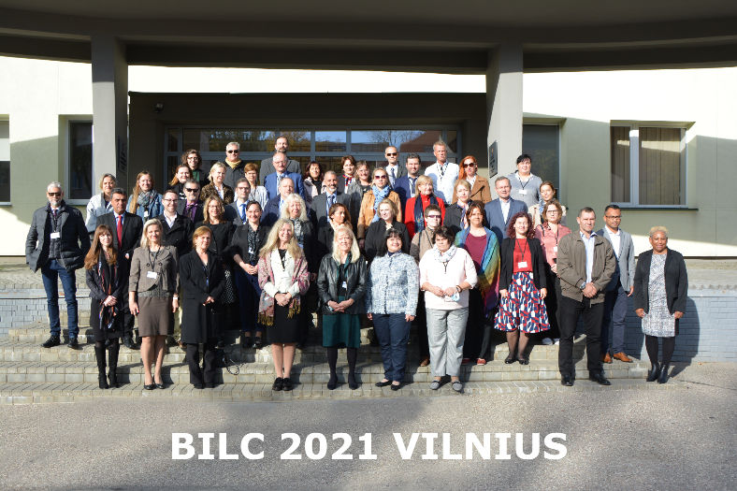
2021 BILC Professional Development Seminar Vilnius, Lithuania
3 – 7 October, 2021
Flexible Training Models: Shaping the Future Learning Journeys
Topics:
Lessons learned from the recent online training experiences
Optimal formulas for hybrid/blended learning
Boosting self-directed learning
Technologies conducive to hybrid learning
Student motivation in hybrid/blended programmes
Teaching writing in a flexible learning environment
Online testing
Learning effectiveness in a hybrid learning milieu
Activities:
18 presentations
4 workshops
4 panel Q&A sessions
4 group discussions on changes to BILC events

Slide 9

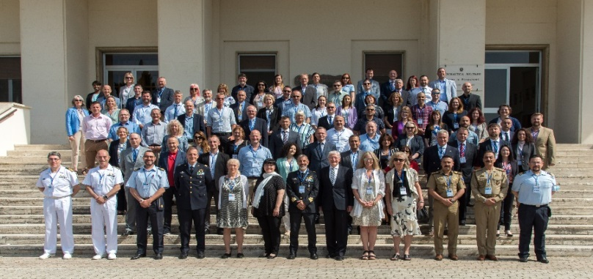
2022 BILC Annual Conference
Loreto, Italy
22 – 26 May, 2022
Learning from the Past and Building for the Future
Topics:
Re-examining the systems approach to training
Adhering to the basic principles of course evaluation and validation
Designing new approaches to meet the new needs
Designing training for special missions
Adapting assessment tools to new training realities
Blending online and in-person training to create the best learning experience
Training the writing skill in the 21st century
Enhancing instruction through technology
Managing contract teachers and non-permanent staff
Can we really do more with less?
Study groups:
Towards an effective teacher evaluation framework
Building the case against the pressure for continuous online language training
Getting back to the basics in the post-pandemic reality: a manager’s perspective
How do we know what and how well we are doing
Organizing and executing training of languages other than English
Activities: 21 presentations, 5 study groups , 4 panel Q&A sessions

Slide 10
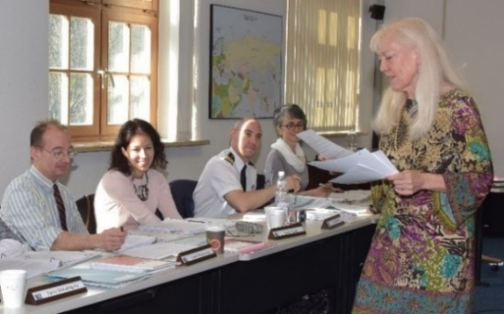
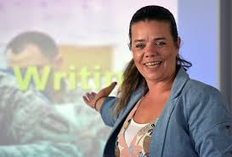

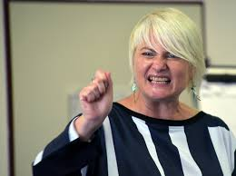
BILC Professional Development
Programme in Partnership Cooperation Menu
(PCM. i. e. ACT-sponsored BILC courses)
  1. Language Testing Seminars (conducted at PLTCE):
  Language Testing Seminar, ACT.647, 2 weeks;
  Advanced Language Testing Seminar, ACT.658, 3 weeks;
  Language Standards and Assessment, ACT.648, 2 weeks.
  2. BILC Methodology Workshops
  English Teaching Faculty Development Workshop “Teaching Speaking and Writing for Military Purposes”, ACT.659, 2 weeks. Conducted at 3 PTECs PLTCE, Bulgaria and Slovenia.
  Facilitators: BILC teaching & testing experts from 24 nations.

Slide 11
BILC Professional Development Introduction to Research Workshop
The aim of the workshop is to familiarize participants with basic principles of research design. By the end of the workshop they are able to:
Identify the differences between qualitative and quantitative research methods;
Develop a research question and align it with a research method;
Identify some appropriate data collection and analysis methods.
(Ms. Mary Jo Dibiase Lubrano)

Slide 12
Cooperation between BILC and Defence Education Enhancement Programme (DEEP)
Clearing House 2022, Rome, Italy
Ukraine, Iraq, Bosnia and Herzegovina, Armenia, Kazakhstan, Colombia, Jordan, Tunisia, Georgia

Slide 13













BILC Support for DEEP
May 2021 – May 2022
Ukraine
Bosnia-Herzegovina
Kazakhstan
Colombia
Iraq
Armenia

Slide 14







Shared Item Bank Working Group
Project launched in February 2020 to:
further standardization of language testing,
help testing organizations in the test development process.
Participating nations:
Canada, Croatia, Estonia, Latvia, Romania, Slovakia, Slovenia

Slide 15

Familiarization with STANAG 6001 for
Non-Specialists WG
Since 2018
Goals:
propose a prototype e-learning module building on the existing BILC documents that will include samples of language at each proficiency level and explanations;
explore ways to make the Familiarization with the STANAG 6001 for Non-Specialists module readily available as a practical resource for non-specialists.

Slide 16
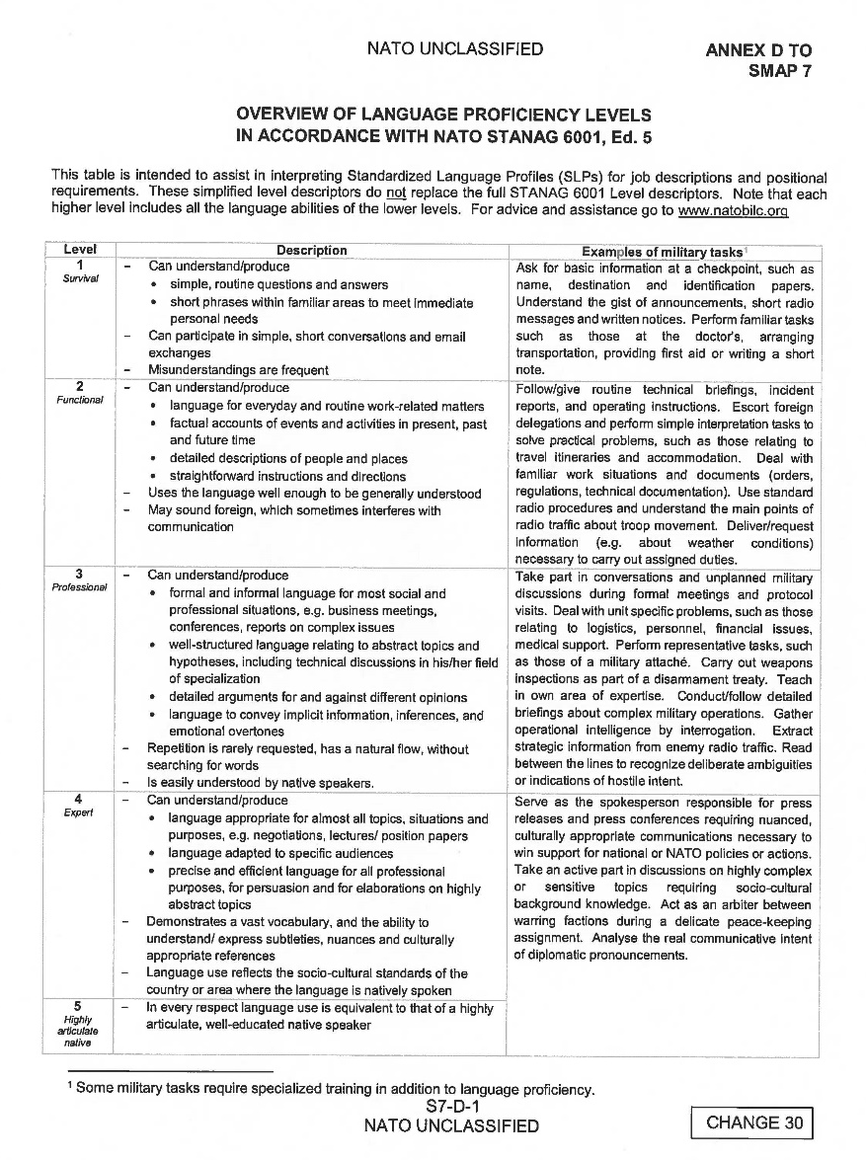

Slide 17
L4 Working Group
Since 2010
Purpose:
to formulate recommendations which could alleviate the national testing burden, by proposing different courses of action to the Secretariat to report to higher authorities
to analyze level 4 proficiency, and study the feasibility and implications of testing at this level
(Ms. Jana Vasilj-Begovic)

Slide 18
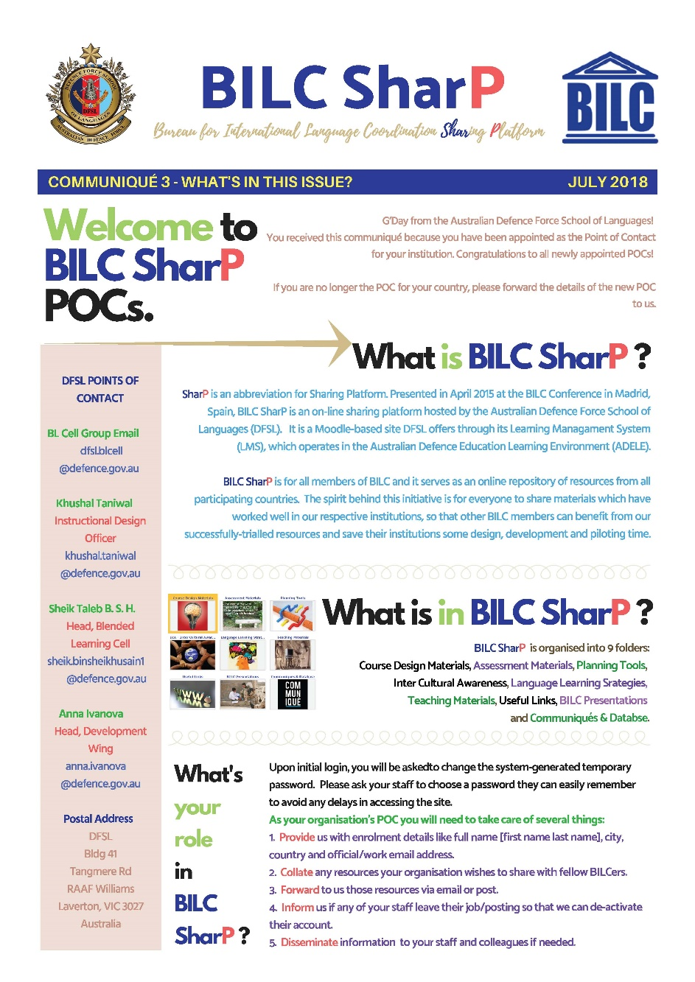
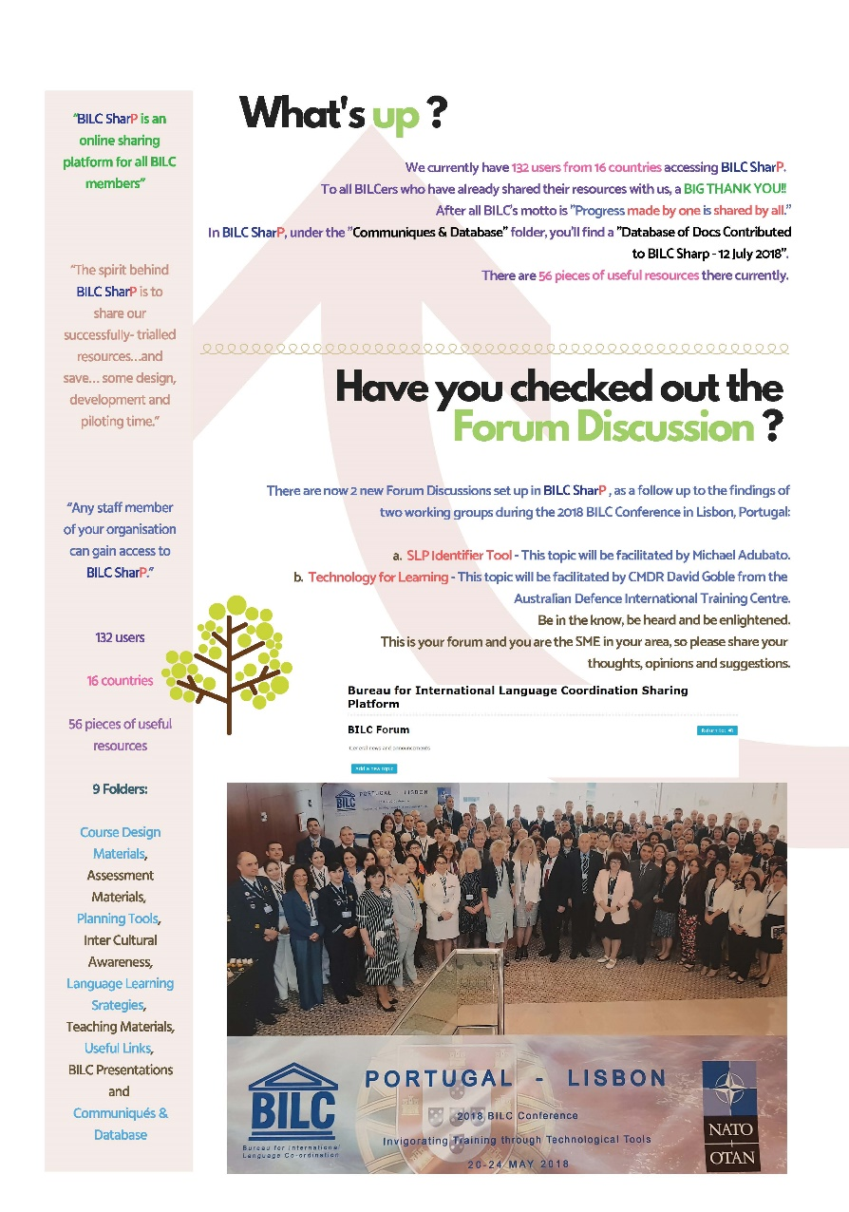
BILC SharP

Slide 19
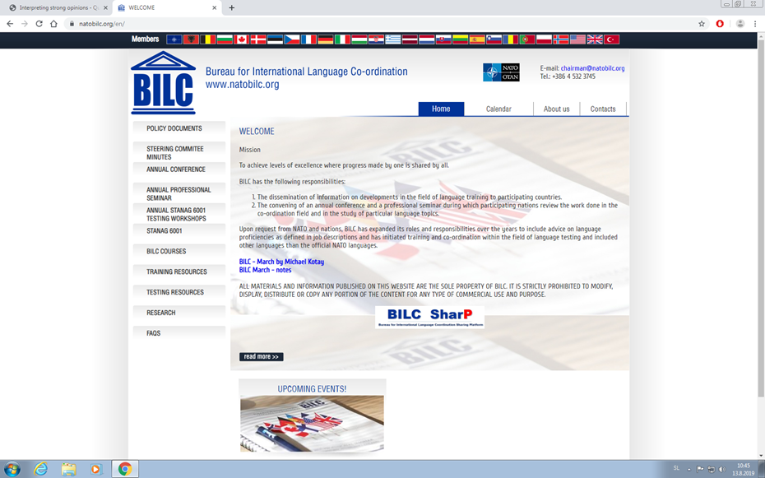
BILC site – www.natobilc.org

Slide 20
BILC site – www.natobilc.org
New:
Presentations from events
Materials on Level 4
Resources in French
Updated version of the calendar 2022 and 2023

Slide 22
Questions?
Contacts:
BILC site https://natobilc.org
Email irena_ines@yahoo.com
Notes:
If you have any questions, do not hesitate to ask.

