Slide 1

Skill Training & Format Training in the Classroom
Techniques & Challenges
Silke Gommers
English teacher & tester
Royal Military Academy
Belgium

Slide 2
Table of contents
The importance of English at the RMA
Intrinsic skill training
2.1 Techniques
2.2 Challenges
3. Format training: techniques & challenges
3.1 Techniques
3.2 Challenges
4. The struggle (and fun) of working for the English DPT of the RMA

Slide 3
The importance of English at the RMA
no entrance exams | 0000 - 3333
SOCIAL & MILITARY SCIENCES SSMW | POLYTECHNICS POL
bachelor 1
bachelor 2
bachelor 3
master 1 | master 1
 | master 2
IN DUTCH & FRENCH
6 official attempts
3232
IN ENGLISH

Slide 4
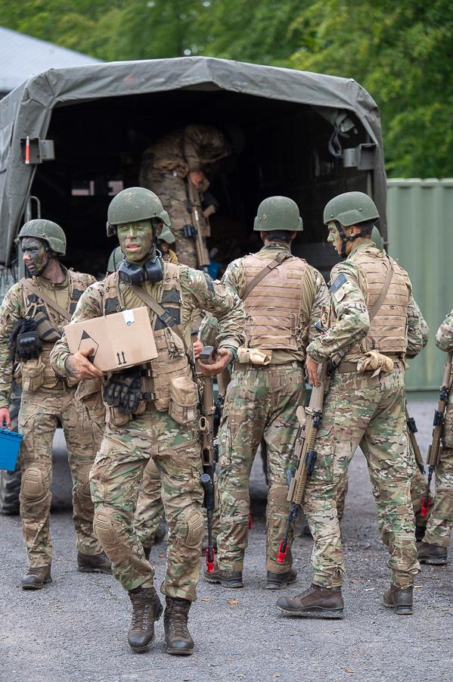

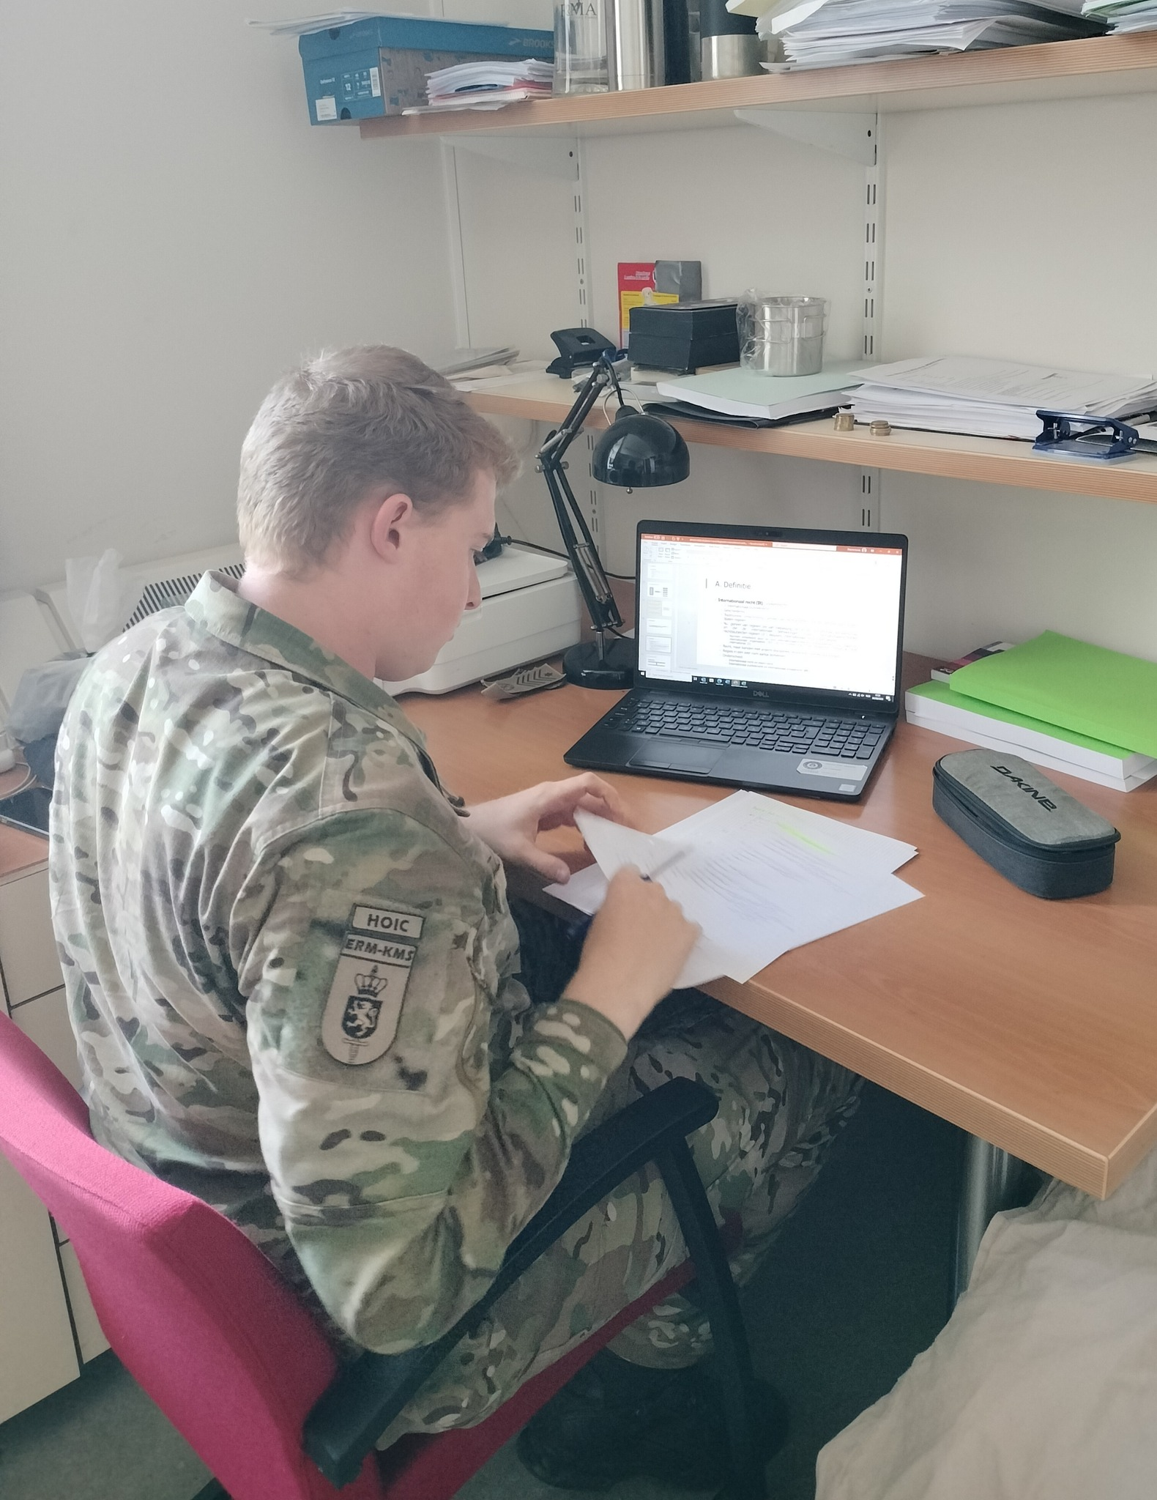

1. The importance of English at the RMA

Slide 5
1. The importance of English at the RMA
Social & Military Sciences
5 three-ECTS courses of 45 hrs → 225 hrs of English in 3 years
Polytechnics
4 three-ECTS courses of 45 hrs → 180 hrs of English in 3 years
→ skill-specific groups / classes
! No entrance exam for English
! Other academic courses
! Legal exam of the 2nd language in BA2

Slide 6
2. Intrinsic skill training
2.1 Techniques
LISTENING 3 | SPEAKING 2 | READING 3 | WRITING 2
Listening booklets L3 videos & podcasts + open questions Portfolio assignments | Intermediates Peer assessment rec. basic voc. & gramm. In class conversations | Reading booklets L3 articles, reviews, editorials + open questions Portfolio assignments | Intermediates basic voc. & gramm. Portfolio assignments

Slide 7
2. Intrinsic skill training
2.2 Challenges
zooming out
not necessarily an English problem
multiple skills vs. limited time
! writing & speaking
teaching reading & listening between the lines
topic: prior knowledge vs. lack of interest
questioning overall relevance
polysemy
individual strategies → heterogeneity
to tread carefully
a red herring
“dry pumpkins”
preference for format training

Slide 8
3. Format training
3.1 Techniques
LISTENING 3 | SPEAKING 2 | READING 3 | WRITING 2
Cambridge Proficiency English 1 extract of 1-5 min. MC-questions 3 - 4 options 1 key | Speaking sessions 15-minute sessions with English teachers individual feedback | Cambridge Proficiency English 1 text of 250-450 words MC-questions 3 - 4 options 1 key | Portfolio assignments individual feedback

Slide 9
3. Format training
3.2 Challenges
speaking
stress ↘
time management vs. efficiency vs.
learning process vs.
heterogeneity
listening & reading
stress ↗
≠ test prepping
reading
literary topics + vocabulary
writing
ChatGPT
the main idea and goal of the author struggle
CPE-format vs. SLP-format
overfocus on MC-training
key?
individual paths to success / lack of self-understanding
self-confidence
CPEs
lack of context
failed by 1 question ↗
previous experiences ↘

Slide 10


4. The struggle (and fun) of working for the English DPT of the RMA

Slide 11
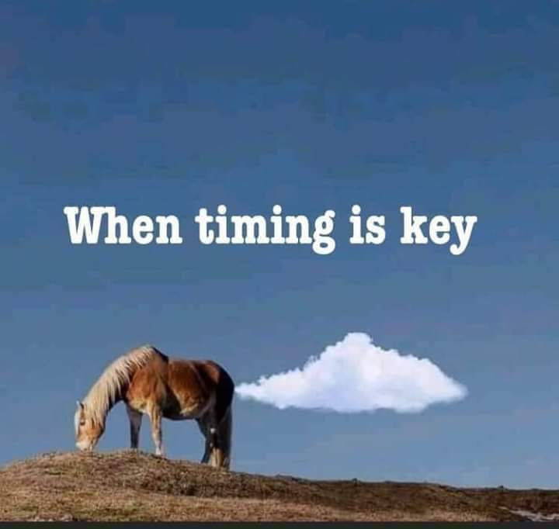
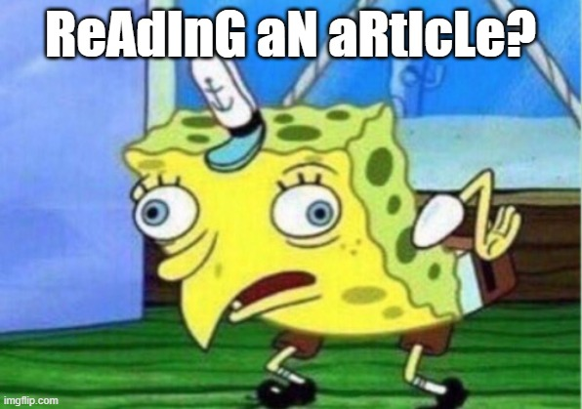
4. The struggle (and fun) of working for the English DPT of the RMA

Slide 12
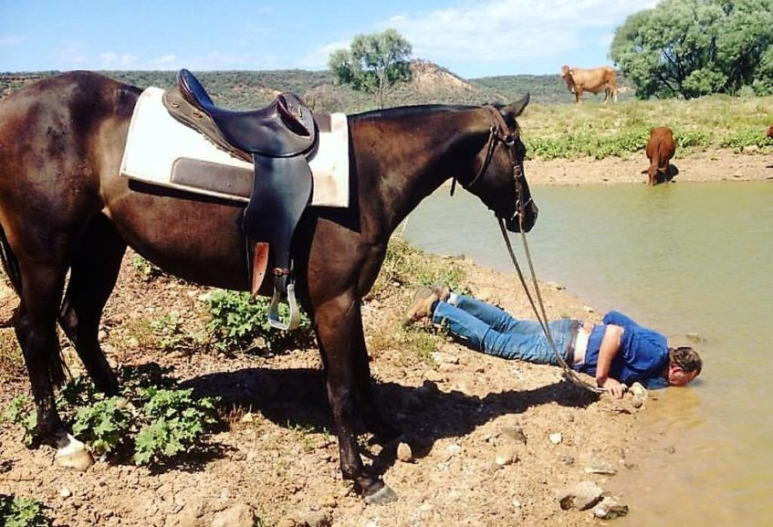
4. The struggle (and fun) of working for the English DPT of the RMA

Slide 13

4. The struggle (and fun) of working for the English DPT of the RMA

