Slide 1

BILC Seminar | Vilnius 2021
Organising and boosting self-directed learning
Silke Gommers | English teacher
Royal Military Academy Belgium

Slide 2

The Royal Military Academy
+/- 800 students
2 main tracks
  Polytechnics (POL)
  Social and Military Sciences (SSMW)
3 bachelor years + 1 or 2 master years
English department

Slide 3
Curriculum
SOCIAL AND MILITARY SCIENCES | POLYTECHNICS
 | Master II
Master I | Master I
Bachelor III
Bachelor II
Bachelor I
ENGLISH
legal prerequisite: 3232
DUTCH or
FRENCH
6 attempts
no entrance exam = 0000 - 3333

Slide 4
Course books
 |  | SOCIAL & MILITARY SCIENCES | POLYTECHNICS | ACADEMIC GOAL
BACHELOR I | SEM I | Intermediate I | Booklet A | Portfolio 3 ECTS | 45 hrs |  | 2 1 2 1
 | SEM II | Intermediate II | Booklet B | Portfolio 3 ECTS | 45 hrs |  | 2 1+ 2 1+
BACHELOR II | SEM I
 | SEM II | Intermediate III | Booklet C | Portfolio 3 ECTS | 45 hrs | Intermediate II/III | Booklet C | Portfolio 3 ECTS | 45 hrs | 2 2 2 2
BACHELOR III | SEM I | Booklet D | Portfolio 3 ECTS | 45 hrs |  | 2+ 2 2+ 2
 | SEM II | Booklet E | Portfolio 3 ECTS | 45 hrs |  | 3 2 3 2

Slide 5
Courses
Wide range of entry levels
Shift: achievement testing proficiency testing
Skill-specific courses
Small groups
Different number of hours of English:
  Format training
  Intrinsic skill training
Individual portfolio work
…

Slide 6
Individual portfolio work
2 or 3 skill-specific assignments per week
+/- 45-60 min per assignment
Weekly feedback
Listening Portfolio
Speaking Individual speaking sessions
Reading Portfolio
Writing Assignments

Slide 7
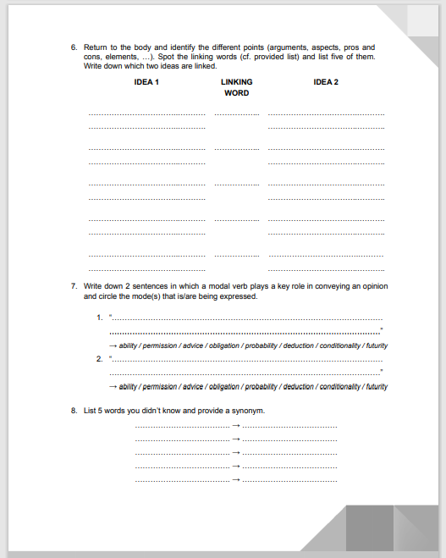
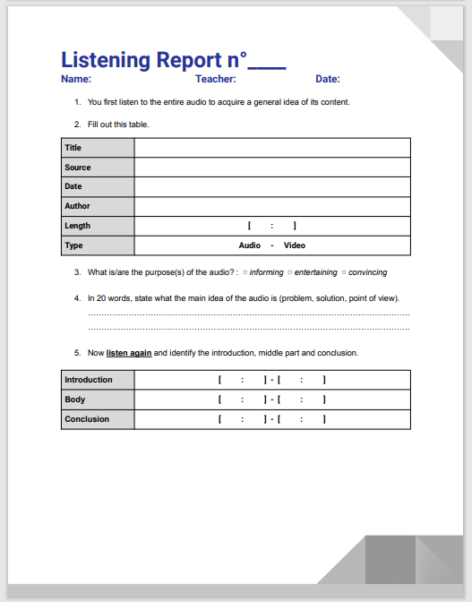
Listening portfolio

Slide 8
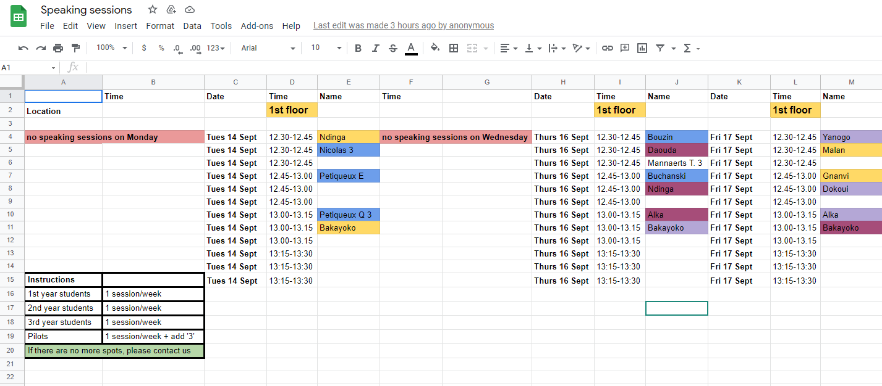
Speaking sessions

Slide 9
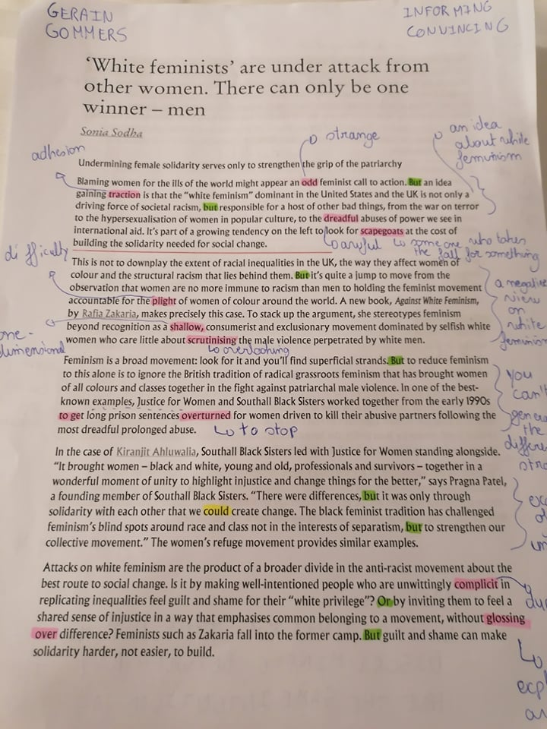
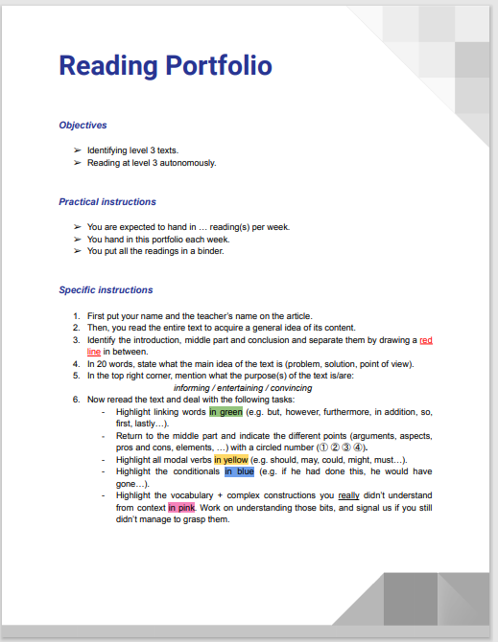
Reading portfolio

Slide 10
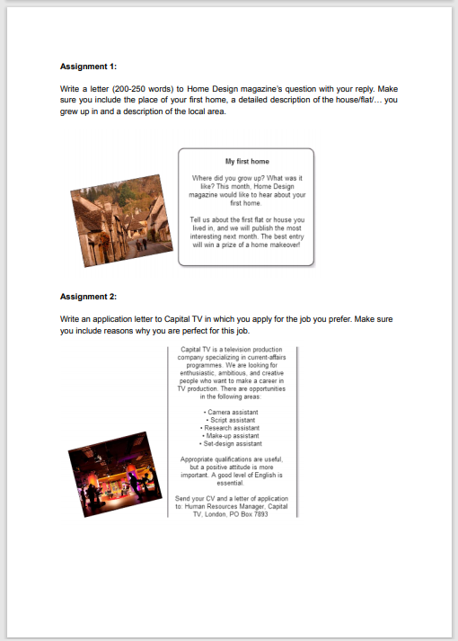
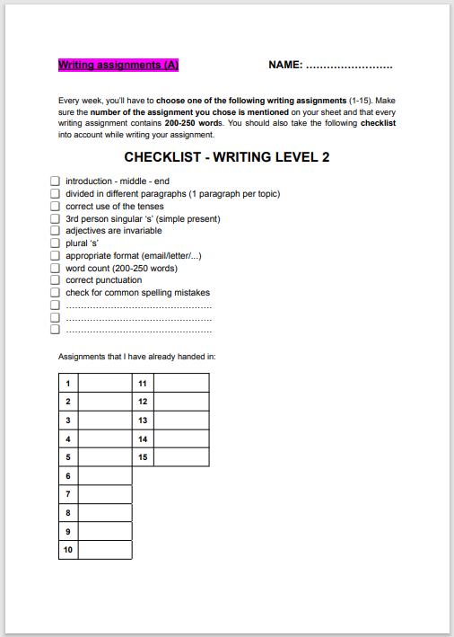
Writing assignments

Slide 11
Lessons learnt so far
Portfolio work > reading / listening logs
Strict follow-up
Increase of workload
Complex schedule
Positive feedback from the students
Combination with online teaching
…

Slide 12
Challenges
Workload
Complexity of our redesigned methods
Perception of the students (short vs. long term effects)
Wide range of entry levels
Limits of skill-oriented learning and teaching
Decay of passive skills in general
Teaching reading/listening comprehension
…

Slide 13
Questions?

