Slide 1
Maintaining student motivation
Mariamma Martin

Slide 2
Methods used
Sense of control and influence to the student
Diverse experiences
Intrinsic motivation
Group work
Give and take feedback
Self-reflection
Friendly competition

Slide 3
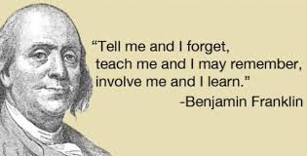

Slide 4

Sense of control and influence to the student

Slide 5
LMS
FILM
DICTIONARY
ARTICLES
BOOKS
METHODS
GRAMMAR
LOG BOOK
FIELD
EXERCISES
EXAMINATION
GLOSSARY
ORAL
PRESENTATION
WRITTEN
ASSIGNMENTS
POP
QUIZZES

Slide 6

Diverse experiences

Slide 7
Human Bingo
Find someone who
knows in what revolution/war the Human Rights first were proclaimed | knows what ”stig” is in English | knows how many insignias a British/an American major has on his/her shoulder straps | knows how many platoons there are in a company
can explain how to prepare Iceland moss for food | knows what is in a ranger’s backpack | knows the first article in the Declaration of Human Rights | can explain the word ”smoke discharger” in English
knows what to say for the letter ”T” on the radio | knows why a modern tank is more reliable than an old one | knows what ”höjdkurva” is in English | knows which alternative is correct: to be ”at, in” or ”on” an observation post
is familiar with briefings | has jumped with a parachute | the opposite of ’in barracks’ | knows what ”armour-plated” means
knows the five standard points within NATO for a so-called Standard Order Format. | knows what’s correct when you mean many of this: equipment equipments | Knows the word in English for ’läsa karta’ | can explain how to use the rifle in English

Slide 8
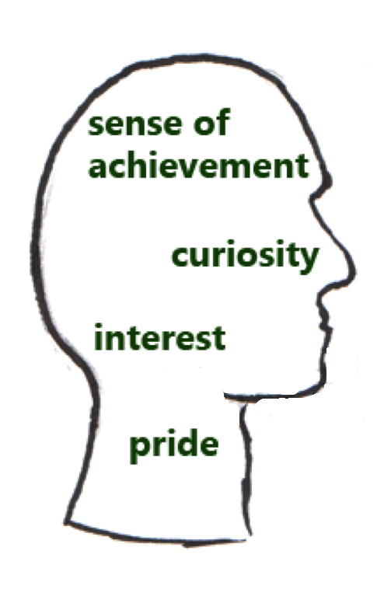
Intrinsic motivation

Slide 9
Situation with Iraq – has it become worse after 9/11?
Is any country really safe from terrorism?
Reasons for terrorism
What changes have taken place in Sweden after 9/11?
What kind of a world leader has Bush become?

Slide 10
Group work
Construct and extend understanding of what is being learned through discussion of multiple perspectives
Receive interpersonal feedback
Motivate one another
Social interaction
Sharing and generating ideas
The sum is greater than the parts

Slide 11
Give and take feedback
LOG BOOK
EVALUATION OF
TEACHING
PUT YOUR IDEAS
INTO WORDS
IDEA OF
KNOWLEDGE
& PROGRESS
ACTIVE
PARTICIPATION
NEED TO
FOCUS
VOCABULARY
NECESSARY
CHANGES
CONSTRUCTIVE
CRITICISM

Slide 12

Self-reflection

Slide 13

Friendly competition
BOOK CHALLENGE

Slide 14
“Student motivation to learn is an acquired competence developed through general experience but stimulated most directly through modeling, communication of expectations and direct instruction or socialization by others.” -Jere Brophy

Slide 15
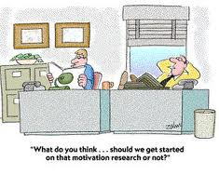

Slide 16


