Slide 1
Tak
Det er meget venligt af dig.
Lærere som dig er ikke lette at finde.

Slide 2
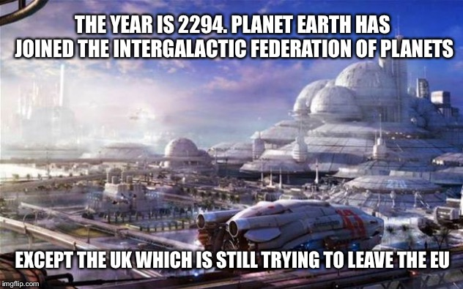

Slide 3
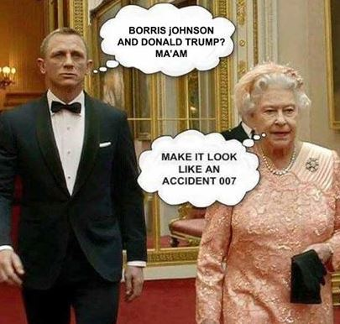

Slide 4
The Journey to Perfection
How meeting the best students’ needs benefits all
Emilie Alice Cleret
Head of Department
Director of Debate
Higher Military Education

Slide 5
The needs:
- An excellent command of the English language
- Culturally competent effective communicators that can master leadership skills in English

Slide 6
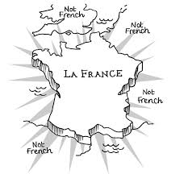

Slide 7
What is cultural competence?
What is an effective communicator?
What are leadership skills?
Public-speaking
Negotiation skills / debating skills
Presentation skills
Critical thinking
Learning agility
Self-awareness
Effective writing

Slide 8
Language teachers to teach a debate programme?
=> Hybrid teachers
Artificial classroom setting vs real life situations
=> The classroom activities solely sustain the real-life project

Slide 9
Just a minute!
You have one minute to pitch on a topic with no repetition, no hesitation, no deviation
If you repeat, hesitate, or deviate, another student picks up your pitch where you left it and has to finish it
You are allowed to repeat words in direct relation to the topic

Slide 10
Rebuttal ball
Give a motion to your students
Each student thinks of one argument to support the motion and one to oppose it
The first student gives an argument and then randomly chooses who will rebut his argument by throwing a ball at him/her.
And so, on until everybody has had a go

Slide 11
Alley debates
Give a motion to your students
Decide who will support and who will defend the students
Have the students face each other
One line of students has to give arguments to support the students and vice versa

Slide 12
Balloon debates
Students imagine that they are in a hot air balloon which is too heavy
One person needs to be thrown from the balloon to a certain death (Side note: I’m not sure this is how physics works.)
The students have one minute to make a case to the others for why they should be allowed to remain in the balloon and, by extension, not hurtle to their deaths

Slide 13
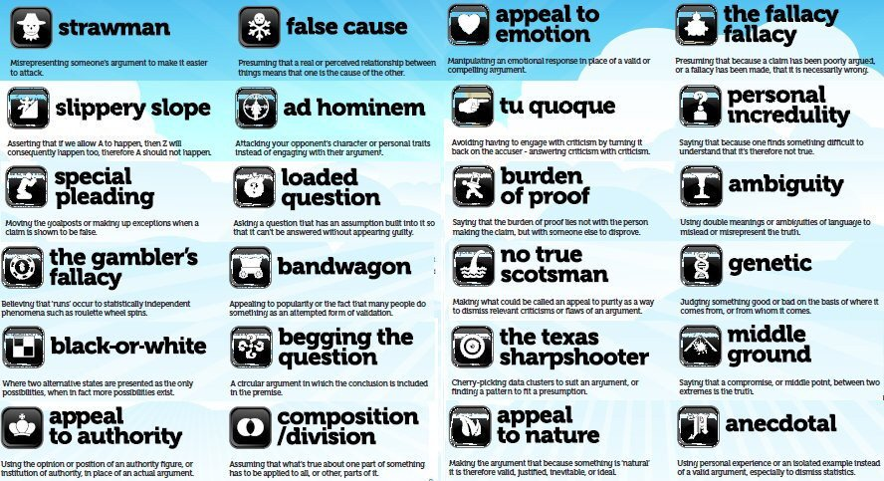

Slide 14
The Straw Man Fallacy
This fallacy occurs when your opponent over-simplifies or misrepresents your argument (i.e., setting up a "straw man") to make it easier to attack or refute.
Bandwagon Fallacy
Just because a significant population of people believe a proposition is true, doesn't automatically make it true. Popularity alone is not enough to validate an argument, though it's often used as a standalone justification of validity.
The False Dichotomy Fallacy
This common fallacy misleads by presenting complex issues in terms of two inherently opposed sides. Instead of acknowledging that most (if not all) issues can be thought of on a spectrum of possibilities and stances, the false dilemma fallacy asserts that there are only two mutually exclusive outcomes.

Slide 15
We can either agree with Safia's plan, or just let the project fail. There is no other option.
Jérôme: I think we should hire someone to help us design a STANAG test in French.
Julie: You're saying we should throw our money away on external resources instead of building up our in-house design team? That's going to hurt us so bad in the long run.
The majority of military stakeholders believe e-learning is the only way to reach level 4, so e-learning is objectively the best form of teaching.

Slide 16
From the classroom to real life
Study trips and debate tours
Competitive debate
Proposition (3 speakers per team) | Opposition (3 persons per team)
10-minute opening speech | 10-minute speech
5-minute speech | 5-minute speech
60 minutes of Q&A with the audience
5-minute summary speech | 5-minute summary speech

Slide 17
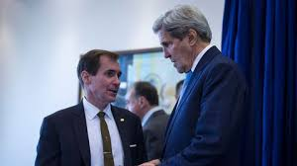

Slide 18






Slide 19


Slide 20
LESSONS LEARNED?

