Slide 1


Report on the BAT2 Project
Peggy Garza
And
David oglesby

Slide 2

What is the BAT?
BAT = Benchmark Advisory Test
The BAT is an external measure, the results of which can be compared and contrasted with the results of national tests in listening, speaking, reading, and writing, and is advisory only in nature.
History
BAT1: 2007-2009
  Advisory measure for nations
BAT2: 2018- 2019
  Evidence of standardization

Slide 3
Description of the BAT
Reading and Listening
  Computer-delivered and computer scored
Speaking test
  Telephonic person-to-person
  Human rated
Writing test
  Computer-delivered and human rated
Levels: 0+. 1, 1+, 2, 2+, 3

Slide 4
Standardization efforts in the bilc community
Language Testing Seminar (LTS) Advanced Language Testing Seminar (ALTS) | STANAG 6001 Testing Best Practices
Annual STANAG 6001 testing workshop and products | Roadmap to Validity concept a and collection of evidence
BILC website: Testing Resources page | Presentations and research by national STANAG 6001 testers, MA degrees from Lancaster
Bilateral/regional cooperation | BILC assistance visits
Networking with colleagues & international testing experts | Speaking and writing norming forums BAT2 tester/rater certification

Slide 5
bat2 goals
To confirm our hypothesis that the STANAG 6001 testing community has made progress over the past 10 years in “what they test” and “how they test”, specifically
  the quality of their tests
  better alignment with STANAG 6001
  more standardization of test results across the nations
To improve/update what we offer to the STANAG 6001 testing community
Notes:
Although not a stated goal, results of norming and testing as a community included: team building and network building professionalization of testers – BAT2 part of professional synergy of BILC testing community – that continues.

Slide 6
BAT2 Project Timeline
Proposed in 2017
21 nations interested in participating
10 tests per nation
First steps in 2018
  Application process
  20 nations participated in the BAT Speaking & Writing norming forums
BAT Administration, Nov 2018-June 2019
  18 nations

Slide 7
2018 bat2 speaking & writing forums
  Blended program of web-based and in-person norming
  Development of writing prompts for BAT2
What
  Experienced STANAG 6001 testers
Who
When
  July & August 2018

Slide 8
Bat2 speaking & writing follow-up
  BAT2 tester and rater certification
What
  Graduates of the BAT S&W norming forums
Who
  Trialling of the writing prompts
What else
Where
  Defense Language Institute English Language Center (DLIELC)

Slide 9
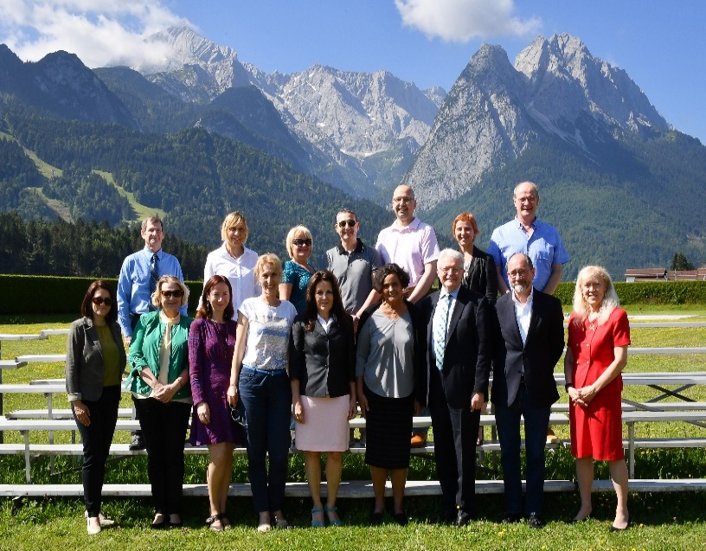
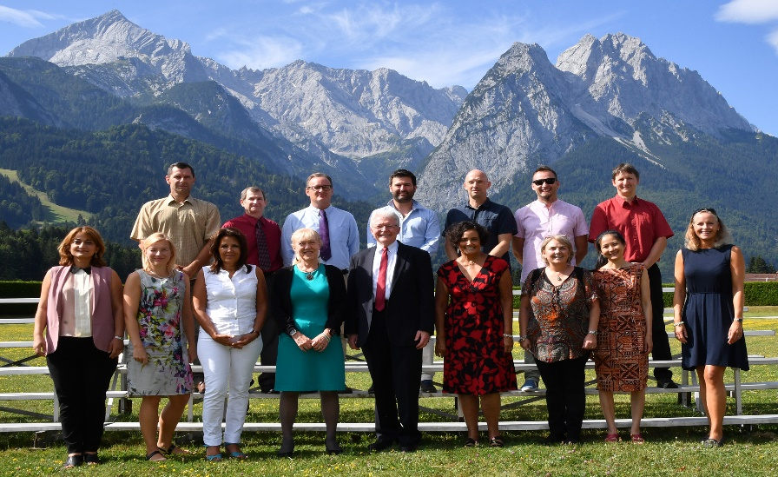
Nations participating in the S&W Norming Forums
Austria, Belgium, Bosnia-Herzegovina, Bulgaria, Canada, Croatia, Czech Republic, Denmark, Estonia, France, Georgia, Latvia, Lithuania, Netherlands, North Macedonia, Norway, Romania, Slovakia, Slovenia, Sweden

Slide 10
BAt2 administration
  Schedule
    One nation in November 2018
    17 nations from January -June 2019
  Description
    Reading and listening, Levels 1-3
      Computer-delivered multi-stage adaptive
      Multiple choice-4 options plus “I don’t know” option
    Writing
      Computer-based, 3 prompts; Levels 1 & 2, Level 2 & 3, Level 3
      Rated by 2 certified BAT2 raters
    Speaking
      Telephonic, Levels 1-3
      Conducted by one BAT2 certified tester/rater
      Second rating by another BAT2 certified rater

Slide 11
Bat2 administration: proctor
Proctors
  Training
  Sign agreement
  Confirm computers and network systems met the technical requirements
  Identify 10 test takers
    National scores within 6 months of BAT2 administration
    Ideally 2+/3 in speaking
  Administer the computer-delivered reading, listening and writing tests
  Proctor the telephonic speaking tests
  Provide feedback via online questionnaire

Slide 12
Bat2 administration: test taker
Test takers
  Read Examinee Guide and take BAT2 demo test
  Sign agreement
  Take BAT2 listening, speaking, reading and writing tests
  Provide feedback via online questionnaire

Slide 13
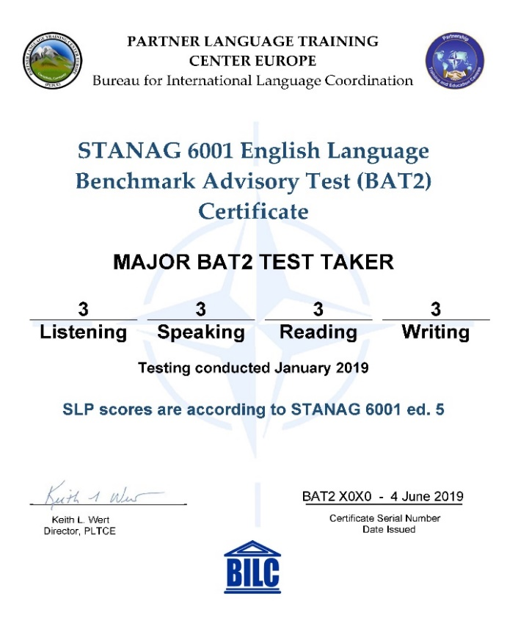
What did the participating nations receive?
BAT2 and national score comparisons
Compilation of proctor and test taker responses
BAT2 certificates

Slide 14
Were the project goals achieved?
196 test takers from 18 countries took both the BAT2 and national STANAG 6001 tests
Our very own Allan, Corina, Julija, Martina, Tamar & Birgitte conducted all of the Speaking tests
Speaking & Writing test raters included the six testers as well as Gabriela, Irena, Jan, Krassimira, Nermin, Tadeja, Vlad, and, of course, Mary Jo & Elvira
BAT2-National score adjacency (within a plus level)
  Listening – 73%
  Speaking – 88%
  Reading – 74%
  Writing – 89%

Slide 15
What went well?
All S & W testers/raters were intimate with STANAG 6001
New/updated test specs were written for Productive skills
Rater norming/retraining conducted before start of testing
Familiarization guides written for test takers
Writing test prompts trialled with 70+ test takers
Standardized administration procedures shared with proctors
High level of S & W rater agreement
Lots of new materials available for future BILC purposes

Slide 16

BAT2 analysis meeting 24-28 June 2019
BAT2 Analysis Team
Dr. Ray Clifford, Brigham Young University
Dr. Troy Cox, Brigham Young University
Mary Jo Dibiase Lubrano, Yale University
Peggy Garza, PLTCE
Roxane Harrison, PLTCE
David Oglesby, PLTCE
Dr. Elvira Swender, past Director ACTFL Professional Programs

Slide 17
Bat2 analysis meeting: productive skills
Discussion on data analysis
  BAT1 vs BAT2
  National vs BAT2
  Ways to measure the “no stakes” effect on results
  Test taker / Proctor / Tester-Rater feedback
Effectiveness of BAT Examinee Guide
Speaking
  IRR/Rater agreement stats
  Lessons learned
Writing
  IRR/Rater agreement stats
  Analysis of the effectiveness of the prompts
  Lessons learned
Positive effect of norming forums and recommendations for the future
Selection of speaking and writing sample for A(LTS) and norming sessions

Slide 18
Speaking inter-rater reliability
Level 1 | 4 | 0 | 4 | 100%
Level 1+ | 15 | 7 | 22 | 68%
Level 2 | 69 | 14 | 83 | 83%
Level 2+ | 53 | 13 | 66 | 80%
Level 3 | 48 | 2 | 50 | 96%
Total | 189 | 36 | 225 | 86%

Slide 19
writing inter-rater reliability
Level 1 | 1 | 1 | 2 | 50%
Level 1+ | 24 | 7 | 31 | 77%
Level 2 | 55 | 14 | 69 | 80%
Level 2+ | 34 | 8 | 42 | 81%
Level 3 | 23 | 6 | 29 | 79%
Total | 136 | 35 | 171 | 79%

Slide 20
Bat2 analysis meeting: receptive skills
General topics on testing the receptive skills
  Applying CR-scoring to multi-stage adaptive testing
  Effectiveness of the BAT2 demo test
Reading
  Quantitative and qualitative analysis
  Distractor analysis including the “I don’t know” option
  Lessons learned
Listening
  Quantitative and qualitative analysis
  Distractor analysis including the “I don’t know” option
  Lessons learned
New sample items for the (A)LTS
Model reading and listening test specs for the A(LTS)
Considerations for computer delivered/adaptive testing

Slide 21
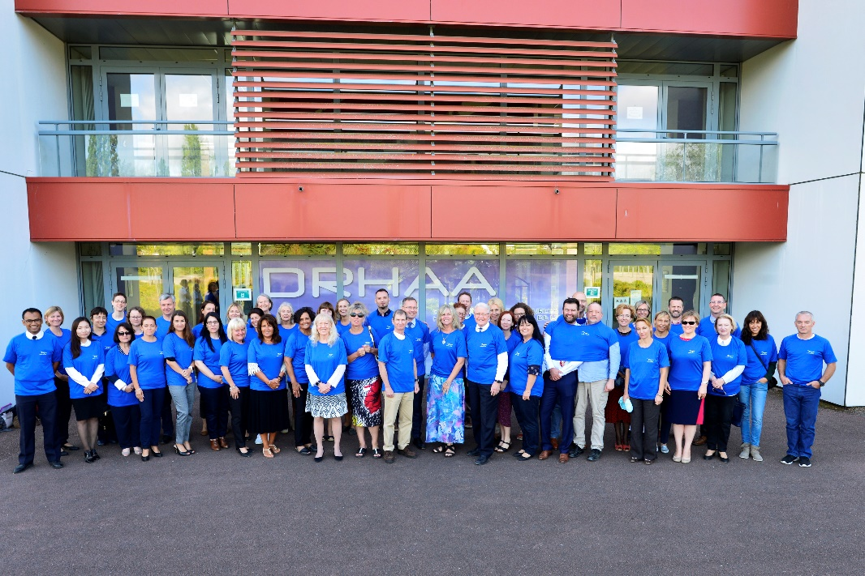
2019 Stanag 6001 testing workshop
3-5 September in Tours, France
Two strands
  Theme: Standardizing Testing: Lessons Learned
  Testing French IAW STANAG 6001

Slide 22

27 Nations
& SHAPE
Austria
Belgium
Bosnia-Herzegovina
Bulgaria
Canada
Croatia
Czech Republic
Denmark
Estonia
Finland
France
Germany
Italy
Latvia
Lithuania
North Macedonia
Mongolia
Norway
Poland
Portugal
Romania
Slovakia
Slovenia
Spain
Sweden
Ukraine
USA

Slide 23
Standardizing Testing: Lessons Learned
PROGRAM
Presentations
Panels
  BAT2 lessons learned
  National practices for testing writing
Hot Topic Discussions
  Standardizing testing: lessons learned
  Using technology for STANAG 6001 testing
Workshops
  Norming session on BAT2 speaking tests
  Norming session on BAT2 writing tests
  Drafting and moderating writing prompts
  Distractor analysis of selected response test items
  Familiarization with Level 4 writing proficiency and its assessment

Slide 24

Recommendations for updating the testing seminars
Selection of BAT2 speaking and writing tests for training
  Classic benchmark samples
  Borderline samples
Sample reading and listening items
Sample test specifications
How to calculate tester/rater agreement
How to perform distractor analysis

Slide 25
Recommendations from the nations for the way ahead
Add new resources to the BILC website
Conduct norming sessions for testers and raters of the productive skills in conjunction with the annual STANAG 6001 testing workshop
Collaborate on a listening and reading item bank
Training on item banking
Workshop on converting from paper-based to computer-based testing

Slide 26

Many Thanks to
Participants from 20 nations who participated in the Speaking & Writing Norming Forums
18 nations that administered the BAT2 tests
Certified BAT2 testers of speaking and raters of speaking & writing
All BILC members who have been involved in the 10 years of STANAG 6001 standardization efforts

