Slide 1
Norming speaking assessment
Inga Farte-Zalite, Latvian NAF Language School
Marju Laurits, Estonian Military Academy
Birgitte Grande, Norwegian Defence University College
Gabriela Repova, The Language Institute of Slovak Armed Forces
BILC Testing Workshop 2023, Riga

Slide 2
Structure
Intro
Methodology
Results of the norming activity
Analysis of the extracts and ratings

Slide 3
Background
BILC Hybrid Testing Workshop in 2021
- 6 BAT2 interviews
BAT2 in 2018
Testing foreign military personnel
Notes:
MFRM consultation:
Troy Cox, Brigham Young University

Slide 4

Collective effort (JAN-JUN 2023)
LAT team - Jūlija, Zanda, Iluta, Kristīne, Santa (Step 1)
BILC experts - mostly BAT2-trained
Merit Kompus & Marju Laurits EST
Gabriela Repova SVK
Birgitte Grande NOR
Tamuna Shavlakadze GEO
Mary Jo DiBiase USA
Cristina Salageanu ROM
Peggy Garza (BAT2 interviews )

Slide 5
Methodology
Instead of full interviews → extracts
shorter → a range of performances/ topics/ …
shorter → more likely to attracts raters :)
not all interviews are ideal ;)
more appropriate for statistical analysis
No opportunity for discussions :( → almost absolute expert agreement needed

Slide 6
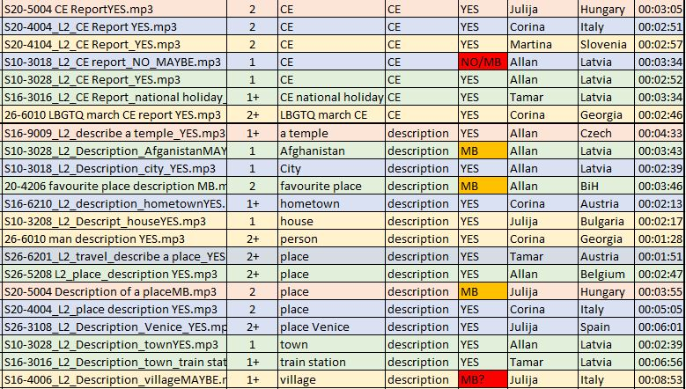
Methodology
Interviews
BAT2 rater agreement (diff levels L1-3 / interviewers/ nations) - 13:37:39
cutting interviews into extracts -133 & labelling
shortlisting extracts based on (sound) quality & variety of topics

Slide 7
Methodology
Round 1 of expert ratings (42 extracts) - ≈03:00:00
3 pairs of experts rating 14 extracts per pair - ≈01:00:00
shortlist extracts based on (dis)agreement in ratings & appropriacy for norming
Round 2 of expert ratings (17 extracts)
all 6 experts rating
shortlisting extracts based on disagreement in ratings (at least 5 out of 6)
Round 3 (11 extracts)
Fine-tuning justification of ratings

Slide 8
Methodology
Google form
Determining both speaking task and level of performance
Comments about the rating

Slide 9
Results of the practical activity
“Few wish to assess others, fewer wish to be assessed, but everyone wants to see the scores.”
Paul Holland

Slide 10
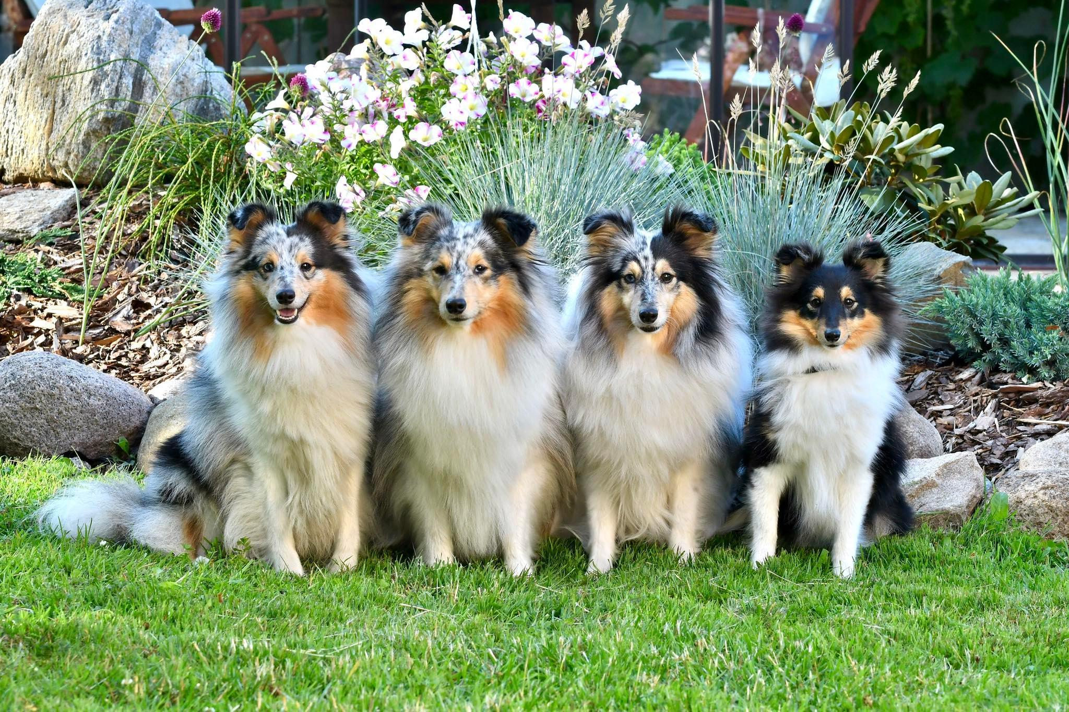

Slide 11
Rater behaviour
Leniency and harshness
Consistency
Halo effect
Central tendency or restriction of range
Bias
Use of scoring criteria

Slide 12
Norming - why?
Helps ensure raters use the rating scale as intended.
Helps ensure raters follow the rating protocol.
Rater behaviour changes over time, hence the need for regular re-norming.
Through norming we help to strengthen the linguistic interoperability among NATO and Partner countries by furthering standardization of language testing.

Slide 13
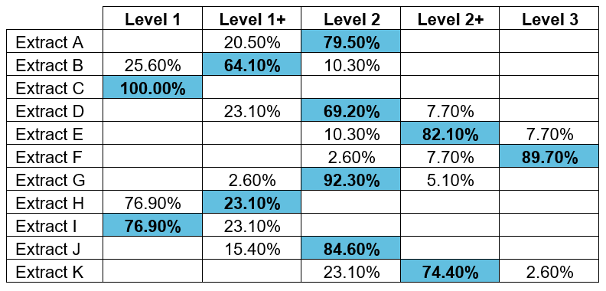
Overview of the raters’ ratings

Slide 14
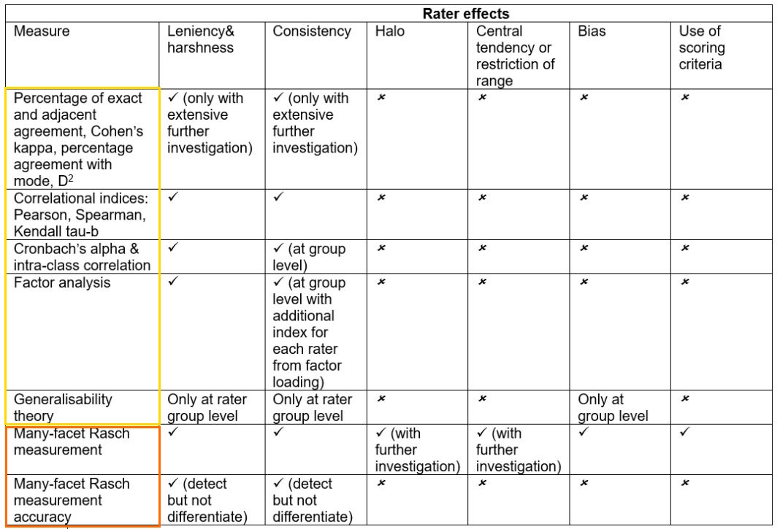
Table 2.5. Rater quality measures - ability to detect rater effect (Knoch, Fairbairn & Yan, 2021)
Notes:
Paul Holland: Few wish to assess others, fewer wish to be assessed, but everyone wants to see the scores.

Slide 15
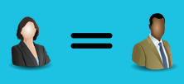
Observed rating tradition
Consensus:
Average pairwise agreement between expert and participant: 69.7%
Expected values should be around 80%
Raters agreement ranged between 45.5% and 100%
45,5% = 5 extracts rated the same as experts

Slide 16
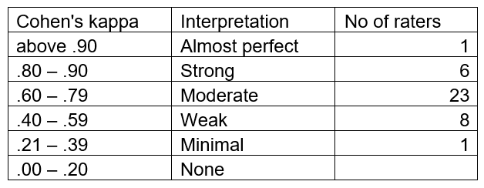
Observed rating tradition
Consensus:
Average pairwise Cohen’s kappa between expert and participant = 0.61 Raters kappas were between 0.29 and 1

Slide 17
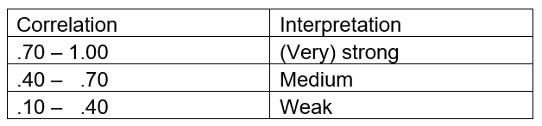
Observed rating tradition
Consistency:
Average pairwise Spearman correlation between
expert and participant: 0.95
Raters correlations were between 0.84 and 1

Slide 18

Scaled rating tradition
Many Facet Rasch Measurement: helps detect and measure rater effects.
Places the factors that we want to study on a single linear scale, it is like
a vertical ruler.
The factors are called facets and usually language testing research focuses on examinees, raters, tasks, and rating criteria (eg, fluency, vocabulary, grammar etc).
For each element of the facet, the analysis gives us a measure that is expressed as a numeric logit value. These logit values are the same distance apart. This makes it easier to compare the results for the facets we want to study.

Slide 19
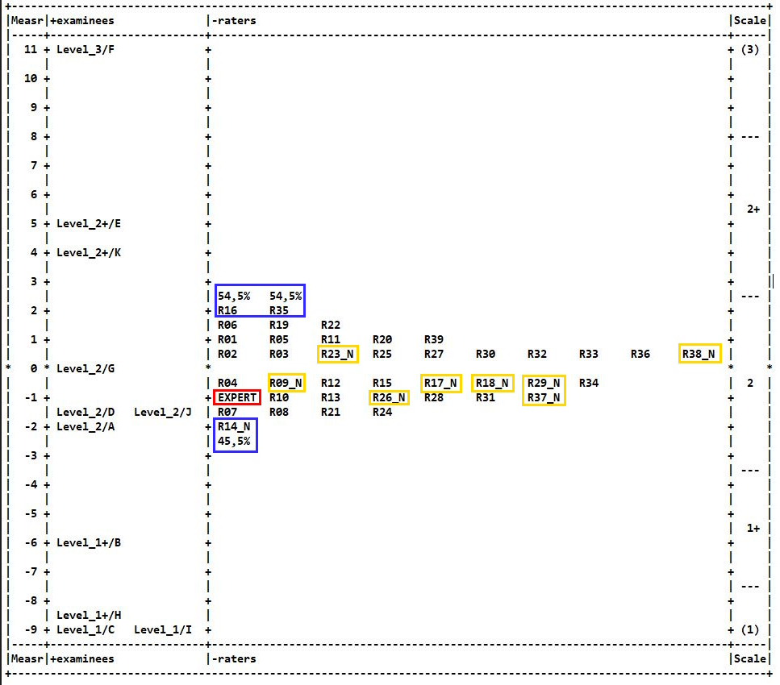
Wright map

Slide 20
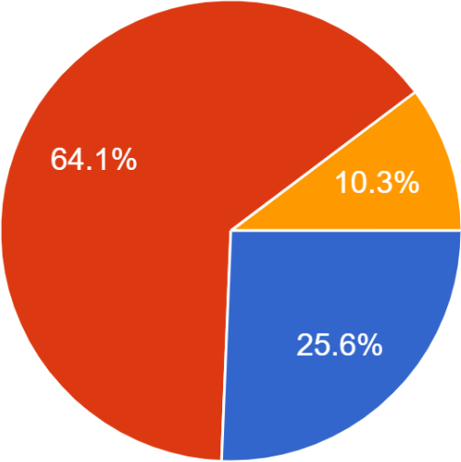
Extract B
LEVEL 1
can speak at the sentence level and may produce strings of
two or more simple, short sentences joined by common linking words
frequent errors in pronunciation, vocabulary, and grammar often distort meaning
time concepts are vague, may often use only one tense or tend to avoid certain structures
speech is often characterized by hesitations, erratic word order, frequent pauses, straining and groping for words, ineffective reformulation, and self-corrections

Slide 21
LEVEL 2
narrate current and past activities in complete, but simple
paragraphs
simple structures and basic grammatical relations are typically
controlled, while more complex structures are used inaccurately or avoided.
vocabulary use is appropriate for high frequency utterances but unusual or imprecise at other times
errors in pronunciation, vocabulary, and grammar may sometimes distort meaning
speaks in a way that is appropriate to the situation, although command of the spoken language is not always firm

Slide 22
LEVEL 1+
a limited and inconsistent ability to talk about current events
discourse consists of strings of related sentences not full
paragraphs
may hesitate because of lack of language resources
simple structures and basic grammatical relations are only somewhat controlled
time references may be used incorrectly
frequent errors in pronunciation, vocabulary, or grammar may impede communication
delivery may be laboured
repetition requested to understand the speaker

Slide 23
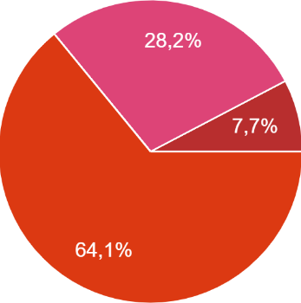
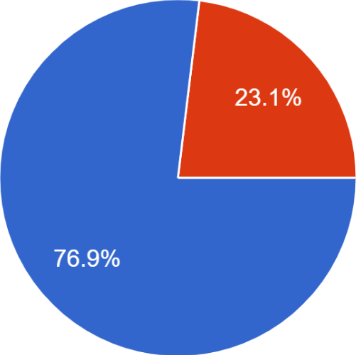
Extract I
Level 2
The level of the task
Level 3
Roleplay:
Level 1 Basic survival situation
Level 2 Survival situation with a complication
Level 3 Unfamiliar situation
Level 1
Level 1+
The level of the performance
Level 1

Slide 24
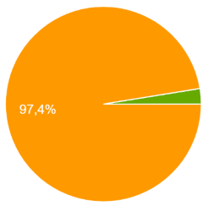
Extract D
Task: L2 Current events report
L3 Expressing an opinion
Rating: L2+ (3)
L2 (27)
L1+ (9)

Slide 25
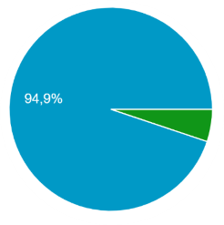
Extract H
Task: L2 Past narration
L3 Expressing an opinion
Rater comments (n = 18) fell into three main categories:
Delivery & comprehensibility
Mistakes made
Discourse produced

Slide 26
Delivery & comprehensibility
Delivery is labored - sounds very uncomfortable
Hesitant
Struggled to get a story out
Speaks with difficulty - groping for words
Difficult to understand/hard to follow
Sympathetic listener required
Comprehensible to native speakers

Slide 27
Mistakes made
Vague time frames - time references not clear
Mistakes in simple structures
Problems with pronouns and vocabulary
Lack of vocabulary
Frequent errors in grammar, vocabulary, and pronunciation distort meaning
Inaccuracies frequently made comprehension difficult

Slide 28
Discourse produced
Sentence level
Able to produce sentences
Short simple sentences
Strings of related sentences
Can only make short utterances using memorized material
Limited and inconsistent ability to narrate

Slide 29
Key: LEVEL 1+
limited and inconsistent ability to narrate
discourse consists of simple sentences/strings of related sentences
may hesitate because of lack of language resources
simple structures and basic grammatical relations are only somewhat controlled
time references may be used incorrectly
frequent errors in pronunciation, vocabulary, or grammar impedes communication
delivery is laboured
a sympathetic listener is required

Slide 30
References
Eckes, T. (2011). Introduction to Many-Facet Rasch Measurement. Bern, Switzerland: Peter Lang D.
Freelon, D. (2010). ReCal: Intercoder reliability calculation as a web service. International Journal of Internet Science, 5(1), 20-33.
Knoch, U., Fairbairn, J. & Yan, J. (2021). Scoring Second Language Spoken and Written Performance. Issues, Options and Directions. Equinox Publishing.
McNamara, T., Knoch, U., & Fan, J. (2019). Fairness, Justice, and Language Assessment: The Role of Measurement. Oxford University Press.
Mizumoto, A. (2015). Langtest (Version 1.0) [Web application]. Retrieved from http://langtest.jp
Myford, C. M., & Wolfe, E. W. (2003). Detecting and Measuring Rater Effects Using Many-Facet Rasch Measurement: Part 1. Journal of Applied Measurement, 4(4), 386–422.

