Slide 1
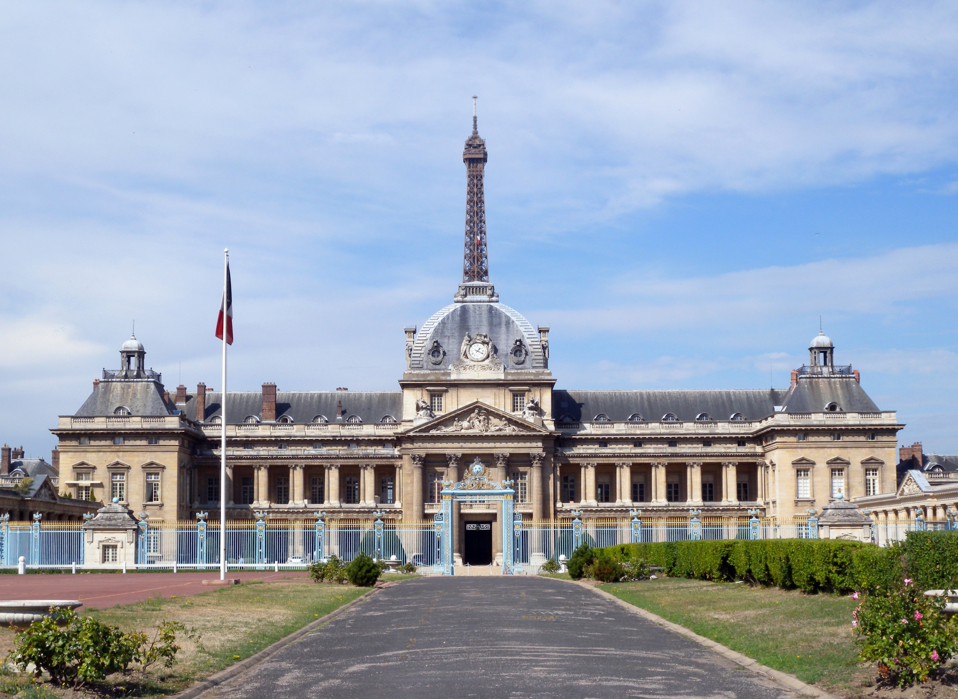

Émilie Cléret
Head of the Leadership and English Studies Department
French Higher Military Education
BILC PROFESSIONAL DEVELOPMENT SEMINAR - BAKU 2023
THROUGH THE LOOKING GLASS
THE ILLUSION OF THE NATIVE SPEAKER

Slide 2
A FRICTION?
Native English-Speaking Teachers (NESTs)
Non Native English-Speaking Teachers (NNESTs)

Slide 3
WHAT IS THE ILLUSION?
NATIVE-SPEAKERISM
IDEOLOGY THAT REFERS TO THE IDEA THAT NATIVE-SPEAKING TEACHERS (PEOPLE FROM COUNTRIES WHERE ENGLISH IS THE FIRST LANGUAGE) ARE BETTER AT TEACHING ENGLISH THAN NON-NATIVE SPEAKERS
THE IDEALISED NATIVE SPEAKER

Slide 4
WHAT IS THE BIAS?
About teaching:
Being knowledgeable or holding a skill =/= knowing how to teach it
About language:
Native speaker = a vague and problematic concept

Slide 5
WHY IS THERE A BIAS?
Counter-arguments when you question native-speakerism:
1. Students prefer NESTs
2. Students need NESTs to learn ‘good’ English
3. Students need NESTs to understand ‘the culture’
4. It’s the market demand

Slide 6
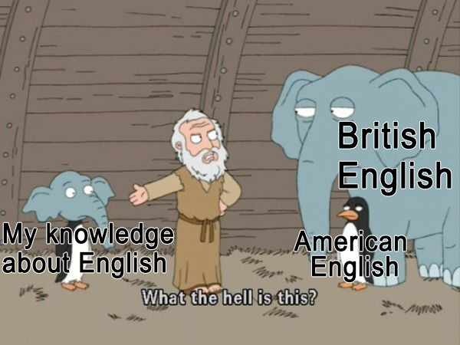

Slide 7
WHY IS THERE A BIAS?
Counter-arguments when you question native-speakerism:
1. Students prefer NESTs
2. Students need NESTs to learn ‘good’ English
3. Students need NESTs to understand ‘the culture’
4. It’s the market demand

Slide 8
NON NATIVE ENGLISH SPEAKER:
I am awfully sorry at the terrible state of my English abilities, as for the English language is not my mother tongue. I hope you can forgive me for every foolish mistake I might make.
NATIVE ENGLISH SPEAKER:
LOL No probs it(‘s) ok

Slide 9
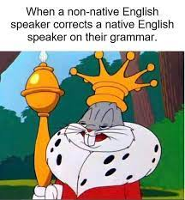

Slide 10
WHY DID WE GO ALONG WITH THE BIAS?
Civilian academics and teachers in a military environment with a strong support for
native-speakerism

Slide 11
COUNTER-ARGUMENTS TO NATIVE-SPEAKERISM
LEGAL ISSUE
A STRONG CONNECTION DUE TO SHARED EXPERIENCE WITH THE STUDENTS
MANAGING CULTURE SHOCK
COST EFFECTIVENESS

