Slide 1

Computer
Adaptive
Tests:
A Primer
BILC Testing Workshop
Troy L. Cox, PhD
September 10, 2020

Slide 2
Computer Adaptive Tests: Formal Definition
A computer-assisted, sequential form of testing in which successive items in the test are chosen based on the responses to previous items.
(Source: Concise Encyclopedia of Psychology, 2nd Ed.)

Slide 3
Stages of Computer Adaptive Test
Select Initial Item(s)
  Item with midrange difficulty
  Small range of items with varying difficulties
Calculate examinee ability estimate
Present item with difficulty level near examinee ability level
  Item bank needed with calibrated items
Stop test mechanism
  Standard error reaches predetermined level
  Time

Slide 4
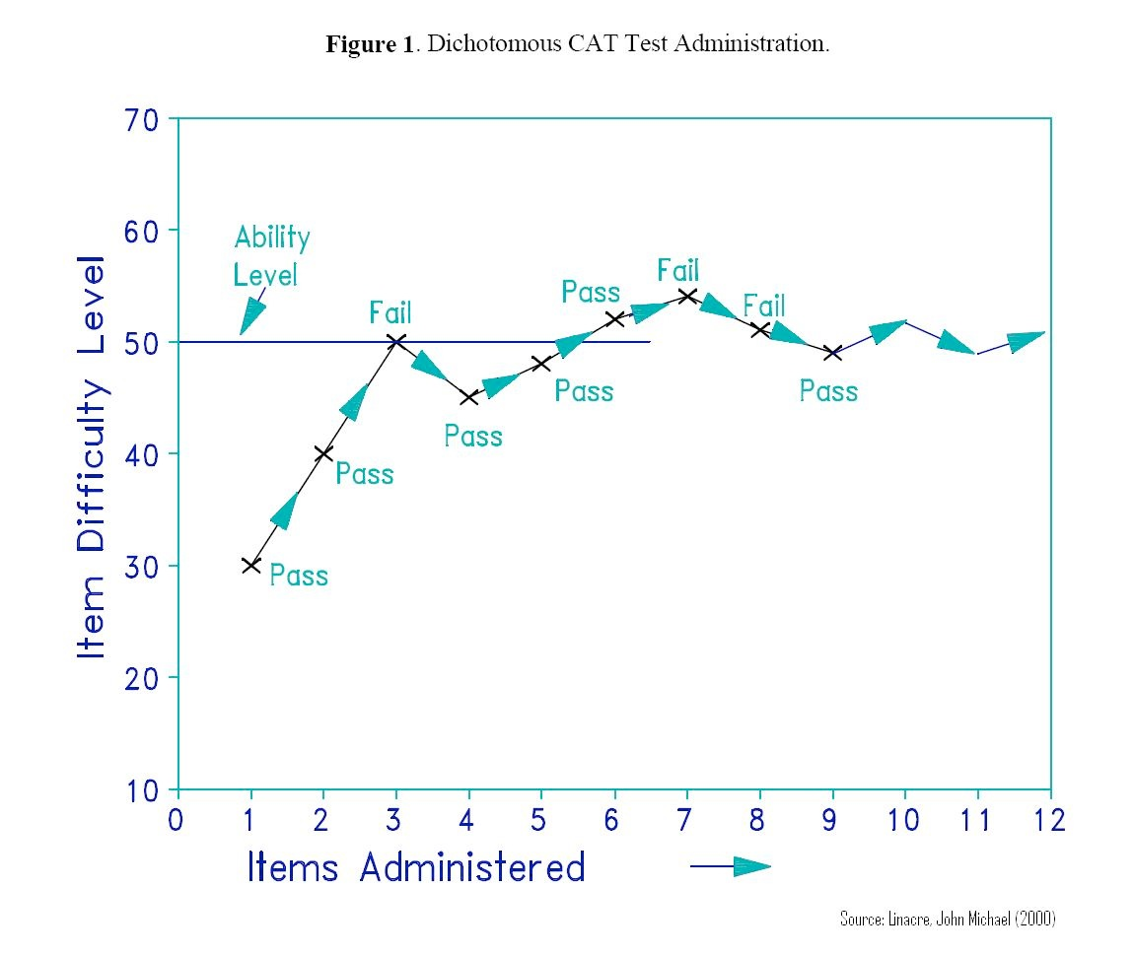
Computer Adaptive Test Ability Scoring Example

Slide 5
Calibrating items with Item Response Theory (Rasch)

Slide 6
Advantages
Avoids the use of too easy/difficult items
Test security can be increased
  Reduces Item Exposure
  Cheating less likely
Test can be shorter (with smaller standard errors than classical test theory)
Test is tailored to each examinee
Tests are individually paced
Can provide accurate measures over a wide range of abilities.
Examinees can’t go back and change
  Increases local independence

Slide 7
Disadvantages
Development is MUCH more expensive
All items need to be calibrated prior to being included
Item exposure needs to be carefully monitored-some items might be overexposed due to ability of examinees
Examinees can’t go back and change answers (face validity)

