Slide 1


Computer Based Tests vs. Paper based Tests
Lela Khubuluri
National Defense Academy of Georgia
2019
Copenhagen, Denmark

Slide 2
Content
Brief review of development of CBT
Facilities and devices for CBT
Implementing CBT at NDA of Georgia
Pros and cons of CBT

Slide 3
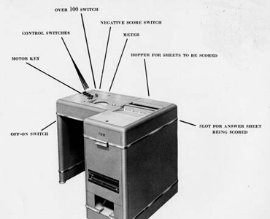
Brief review of development of CBT
1935, the IBM model 805 for scoring
1970-1980 –for delivery, scoring and
reporting
1970s –development of CAT
(computer adaptive testing)
1998-CBT of TOEFL was presented

Slide 4



Facilities and devices for CBT
Facilities
CBT center/multipurpose computer labs
Devices
PC
Laptop
Netbook
Tablet/smartphone

Slide 5
Implementing CBT at NDA of Georgia
2014 – ILIAS educational platform was introduced
2015- CBT were launched (except foreign languages)
2016 – CBT foreign language tests were launched

Slide 6

Pros and Cons of CBT
Pros
Eco-friendly
Saves time
Less human resources
Offers more response options
Item content may include multimedia content
Item banks can be easily updated
Tests can be easily created by rearranging items
Most questions types can be scored instantly
Records test-takers performance
Reduces opportunity to cheat

Slide 7
Cons
Time consuming for test developers (developing, uploading)
Reading tasks require scrolling up and down
Key to open-ended items cannot include all possible answers
Predefined key cannot predict all specificities in responses of test-takers (double space, typing errors, capital letters etc)
Cannot assess speaking skill
Internet problems, energy breaks etc.
Security (hacking)

Slide 8
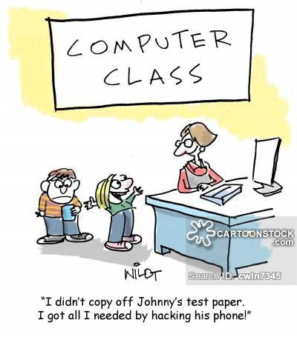

Slide 9


Scoring test results

Slide 10
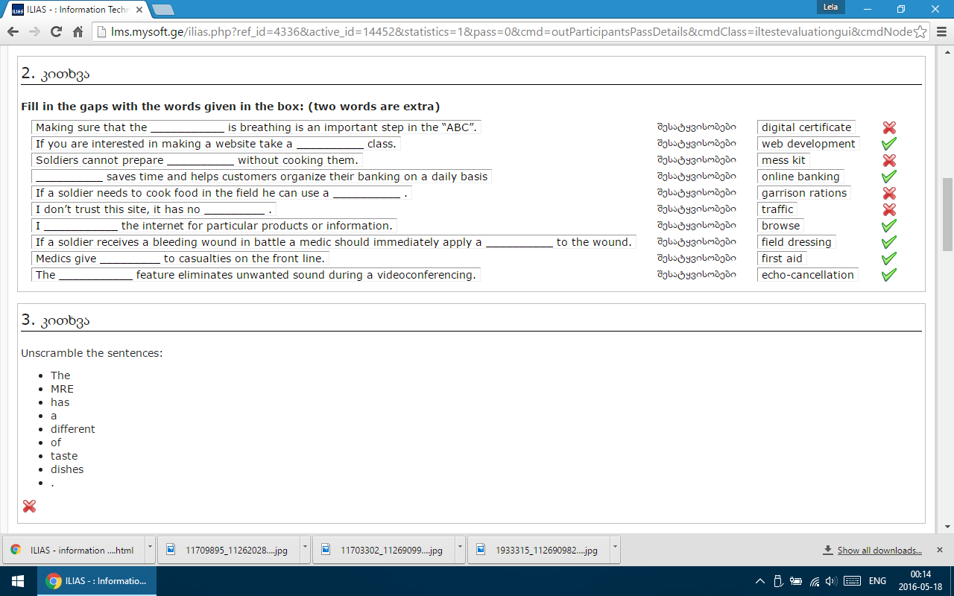
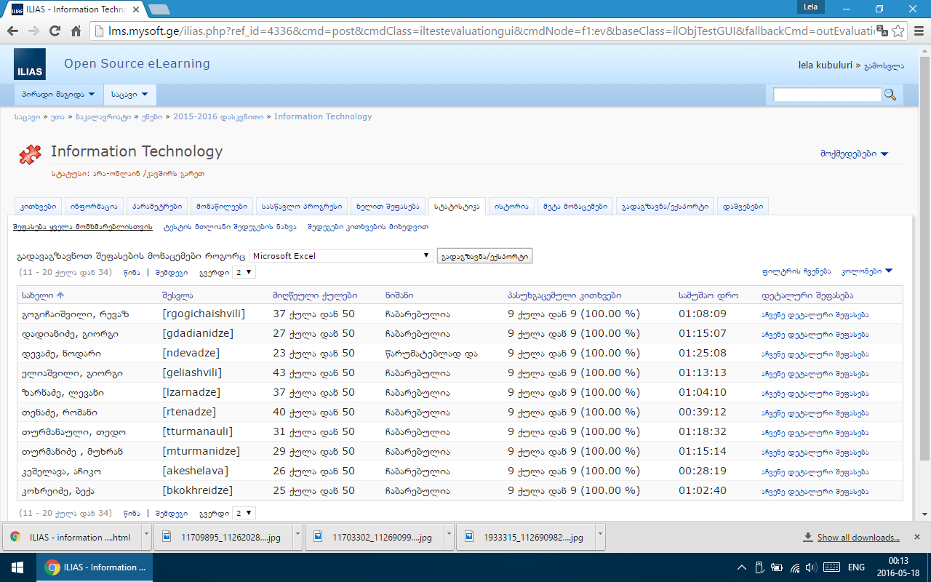

Slide 11
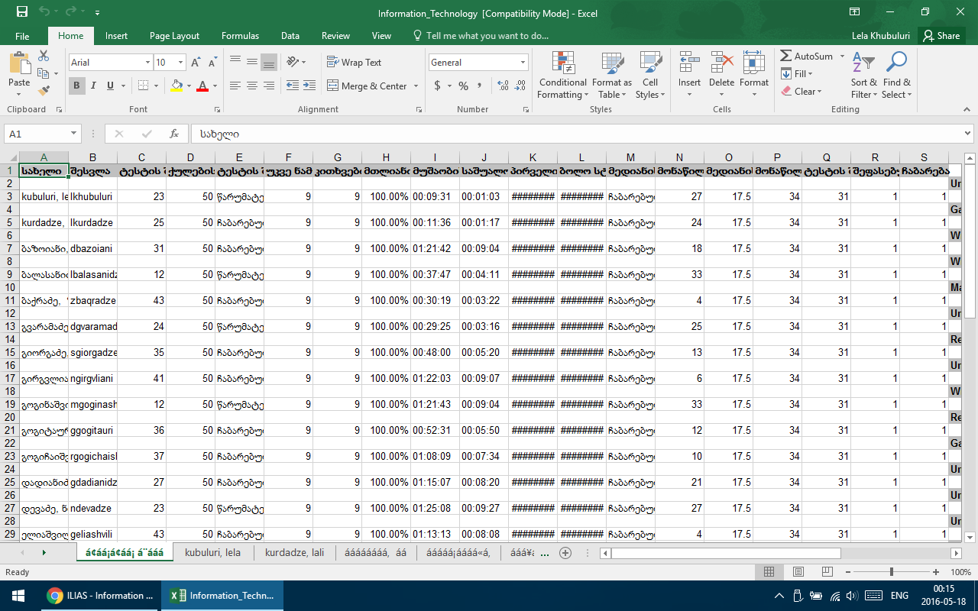

Slide 12


Slide 13


