Slide 1


BILC SEMINAR, COPENHAGEN 6-11.10.2019
INFORMACJA O WSOSP
„Signposting the way to success for CBI courses on the example of English language courses for aircraft maintenance purposes „
Agnieszka Burda, Deputy Head Foreign Languages Department
POLISH AIR FORCE UNIVERSITY

Slide 2
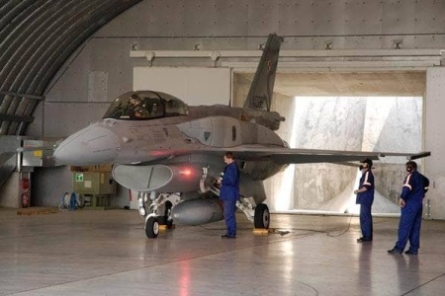
ENGLISH FOR SPECIFIC PURPOSES TRAINING CENTRE,
PAFU DĘBLIN
English for aeronautical communication
English for AVSEC personnel
Aviation English testing
English for Aircraft Maintenance Technicians (AMTs)

Slide 3
FIRST COURSES 2006
Emphasizing reading skills
Focused on topics from Maths, Physics to Engine Modules
Heavily overloaded with lenghty academic texts
Addressed at experienced and novice maintainers
Too few SMEs and language instructors lacking expertise

Slide 4
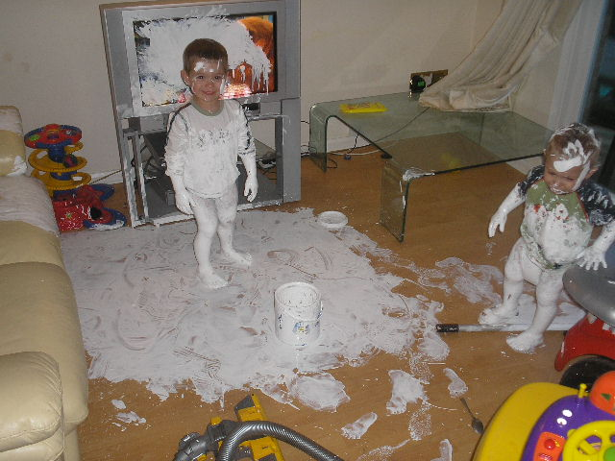
FIRST EXPERIENCES

Slide 5
TARGET POPULATION ANALYSIS
Gathers information about future trainees
Identifies knowledge and skills already possessed
Provides information about their preferred learning styles, social and linguistic environments

Slide 6
TARGET POPULATION ANALYSIS
Wide range of professional areas with no common center of interest
Reluctance to learning ”from the book” and academic explanations
Not used to remaining in class all day
Tendency to have visual intelligence
Tendency to underestimate own learning abilities (aircraft maintenance career often a second choice)
Being used to necessity to reach professional, though not linguistic, proficiency standards
Increased needs to incorporate reading/writing activity
Working in a team
Mixed language competencies and educational backgrounds

Slide 7
JOB ANALYSIS
necessary to establish how, where and with what a job is done in order to define the language areas and skills required for the acceptable level of competency
carried out by course developers in association with SMEs
ensures the course focuses entirely on the actual needs
ensures genuine skills/knowledge deficiencies are addressed in the training

Slide 8
TARGET POPULATION AND JOB ANALYSIS CONSTRAINTS
No procedures and technical instructions available for analysis
The posting for which training was to provided was not created at the time
Equipment on which the trainee was intended to work was not installed
Problems with acquiring technical documentation to develop hands-on practical exercises
Scarcity of SMEs on site or SMEs located at other units
Limited number of qualified course developers
Variety of equipment for which technical manuals were needed

Slide 9
TYPES OF COMMUNICATION USED BY AMTs
Synchronous Communication:
communicating with English speaking instructors
sharing information, giving and receiving instructions, planning tasks in multinational teams where English is the only common language
communicating with foreign flight crews
non-verbal communication (pointing at things, etc.)
Asynchronous Communication:
reading technical orders/manuals, job guides, and other documentation
making written technical entries in documents
Drury, C. G., Ma, J. (2003)

Slide 10
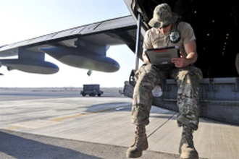
AMTs’ LEARNING NEEDS
Reading comprehension (manuals, job guides, illustrated parts
breakdowns)
Writing (making technical entries in documentation)
Listening comprehension
Speaking

Slide 11
SPEAKING
Sharing information
Giving and receiving instructions
Planning and performing procedures
Analysing a problem and debating
Discussing possibilities of solving a problem
Reaching a consensus

Slide 12
LISTENING
Following spoken instructions
Note taking during follow-on training
Reporting daily activities and duties
Efficient interaction with foreign counterparts
Discussing possibilities of solving a problem
Reaching a consensus

Slide 13
WRITING TASKS
Brief and to the point. Mostly elliptical sentences which convey observations that technicians may have to enter in their work cards. Basic types of written entries include:
Work performed: Oil filter replaced.
Inspection results and actions taken: – NLG tire tread
depth below minimum. Tire removed and replaced
No action necessary/taken: Turbine duct cracks: none. No
action required.
Test reports: Serviceable LRU (line replaceable unit)
installed. Operation correct.
Servicing reports: Oil level checked. Replenished with 1 liter
Work deferred with reasons: Unit cracked but serviceable.
Replacement deferred until next check due to current lack
of spares.

Slide 14
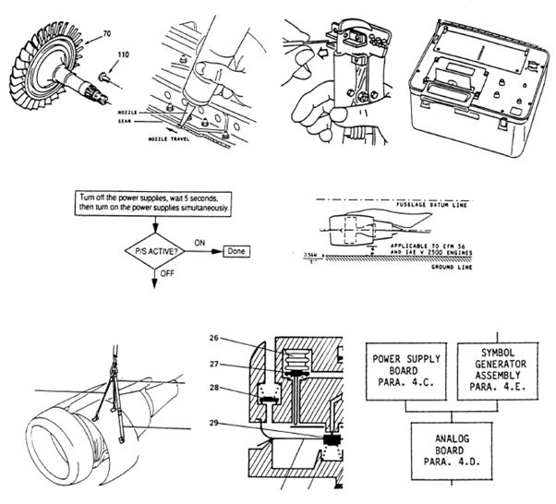
READING - DOCUMENT TYPES
manuals, job guides, illustrated parts breakdowns, block diagrams, flow charts,
work cards etc.

Slide 15
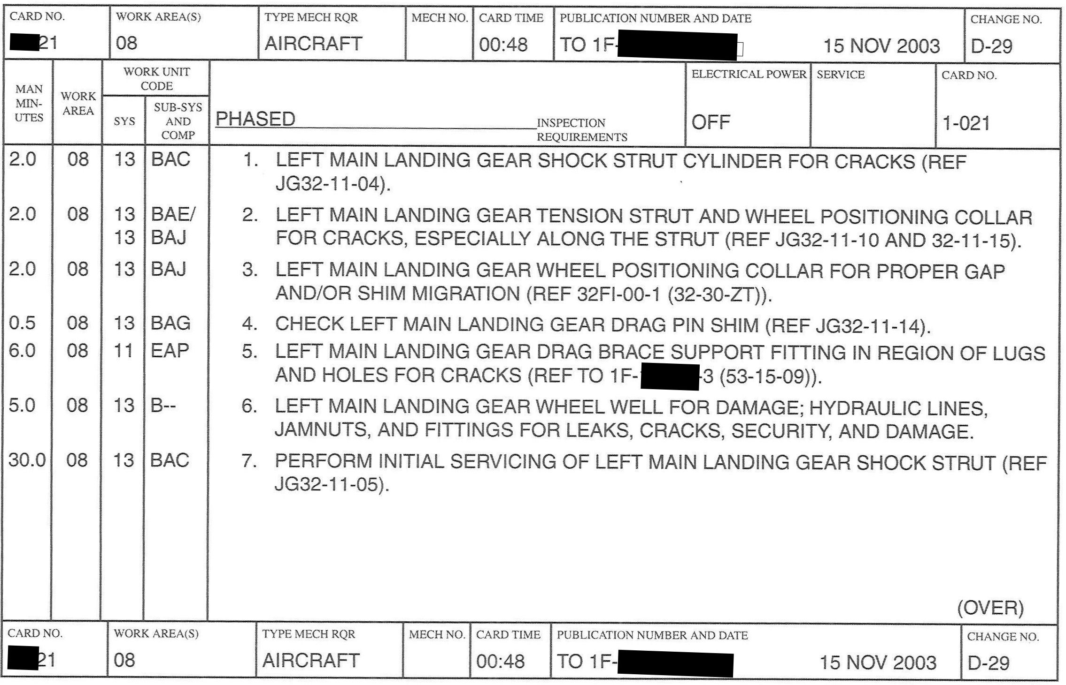
DOCUMENT TYPES

Slide 16
DESIGN OF CURRICULUM
Purpose of design of curriculum
Sequencing the teaching events
Designing tests which are valid and reliable

Slide 17

TESTS
I’m afraid that
we’ll have to remove
your appendix
Have you
ever done
this operation
before,
Doctor?

Slide 18
TESTS
No, but I passed all
the tests.
Oh, what
sort of tests?

Slide 19
TESTS
Mainly multiple choice,
but there were some
traditional written
exams as well.
HELP!
Example extracted from R.F. Mager’s
book “MAKING INSTRUCTION WORK”

Slide 20
Desired Test Qualities - Other Qualities
Balance – the distribution of the items reflects the relative importance of the objectives
Efficiency - not too time-consuming to administer and allows for quick scoring and processing of results
Objectiveness - minimizes personal interpretation of answers when the test is scored
Fairness – encourages trainees and gives them equal chances

Slide 21
TRAINING COURSE CONTENT: PLAIN AND MAINTENACE-SPECIFIC LANGUAGE TRAINING
What and how?
Subjects, topics and issues of direct interest to learners
Language training supports developing competence in work-
specific domain

Slide 22
EXAMPLES OF MAIN GRAMMAR AREAS INCLUDED IN THE
COURSE
Verb forms and tenses
Noun clusters
Cause, effect, and purpose clauses
Word formation, prefixes and suffixes
Expressing movement and locations, directional references

Slide 23
VERB FORMS AND TENSES
Imperatives
Present Simple, Past Simple, Future Simple
Gerund (e.g. A diffuser is used for reducing the velocity of already heated air by increasing its pressure)
Present and Past Participle including their use as parts of compound adjectives (e.g. forward-looking, engine-driven)
Passive Voice
Modal Verbs (e.g. can’t vs may not, shall (=must), is/are to, should; mandatory vs. recommended, expressing warnings )

Slide 24
NOUN CLUSTERS
importance of word order (qualifiers normally before the key word):
bleed air -> air from engine compressor
air bleed -> a system that provides hot air
structure of noun clusters in technical manuals:
Location/system + function/assembly + key word
(e.g. Left wing leading edge)
structure of noun clusters in part catalogues:
Key word + function/assembly + location/system + additional information (e.g. bolt, connecting rod, upper special)
Very long noun clusters or combinations thereof in e.g. OBD codes and error messages, e.g.:motor lock roof lock motor,
air outlet damper control servo motor circuit (low/high/range/performance)

Slide 25





TRAINING MATERIALS
USE OF REALIA
Pre-flight checklist
Conversion tables (e.g. converting miles to kilometres)
A pocket-size foldout showing markings for different classes of dangerous goods
Diagram of equipment maintenance steps
A decision table giving instructions on what to do in various
situations

Slide 26
TRAINING MATERIALS
Instructor manuals with practical clues help to deliver contents more comfortably
Student assessment forms/documents facilitate
implementation of remedial actions
Proper progress monitoring and testing provides
instructors and administrators with feedback on
curriculum assimilation.

Slide 27
COURSE INSTRUCTORS
Induction of language instructors
Working in tandem with SMEs
Commitment to life-long learning

Slide 28
ENGLISH FOR AIRCRAFT MAINTENANCE COURSE -
INSTRUCTORS’ PREREQUISITES
Fully qualified ESP Teacher (ELE) or Aircraft Maintenance Engineer (SME)
Knowledge of English vocabulary related to aircraft maintenance and general science and technology
Teaching experience in the relevant ESP field
English (SME): Common European Framework for Languages (CEFR) Level B2 or NATO STANAG 6001 Level 3 or above

Slide 29
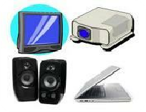
TRAINING DELIVERY METHODS
Traditional classroom environment training
Computer-assisted language learning
Blended solutions
Notes:
.

Slide 30
STUDENT-RELATED CHALLENGES FACING COURSE
DEVELOPERS AND INSTRUCTORS
Insufficient language competence of students
Variety of professional specialties of students
Variety of educational backgrounds of students
Variety of needs and, consequently, lack of clear or common goals
Inablility to distinguish a language course from a professional development course

Slide 31
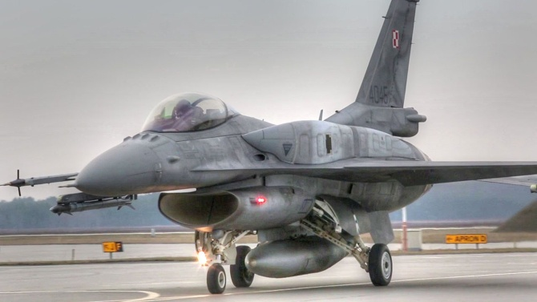
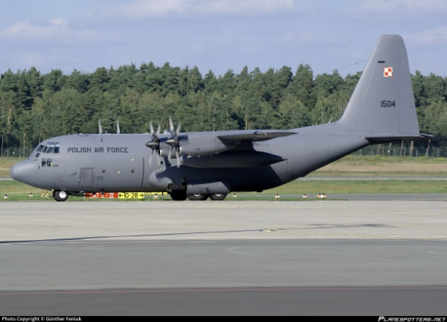
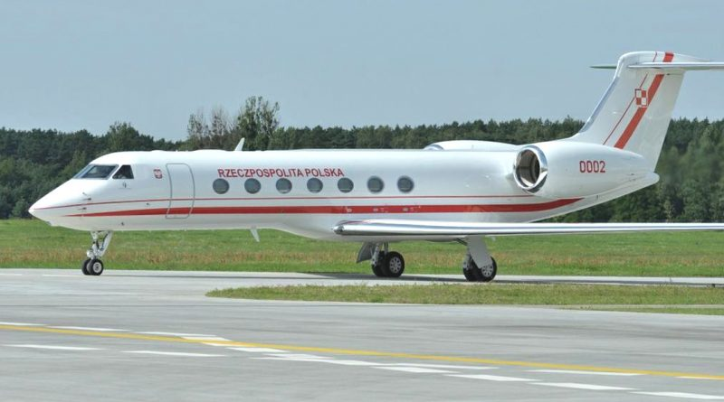
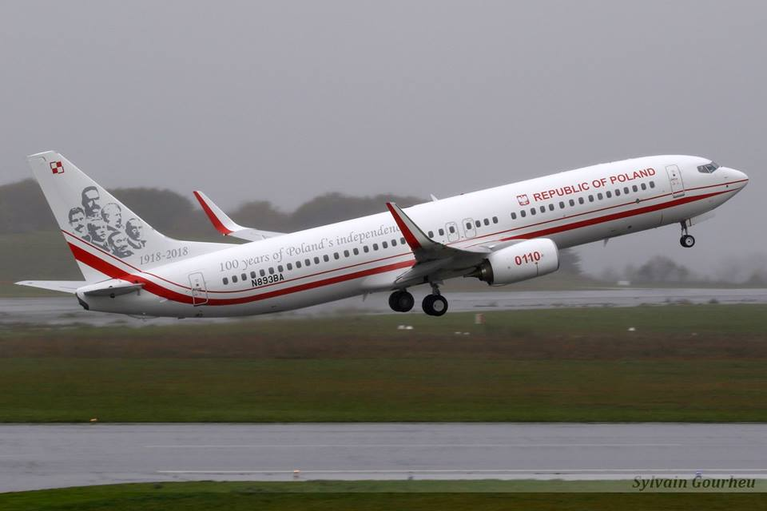

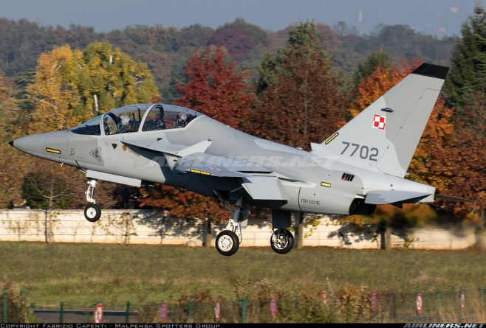
OTHER CHALLENGES FACING COURSE DEVELOPERS AND
INSTRUCTORS
F-16
C-130 Hercules
Gulfstream G550
Boeing 737 800
SH-2 Seasprite
M346 Master

Slide 32
OTHER CHALLENGES FACING COURSE DEVELOPERS AND
INSTRUCTORS
Variety of equipment the students work on (F-16, C-130 Hercules, Gulfstream G550, Boeing 737 800, M346 Master, CASA C-295, etc.)
Variety of maintenance documentation management systems used by various equipment manufacturers (USAF: Technical Orders, Boeing: Maintenance Performance Toolbox , etc)
Variety of terminology used by various equipment manufacturers (e.g. main, service, reservoir fuel tank)
Classified status of a large part of technical documentation making it impossible to be used in the classroom

Slide 33
OTHER CHALLENGES FACING COURSE DEVELOPERS AND
INSTRUCTORS
Lack of common language certification standards for AMTs:
”Holders of a Part-66 aircraft maintenance license may not exercise certification privileges unless they have a general knowledge of the language used within the maintenance environment including knowledge of common aeronautical terms in the language”.
Source: European Aviation Safety Agency (EASA), Part-66, GM 66.A.20(b)3.
” Be able to read, write, speak, and understand the English language. (Note: If the applicant does not meet this requirement and is employed outside the United States by a U.S. carrier, the certificate will be endorsed “valid only outside the United States.”)”
Source: Title 14 of the Code of Federal Regulations (14 CFR) part 65

Slide 34
CONTENT-BASED LANGUAGE TRAINING CHOICE - CONCLUSIONS
Manuals, Job Guides, professional publications published in English
Safety awareness is increased
Learners’ motivation is increased

Slide 35
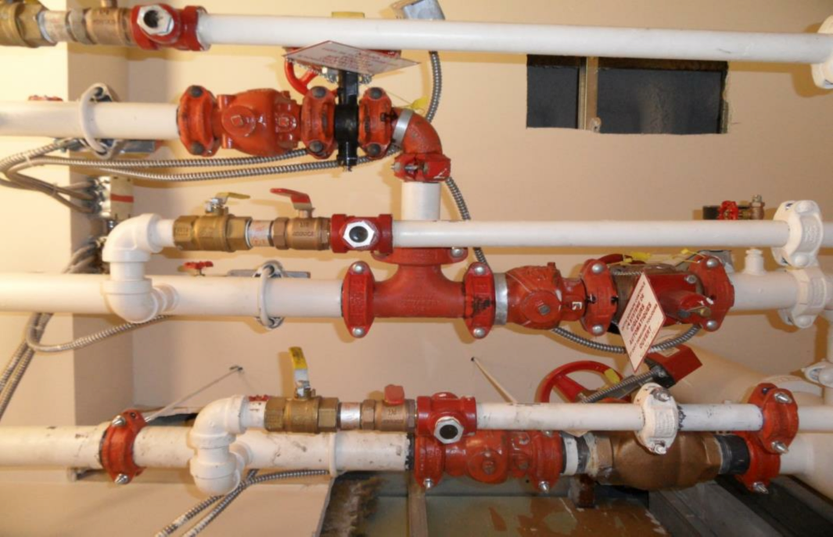
BEFORE

Slide 36
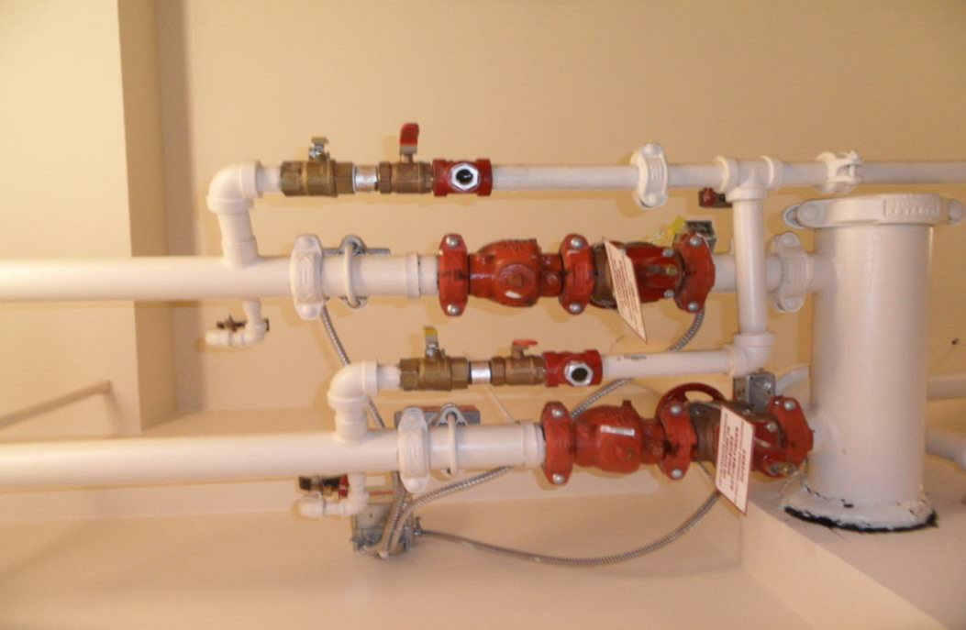
AFTER

Slide 37
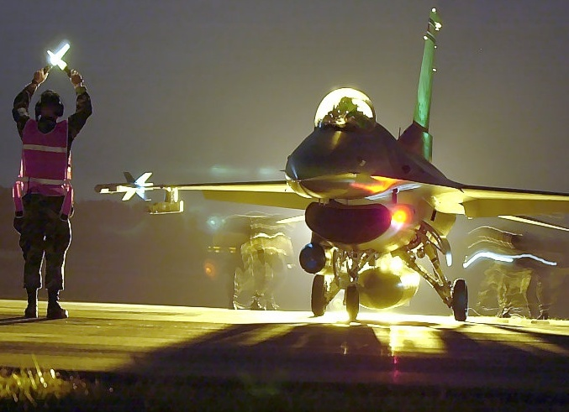
THANK YOU FOR YOUR ATTENTION
QUESTIONS?

