Slide 1

Using technology to harness language learning: challenges and benefits
Teacher Camelia Gheorghita
The Foreign Language Learning Center of the Naval Academy - Romania​

Slide 2

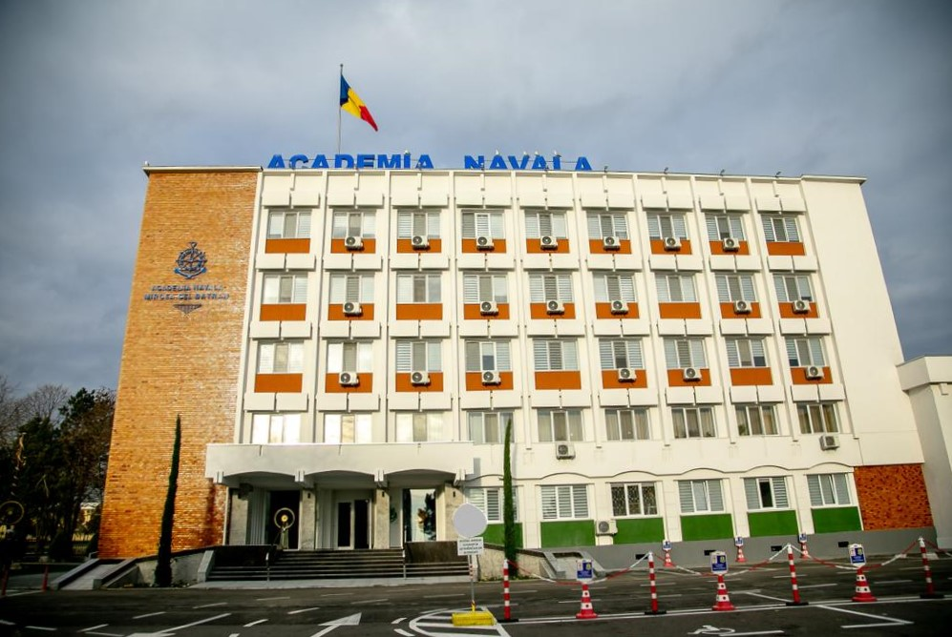
The “Mircea cel Bătrân” Naval Academy – Constanța, Romania
The Foreign Language Learning Center
Using technology to harness language learning: challenges and benefits

Slide 3
Agenda
1
2
3
4
5
Introduction
Today’s students
Digital pedagogy
Our online courses
Benefits and challenges

Slide 4



Slide 5
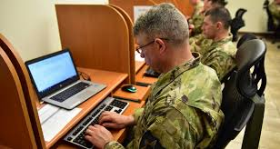
Our students today
Andragogy vs pedagogy
(1) self-directed
(2) learning based on prior experience
(3) learn when they experience a need
(4) problem-centered
(5) self-motivated (Knowles, 1980)
digital native or digital immigrant (Prensky, 2001)

Slide 6
Teaching language with learning technologies

Slide 7
New digital
technologies
Educational context

Slide 8
Principles of using new digital technologies (Nicky Hockly, 2022)
availability and appropriacy
value for learning
time and effort
digital skills

Slide 9
Digital pedagogy – definition
“Digital pedagogy is the part of pedagogy that studies the design, implementation and evaluation of educational situations comprising a significant component of digital technologies, as well as the necessary conditions for their implementation – synchronous and asynchronous interactions in virtual and mixed learning environments, learning management platforms and tools, digital educational resources, educational usage of various digital applications and tools, virtual assistants for learning and teaching, digital competences of teachers, educational policies and specific programs.” (https://educatia-digitala.ro/digital-pedagogy-definition-and-conceptual-area/)

Slide 10


*** Digital pedagogy is the study of how to teach using digital technologies. (OUP, Howell)
Digital pedagogy = +
https://clipart-library.com/free-computer-images.html
https://www.freepik.com/free-photos-vectors/teacher

Slide 11
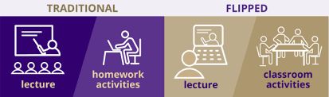
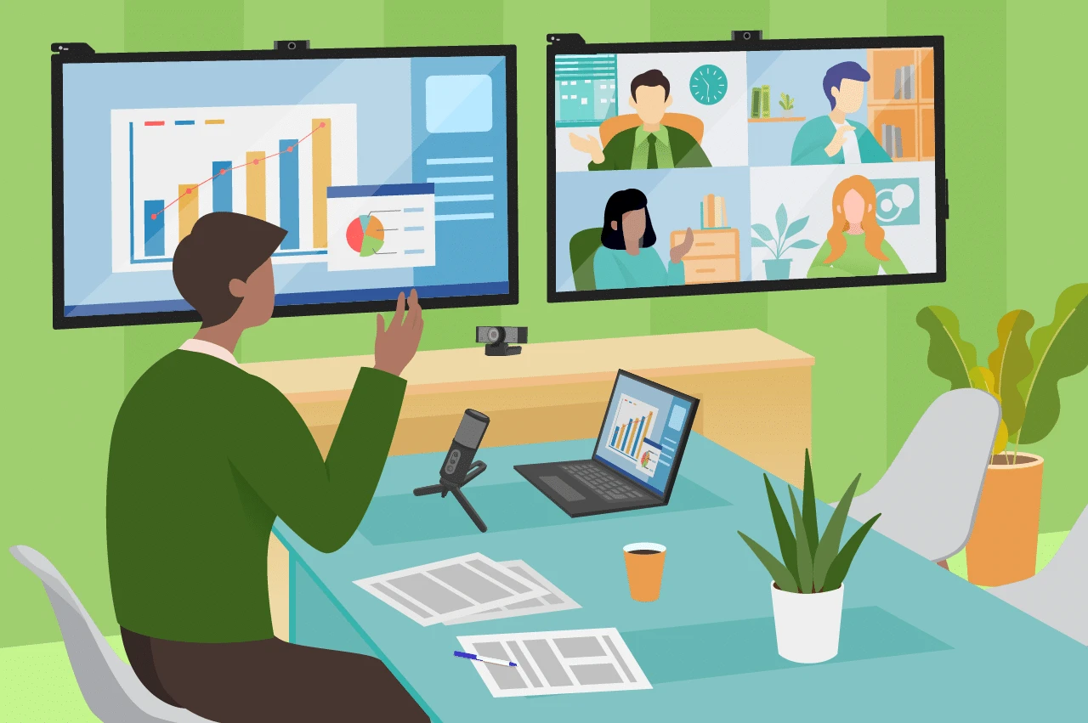
FLIPPED CLASSROOM
virtual classes
Source: https://teaching.washington.edu/course-design/flipping-the-classroom/

Slide 12
FLIPPED CLASSROOM - benefits
time efficiency
authenticity
critical thinking skills
student-centered activities
appropriate

Slide 13

Our online courses
Asynchronous
Digital content
Synchronous
Student-centered
virtual classes

Slide 14
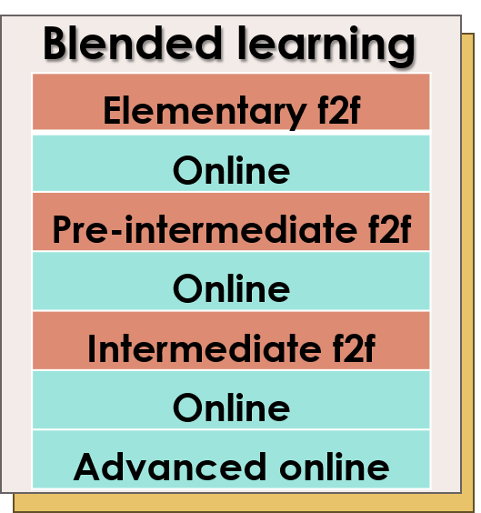
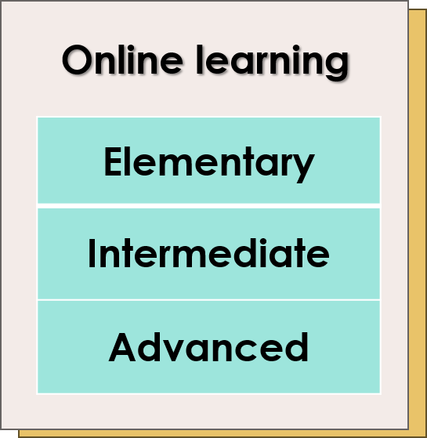
English Learning programs​
*Similar learning programs for other languages such as French, German or Russian.

Slide 15
Teaching online ​
HARDWARE
SOFTWARE
LIVEWARE
COURSEWARE

Slide 16
Our online courses - components
content – relevant, appropriate, informative, easy to access
practice – exercises, oral and written assignments
feedback –instant and teacher-guided
self-evaluation – validity, increased motivation
virtual classes – synchronous interactions with peers and the teacher
tutoring area - remedial and motivational activities

Slide 17
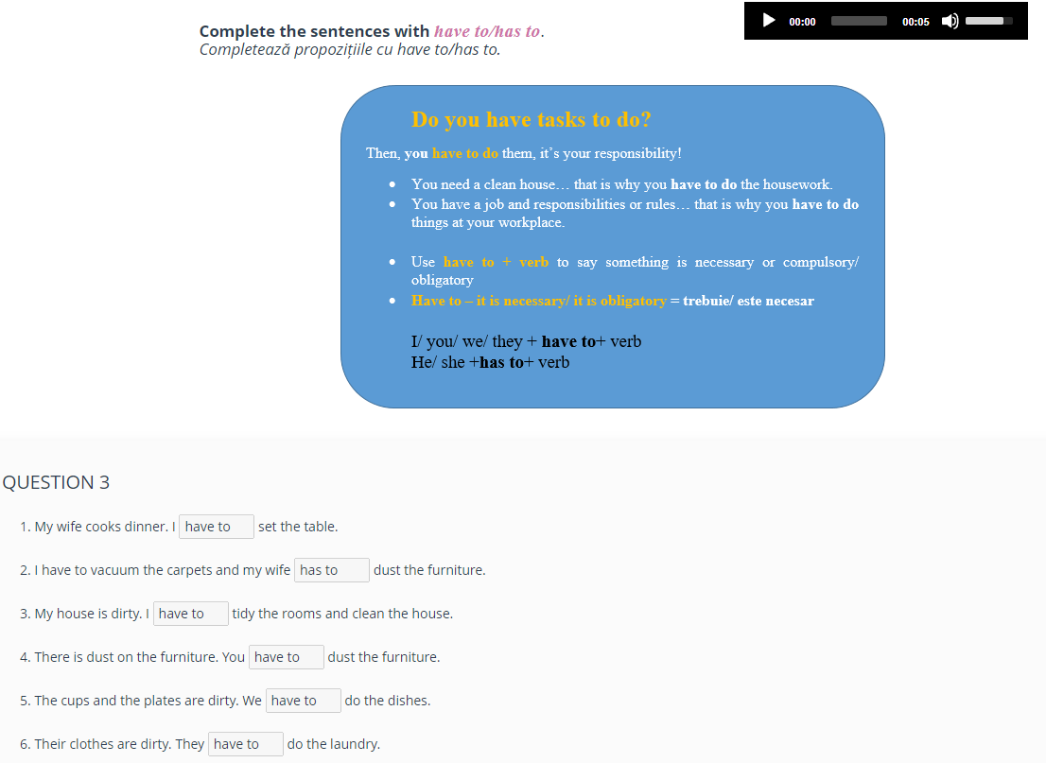
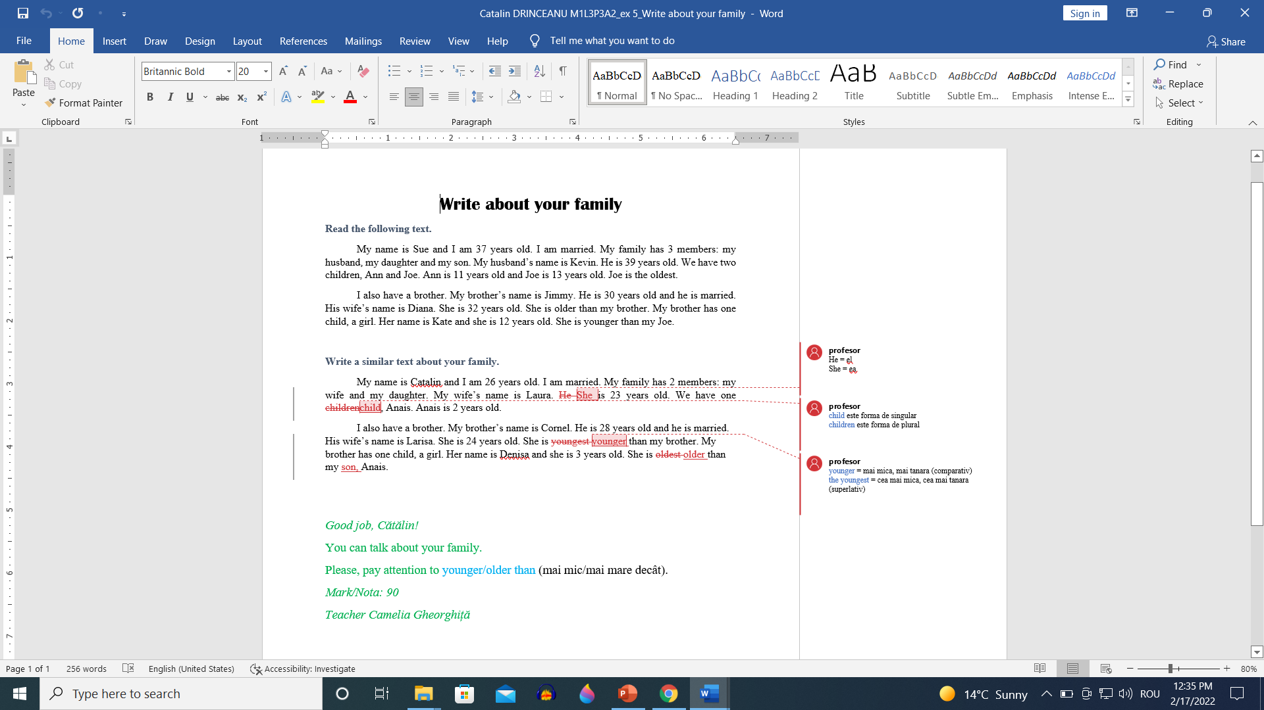
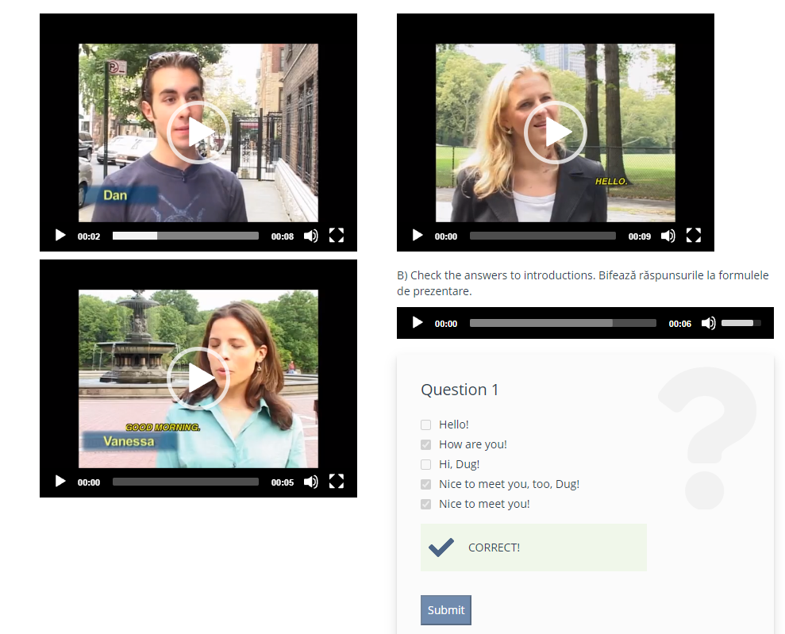
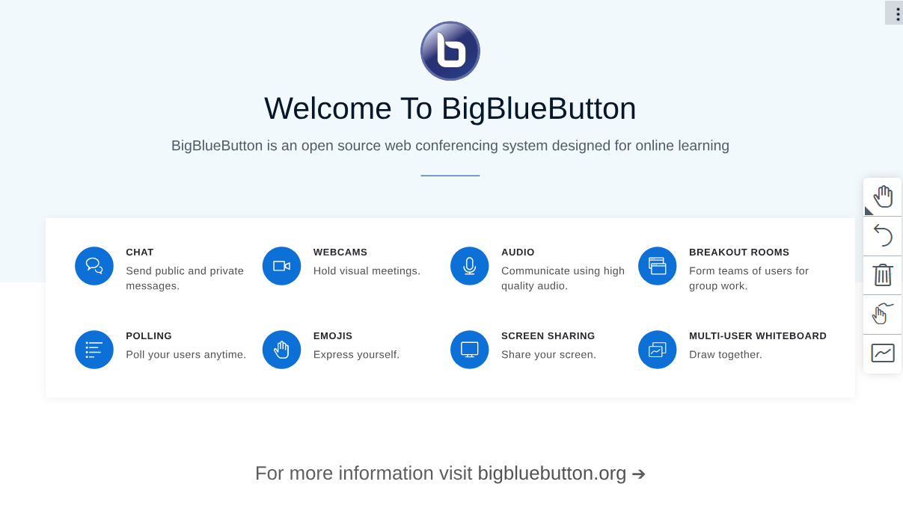
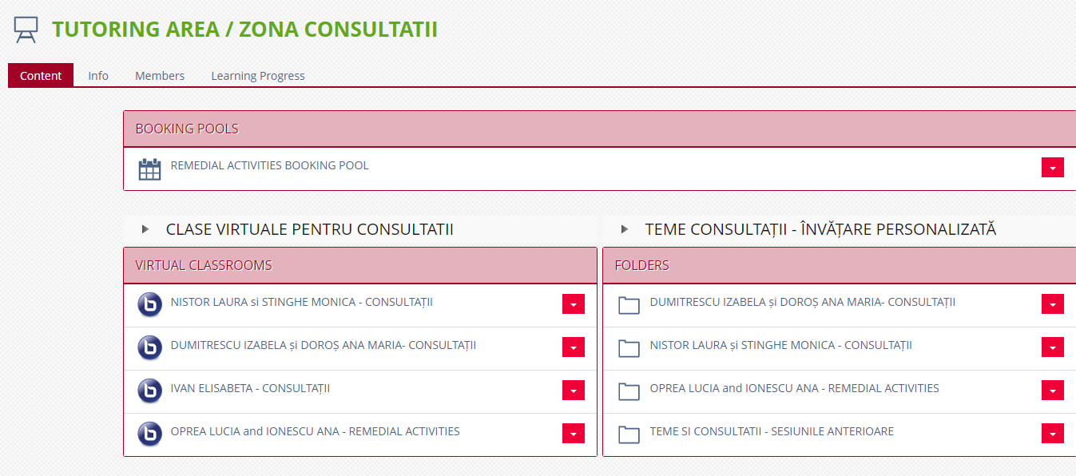
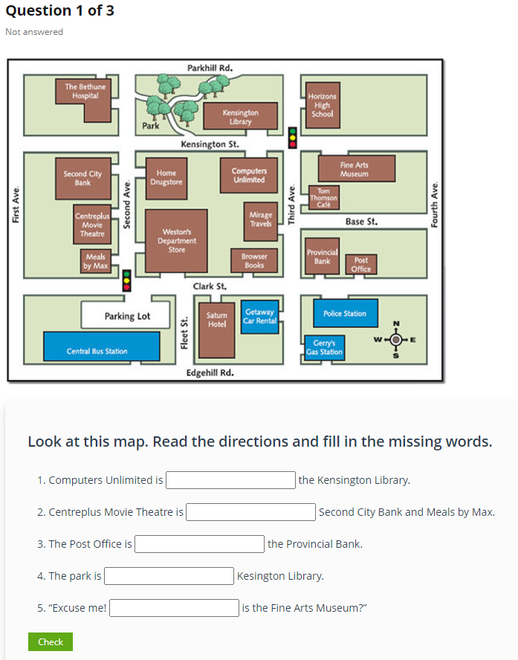
Benefits – pedagogical perspective
authenticity
critical thinking skills
personalization
validity
speaking skill development
addressing individual learning needs

Slide 18
Benefits – learners’ perspective
time and space flexibility
self-paced learning
enhanced time management skills
reduced costs
comfortable learning environment

Slide 19
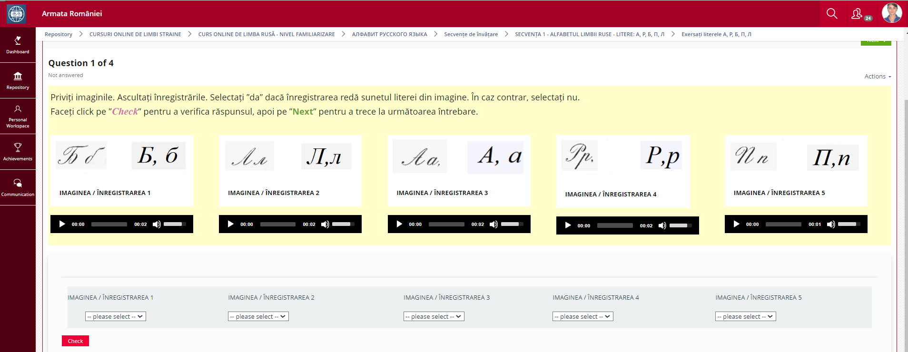
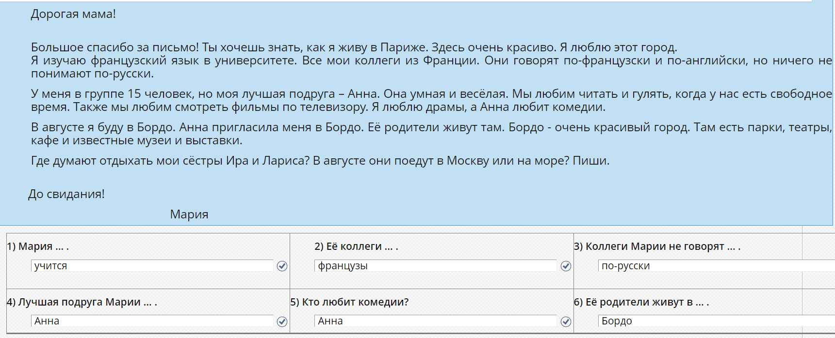
My online learning experience

Slide 20
Challenges – liveware perspective: learners
Lack of tech facilities
Technical issues
Too many distractions
Health issues
Lack of motivation

Slide 21
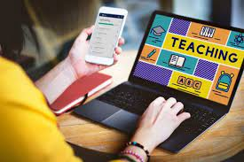
Challenges – liveware perspective: teachers
Tech savvy teachers

Slide 22
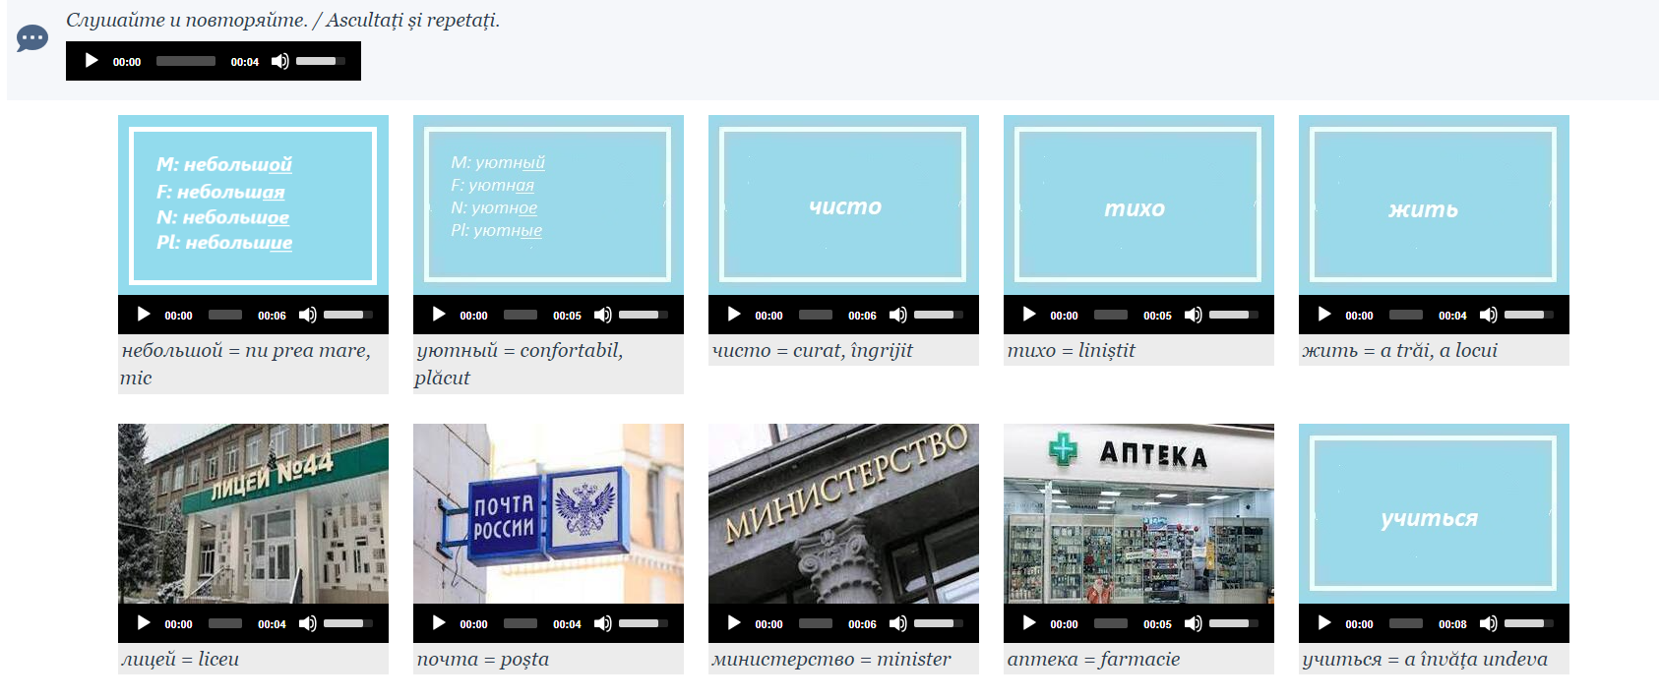
Challenges – courseware perspective
Too much content
KEEP
I T
SIMPLE

Slide 23
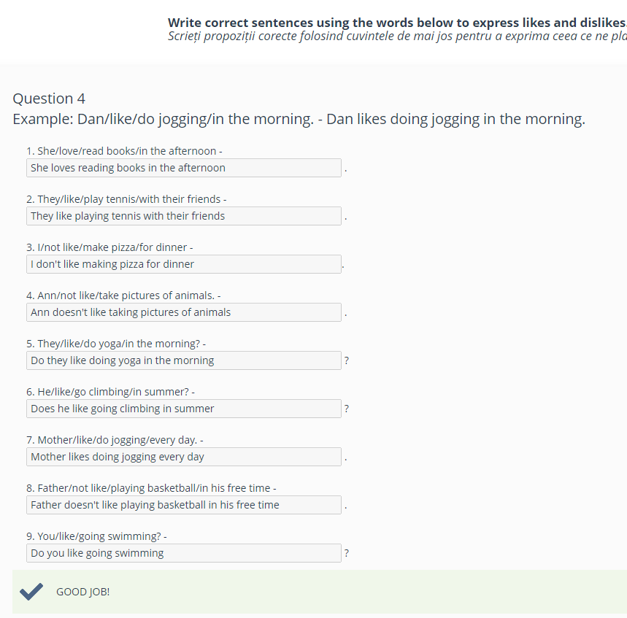
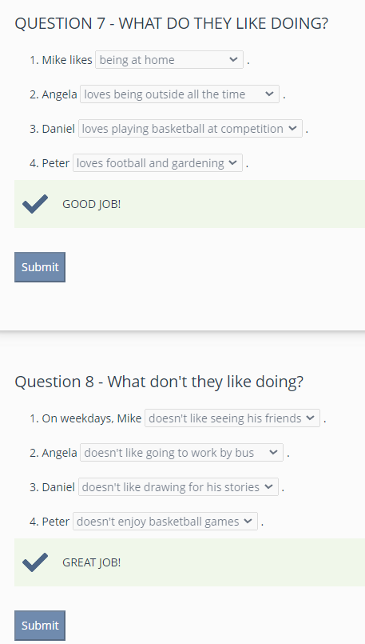
Challenges – courseware perspective
Lengthy practice activities
x
√

Slide 24
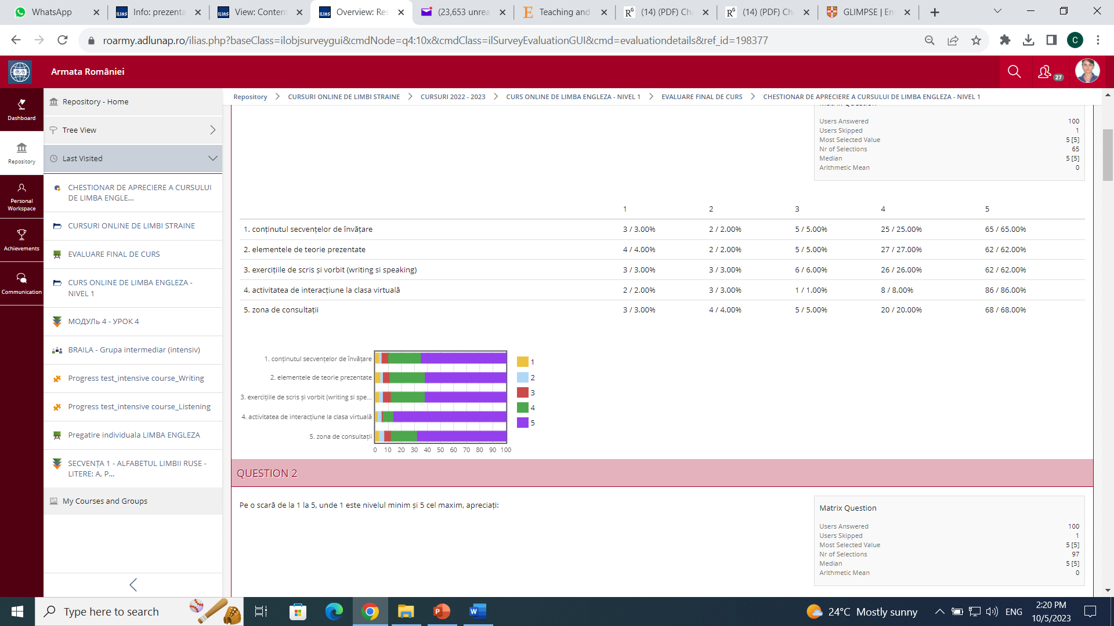
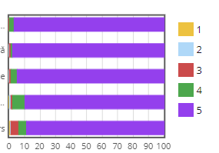
Student survey – online course evaluation
Learning content
Theoretical aspects
Oral and written assignments
Virtual class activity
Tutoring area
Teacher support
Communication with the teacher
Assignment feedback
Technical support form course administrator
Communication with course administrator

Slide 25
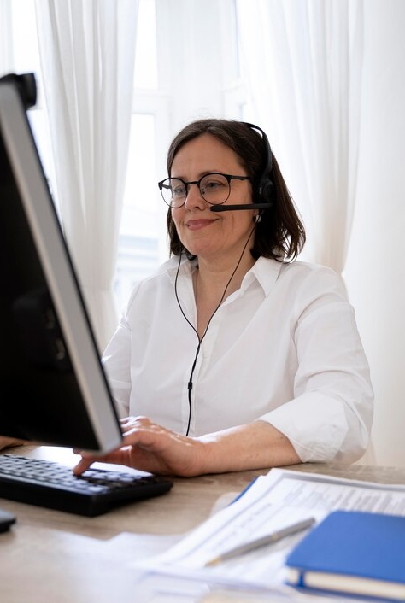
“Technology will not replace great teachers but technology in the hands of great teachers can be transformational. ”
George Couros
https://www.freepik.com/free-photo/english-teacher-doing-her-class-with-whiteboard_15184727.htm#query=teach%20english%20using%20technology&position=0&from_view=search&track=ais

Slide 26
Thank you

