Slide 1

The Dubious Endeavors of a Quack Terminologist….

Slide 2
HOW WE ”MANAGE TERMINOLOGY”
Intro:
Who are we?
What do we do when we don’t dapple in terminology?
Terminology tasks:
One recent anecdotal example
One ongoing project

Slide 3

English Training and Language Testing
The Danish Defense College (joint, offers tertiary-level education)
  The Foreign-Languages Academy
    The English-Training and Language-Testing Section
    We are seven full-time civilians with degrees in English
    We are hired to teach
    We teach service-specific military and tactical terminology at separate service academies
    English is integrated into officer commissioning courses
    In time we become experts in the relevant terminology, and very knowledgable about subject-matter contexts

Slide 4
English Training and Language Testing
Besides teaching we
- develop curricula, syllabi, and teaching materials
- test (and develop tests) in accordance with ATrainP-5 (STANAG 6001)
- attend meetings ☹
- serve as service-specific English-language POCs and coordinate with military subject-matter instructors
- attend more meetings ☹☹
- translate ad-hoc documents and update our in-house glossaries
So why not leave terminology to the terminologists, and translating to the translators?

Slide 5

Danish interpreters and translators at the Council of Europe
Request for authorized Danish military terminology
Issues:
Ignorance of military matters and tactical terminology (they refer to IATE)
”Close” friends (kapacitet is tricky in Danish military lingo)
Transfer from English (operationel vs operativ)
Cases with no Danish equivalent terms
Target audience?

Slide 6
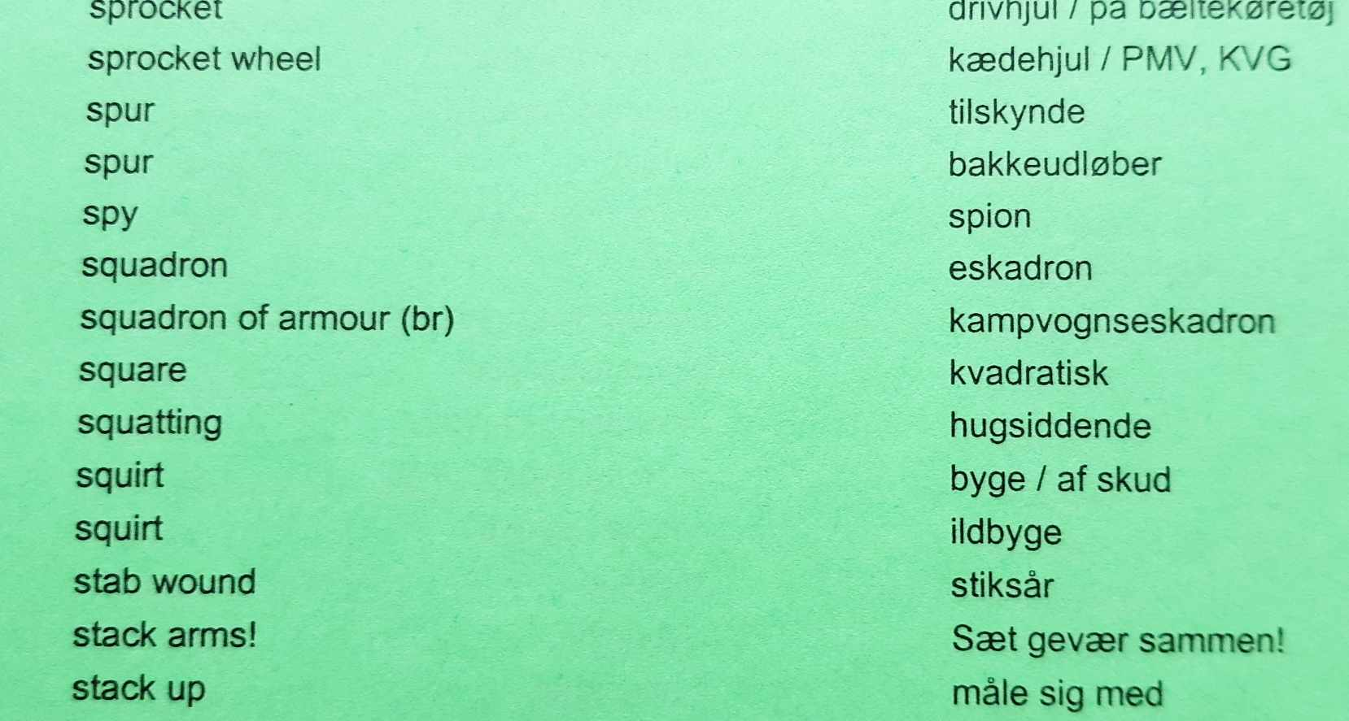
From clunky print version to snazzy app: our in-house army tactical glossary
Scope: Military activities on land, two-way (approx 15,000 entries). 1997-2011
Methodology: All “sources”, be they authorized documents, movies, slang from individual deployments, etc.
Target audience: Army cadets and Army Academy English teachers
Format: Print, color-coded; updated twice a year.
Resources: Residual time left for two designated custodians

Slide 7
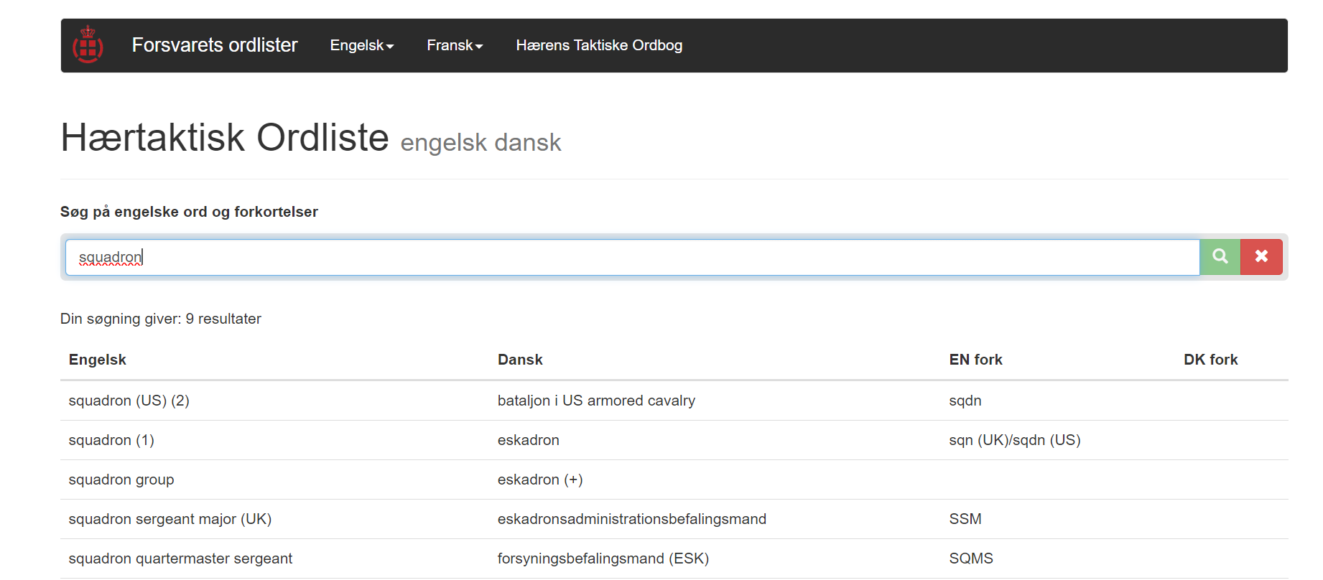
From clunky print to snazzy app: our in-house army tactical glossary
Scope: Army tactical terms, two-way (approx 6,000 entries). 2011-2024
Methodology: At least two authorized written sources from NS Army documents. Danish terms cross-referenced with Danish SMEs.
Target audience: Army cadets and Army Academy English teachers
Format: Online, open source; updated at custodians’ discretion (editing rights).
Resources: Residual time left for two designated custodians.
https://fol.fels.dk/searchEngDa

Slide 8
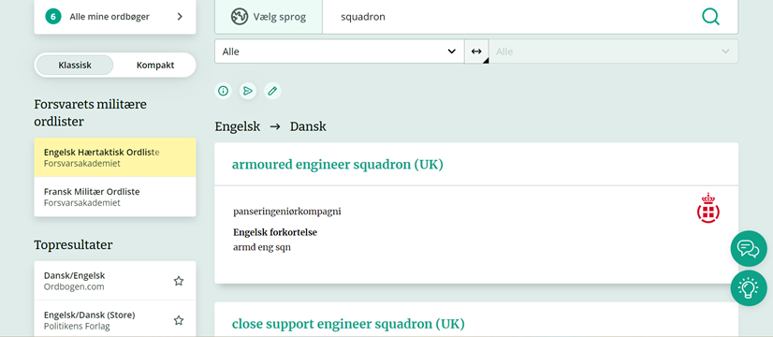
From clunky print to snazzy app: our in-house army tactical glossary
Scope: Army tactical terms, two-way (approx 6,000 entries).
Methodology: At least two authorized written sources from NS Army documents.
Target audience: Army cadets and Army Academy English teachers.
Format: App, accessible for members of the DNK Armed Forces only; will be edited once every quarter. To be launched 2024, inshallah…
Resources: Residual time left for two designated custodians.
https://www.ordbogen.com/da/search/classic?query=squadron&dictionaryId=firm-57&allowSwitchDictionary=0

Slide 9
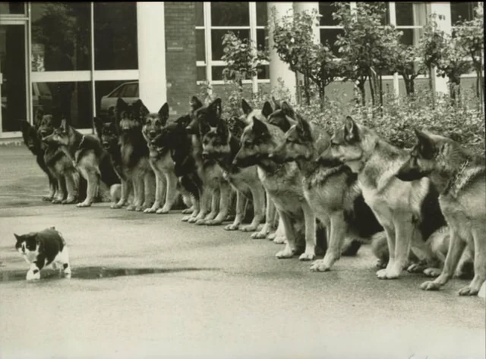
QUESTIONS?

Slide 10
Abstract
Despite having no designated personnel nor any earmarked resources for terminology tasks, the Danish Armed Forces Foreign-Languages Academy’s section responsible for English training of cadets and STANAG-based language testing is required to solve assignments that involve translating and updating of in-house glossaries.
The purpose of our glossaries is to make officer cadets aware of authorized English terminology. In other words, our focus is descriptive. This contrasts with many other organizations at this conference, who have prescriptive mandates in order to create authorized terminology in their national language(s).
Since 1997 our glossaries have progressed from a loosely structured process focusing on quantity to a disciplined criterion-based approach highlighting relevance and validity.
In 2024 we hope to launch our latest version; an app with access for Danish Armed Forces personnel only.

