Slide 1
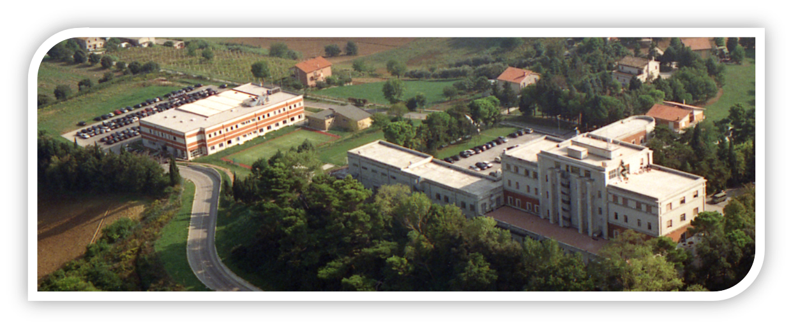



- ITALIAN AIR FORCE -
AVIATION ENGLISH TRAINING CENTER
Col. LUCA MASSIMI
Vilnius, 07 October 2021

Slide 2



ITALY WILL HAVE THE PLEASURE & HONOR TO HOST
2022 BILC CONFERENCE
WHEN
22-27 May 2022
Travel included

Slide 3




WHEN ?
22-27 May 2022
Travel included
WHERE ?
Direct flights from Paris, Munich & London

Slide 4



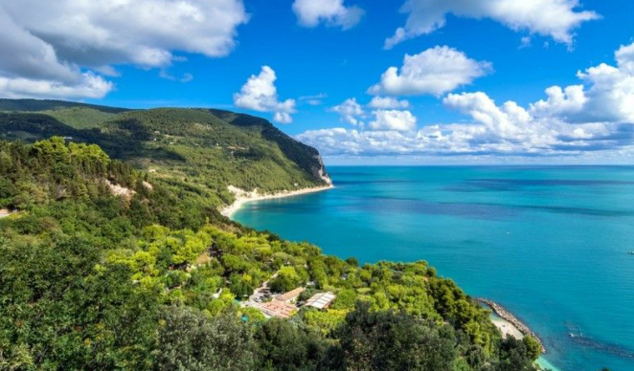

REGION
Marche: 2nd top region to discover in 2020 according to Lonely Planet
https://www.facebook.com/marche.tourism/videos/2398845510376534/

Slide 5

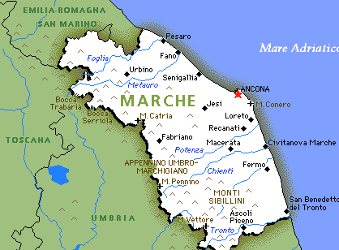

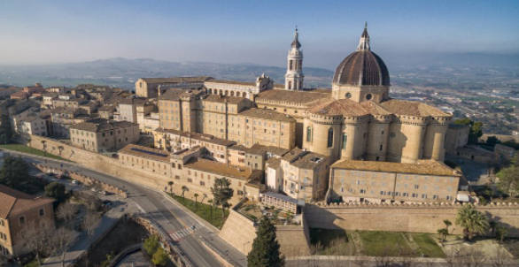
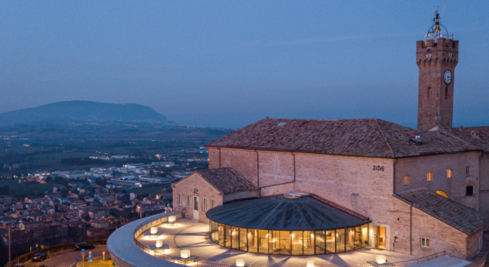
LOCATION : LORETO
25’ from ANCONA International Airport
https://www.turismo.marche.it/

Slide 6

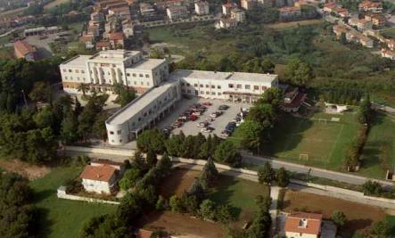
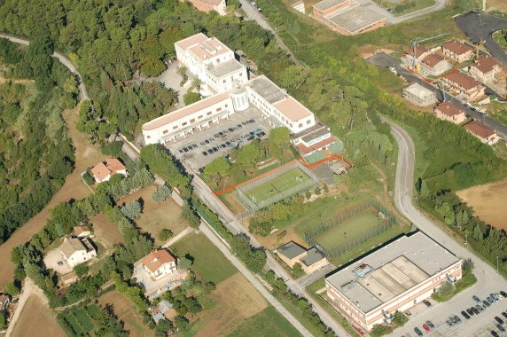
VENUE
ITAF - AVIATION ENGLISH TRAINING CENTER

Slide 7
VENUE
ITAF - AVIATION ENGLISH TRAINING CENTER
CONF THEME
  WIP
ACCOMODATION
  WIP
SEMINAR FEE
  250 Euro
SPOUSE PROGRAMME
  Min 08 pax

Slide 8

Thanks for your attention
…See you in ITALY
luca.massimi@am.difesa.it
aerocenforaven@am.difesa.it
Col. LUCA MASSIMI

