Slide 1

The switch from onsite to online teaching during COVID-19 pandemic
Specialized aeronautic language center, October 4 2021

Slide 2
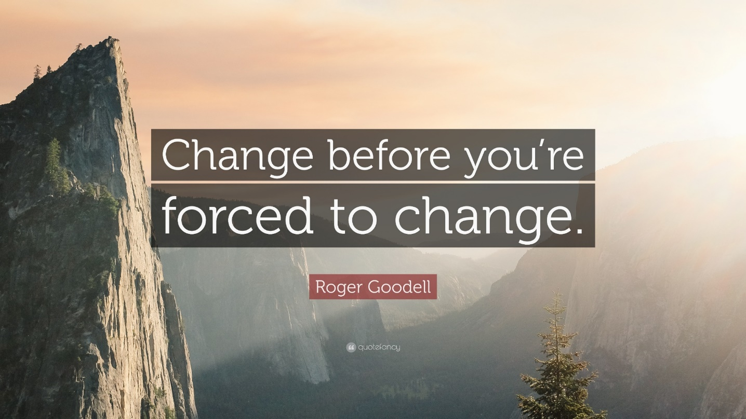
The switch from onsite to online teaching during
COVID-19 pandemic

Slide 3
The switch from onsite to online teaching during
COVID-19 pandemic
Introduction/ missions of the center
Benefits of online teaching
Drawbacks of online teaching / Solutions ?
Conclusion

Slide 4
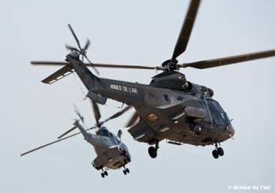
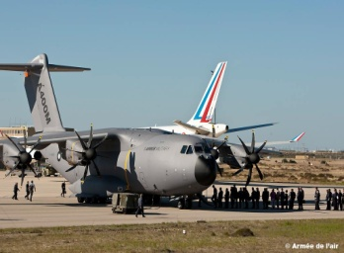
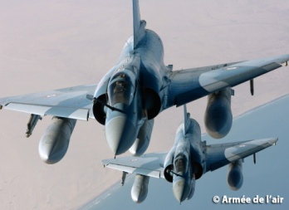
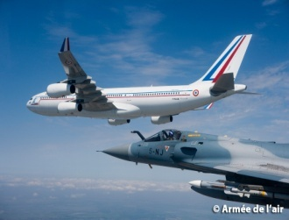
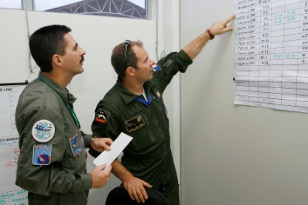
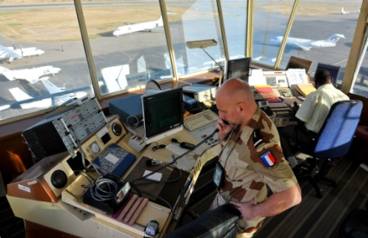
Stage 1
Basic military / academic training
Stage 2
Specialty / occupational training
Stage 3
continuous training
Who?
Military trainees (cadets, NCOs)
What?
General English training
Where?
In FAF Academy and NCO school
Objective?
Make sure trainees are proficient enough in general English to take specialized English courses
Who?
Air Force specialist trainees
What?
Specialized English training
Where?
In branch school centers
Objective?
Provide trainees with the English-language skills required in their respective professional fields
Who?
All Air Force personnel
What?
English training throughout the career
Where?
- Specialized Aeronautic Language Center
- 13 local English training centers
Objective?
Help personnel keep up and improve proficiency in professional English

Slide 5
EXPERT CENTER
Specialized Aeronautic Language Centre (CLAS),
in Tours, France.
Expertise in all fields of professional English related to the aeronautic environment: English for pilots, air traffic controllers, aircraft mechanics and technicians , etc.
Other areas of military interest: meteorology, telecommunications, English for external operations etc.
English teacher training

Slide 6
TEACHING TOOLS
☞ Specialized books and dictionaries (Aviation English, Campaign, English for Aircraft, technical documentation on specific aircraft …)
☞ Multimedia labs (pronunciation / listening / placement tests…)
☞ … and feedback from multinational military operations participants

Slide 7
The switch from onsite to online teaching during
COVID-19 pandemic

Slide 8

The switch from onsite to online teaching during COVID-19 pandemic

Slide 9
The switch from onsite to online teaching during COVID-19 pandemic
What are the benefits of teaching online ?
We could ensure continuity in our teaching.
During the different lockdowns, remote teaching allowed us to continue delivering classes to our trainees from our homes.
We managed to keep a link with our trainees and make them progress in their learning of English.
BUT we were NOT prepared at all to teach online !!!

Slide 10







The switch from onsite to online teaching during COVID-19 pandemic
What was the solution ahead of us ?
scan the web for « free » digital tools
Tools for videoconference : Big Blue Button, Zoom, Discord, Skype, Whatsapp…
Tools for sharing our pedagogical materials : Padlet, any Drive (to save the files for our trainees), useful for homework.
Our learners could have much more resources at their disposal. But they had to be directed in their learning. We managed to do that thanks to the different digital tools for videoconference I mentioned beforehand…
BBB for example : free but some limitations !!!

Slide 11
The switch from onsite to online teaching during
COVID-19 pandemic
BBB was victim of its success : lots of issues in terms of connectivity for instance.
With Discord, we could create private servers we could customize to act as a virtual classroom where we can share pedagogical content and hold meetings.
But again we experienced connectivity issues !!!
We had to switch from video calls to voice calls.
We managed to teach our trainees by simply using Skype or Whatsapp.
Padlet :
It is a digital pinboard that allows participants (trainees and teachers) to contribute by pinning different images, videos, text files, links, and more.

Slide 12
The switch from onsite to online teaching during COVID-19 pandemic
Here are some examples of our Padlet boards :
https://padlet.com/pascal_proust/vghgl7i6xqbq5i0c (FCL)
https://padlet.com/pascal_proust/nj61biilmq4gxj2u (ADEPT-4C)
https://padlet.com/pascal_proust/ty33e0ip2z18vrmy (AVIONICS)
Some technical training courses worked well with the free digital tools that we found but some others were quite difficult to implement online because of the connectivity issues :
for example it was quite hard to do debate activities as the videos sometime froze or the teacher could not hear what was said by the trainees…

Slide 13
The switch from onsite to online teaching during COVID-19 pandemic
What are the drawbacks when teaching online?
From the teacher’s view :
Connectivity issues, inequality on bandwidth capacity
Usual group activities are very hard to implement online
Teaching online is tiring but stimulating
Lack of knowledge on the digital tools
There’s a digital divide among the trainees (younger generation trainees are more savvy with new technologies).
Having to explain to trainees how the tool works again and again is a loss of time
Anything done online suffers from attention span, because students also do something else while attending online lessons… We should not forget that some of them have small children around too…

Slide 14
The switch from onsite to online teaching during COVID-19 pandemic
How did we manage to offer a solution accessible to all ?
We had to adopt a contact process for the teachers and we chose to email our trainees :
The teachers e-mailed the instructions to the group
informed the students about the tool that they would use.
gave the timetable for students to connect at the correct time.
told students that homework would be given for self-directed work.
gave a tutorial of the tool.
At last, what we retained was to combine a digital tool for videoconference (BBB, Discord or even Skype would do the job) with a tool aimed at sharing files (Padlet, Google Docs etc…)

Slide 15
The switch from onsite to online teaching during COVID-19 pandemic
As a backup, we created a whatsapp group in order to handle connectivity issues and switch to a phone call.
A two-hour session in the morning and a two-hour session in the afternoon are the limits we should not go beyond…
As director of studies, I am in charge of the students’ feedback and I could most of the time lead a live feedback session (15 minutes) at the end of the training course. For those I could not do live, I sent a written questionnaire to the students.
From the students’ side:
FCL training course requires self-directed work. I appreciated to have the correction of the listening exercises
Skype and Google Drive are very good tools
BBB is a very good tool even if we had some connectivity issues
We used Skype. I received some exercises to do as homework. It was easy to use.
We used Padlet, a tool that is well adapted to teaching English online.
Sometimes, some files were impossible to open…

Slide 16
The switch from onsite to online teaching during COVID-19 pandemic
What we have learned…
….you can’t just replicate what you do in real life…
But, we do think that there is a value to hosting live classes …
…And then we could give the rest of the materials to students for self-directed work.
What is most important is to promote participation from the trainees !!!

Slide 17

The switch from onsite to online teaching during COVID-19 pandemic
To conclude, I would say that switching from onsite teaching to remote courses was not plain sailing. We completely had to start from scratch …
Delivering classes — at short notice — to learners who are sometimes skeptical of the value/quality of teaching you might provide was somehow quite challenging for my team.
We have today moved back to our physical classrooms… But the lesson to be learned from this crisis is that we definitely have to work more on digital classes in the future and include blended learning in the training courses we offer !

Slide 18
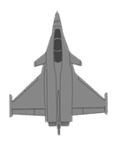
QUESTIONS ?

