Slide 1
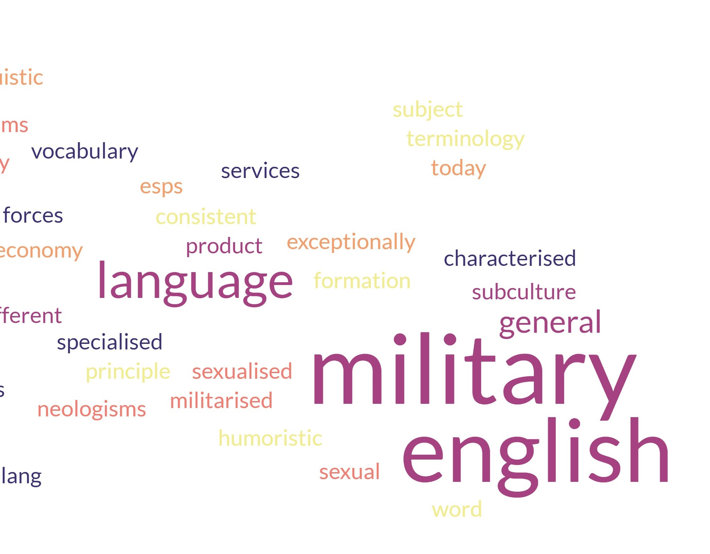





Military English Terminology and Its Impact on Bulgarian Military Terminology
Assoc. Prof. Dr Valentina Georgieva
Rakovski National Defence College
9 Apr 2024

Slide 2
Agenda
Definition of Military English
Specific features of Military English
Military English and humour
Origin of English military terms
Military English and political correctness
Military English word formation
NATO English terms: the Bulgarian case
Standardisation of Bulgarian military terms
Summary of the impact of the English military terminology on Bulgarian military terminology

Slide 3

Some theory
1. Military English: definition
Military language as one of languages for special purposes comprises all linguistic means – terms, military slang and military symbols as semiotic signs – for designating military organisations, personnel, military ranks and hierarchy, armament and military equipment, military systems, types of military activities, tasks and operations, which are defined in doctrines, strategies, manuals, guides, orders and similar specialised military/defence national and international documents and collections of informal military slang. Thus, a distinction can be made between official and informal military lexis.

Slide 4
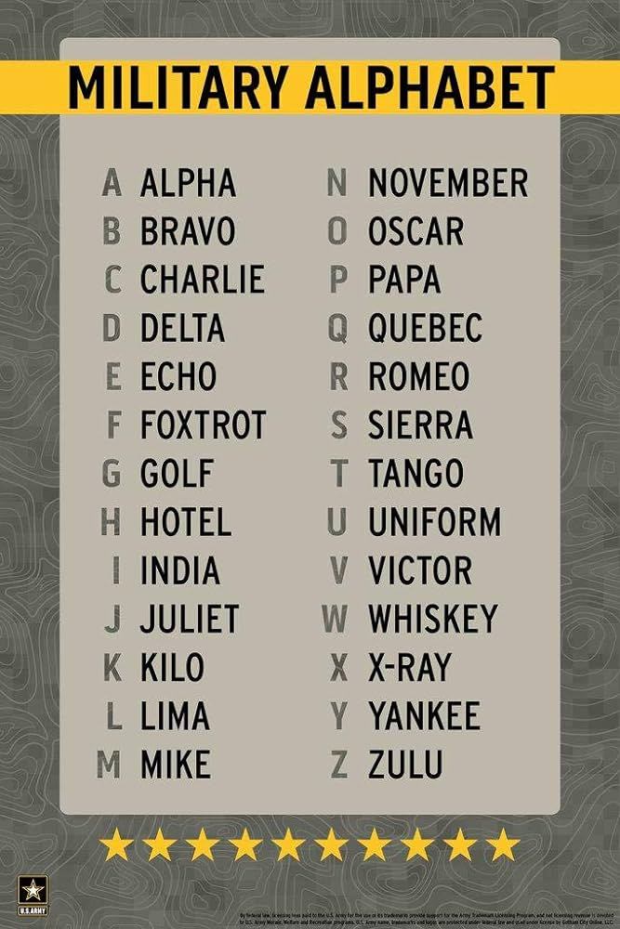
Some theory Cont’d
2. Military terminology: the most important ingredient of the military language as a special type of Language for Specific Purposes (LSP) because terminology is that part of linguistics which describes the lexicon of special languages. “Without terminology [there is] no professional communication; without professional communication [there is] no knowledge transfer; without knowledge transfer [there is] neither intellectual, nor material development, neither teaching and training, nor professional research, which leads to non-development and isolation” (Picht 2009)
3. Official military terminology takes a wide range of forms, some intended purely for internal use, others meant to represent the military to the outside. At its most basic level, official terminology functions to narrow the potential meaning of particular words. In casual speech there can be a wide range of possible interpretations and a misunderstanding can be rectified; but military organisations must be prepared to operate under great stress, in situations where misunderstanding can lead to catastrophe.
Thus, official terminology attempts to foreclose as many interpretive options as possible in order to reduce the likelihood of error or misjudgment (Chambers 2000).

Slide 5
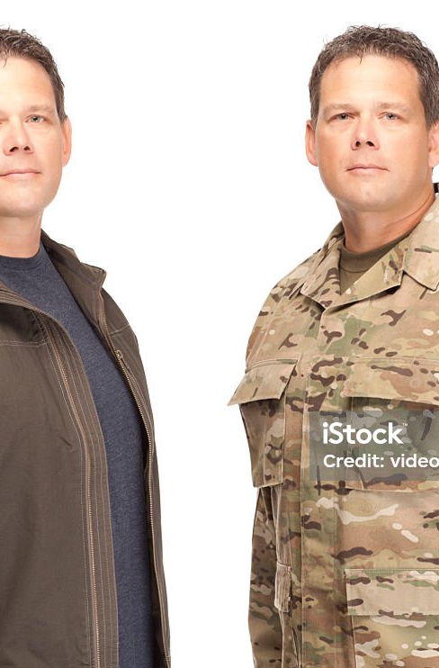
Specific features of Military English
Interdisciplinarity
- Military terminology and general language words with a new specialised military meaning, e.g. fire, head
Military terminology and legal terminology, e.g. refugee, genocide, doctrine, embargo, international sanctions, international peace and security, minority,
Military terminology and political terminology
Military terminology incorporates technical terms
Standardisation
The beginning of terminology as an independent field of study was stimulated by World War I when standardisation of calibres was required by different manufactures of armament and ammunition -> standardisation of the lexical terms for industrial items was initiated in the 20s of 20th century, and the first standardisation recommendations were introduced in the 30s.
Communicative importance
Some of the terms are understood and applied only by the military
Most of the terms are monosemous in a given context to ensure professional communication

Slide 6
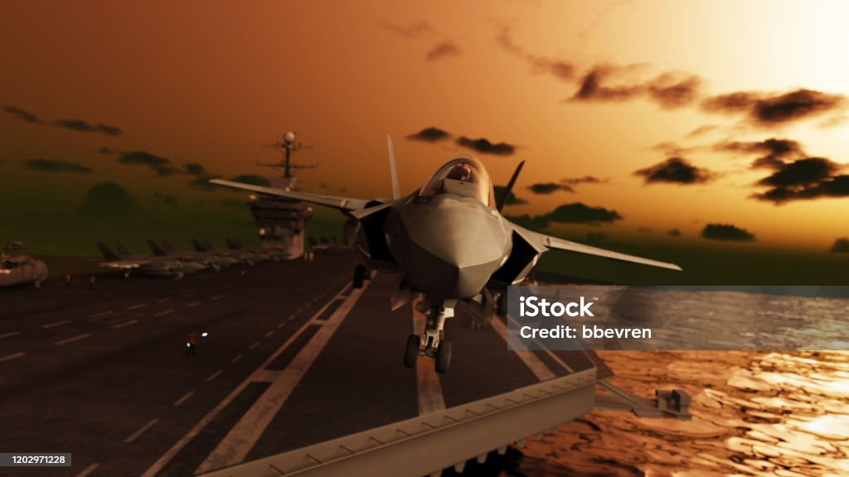
The most important feature of Military English
life saving or life threatening character
Example: miscommunication between American and British allies during World War II which resulted in a serious defeat. When an American pilot reported about an enemy ship (meaning aircraft), the British interpreted this term through their understanding of the word ship as a vessel only.
“In any coalition, communication is vital. But if miscommunication amuses in peacetime, it can be disastrous in wartime. Even in a well-established alliance such as NATO with only two official languages, difficulties are endless” (Silkett 1993: 74).
Terminological studies of military language play a vital role in facilitating communication between military specialists.

Slide 7
Military English – a productive part of English language
Reasons:
1/ the most important: “each crisis creates its own vocabulary” -> each war produces a new dictionary with military terms or slang words
As a BBC journalist states “The British Army has a centuries-long tradition of picking up slang terms from the many countries in which it serves, both within the British empire and from other places around the world. And while the British Army lowered the flag at its last base in Afghanistan, the country has left its own mark on British military language and culture”.
2/ Military technological advances -> new terms have been created to express the new concepts
The following terms and expressions became popular during WW I:
tanks: first used in the Battle of the Somme, 1916.
D-Day: initial day of a military operation. First used by American First Army at St. Mihiel, September 12, 1918;
doughboys: US soldiers of WW I; being a disparaging name for American infantrymen, its usage broadened and became positive in the war;
fed-up: disgusted. First used in Boer War and carried over by British Army
Some examples of WW II-era American military slang:
eggs: bombs; fish: torpedoes; kite: airplane; skin: a reprimand, oral or written, for a violation of Army rules. Presumably from ‘skin ‘im alive’; prang v.: to smash or bomb a target
from operations in Iraq and Afghanistan
moon dust: the powdery dust that covers everything in southern Afghanistan and much of Iraq;
sandbox: usually refers to Iraq, sometimes Kuwait;
T-Man (American), Terry (British): Taliban;
speedball: a body bag filled with supplies, usually ammunition and bottled water, dropped from a plane or helicopter to resupply soldiers far afield or in need

Slide 8
Military words based on metaphors
from WW I:
hush-hush: used to describe top-secret operations; trench mouth: formerly Vincen’s Infection, characterised by painful, bleeding gums and bad breath; fatal pill: a cannonball
from WW II:
behavior report: a letter to a girl; French leave: absent without leave/ AWOL
from Vietnam war:
co van advisor, an American assigned to Vietnamese military units or to political division within the country to help and train Vietnamese military and civilian officials; grunt: infantryman, originally slang for a Marine fighting in Vietnam but later applied to any solder fighting there; Iron Triangle: Viet Cong dominated area
from 2001:
ground zero: the wreckage of the World Trade Center and the site of any disaster. The official pre-9/11 Army definition was: “The central point of a nuclear detonation (or other large blast); fog of war: the ages-old condition of combat confusion that modern digital military technology is aimed at lifting
from the operation in Afghanistan:
rats: rations or a description of unpleasant conditions, such as being wet, cold and hungry; armourbarma: method of checking for IEDs; jinglytruck: a highly decorated Afghan vehicle

Slide 9
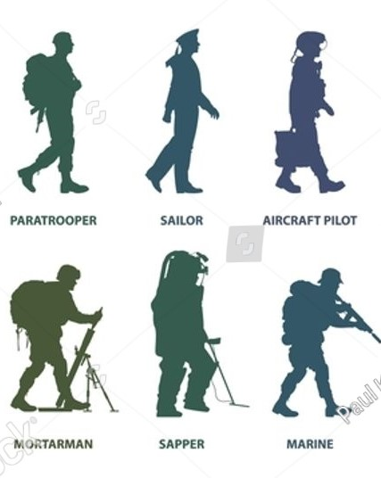
Specialised vocabularies of military services
“Not only do different services use different terms; sometimes the same word can mean different things to different services” (Chambers 2000).
humorous example: to secure a building: 1/the Navy personnel would, following a checklist written on a clipboard, unplug the equipment, turn off the lights, lock the doors, and depart; 2/Army personnel would follow a checklist written in a notebook. They would occupy the building, so that no one could enter, and nothing could leave; 3/Marines, following a plan written on the palm of their hands, would assault the building, capture it by close combat, and defend it with suppressive fire; 4/ The Air Force, following a protocol printed on a portable computer, would secure a building by taking out a three-year lease on it, with an option to buy.
NATO Glossary of Terms and Definitions AAP-6
recovery (AAP-6 2024) * In air operations, that phase of a mission which involves the return of an aircraft to a base; *In battlefield maintenance, the extrication of an abandoned, disabled or immobilized vehicle and, if necessary, its removal to a maintenance point; *In naval mine warfare, salvage of a mine as nearly intact as possible to permit further investigation for intelligence and/or evaluation purposes; * In land operations, contacting, protecting and extracting personnel, a non-hostile individual or group and/or materiel from a location not under friendly control, with or without force; *An explosive ordnance disposal procedure used to take physical control of and move explosive ordnance to an alternative, safer location in order to conduct further actions.
The reasons for polysemous military terms: the longstanding rivalries between military subgroups
Example: term infantry

Slide 10
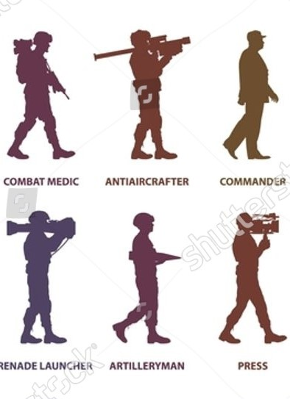
Results of the rivalries between military services
productivity and creativity of military language: each service has created their own words
social cohesion of the members within a military subgroup
Example: navy and air force fighter pilots: a) speak different dialects; b) naval fighter pilots’ language changes with the time; c) their language is different from the language of air force fighter pilots. (Murray 1986: 126).
Why do the military speaks its “own language”?
the process of teaching, or rather indoctrinating, future soldiers to military language: “Military members are trained through classroom discourse, “hands-on” instruction, and by written texts such as technical orders, operating instructions, and checklists. In all services, new recruits learn “basic responses” such as “yes, sir,” “no, sir,” “no excuse, sir,” and, “I do not understand the question, sir.” In fact, recruits are only allowed to use those basic responses and must make all answers conform to this small repertoire” (Disler 2008: 6-8)

Slide 11
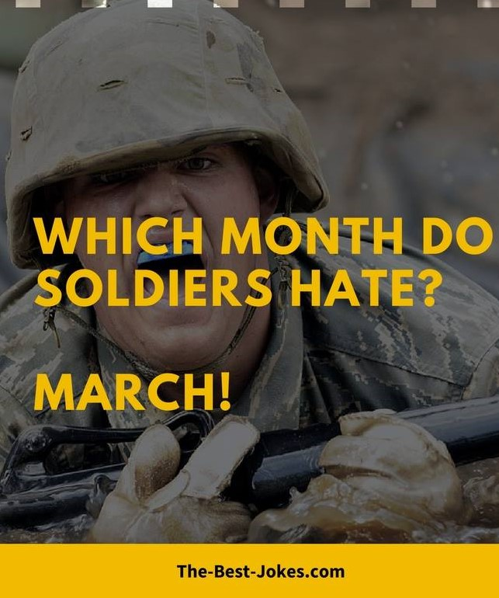
Military English and humour
Reasons:
1/ relief of psychological tension through humour: “it’s much easier to fight someone if they are an object of ridicule than if they are an object of fear. The tendency towards something like ‘Terry’ is not intended to humanise the enemy – quite often the opposite. [Terry is short for the enemy = Taliban]. Terry has overtones of Jerry (the sarcastic name British soldiers used for German forces during the world wars)”
2/ authoritarianism of the military structure -> humour is a controlled form of resistance
Examples:
armored cow ‘canned milk’, hell buggy/iron horse ‘tank’, saw bone ‘the doctor’
bull pen ‘military prison yard’, old file/old issue ‘old soldier landing gear ‘legs’,
devil’s piano ‘machine gun’ red leg ‘artilleryman’ dogface ‘enlisted man’
zombie ‘a soldier who falls in next to lowest category in Army classification tests’
(Hersey 2010: 238- 252)
shit-hot ‘the most elite kind of fighter pilot’, top gun-esque ‘in the style of the film “Top Gun”, wargasm ‘excessive patriotic emotional reaction to war, specif. the Gulf War’, etc. (Wilson 2008)

Slide 12
Origin of English military terms
Germanic origin
bow, arrow, sling, axe, spear
Latin origin
lethal, private, colonel, interdiction, satellite, general, captain, major, synergy
French origin
rifle, attack, force, fortification, victory, soldier, sergeant, lieutenant, logistics
esprit de corps /isˌpri:dəˈko:r/ Fr. from 1770–80 ‘feelings of loyalty, enthusiasm, and devotion to a group among people who are members of the group’; force majeure /ˌfɔːs maˈʒəː/ from Fr. 1880–85, literally ‘superior strength’, coup /kuː/ c. 1400, from Old Fr. coup, colp ‘a blow, strike’ (12 c.), from Medieval Latin colpus, from Greek kolaphos ‘a blow, slap’. Meaning ‘a sudden and illegal seizure of power from a government’ is from 1852
borrowed from German mainly during world wars
flak or flack, from German Fl(ieger)a(bwehr)k(anone) ‘aircraft defence gun’ – English meaning: ‘anti-aircraft fire or artillery’; blitzkrieg from German ‘lightning war’; кaserne from the Kaserne ‘barracks’; Luftwaffe a German word meaning ‘air weapon’, used for the German air force; Wehrmacht ‘the armed forces of Germany from 1935 to 1945’, erzatz – literally ‘replacement’, but used in English to mean ‘cheap substitute’ and spelled ersatz
Italian origin
brigade from 1630s, from Fr. brigade ‘body of soldiers’ (14 c.), from Italian brigata ‘troop, crowd’ from brigare ‘brawl, fight’
cavalcade 1590, from Fr., from Italian cavalcata, from cavalcare ‘to ride on horseback’, from Late Latin caballicāre, from caballus ‘horse’
corporal ‘a rank of non-commissioned officer in the army’ from 1570, from Fr. obsolete of caporal, from Italian caporale, based on Latin corpus, corpor- ‘body (of troops)’, from capo ‘head’

Slide 13
Borrowed military terms in English
from Dutch: trigger 1650s from trekker ‘trigger,’ from trekken ‘to pull’; commodore late 17 c. from Dutch komandeur, from Fr. commandeur; decoy mid 16 c. from Dutch de kooi ‘the decoy’, from Middle Dutch de kouw ‘the cage’, from Latin cavea ‘cage’; many naval and maritime terms are of Dutch origin
from Russian: Kalashnikov, Katyusha, cosmodrome, sputnik
from Arabic: caliber from 1560 from qālib ‘mould’; admiral from medieval Arabic amir ‘military commander,’ meaning ‘highest-ranking naval officer’ in English is from early 15 c.
from Japanese: kamikaze from 1945 ‘a member of a Japanese air attack corps in WW II assigned to make a suicidal crash on a target’; samurai from 1727 ‘a member of a powerful military caste in feudal Japan’

Slide 14
Military English and political correctness
need to avoid denoting military activities or conditions which are scary, frightening, insulting or unpleasant for the society.
Example: enemy → adversary “An individual, group or entity whose intentions or interests are opposed to those of friendly parties and against which legal coercive political, military or civilian actions may be envisaged and conducted.” (AAP-6 2024) = (BG противостоящи сили)
pacification (BG умиротворяване) ←repressing or destroying the enemy, e.g. Pacification of Algeria 19th C.
killed, dead → Missing In Action, KIA (killed in action), non-operative personnel, deceased, erased, annihilated, defused, liquidated, terminated, depopulated, whacked, wasted, done in, snuffed; to kill → to neutralise, to erase, to liquidate, to terminate, to take down
collateral damage ← civilian victims (BG съпътстващи загуби) during the Vietnam War, now in AAP-6
(global) war on terror → Overseas Contingency Operation
friendly fire (BG приятелски огън) – the modifying friendly has a positive meaning which helps disguise the negative effect of the base term fire;
gunboat diplomacy – used in the 19th century for a demonstration of a superior naval power → power projection
shell shock (WW I) → battle fatigue (WW II) → operational exhaustion (Korean War) → post-traumatic stress disorder (after the Vietnam War) (пост-травматичен шок BG)

Slide 15
Military English word formation
Term formation technique |  |  | Peace support (PS) terminology
Semantic (terminologisation) |  | Metaphorical transfer | ≈ 26 %
 |  | Metonymic transfer | 2.5%
Morphological |  | Affixation (derivation) | 35 %
 |  | Compounding | 13 %
Syntactical (multiword terms) |  |  | 52 %
Compression | Abbreviation |  | ≈ 100 %
 | Blending |  | < 1%
Borrowing |  |  | < 50% (diachronically)
affixation
compounding
multiword military terms
conversion
blending
abbreviation
terminologisation

Slide 16
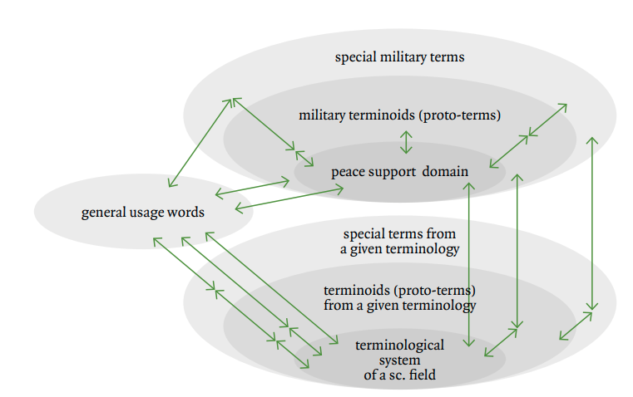
Migration processes of terms

Slide 17
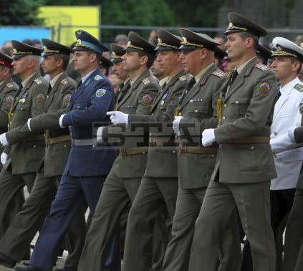
NATO English terms: the Bulgarian case
State regulation: Rules for Terminology Standardisation, formulated by the Bulgarian MoD in 2010, which state that “Bulgarian military terminology is defined on the basis of NATO approved terminology by translation of terms and their definitions in Bulgarian. The translation of terminology into Bulgarian is approved by the Standing Terminology Group. The main task of this Group is to update and approve the Bulgarian translation of the NATO terms in AAP-6 and AAP-15”
translation of military terms
disagreements among the members of the Group

Slide 18
NATO English terms: the Bulgarian case
Shortening
mopping up: военни действия за прочистване → прочистване;
NATO earmarked forces: войски, предназначени за предаване в оперативно подчинение на НАТО / въоръжени сили, определени да бъдат под командването на НАТО → сили, предназначени за НАТО.
Unification
munition: (originally): боеприпас, средство за поражение, военно имущество)→ боен припас
forces: (originally: войска) → сили; landing forces: (originally: десантно съединение) → десантни сили
chain of command: (originally: ред на подчинение, команден ред) → командна верига
commander: (originally: командващ) → командир; NATO commander: командир от НАТО; BUT: NATO strategic commander: стратегически командващ на НАТО
organization: (originally: организация) → структура
collateral damage: (originally косвени щети) → съпътстващи загуби
Bulgarian terms with English constituents
NATO off-the-shelf: (originally: разработен (съществуващ) продукт на НАТО / наличен в НАТО) →“off-the-shelf” продукт по стандартите на НАТО
NATO standardisation agreement: стандартизационно споразумение на НАТО (STANAG)
G-hour: часът „G”

Slide 19
NATO English terms: the Bulgarian case
Bulgarian term is more descriptive than the English term
exfiltration: скрито преминаване през линията на съприкосновение (instead of ексфилтриране)
hasty breaching: преодоляване на заграждения без подготовка
mounting: подготовка на районите за съсредоточаване и товарене
naval stores: запаси от материални средства за военноморските сили
nerve agent: нервно-паралитично отровно вещество
mineable waters: води, позволяващи миниране
mission report: донесение за изпълнение на мисията
Inconsistency of Bulgarian terms
Some of the English terms are translated with different Bulgarian terms that are considered synonyms and are given with a slash or in parenthesis. Some examples of inconsistent/synonymous (yet standardised) Bulgarian terms include:
amphibious operation: амфибийна операция / морскодесантна операция
control: контрол, управление
misfire: засечка / неразрив
multimodal: мултимодален/ комбиниран

Slide 20
Borrowings and standardisation of Bulgarian military terms
process of active adoption of English terms→process of standardisation of NATO terms in Bulgarian military terminology.
1) positive: defining new military concepts, doctrines, strategies, technologies, etc. that need to be denoted by new terms → enrichment of the Bulgarian language in the cases when:
new military meanings are added to the meaning of widely accepted terms:
e.g. mission→мисия “a specific combat operation assigned to an individual or unit”, doctrine→доктрина “fundamental principles by which the military forces guide their actions in support of national objectives”;
new calques are accepted and systematized in the Bulgarian military terminology,
e.g. conventional forces→ конвенционални сили, peace enforcing operation→мироналагаща операция, operational art→оперативно изкуство, smart defence→интелигентна отбрана, asymmetric threat→асиметрична заплаха, hybrid warfare→ хибридна война, etc. There is a tendency for an increased number of Bulgarian terms of this type;
adoption of specialised terms which are direct borrowings helps specialists from different countries in their communication and prevents them from misunderstanding, e.g. логистика ← logistics, буферна зона ← buffer zone, камуфлаж← camouflage, интервенция ←intervention, комуникационен център← communication centre, etc.
2) negative: new military terms remain obscure and unclear for the public and this hampers their proper understanding, e.g. bilateral → билатерален (instead of Bulgarian двустранен), classified information → класифицирана информация (Bulgarian: секретна информация), conversion→ конверсия (Bulgarian: преобразуване, преоборудване), acquisition→ аквизиция (Bulgarian: придобивка, присвояване, закупуване), etc.

Slide 21
Abbreviated military terms in Bulgarian
Significant influence of English abbreviations is official Bulgarian documents: reason
“The aim is not to create new terms and abbreviations in the Bulgarian language, but to use the ones already accepted in the English language“ (the Bulgarian edition/translation of the “Allied Doctrine for Joint Operations” (AJP)-3(A)
Командване и управление (C2). Съвместното С2 включва всички сили, участващи в операцията”, „Гражданско-военното сътрудничество (CIMIC) може да бъде най-важната част от мисията”, „Зона за отговорност (AOR). Зоната за отговорност е географски район, свързан с бойното командване”, „За да се подготви и проведе една военна операция е необходимо да се разработи оперативен план (OPLAN)”, „Правила за употреба на сила (ROE). Военните действия се контролират чрез правилата за употреба на сила, които се определят от NAC при получаване на одобрение на OPLAN.”
Digraphic (bilingual) writing
In Bulgarian texts, in many cases the use of English abbreviations is more important (or is assumed to be more important) than the formation and use of Bulgarian ones; in practice, Bulgarian terms and their abbreviations perform an explanatory function in the use and imposition of English ones, which are more important because their use is critical in an international environment

Slide 22
The impact of English military terminology on the Bulgarian military terminology
English military terminology is constantly developing being directly related to the social and political phenomena not only on a national, but also on a global scale → strong influence of English terminology
Reason: ​​military activities and doctrines are initially formulated in English in international documents, and then the terms for the respective concepts are created in Bulgarian (and other national) military terminology.
Borrowing (direct borrowing or calques) of English military prefixes (counter-, anti-, de-, re-), postfixes (-ing), and terms: бърза реакция ←quick reaction, бойно пространство ← battle space, военен компонент ←military component
Military terminology is a product of political and social phenomena and processes.
The main part of the term systems in both languages ​​are two- and multi-component terms.
The military terminology in both languages ​​is not isolated from the general English vocabulary, and the boundaries between it and other terminologies (political, legal, medical, informatics, economics, electronics, etc.) are open.
Military terminology is an open terminological system that is interdisciplinary in nature due to the specifics of military knowledge and is in a continuous process of enrichment and development.

Slide 23
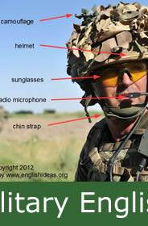
Summary
Military English is the product of military subculture;
Different armed forces services and branches are characterised by their own specialised vocabulary;
Some English military slang words are humoristic;
Military terminology is consistent with general trends in English word formation;
Military English is exceptionally productive part of English language today;
Military Language impacts General English and other ESPs;
Many English military terms, especially neologisms, are euphemisms/politically correct terms.

Slide 24
References:
Chambers 2000: Chambers II, J.. Language, Military: Official Terminology. The Oxford Companion to American Military History. Oxford University Press
Disler 2008: Disler, E. Language and Gender in the Military. Cambria Press.
Elkin 1946: Elkin, Fr. The Soldier’s Language. American Journal of Sociology Vol. 51, No. 5, Human Behavior in Military Society. Mar., 1946.
Silkett 1993: Silkett, W. Alliance and Coalition Warfare. Parameters, Summer 1993, pp. 74-85.
Smith 1997: Smith, D. De-Militarizing Language.: Peace Magazine Jul-Aug 1997. http://peacemagazine.org/archive/v13n4p14.htm
Picht 2009: Picht, H. Introduction to Terminology Theory. http://www.termnet.org/downloads/english/events/
Wilson 2008: Wilson, A. Military Terminology and the English Language. <http://homes.chass.utoronto.ca/~cpercy/courses/6362-WilsonAdele.htm>.

Slide 25
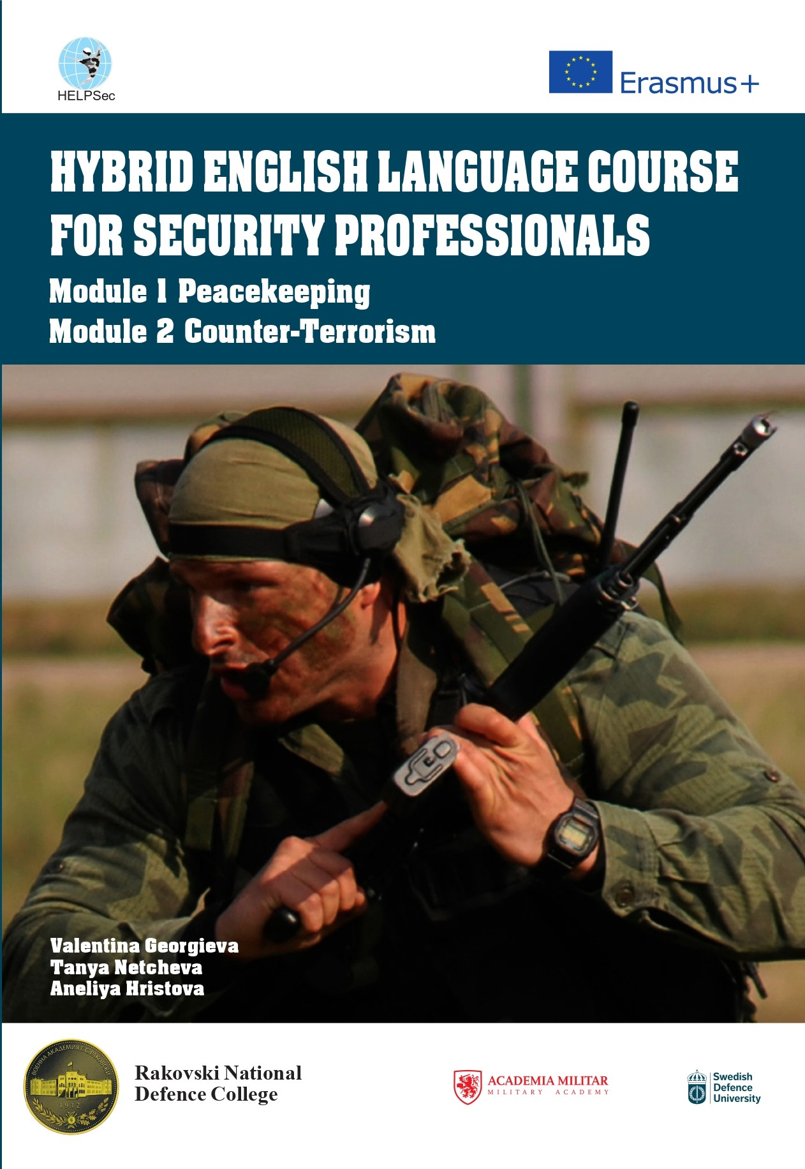

Thank you
Valentina Georgieva
valgeorgieva@yahoo.com

