Slide 1


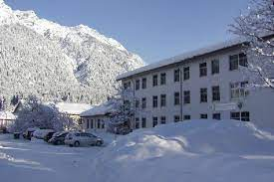



NATO WRITING STRATEGIES COURSE: AN EXAMPLE OF ACTION RESEARCH
Dr. Michael W. Campbell
Ms. Andrea Gjorevski
Ms. Peggy Garza
Partner Language Training Center Europe (PLTCE)
George C. Marshall European Center for Security Studies (GCMC)
NATO BILC Professional Development Seminar
Provo, Utah
16 - 21 October 2022

Slide 2
Action Research - Research in action
Action research is undertaken by educational practitioners because they believe that by so doing they can make better decisions and engage in better actions.
(Stephen M. Corey, 1953, p. viii
NATO BILC Professional Development Seminar
Provo, Utah
16 - 21 October 2022

Slide 3

“It proceeds in a spiral of steps, each of which is composed of a circle of planning, action and fact finding about the results of the action”
Lewin 1946/1948: 206
AGENDA
ACTION RESEARCH
What is it?
Why do it?
NATO Writing Strategies Course overview
ADDIE
ADDIE meets Action research
Questions?
NATO BILC Professional Development Seminar
Provo, Utah
16 - 21 October 2022

Slide 4
WHAT IS ACTION RESEARCH?
BLUF: action research is a useful way of doing research if you are a practitioner who wishes to improve your understanding of your practice-
A systematic approach:
To introduce innovations in TEACHING and LEARNING
To position the educator as producer of educational theory and user of that theory
To improve TEACHING and LEARNING practice
To produce knowledge about TEACHING and LEARNING
It is about change
Sparks evaluation and reflection to help educators to:
Make changes in practice with increased knowledge and confidence
Explore new initiatives and strategies
NATO BILC Professional Development Seminar
Provo, Utah
16 - 21 October 2022

Slide 5
WHAT IS ACTION RESEARCH?
A cycle of planning, action, observation, and reflection, where the reflection phases paves the way for further cycles of planning, acting, observing and reflecting in a spiral of learning
What it is
What it isn’t
Problem solving
Linear
Not research on or about people
Conclusive
Generalizable
About Why
A trend
A Process
Cyclical
Collaborative
Practical and relevant
Contextualized
About how
A way to improve instructional practice by observing, revising, and reflecting
NATO BILC Professional Development Seminar
Provo, Utah
16 - 21 October 2022

Slide 6
WHY ACTION RESEARCH?
We already do it
Action research represents an extension of the reflection and critical self-reflection that an educator employs on a daily basis in their classroom.
No separation between the design and delivery of teaching and the process of researching these activities
Brings theory and practice closer together.
NATO BILC Professional Development Seminar
Provo, Utah
16 - 21 October 2022

Slide 7
AN ACTION RESEARCH CYCLE
Reflection: Identify FOCUS
Action: Develop and implement an action research plan
Reflection: Collect and analyze data
Action: Develop an action plan
Reflection: Evaluate the effects impact of action plan and next iteration of cycle
Many models exist but all share the same basic principles:
A central focus or topic
Observation or monitoring
Collection and synthesis of data
Some type of action is taken
Next stage of action research (varies)
What do we want to investigate
NATO BILC Professional Development Seminar
Provo, Utah
16 - 21 October 2022

Slide 8


WELCOME
THE COURSE
NATO Writing Strategies

Slide 9
BACKGROUND
ELTEC2
Self-paced online resource (Asynchronous)
Real-world NATO workplace scenarios
Authentic NATO writing tasks and documents
Ten micro-learning modules identified in survey of respondents from nine countries:
  Direct and concise
  Cohesion
  Tone
  Parallel Forms
  Gender-Neutral Language
  Common NATO Phrases
  Using “the”
  NATO Spelling
  Comma Usage
  Hyphen Usage
NEEDS ANALYSIS
2016-2017 Language Needs Analysis (LNA)
Assessed the language proficiency of 35 NATO staff officers in the four skills
Survey of work-related language challenges
Forty percent cited writing difficulties (not unexpected)
NATO e-Learning Office
Suggested a self-paced online resource to help staff officers improve their NATO-specific writing skills
Subject matter experts (SMEs) from BILC and instructional designers developed the English Language Training Enhancement Course (ELTEC2).

Slide 10


WELCOME TO ELTEC2
ELTEC2 is a resource for just-in-time or refresher training. The course includes topics that are common problem areas for many staff officers. You can decide for yourself which topics you would like to work on and select them in any order. Finally, you can apply what you have learned in the practical activities.
Limitations:
Focus on mechanics
Does not provide feedback on extended written discourse
Considered an INITIAL training solution
NATO BILC Professional Development Seminar
Provo, Utah
16 - 21 October 2022

Slide 11


SOLUTION
BILC asks PLTCE to design and develop a course to:
enhance ELTEC2 that would give staff officers individualized feedback
provide additional, targeted instruction on NATO-specific written writing assignments and documents
Provide individual feedback
Target specific writing topics:
- The writing process
- Self-editing/peer editing
- Genre analysis
- Writing tailored for the audience
The NATO Systems Approach to Training
The ADDIE model
NATO BILC Professional Development Seminar
Provo, Utah
16 - 21 October 2022

Slide 12
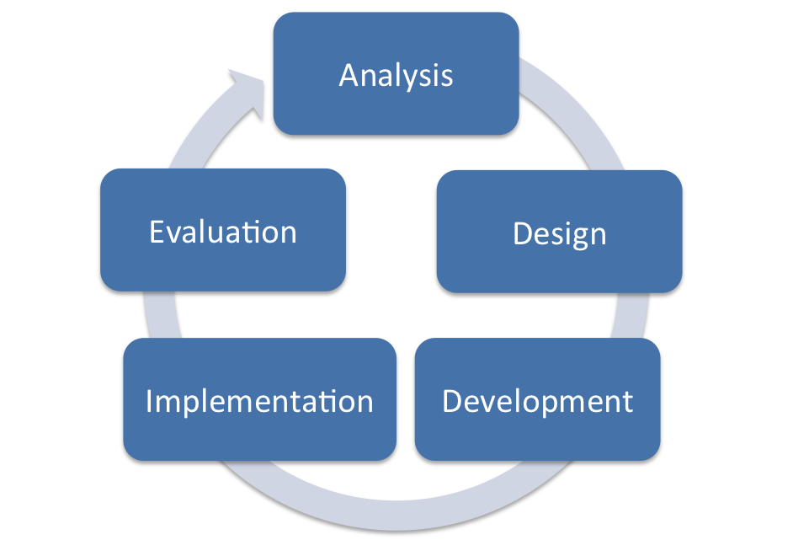
ADDIE
Reflection: Identify FOCUS
Action: Develop and implement an action research plan
Reflection: Collect and analyze data
Action: Develop an action plan
Reflection: Evaluate the effects impact of action plan and next iteration of cycle
What do we want to investigate?
Remind you of anything?
NATO BILC Professional Development Seminar
Provo, Utah
16 - 21 October 2022

Slide 13
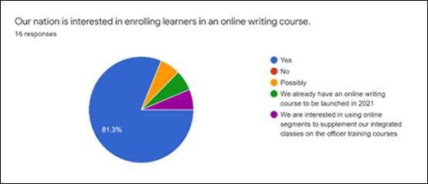
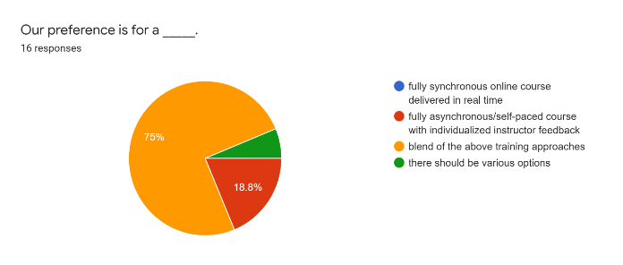
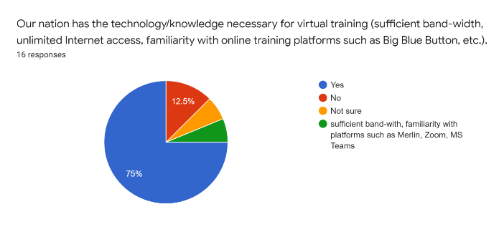
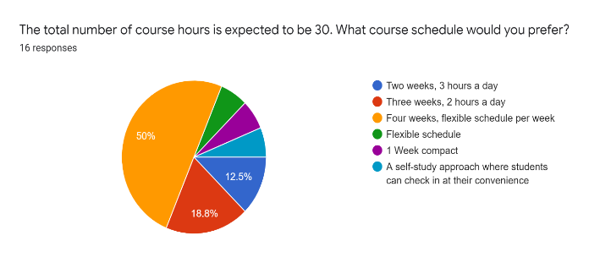
ANALYSIS
Establish PLTCE Working Group
Target audience
Course goal
Performance objectives
Create questionnaire for a wider audience:
- gauge national interest in such a course
- explore preferences on course modalities
- identify writing content areas
- understand tech limitations/requirements
NATO BILC Professional Development Seminar
Provo, Utah
16 - 21 October 2022

Slide 14

DESIGN
Online course (Totally? Fully? Completely?)
A mix of asynchronous or self-paced e-learning and synchronous e-learning*
One-on-one feedback sessions with an instructor
A video-teleconferencing (VTC) platform for synchronous and one-on-one feedback sessions.
Learning Management System (LMS) - Asynchronous sessions, document handling, and communication
Thirty to thirty-five hours over four weeks.
- 3 hours per week synchronous
- 1 hour individual conferencing per week
- 4 hours asynchronous per week
*Asynchronous activities-short video presentations, readings, and peer interaction
*Synchronous-, to practice writing concepts through practical, hands-on application, and to increase social presence, to foster interoperability
NATO BILC Professional Development Seminar
Provo, Utah
16 - 21 October 2022

Slide 15

DEVELOPMENT
Course Content and Tasks
- Only authentic NATO texts and writing tasks
Four progressively difficult writing tasks
- E-mail, formal
- Point Paper
- Executive Summary
- Extended Opinion, Summary, and Analysis
Assessment
- Portfolio
- Rubrics defined standards in the objectives
related to NATO writing principles
- Holistic rubrics
Asynchronous and synchronous balance
- SOFLA (Synchronous Online Flipped Learning Approach)
NATO BILC Professional Development Seminar
Provo, Utah
16 - 21 October 2022

Slide 16
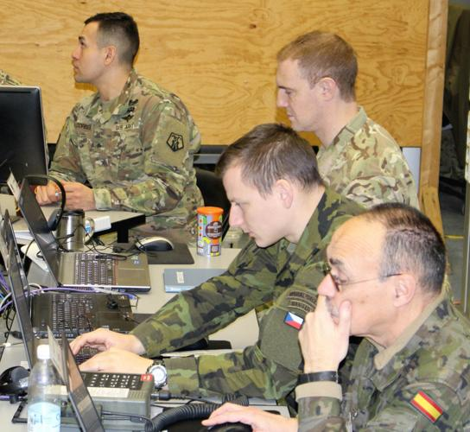
IMPLEMENTATION: PILOT COURSE
Participants
Staff officers with a STANAG 6001 level 2+/3 writing proficiency
Limited to eight participants
Seven different countries: Bulgaria (2), Czechia, Denmark, Spain, Romania, Slovakia, and Slovenia
Four majors and four lieutenant colonels with a variety of experience and duties
Participants of convenience
Course registration included self-assessment of work-related English writing tasks, frequency of work-related English writing, editing strategies, course expectations, and previous experience with online courses.
Instructors: the instructors were the course designers
NATO BILC Professional Development Seminar
Provo, Utah
16 - 21 October 2022

Slide 17

EVALUATION
Data collection and analysis
Continuous evaluations by instructors
Informal feedback in one-on-one conferences
Daily collaborative reflectionon
Weekly surveys
End of course survey
Focus group
Findings
Relevant Course content
Improved writing
Mixed regarding course structure (length of synchronous sessions and blended vs. online)
Importance of synchronous sessions
Peer interaction and engagement
Individualized feedback
NATO BILC Professional Development Seminar
Provo, Utah
16 - 21 October 2022

Slide 18

ADDIE Meets ACTION RESEARCH
Dovetails with Action Research– both are self-reflective spirals of planning, acting, observing, reflecting, and re-planning
Opportunity knocks - invitation to action
Apply AR to unique context
Few examples of online international military writing instruction
- multiple nations and L1s,
- professional level writing,
- a fully online context
NATO BILC Professional Development Seminar
Provo, Utah
16 - 21 October 2022

Slide 19
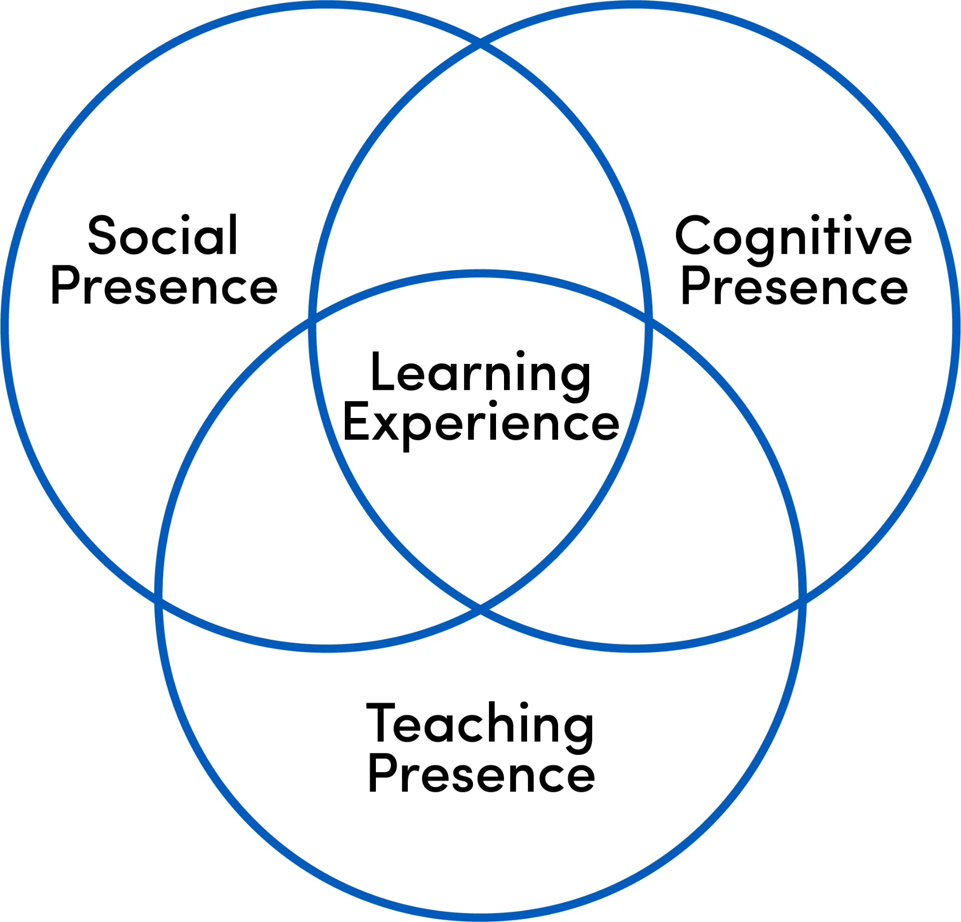
FOCUS - Research Questions
The two action research questions were:
1. How effective were the synchronous sessions in creating a social presence?
2. In what ways, if any, can the synchronous sessions in the fully online NATO Writing Strategies Course contribute to NATO interoperability?
To elicit the participants’ perceptions of the value of the synchronous sessions in the fully online NATO Writing Strategies course
Especially whether they believed the synchronous sessions increased interoperability through social presence
IMPORTANCE OF SOCIAL PRESENCE-Community of Inquiry
can lead to students’ perceptions of increased learning, course satisfaction, and emotional satisfaction
Can foster critical thinking and make interaction intrinsically rewarding
may be necessary for effective online instruction, the construction and negotiation of knowledge, and the establishment of a community of learners
NATO BILC Professional Development Seminar
Provo, Utah
16 - 21 October 2022

Slide 20
DEVELOP AND IMPLEMENT AN ACTION RESEARCH PLAN
COLLECT AND ANALYZE DATA
Weekly Surveys
Daily Facilitator Observation and
Collaborative and individual Reflection
End of Course Survey
End of course Focus Group
Informal interviews
Changes to original Syllabus/Course structure for second iteration:
Increase Synchronous sessions from 1.5 hours to 2 hours
Include ”Syndicate (Breakout room) objectives”
Use Individual conferencing sessions as opportunity for creating Community of Inquiry
Increase opportunities for interaction in Synchronous sessions-more polling, refined activities
Triangulate data collection opportunities

Slide 21
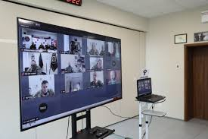
ANALYSIS-Survey
The Week One Survey asked two open-ended questions about the Synchronous Sessions
What was the most beneficial part of Synchronous Session #1
Meeting peers and facilitators of the course.
Speaking and listening native speakers
Details of BLUF and KISS principles
Discussion
The rerun of essential parts of the micro lectures
Getting the technical aspects straight away
The explanations provided by the instructors
NATO BILC Professional Development Seminar
Provo, Utah
16 - 21 October 2022

Slide 22

ANALYSIS-Survey
What was the most beneficial part of Synchronous Session #2 (Thursday.
Talking about writing strategies and exchanging of experience on this topic
The issue (Analysis) was in detail debated
The description of writing process
Discussion
Working in smaller groups
Getting to know each other and the instructors.
The instructors' explanations and the shared thoughts

Slide 23
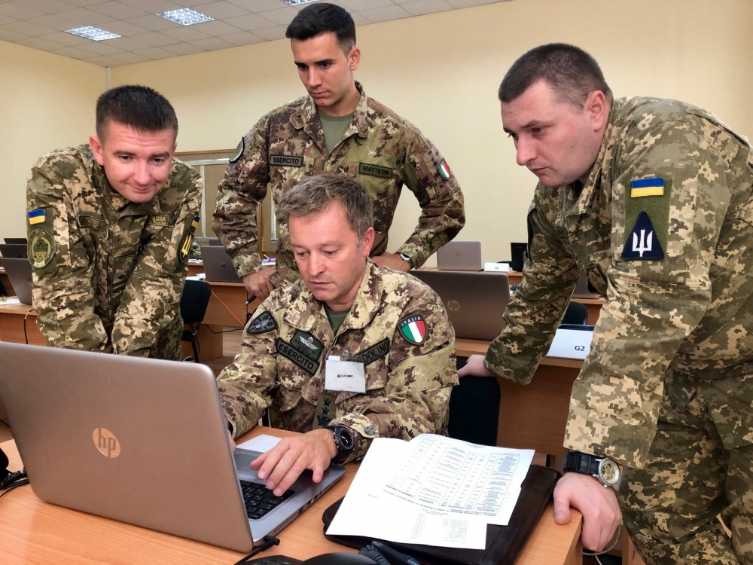
SURVEY:
The synchronous sessions were helpful because there are different points of view on different topics. To hear the opinions of others from different countries is beneficial and fruitful. This usually gives me a different perspective on some things.
Synchronous sessions effective:
in reviewing reinforcing or practicing the concepts presented asynchronously
In developing a social presence and in fostering NATO interoperability on a limited scale
The synchronous work was pretty much like a classroom lesson. It gives one the sense, the social sense of being in a group with someone, and that you are trying to learn something.
NATO BILC Professional Development Seminar
Provo, Utah
16 - 21 October 2022

Slide 24
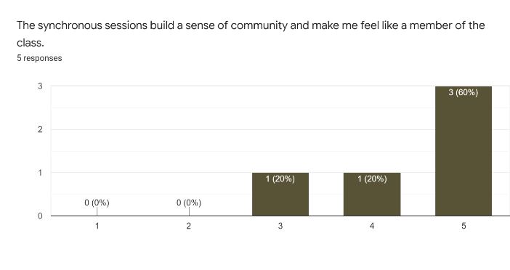
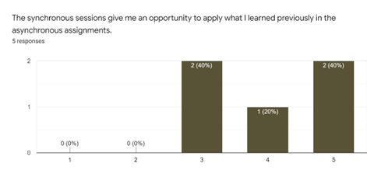
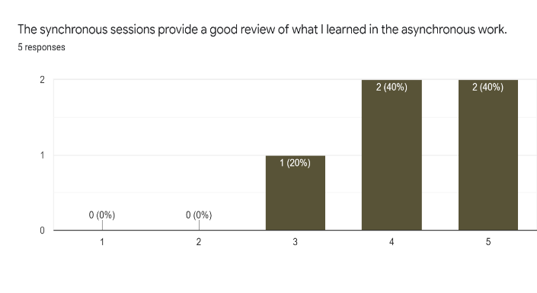
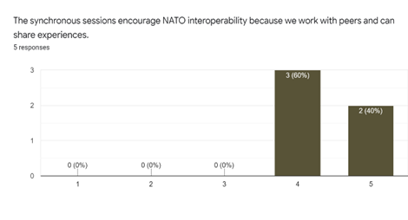
DATA ANALYSIS - The team modified the surveys for weeks 2, 3, and the final week to capture additional quantifiable data. The participants responded to statements on a 5-point Likert scale from “Strongly Disagree” to “Strongly Agree”.
NATO BILC Professional Development Seminar
Provo, Utah
16 - 21 October 2022

Slide 25
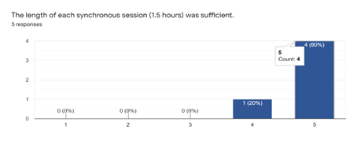
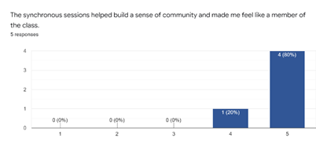
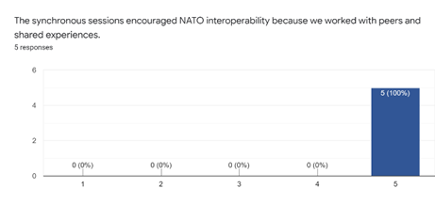
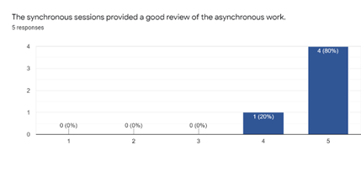
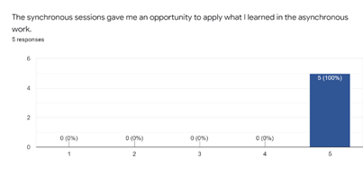
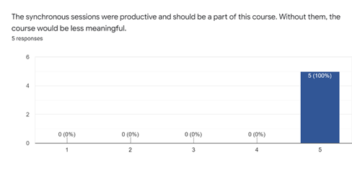
DATA ANALYSIS-Week 4
NATO BILC Professional Development Seminar
Provo, Utah
16 - 21 October 2022

Slide 26
ANALYSIS-FOCUS GROUP Week 4
General Questions
What did you like best about the course?
What was the most challenging part of the course?
Do you think that the material you worked with was authentic and relevant to the NATO context and a staff officer’s writing tasks?
Synchronous-Specific Questions
What are your learning preferences: learning collaboratively with others in your class or learning independently with asynchronous work only?
Did the synchronous sessions help you feel like part of a learning community?
Were the synchronous sessions helpful as a review of the asynchronous material or way to practice what you learned in your asynchronous assignments?
In your opinion, did the synchronous sessions foster NATO interoperability? If so, how?
Questions on the Course Structure
Assume a total of 40 hours and individual conferencing...
Keep as is
Make the synchronous sessions optional
Fully online over two weeks, not four
Include a one week in-person component at PLTCE
NATO BILC Professional Development Seminar
Provo, Utah
16 - 21 October 2022

Slide 27
ANALYSIS-FOCUS GROUP
Participant C, responding to what he liked best, touched on the core of interoperability and authenticity:
It provided needed standardization…as to what are the documents that need specific NATO writing and how to properly prepare them. I have encountered these types of documents but I have never had them…in a form of training. It provided the needed standardization and formatting for what NATO writing is.
In response to General Question 1, Participant H mentioned the structure:
I really liked the structure of the course…that there was synchronous work, asynchronous work. The flexibility, well, even though I had to skip a couple of synchronous, I still felt that I was doing the course…
Likewise, Participant N nicely touched on the relevancy of the Community of Inquiry framework:
The synchronous work was pretty much like a classroom lesson. It gives one the sense, the social sense of being in a group with someone that, and that you are trying to learn something.
NATO BILC Professional Development Seminar
Provo, Utah
16 - 21 October 2022

Slide 28
ANALYSIS-FOCUS GROUP
Participant H elaborated on the idea of opportunities to expand social and workplace networks:
It definitely fosters interoperability because I get to work with people I wouldn’t unless I was in a staff position or a NATO mission but I could do that being part of my normal job working with you guys, so yes.
Responding to more targeted questions regarding interoperability, the participants generally agreed that the course supported it for different reasons and to different degrees.
Participant N: Having others speak about their experiences is what NATO does because it is a multinational community.
NATO BILC Professional Development Seminar
Provo, Utah
16 - 21 October 2022

Slide 29

ANALYSIS Self-reflection
Take Away #1: The asynchronous sessions directly affected the synchronous sessions
The relationship of the asynchronous and the synchronous were much more symbiotic than the instructors initially realized
See Take Away #2
Take away #2: Don’t make assumptions
The instructors made the assumption that the students would view the Asynchronous micro lecture before class and designed the Synchronous activity to build on that..
Instructor A: The questions were based on the (Asynchronous) genre analysis video, so participants who did not view the video could not answer the questions; therefore, not much interaction took place. The recommendation here is to make the questions more of a review of the material.
NATO BILC Professional Development Seminar
Provo, Utah
16 - 21 October 2022

Slide 30

ANALYSIS Self-Reflection
Take away #3: Mix it up
Week 3, session 2 included a guest speaker: However, several factors contributed to a successful session in addition to the quality of the speaker.
Instructor A: It went very well. J provided so much background and expertise to the discussion. The interview questions as well as the poll questions worked well to engage the audience. Everyone had a chance to speak, and our participants asked really insightful questions, … Participants typed their responses into the chat so we could all discuss. It was a highly interactive lesson that way.
Instructor M: How do we replicate it for future iterations?
Take away #4: How DO we replicate it for future iterations?
This question remains unanswered. Further analysis is needed to tease out which activities were successful because of design decisions and which were successful because of personalities.
NATO BILC Professional Development Seminar
Provo, Utah
16 - 21 October 2022

Slide 31
DEVELOPMENT DISCUSSION
This aligned with the PLTCE team’s decision to include a synchronous component.
Synchronous sessions add to the quality of the learning experience
can contribute to increased retention
can serve as a catalyst for creating targeted opportunities for learners to address course content through active engagement
Participants found the synchronous sessions to be effective in:
reviewing, reinforcing, and practicing the concepts presented asynchronously
Developing a social presence
Fostering NATO interoperability on a limited scale.
When the participants experienced the presence of others in a class with them, they felt supported in what they were trying to accomplish
NATO BILC Professional Development Seminar
Provo, Utah
16 - 21 October 2022

Slide 32
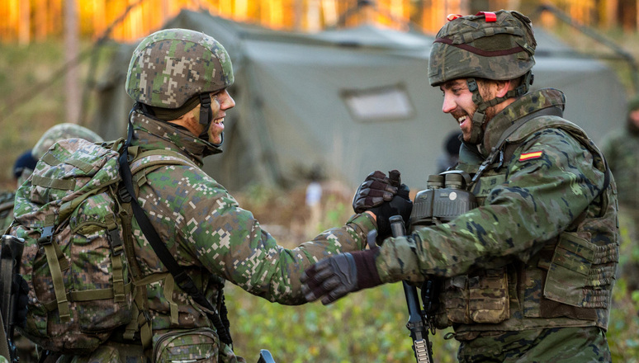
EVALUATE (and begin the cycle again)
On going revisions.
Although the participants perceived the NATO writing tasks and documents as authentic, the goal of simulating NATO interoperability through collaboration during the synchronous sessions needs to be clarified and elaborated.
Additional collaborative activities and opportunities to share personal NATO and military experiences can be included in the course as well.
Synchronous and Asynchronous
The benefits and limitations of the asynchronous/synchronous balance should be reviewed in light of the time considerations and potential conflicts with the participants’ work schedules. Ultimately, when the course has NATO-approved status, leadership in the NATO workplace will consider the course professional development, allowing staff officers the time to engage with the asynchronous work and to participate in the synchronous sessions.
NATO BILC Professional Development Seminar
Provo, Utah
16 - 21 October 2022

Slide 33
CONCLUSION
Continue to:
Reflection: Identify FOCUS
Action: Develop and implement an action research plan
Reflection: Collect and analyze data
Action: Develop an action plan
Reflection: Evaluate the effects impact of action plan and next iteration of cycle
What?
Who?
Why?
How?
make improvements through action and reflection
research the real, complex and often confusing circumstances and constraints of the online instruction
recognize and translate evolving ideas into action
think systematically about what happens in the online classroom
implement action where improvements are thought to be possible
monitor and evaluate the effects of the action with a view to continuing the improvement in continued versions of the course
NATO BILC Professional Development Seminar
Provo, Utah
16 - 21 October 2022

Slide 34
References
Corey, S. M. (1953). Action research to improve school practices. Bureau of Publications, Teachers Co.
Lewin, K. (1946) Action research and minority problems, in G.W. Lewin (Ed.) Resolving Social Conflicts. New York: Harper & Row (1948).

Slide 35
How might we change things at the same time as studying them?
QUESTIONS?

