Slide 1


Experiences in Distance Learning
in a Project to Provide Refreshment Training
for Level 3 Graduates
maj Dariusz Ćwierzona
Distance Learning Project Manager
Polish Armed Forces School of Languages
Notes:
Ladies and gentlemen, my name is maj dariusz ćweirzona. I workd for the PAFSL, for the Central Examinations Board for Foreign Languages, which is part of it. I became the head of the newly create E-learnign Secion in 2012 and I offered to start developing a distance learning refreshment course for graduates of level 3 courses. The course was supposed to be based on a 7-point formula I had been working on for some time.

Slide 2
Distance Learning
Tailored for Polish Armed Forces
Refreshment for L3 graduates
Distance Learning Format
For those who can’t participate in stationary training
Learning in the workplace & at home
Facilitated by full-time teachers
To refresh 4 skills
Internet & telephone
Individual tutoring
Inherent frexibility
Quality not quantity
Notes:
Refreshment stationary training is hardly available for officers once they obtain a full level 3 certificate, so I thought a distance-learning format might be a good idea.

Slide 3
Distance Learning Project
Development phase – 2012/2013
  2 teachers + 1 IT expert
  Moodle training
  Draft curriculum
  Producing a bank of interacitive exercises
  Short courses/very small groups
  Gaining experience/writing procedures
  Goal: to launch a 5-month-long course
2014 onwards – two courses a year
  Gradual increase in student numbers

Slide 4
Distance Learning Project
The course
  5 months vs. 2-months stationary
  For senior officers (mostly)
  5 years after stationary course completion
  Learning for 1h at work & 2hrs at home
  2 teachers per 10 students
    1 teacher-in-training/12 students
    next course 3 teachers/15 students
  Entrance exam + instruction
  Ends with L3 STANAG exam

Slide 5
Distance Learning Project
  The teachers
  Select and assign tasks
    individual vs. group training
  Provide regular feedback and assistance
  Keep the pace of learning by:
    distributing daily assignments
    issuing reminders
    exercising 7-day-deadline rule
  Conduct telephone discussions/consultations

Slide 6
Distance Learning Project
Telephone discussions/consultations
  Military telephone line vs. Skype
  1 discussion call + 1 consultation call
    a weekly schedule
    discussion instead of consultation
    2 calls = 2 teachers
  30-45 mins
    starting on the hour
    late callers
  Postponing calls
Notes:
Telephone conversations
Czas trwania
Odkładanie
Spóźnianie
zamiana z konsultacjami
mo

Slide 7
Distance Learning Project
Communication with commanders
  Official letter at the outset
    weekly schedule of telephone calls
    course regulations
  Course certificate & progress report

Slide 8
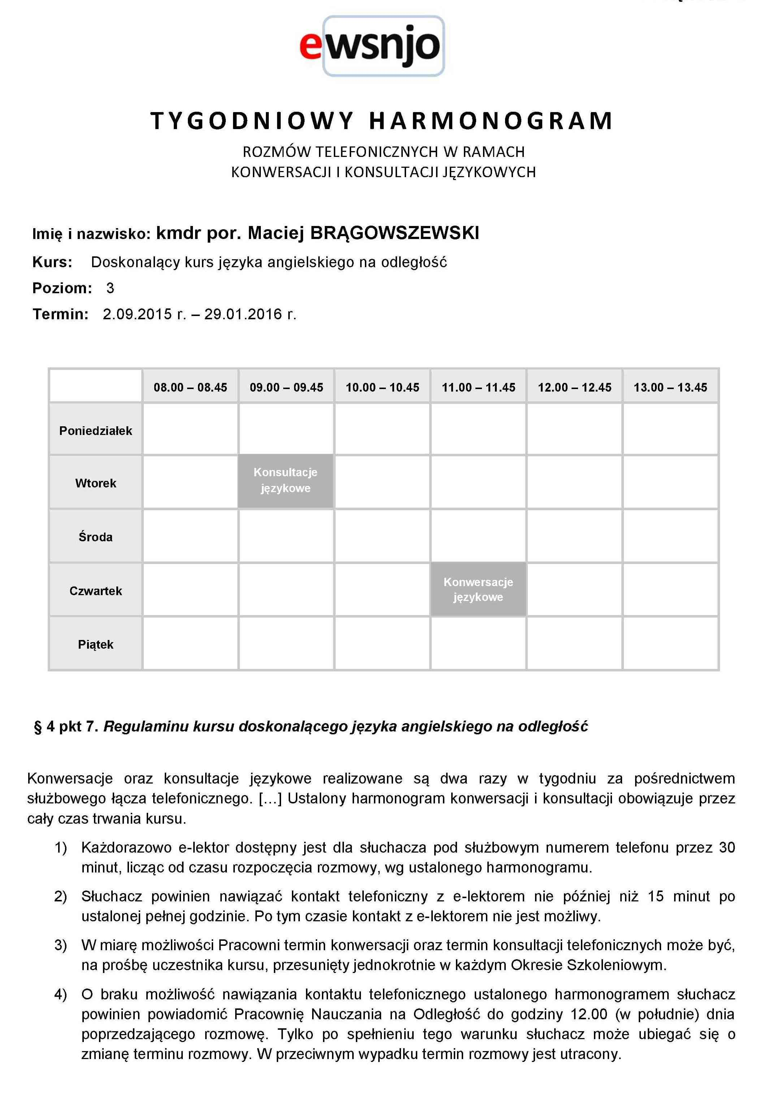

Slide 9
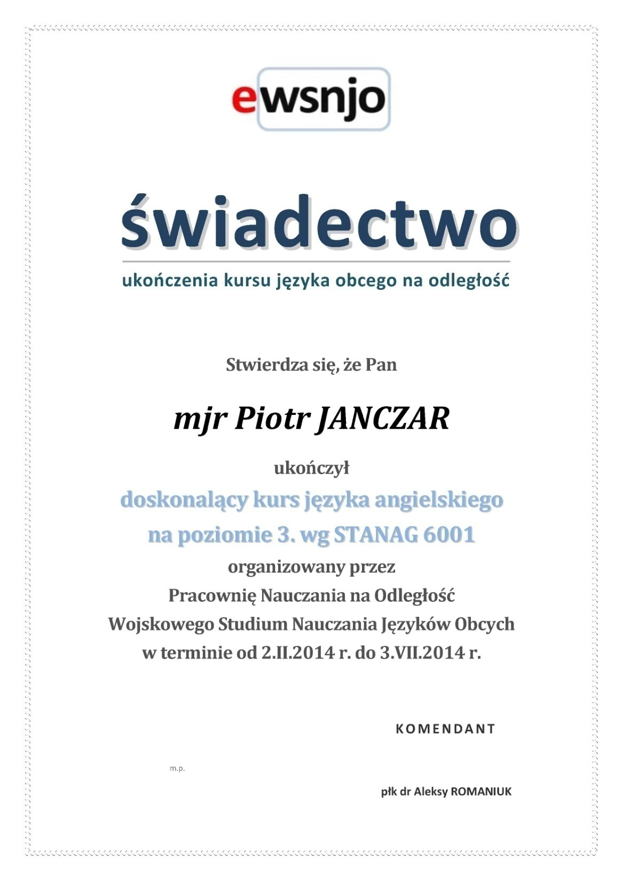

Slide 10
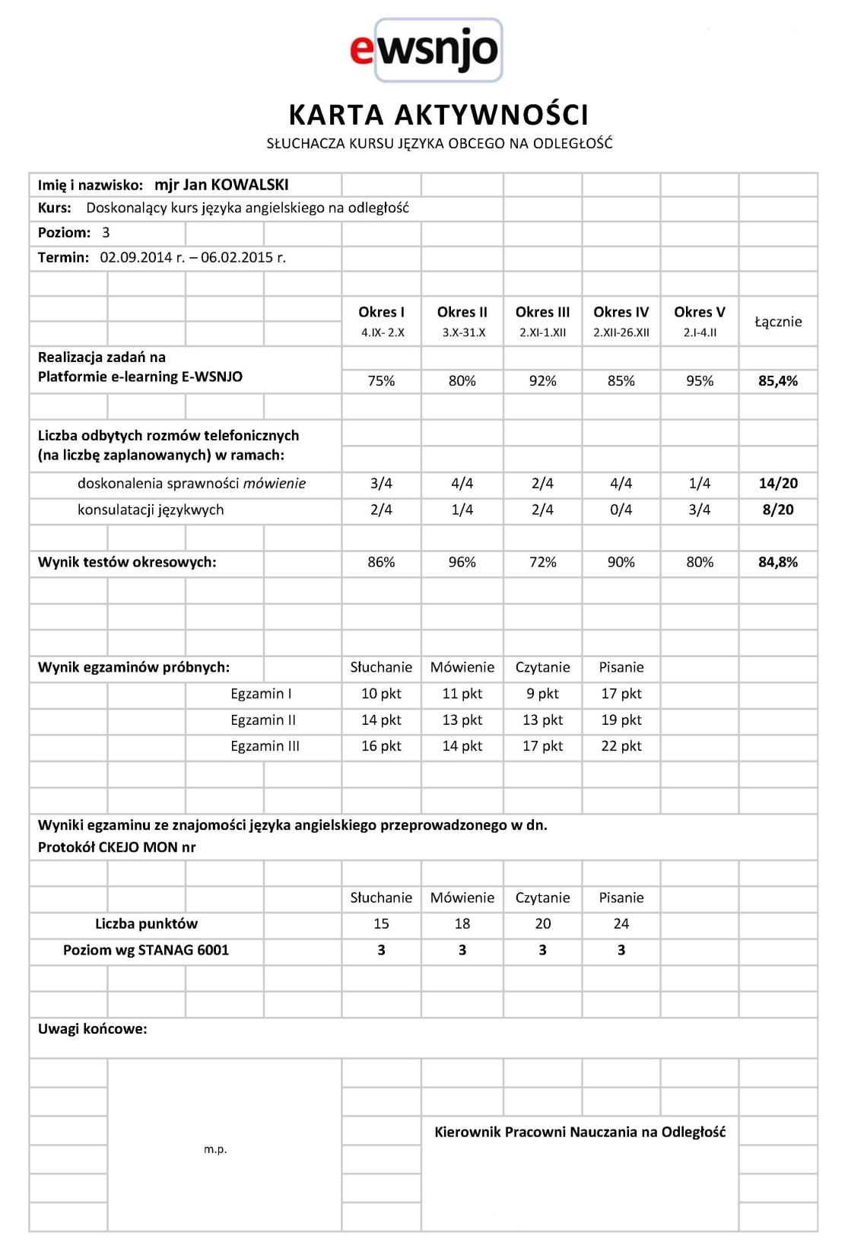

Slide 11
Distance Learning Project
PROGRESS REPORTS IN NUMBERS (JULY ’15)
 | Total | Average/student
No of students | 9
Moodle tasks completed |  | 86%
Discussion calls cunducted | 145/158 | 16/18
Consultation calls conducted | 112/136 | 12/15
Monthly test results |  | 78%

Slide 12
Distance Learning Project
STANAG EXAM RESULTS
L | S | R | W | Students
3 | 3 | 3 | 3 | 17
3 | 3 | 3 | 2+ | 2
3 | 2+ | 3 | 3 | 1
3 | - | 3 | 3 | 1
2+ | 3 | 3 | - | 1
Effectiveness |  |  | 82/88 |  | 93%
Materials
  Internally developed
  External sources
    free sites
    a paid site
    to promote learner-autonomy

Slide 13
Distance Learning Project
Miscellanea
  IT maintenance
  Group collaboration
  Attrition
  Cost efficiency
  Questionnaire results
    level of satisfaction
    suitability of method
  Popularity

Slide 14


