Slide 1

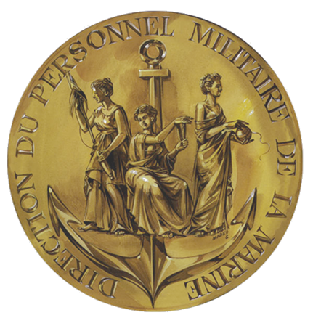
Professional English: giving your class a real-life dimension
LTJG Jade BOUTET,
Head of the Foreign Languages Office of the French Navy

Slide 2
Contents
1. The Foreign Languages Office of the Navy as part of a whole
2. English in the French Navy
3. Why authenticity in training is important for our sailors
4. What we do to meet the right content

Slide 3
1. The Foreign Languages Office of the Navy as part of a whole
Each foreign languages department managed separately but working under a joint foreign languages policy :
Navy + Army + Air Force + Intel Training Centre + Higher Military Education
Foreign languages task group
Sovereignty of each entity due to each Force’s specificities

Slide 4
2. English in the French Navy
In figures :
- the Navy : 36 500 military and 2 800 civilian personnel
- 18 military English instructors and 18 civilian teachers spread in 13 languages centres in the West and South of France

Slide 5
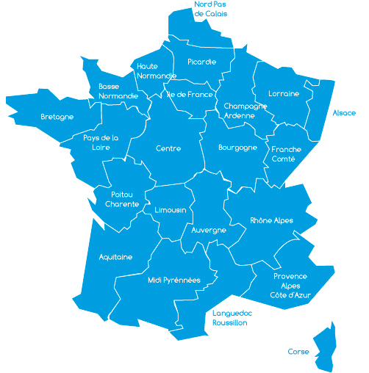
OUR INTRUCTORS ACROSS THE COUNTRY
BREST NAVAL BASE
2 instructors
BREST NAVAL INSTRUCTION CENTER
9 instructors
CHERBOURG
1 instructor
LANDIVISIAU NAS
2 instructors
LANVEOC NAS
2 instructors
MARINES TRAINING CENTER
2 instructors
NAVAL ACADEMY
9 instructors
LANN BIHOUE NAS
2 instructors
ST MANDRIER
7 instructors
TOULON NAVAL BASE
3 instructors
HYERES NAS
1 instructor

Slide 6
Which audience?
-> All levels, from beginners to advanced learners
-> Civilian as well as military personnel
-> All ranks and every level of employment

Slide 7
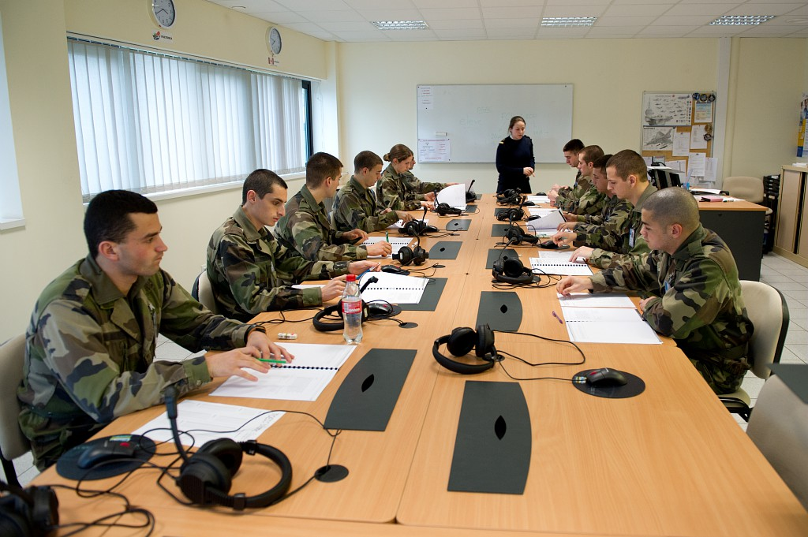
What English?
Operational and technical :
-Maritime,
- Aviation,
- Tactical,
- Armament
- Terrain…
General English : grammar, 4 language skills (L/S/R/W)

Slide 8
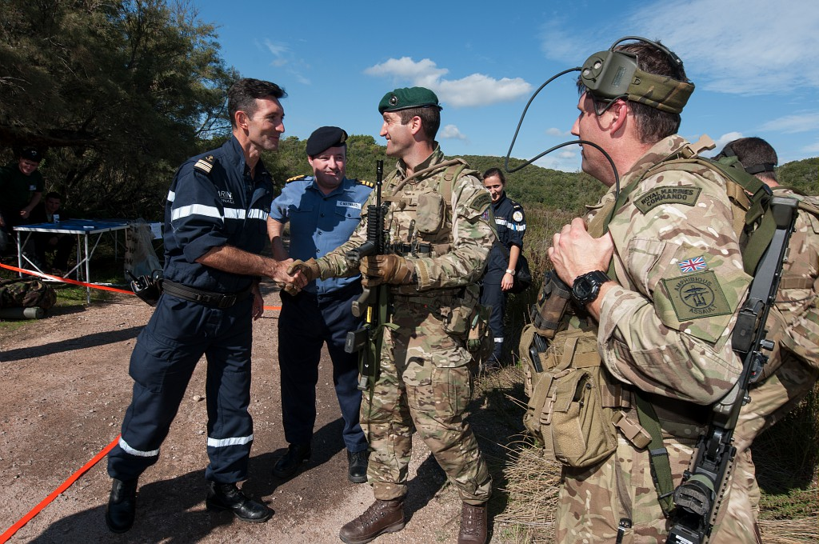
Why English is important for the Navy
Indispensable for numerous jobs
NATO formats
Co-operation between allies
Enjoying a good beer abroad with your military fellows!

Slide 9
3. Why authenticity in training is important for our sailors
From the classroom to drills
Authenticity requires to replicate the professional frame
They will learn much better if you make sense.

Slide 10
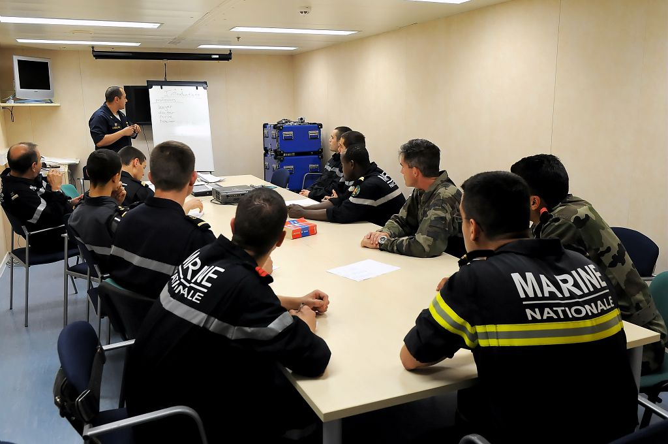
4. What we do to meet the right content
Our military instructors are sea riders
We encourage interactivity in class

Slide 11
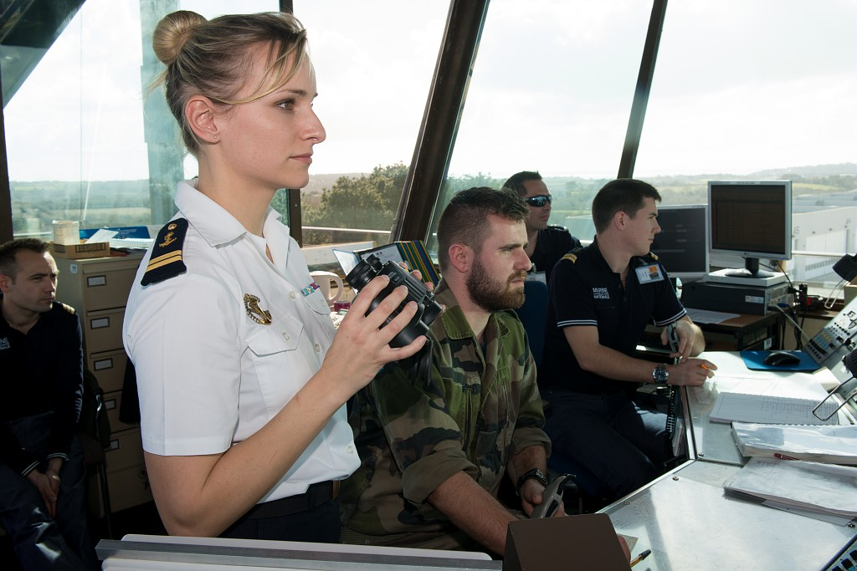
In Naval Air Stations
ATCs: Navy Air Stations instructors develop role-playing games.
Aircraft mechanics : after a theoritical class, time for a practical exercise

Slide 12
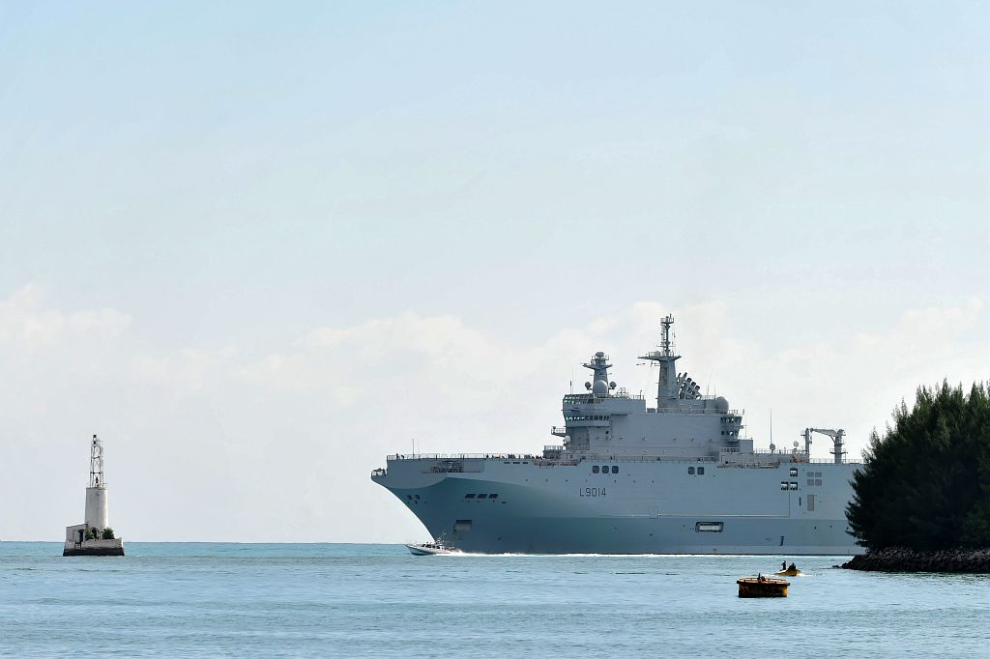
Onboard French Navy Warships
-Cadets from the French Naval Academy
- Classes as well as workshops are given throughout the mission
- Cadets get familiar with the BPC (LHD) and her equipment

Slide 13
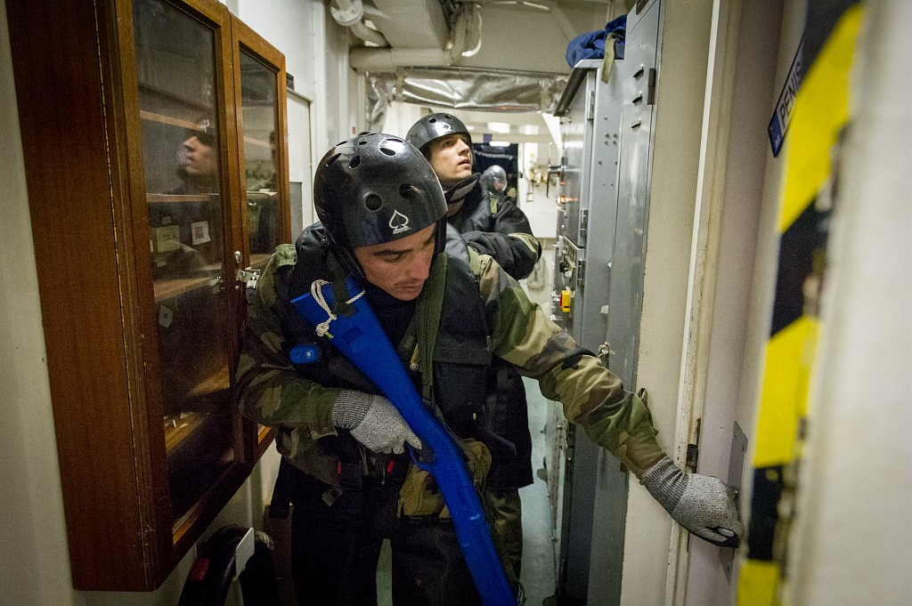
In Naval Bases
-Instructors spend 40 days per year onboard ships
-Anti-aircraft warfare
-VBSS

Slide 14
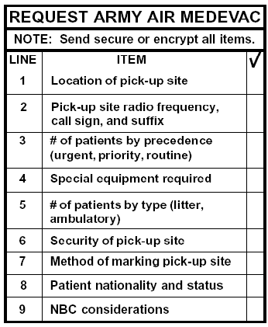
Special Forces Combat Medics
Our combat medics need to be taught specific medical vocabulary
=> While on training, they are provided walkie-talkies to simulate a request

Slide 15
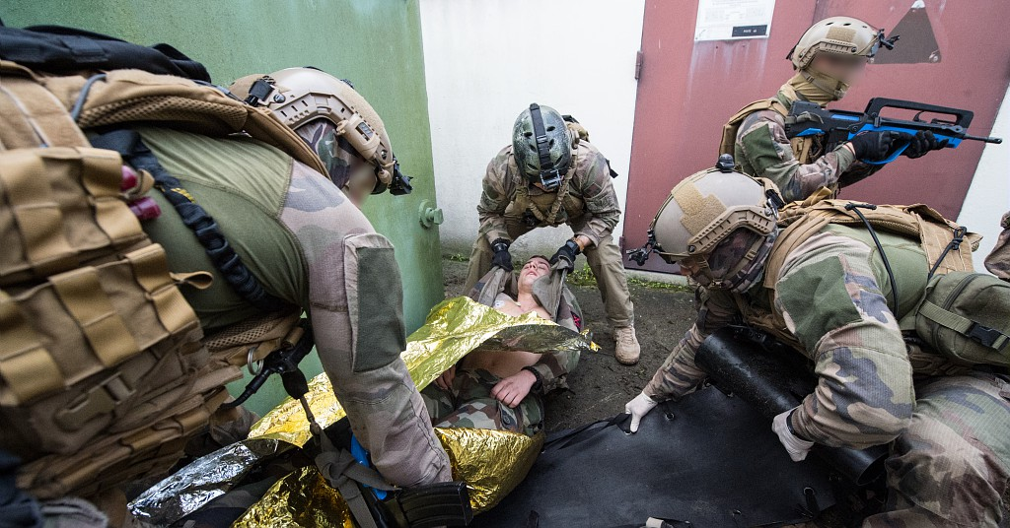

Slide 16
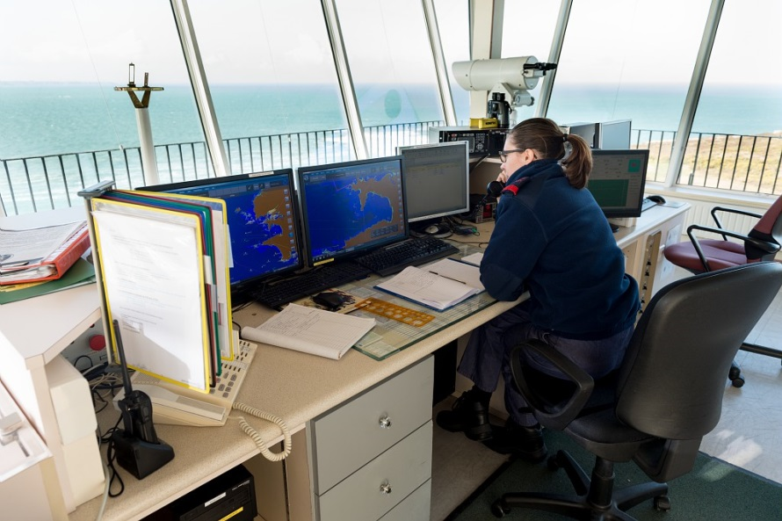
Signal Stations
Watchmen working in semaphoras must be able to understand and collate information via radio links.
To help them get used to weak and broken comms, we use a software called « Spacio Web »

Slide 17
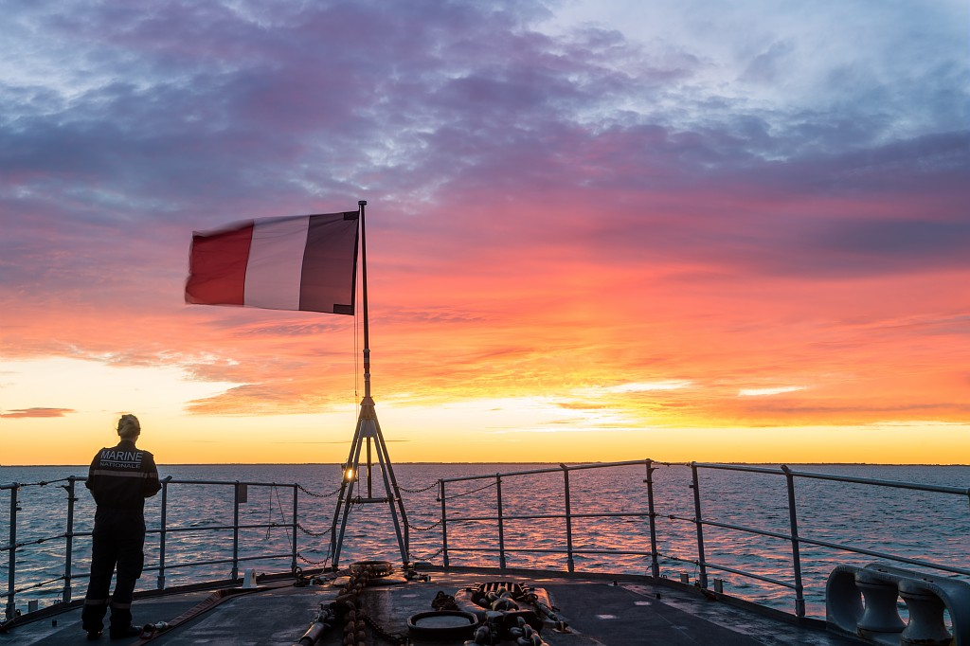
Questions?
Köszönöm!

