Slide 1


Bilateral cooperation on trialling - Latvian & Estonian experience
Inga Fārte-Zālīte,
NATO STANAG 6001 Testing Team
NAF Language School, Latvia
Merit Kompus,
NATO STANAG 6001 Testing Team
Estonian Defence College
Krajnska Gora 2018

Slide 2


Bilateral cooperation since 2007

Slide 3



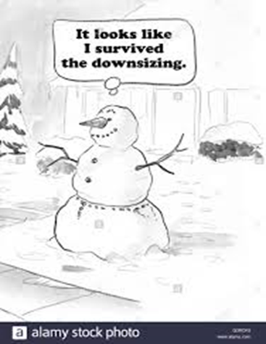
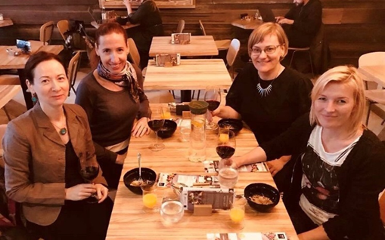
Good reasons for cooperation

Slide 4
Key elements of successful cooperation
Shared values
Communication and planning
Interpersonal relationship

Slide 5
Bilateral cooperation
Cooperation on trialling
Trialling in other countries
Trialling- lessons learnt

Slide 6
EST-LAT cooperation
Common listening & reading tests
Developing tests – common test specs
Moderation meetings in both countries alternately
Trialling - shared items/ keys/data/analysis
Live administration – shared keys/data/analysis
Testing candidates from the other nation

Slide 7
Reasons for cooperation on trialling
Small trialling population
Test security
Standardization

Slide 8
Trialling in other countries
Pluses
- sufficient amount of data – especially for IRT
- trialling more tasks/items/ parallel versions to choose the best
Minuses
differences in course level systems
same items in different countries may produce different results
reluctance to do other country’s test – lower facility values
time

Slide 9
Trialling in other countries
Things to bear in mind
- ALCPT for comparison
- time available
- level/ background & size of trialling population
- lack of exposure to certain task types
- need to reciprocate the favour ☺
- feedback

Slide 10
Trialling- lessons learnt
Organize well in advance – time & levels
Preferably – with people you personally know/ trust & similar systems
Several countries
Takes more time than estimated
Constant checking needed
Not too many items/ tasks
Clear instructions/ guidelines for administrators
Cut-offs – only after 1st live administration

Slide 11
Thank you

