Slide 1


“Developing Listening and speaking Skills-Assumption for Better Communication”
Khubuluri Lela, Ph.D. Candidate. National Defense Academy of Georgia
Chkhikvadze Zurab, Ph.D. National Defense Academy of Georgia;
2017

Slide 2
Content
Introduction - Why Listening and speaking?
Types of listening
Listening skills
Listening resources/devices
Tips for better listening
Difference between knowing a language and speaking a language
Speaking skills
Tips for better speaking
Some most Commonly used speaking activities

Slide 3
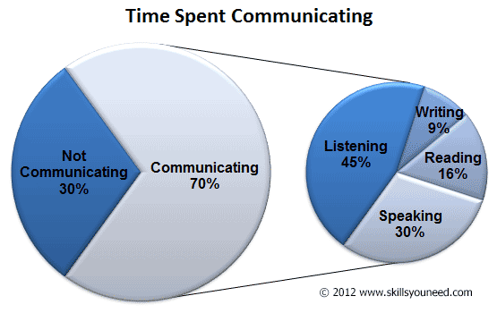
Why Listening and speaking?

Slide 4
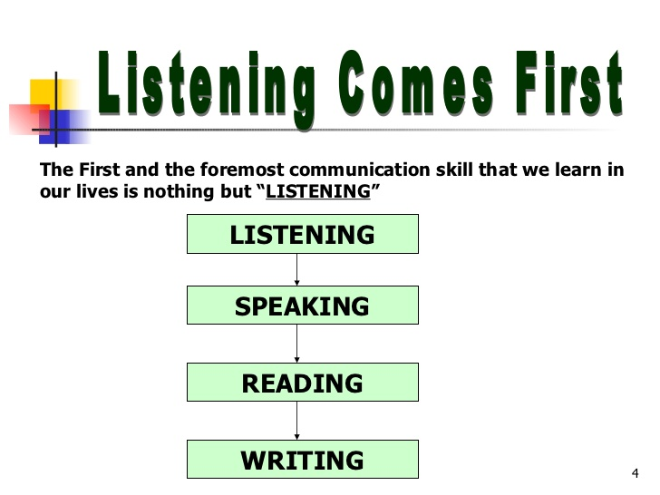

Slide 5
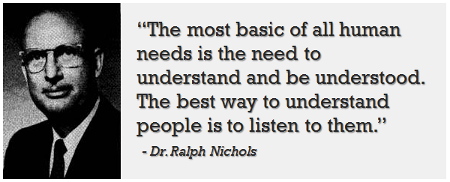
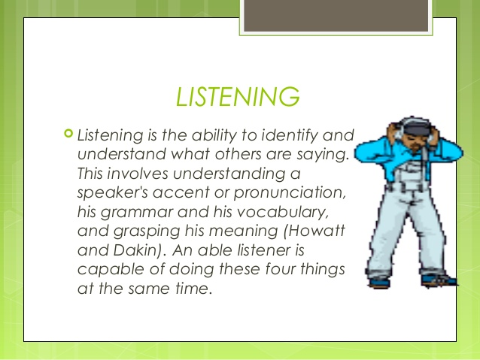
reasons for listening

Slide 6
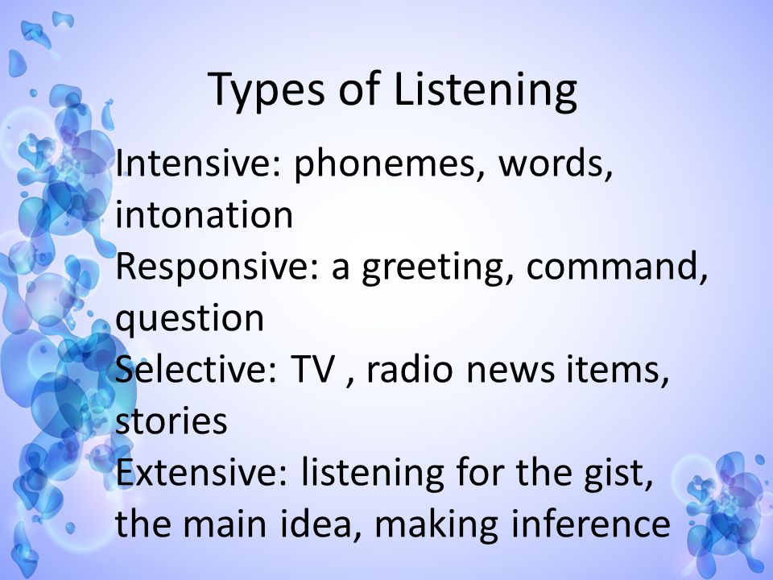

Slide 7

Listening for specific information

Slide 8

listening skill levels
Advance (ability to understand authentic materials)
Intermediate (ability to understand materials corresponding the level)
Elementary (ability to understand materials corresponding the level)

Slide 9

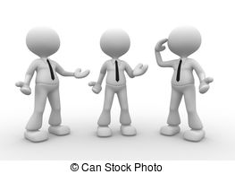
listening sources
Recorded materials
Live listening

Slide 10
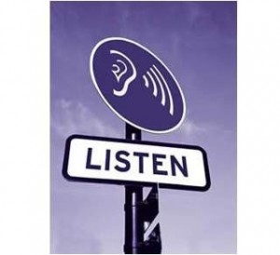
Tips for effective listening
Define students for the necessity of listening
Getting ready for listening activity
Listening once may not be enough
Encourage students for answering pre-listening and after listening questions
Listening at deferent levels require various corresponding activities

Slide 11
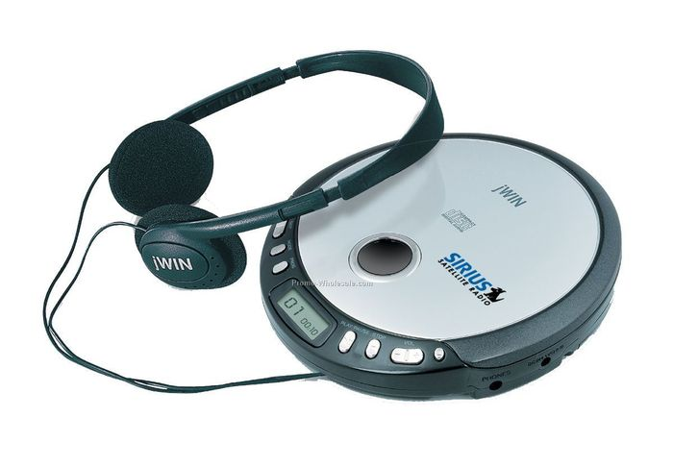
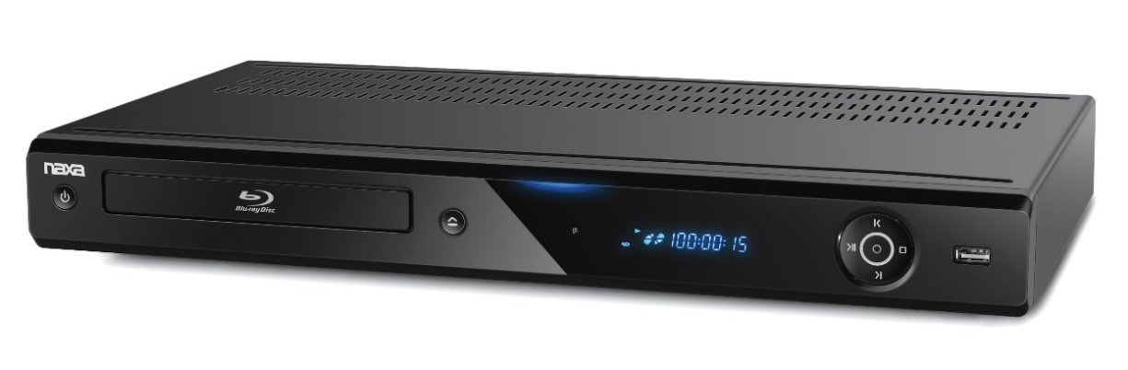
Devices for listening activities

Slide 12
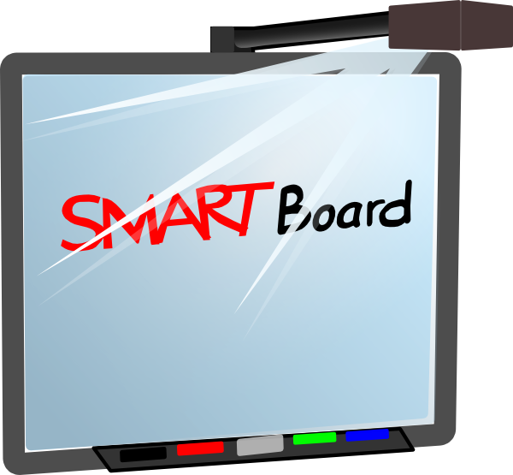
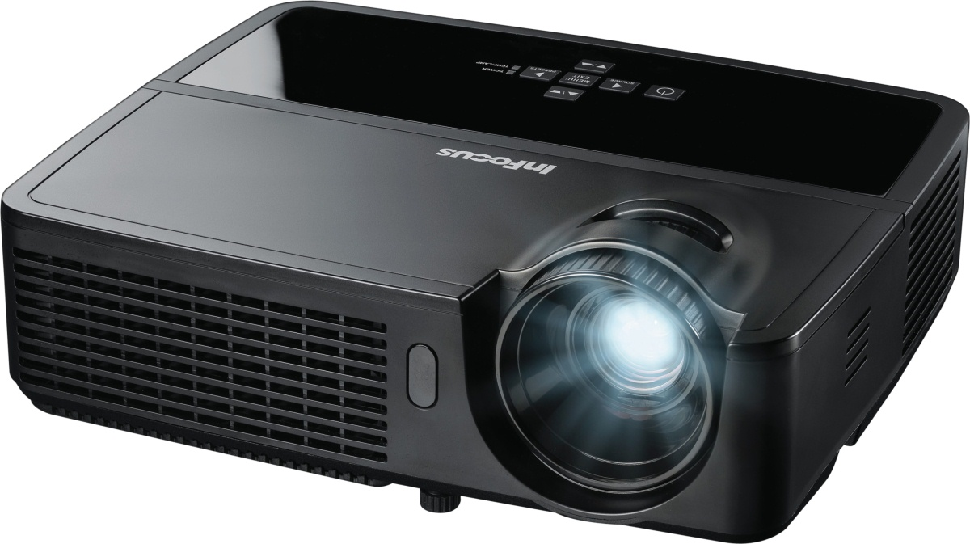
Devices for listening activities

Slide 13
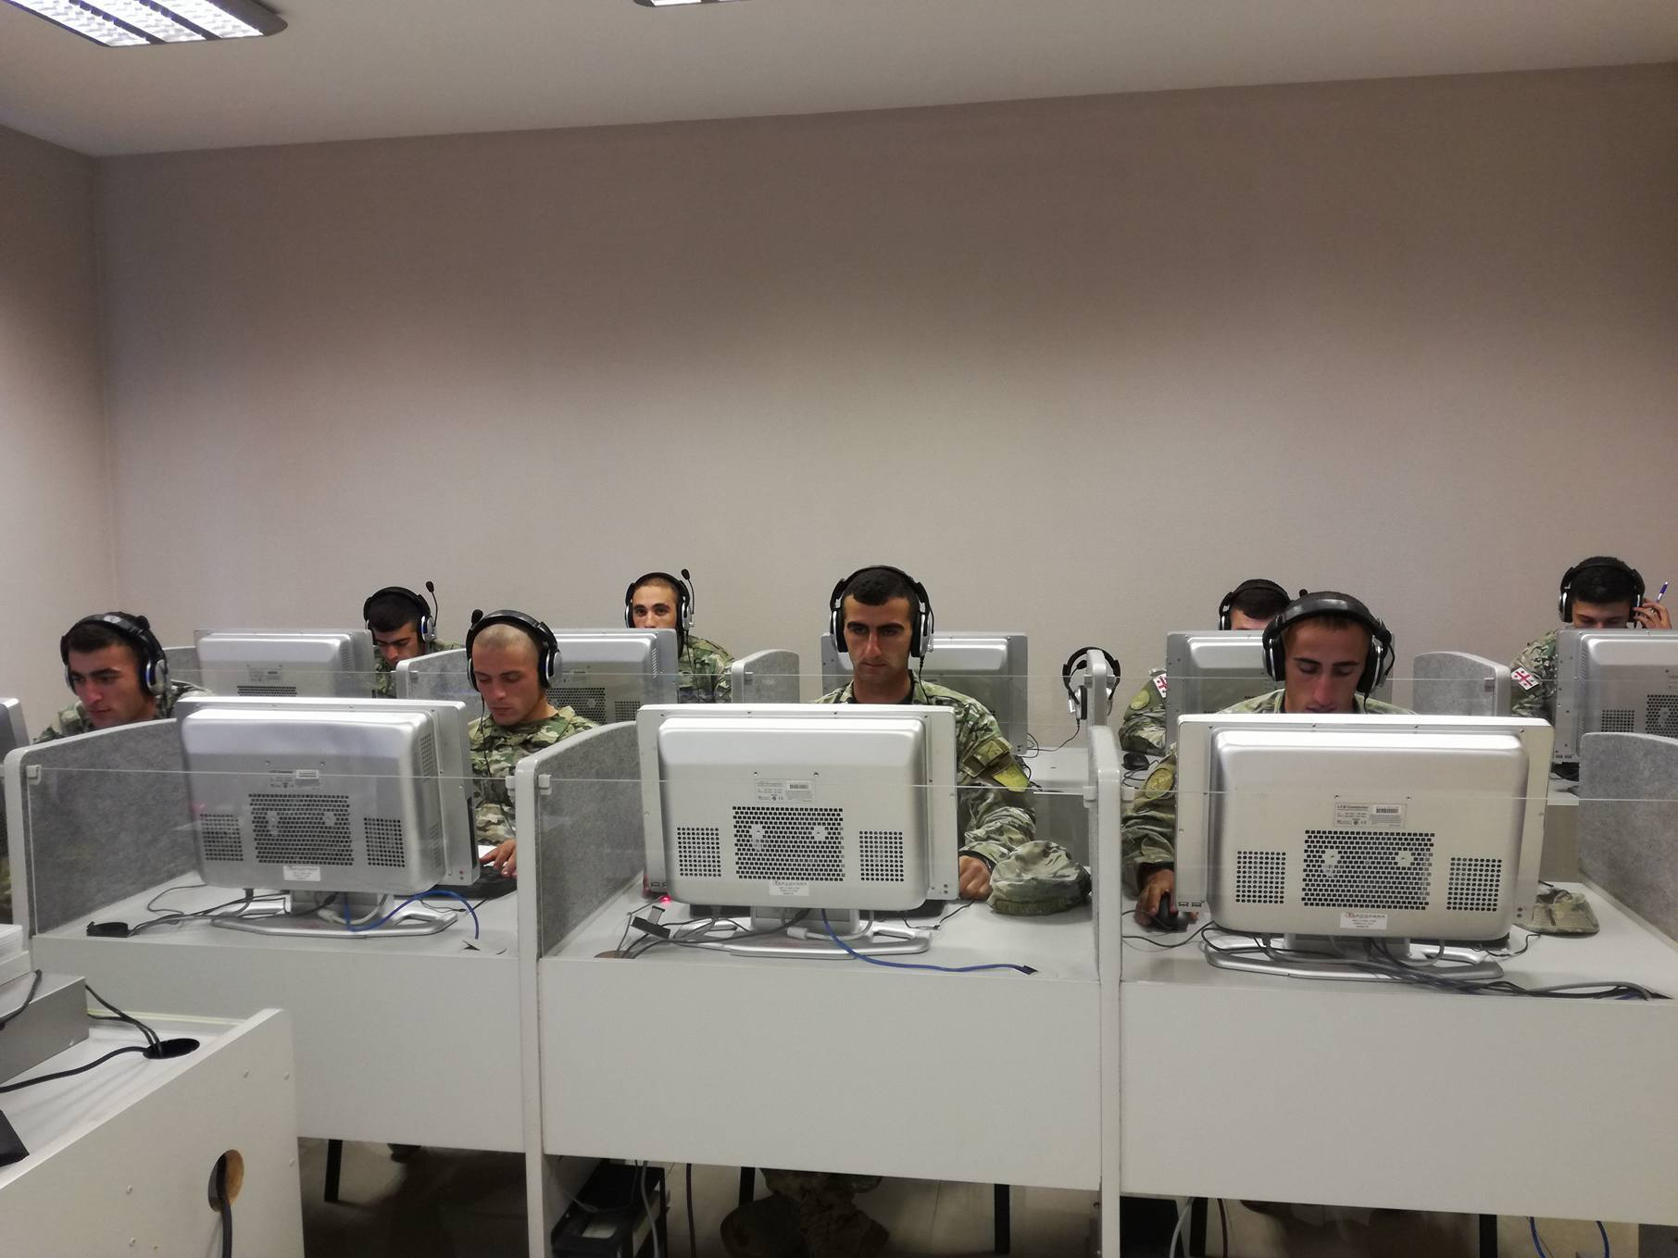

Slide 14

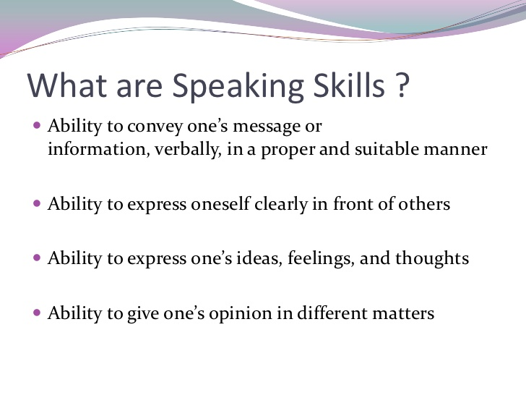
Difference between knowing a language and speaking a language

Slide 15
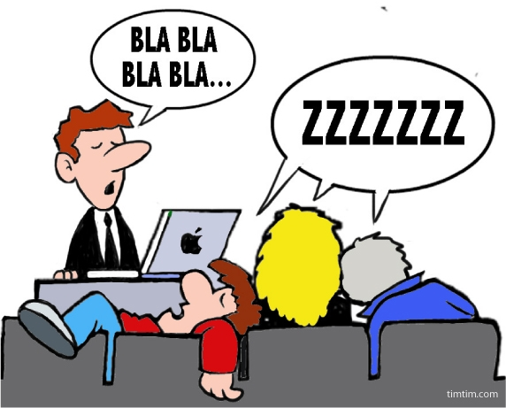

Speaking – the art of communication

Slide 16
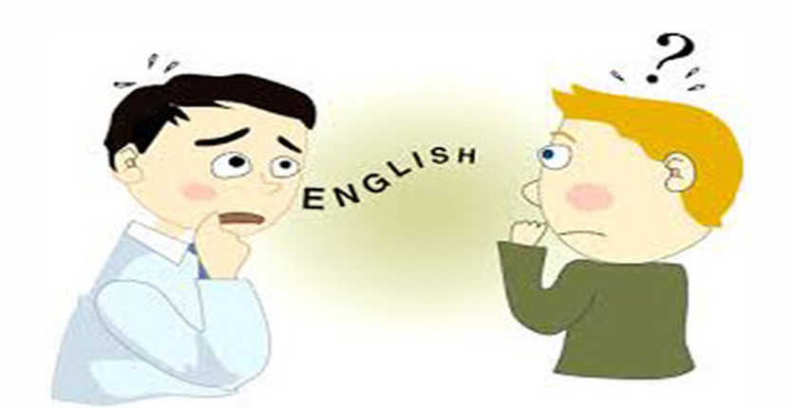
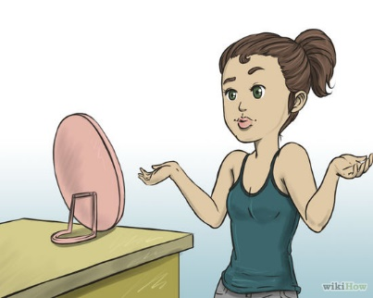
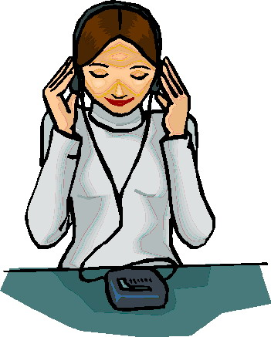
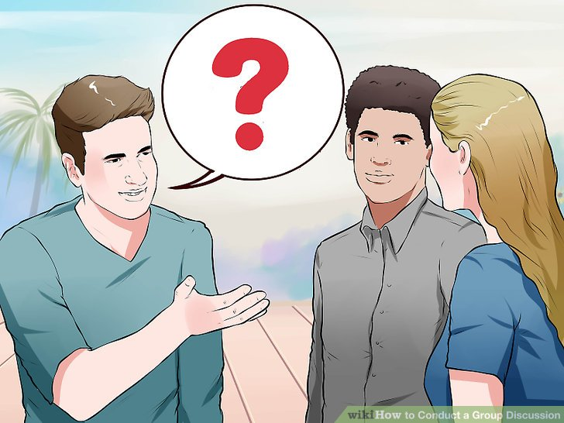
Tips for better speaking
Improving Your English at home
Read aloud
Record your English
Listen and watch TV
Narrate your world
Improving your English with others
Involve yourself into discussions
Create a reason to speak English
Find online friends
Training your brain
Use a dictionary
Study a new word/phrase every day
Make use of the new word/phrase

Slide 17
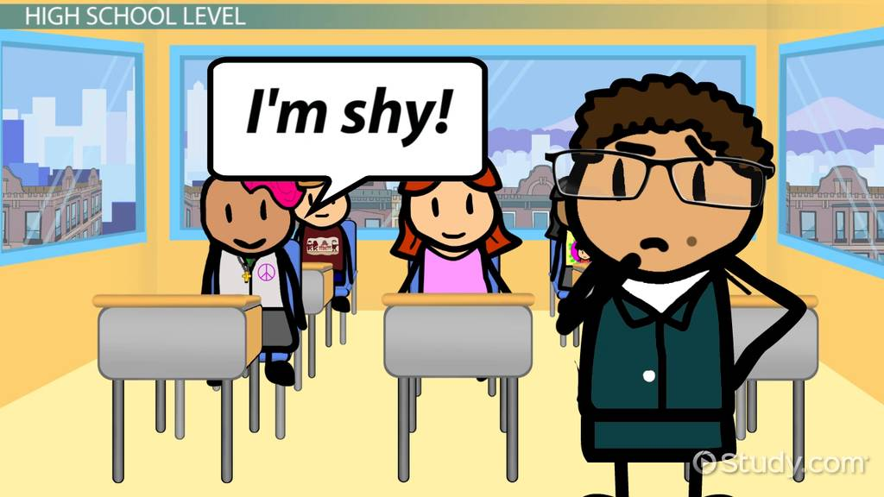




Slide 18
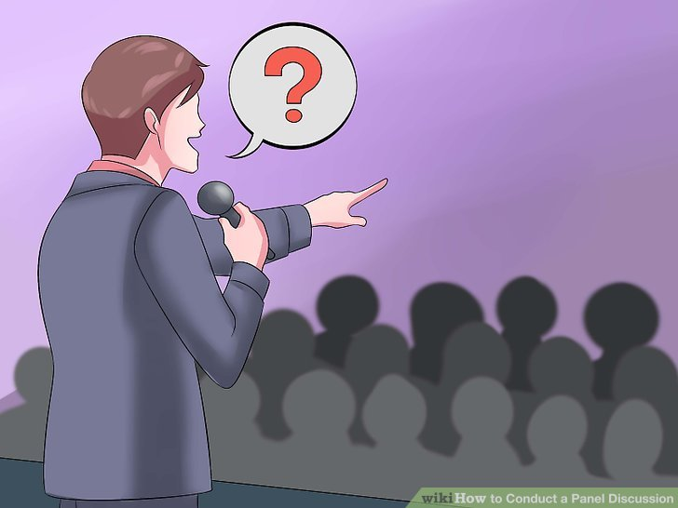
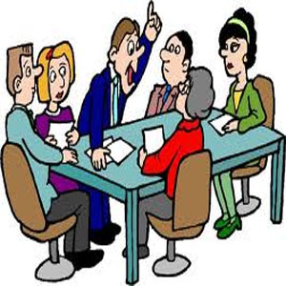
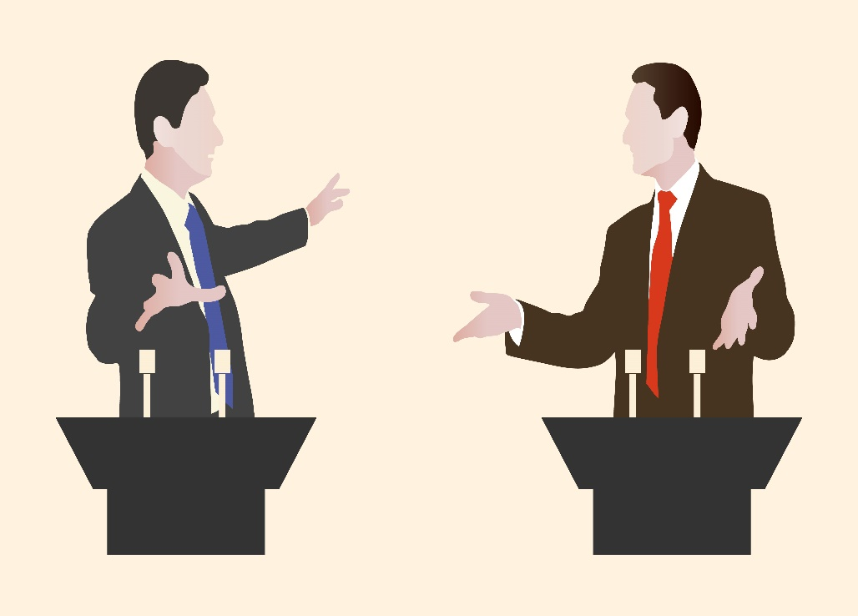
Some most Commonly used speaking activities
Short speeches
Pair work
Role play
Discussions
Debates

Slide 19
“An Imaginary Gift Giving”

Slide 20

Thank You for Listening!

