Slide 1



Test Validation Topics in the
BILC Testing Seminars
Peggy Garza
Associate BILC Secretary

Slide 2

Language Testing Seminar (LTS)
Began in 2000
Traditional approach to test validation

Slide 3
Language Testing Seminar (LTS)
2000-2008
Two phases of test validation
  Preliminary quality control
    Review items (texts and tasks)
    Administer to native speakers
    Pretest with groups with known proficiency levels
  Formal validation
    Concurrent validity: statistical correlation with another validated STANAG 6001 test

Slide 4
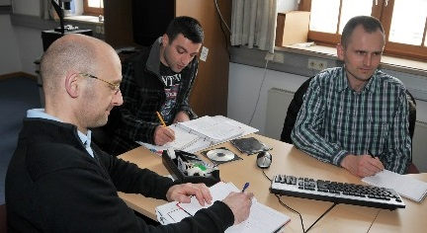
Language Testing Seminar (LTS)
2000-2008
Concepts
  Validity, reliability, practicality
Practical activities
  Item analysis
    Facility value
    Discrimination index
    Distractor efficiency

Slide 5

Language Testing Seminar (LTS)
2000-2008
Reference materials
  The Concepts of Reliability and Validity in Military Training and Education by CDR Andre Gervais, Canadian Forces Language School
  Testing for Language Teachers by Arthur Hughes, Chapter 4, Validity and Chapter 5, Reliability
  Appendix 1, Statistical Analysis of Test Data

Slide 6


Language Testing Seminar (LTS)
2009-2016
Updates influenced by
  Benchmark Advisory Test (BAT) project
  Advanced Language Testing Seminar (ALTS)

Slide 7
Benchmark Advisory Test (BAT)
2005-2009
To promote consistent interpretation of STANAG 6001 across national testing programs.
To provide an external measure against which nations can compare their national STANAG 6001 test results.
To pursue a joint development project as a way of demonstrating how STANAG 6001 tests can be designed, developed and scored.

Slide 8
Benchmark Advisory Test (BAT)
New testing seminar topics resulting from the BAT project
  Criterion-referenced (CR) proficiency testing
  Criterion-referenced (CR) scoring
  Standard setting using modified Angoff
  Random/ Emerging/Developing /Sustained (REDS)
  Item Response Theory (IRT) analyses

Slide 9
Dr Ray Clifford,
2016 BILC Conference in Riga, Latvia
If they align – everything’s fine
Construct Definition ☺
Test Design & ☺ Development
Test Scoring ☺

Slide 10
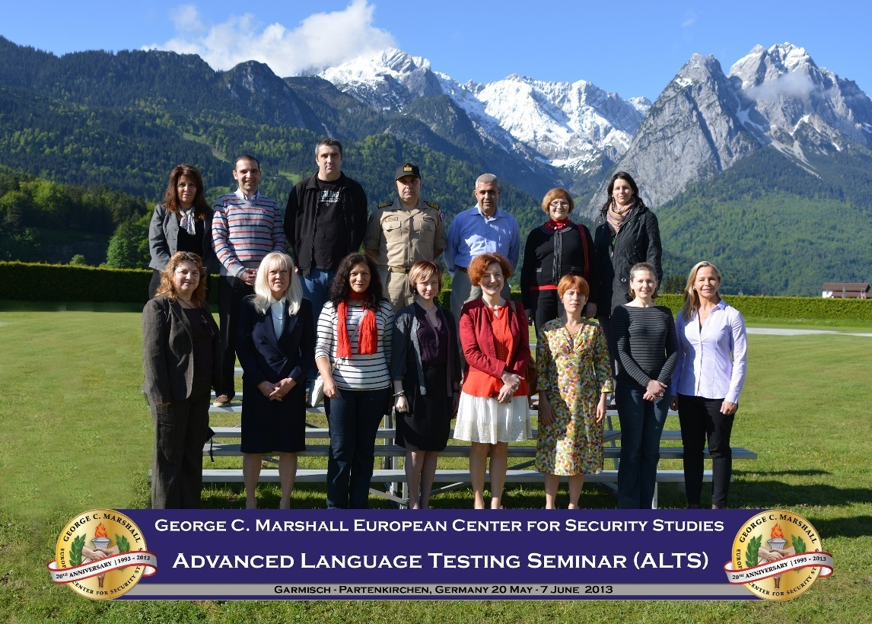
Advanced Language Testing Seminar (ALTS)
Began in 2009
Three-day module on test validation practices

Slide 11
Advanced Language Testing Seminar (ALTS)
2009-2012
Module 3, Test Analysis
Quantitative analysis methods
  Introduction to statistical tools- Excel and SPSS
  Interpretation of results
Qualitative analysis methods
  Questionnaire design
  Additional qualitative analysis methods
Standard setting
  Angoff and contrasting groups method
  Exercises on standard setting using Angoff
  Contrasting groups method

Slide 12
Advanced Language Testing Seminar (ALTS)
2012-2016
Module 3, Test Validation
Revision of Basic Terms in Test Analysis
Quantitative Analysis Methods
  Introduction to statistical tools -Excel and SPSS
  Interpretation of results
  Preparation of alternate test forms
  Challenges of piloting test items
Qualitative Analysis
  Questionnaire design
  Additional qualitative analysis methods
  Standard setting
  Exercises on standard setting using the Angoff method
Validity Argument

Slide 13
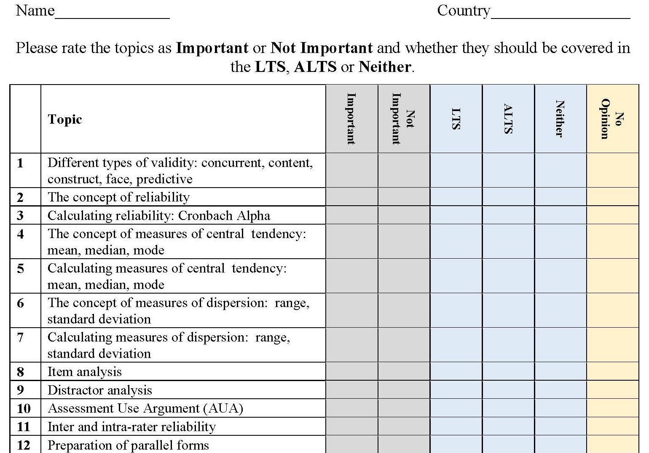
Submit your input by this afternoon

