Slide 1

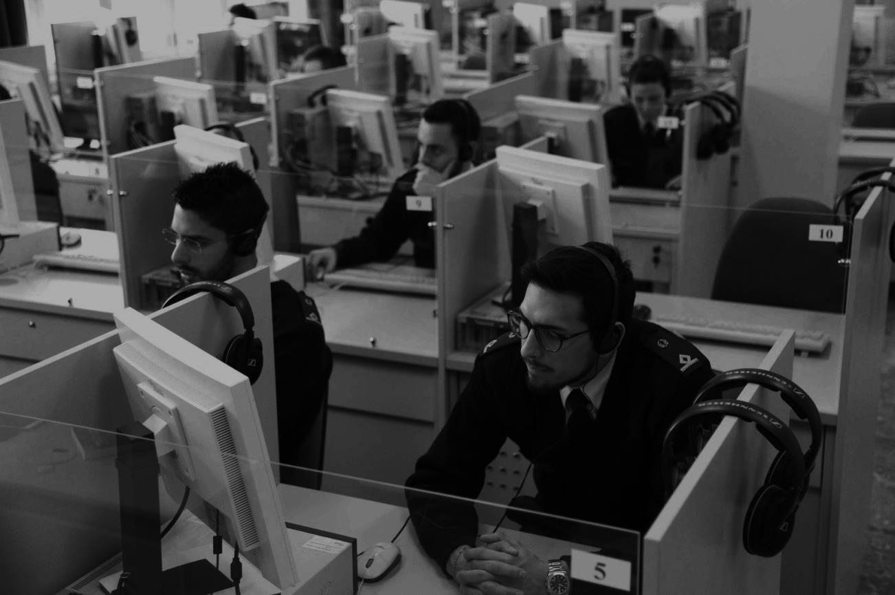
ITALIAN AIRFORCE
AVIATION ENGLISH TRAINING CENTER
NUTS AND BOLTS:
BUILDING A MAINTENANCE ENGLISH COURSE
Mr. BENJAMIN C. PIM - MAJ. D’ADDIO
1

Slide 2
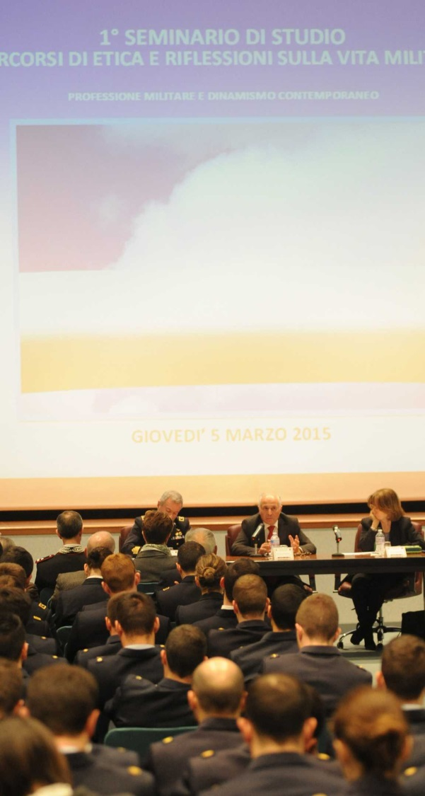
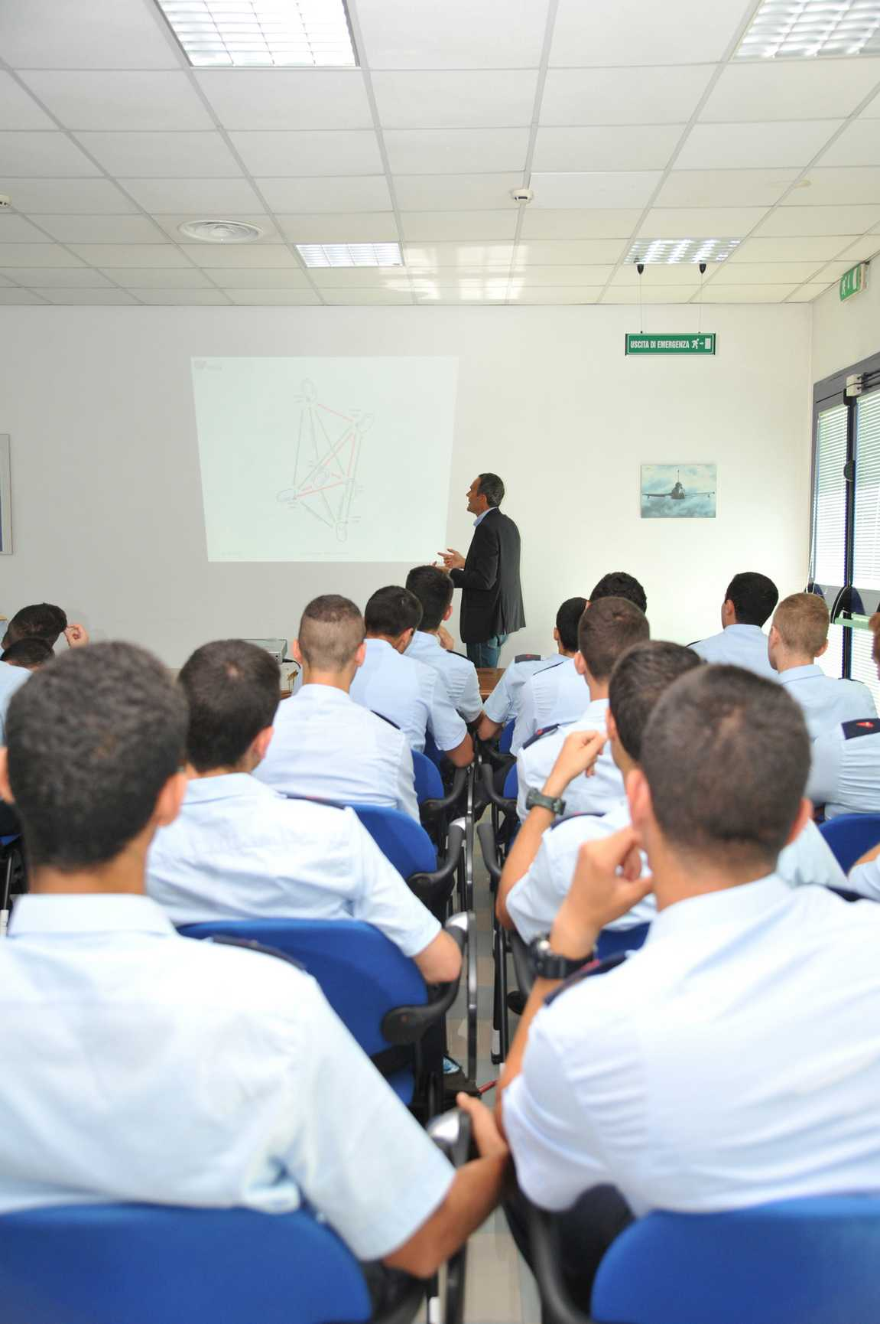


ITALIAN AVIATION ENGLISH TRAINING CENTER
Loreto
ITALIAN AIRFORCE
2

Slide 3

AGENDA
BACKGROUND
PRELIMINARY ANALYSIS
NEEDS ANALYSIS
COURSE DESIGN
FUTURE DEVELOPMENTS
ITALIAN AIRFORCE
3

Slide 4



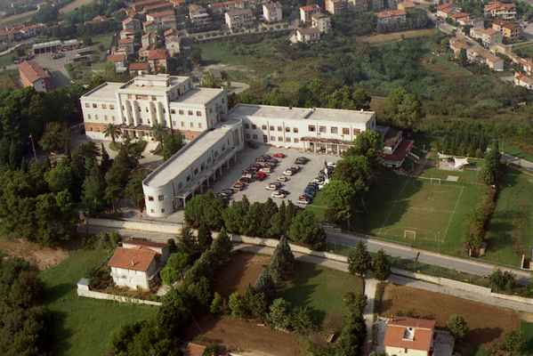
ITALIAN AVIATION ENGLISH TRAINING CENTER
Loreto
ITALIAN AIRFORCE
4

Slide 5


BACKGROUND
ITALIAN AIRFORCE
5

Slide 6

BACKGROUND
RESIDENTIAL COURSES
  GENERAL ENGLISH (MODULAR APROACH)
  AVIATION ENGLISH (PILOTS – AIR TRAFFIC CONTR.)
  MAINTENANCE ENGLISH
  JOINT TERMINAL ATTACK CONTROLLER
  ENGLISH FOR AIR FORCE INSTITUTES
  CRASH COURSE
  ITALIAN FOR OTHER NATIONALITIES
  OTHER LANGUAGES FOR ITAF NEEDS
  GENERAL ENGLISH (MODULAR APPROACH)
  ITALIAN FOR OTHER NATIONALITIES
E-LEARNING COURSES
AERONAUTICA MILITARE
6

Slide 7
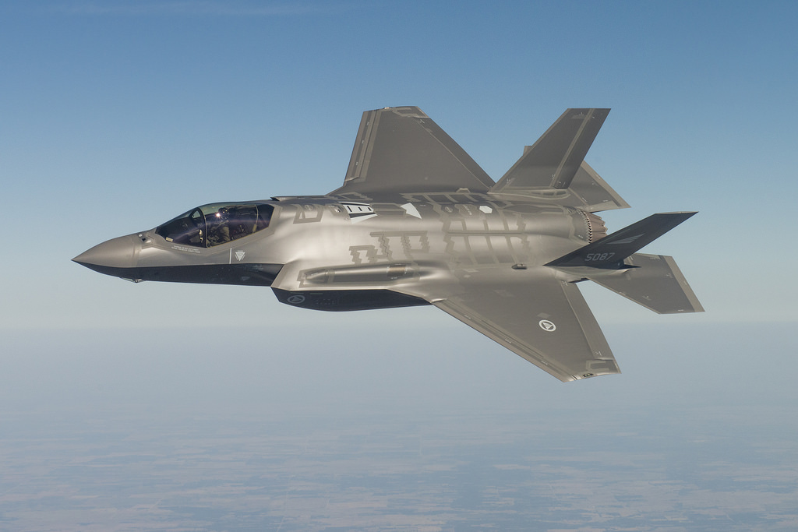
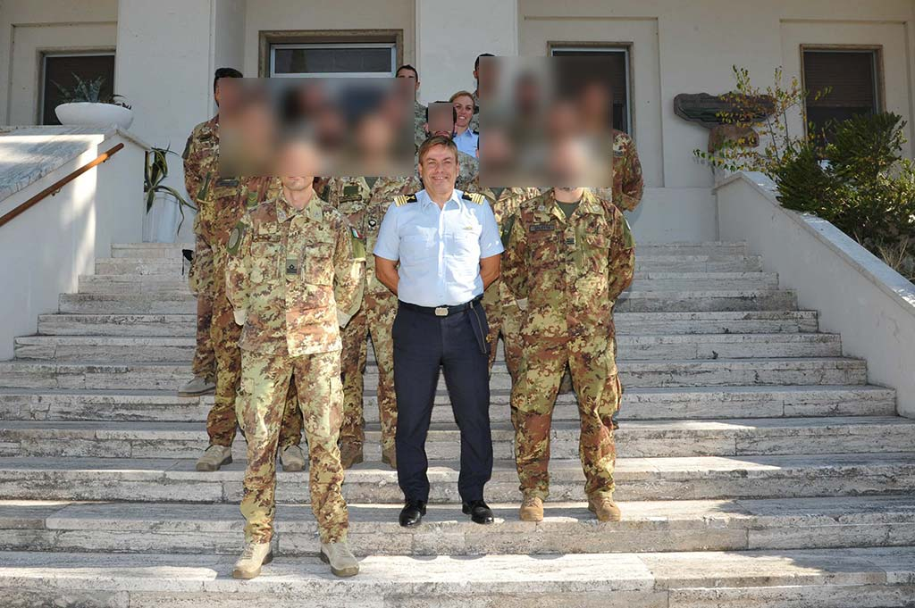
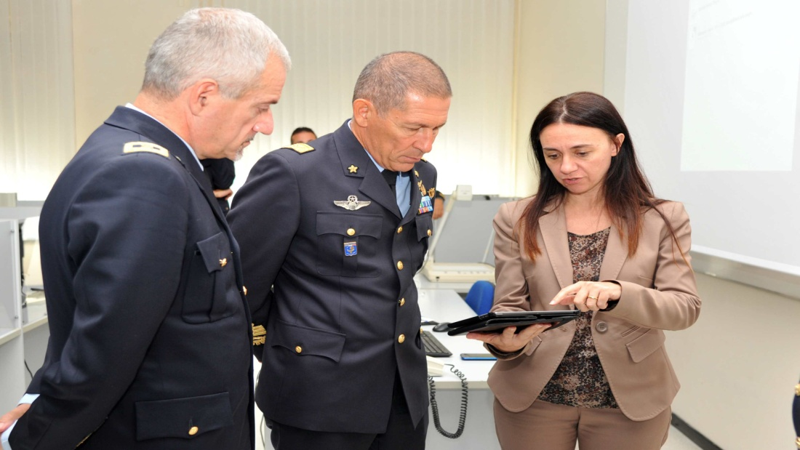
BACKGROUND
JTAC COURSES
AVIATION ENGLISH COURSES
MAINTENANCE ENGLISH COURSES
ITALIAN AIRFORCE
7

Slide 8
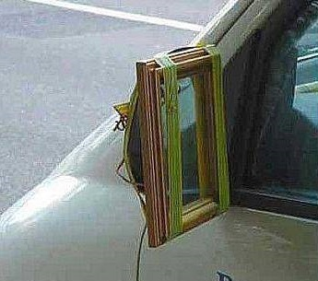
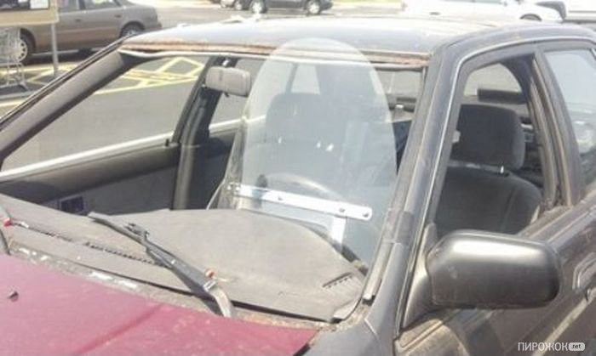

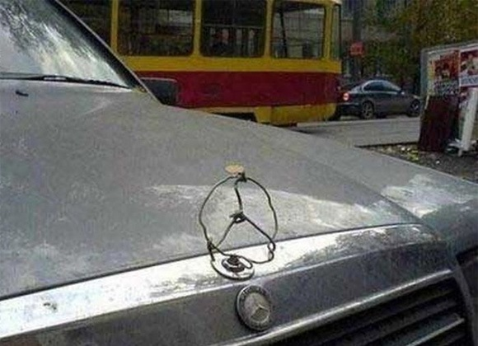
PRELIMINARY ANALYSIS 1
THE ITALIAN APPROACH…
ITALIAN AIRFORCE
8

Slide 9
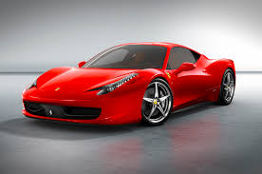
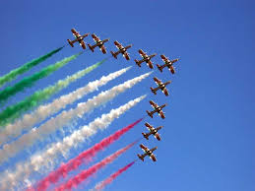
PRELIMINARY ANALYSIS 2
…THE ITALIAN PRODUCT!!!
ITALIAN AIRFORCE
9

Slide 10
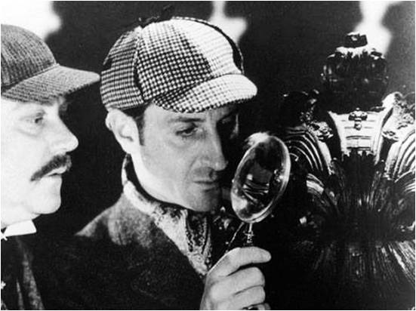
NEEDS ANALYSIS 1
ITALIAN AIRFORCE
10

Slide 11


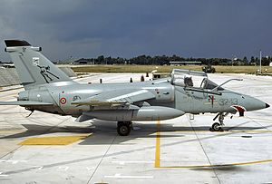
NEEDS ANALYSIS 1
32° Wing AMENDOLA
ITALIAN AIRFORCE
11

Slide 12
NEEDS ANALYSIS 2
Summary of students’ SLP profile according to STANAG 6001 Ed.4
Language Level | L | S | R | W
1 | 8 | 7 | 3 | 4
1+ | 38 | 41 | 44 | 46
2 | 4 | 2 | 3 | 0
Total | 50 | 50 | 50 | 50
ITALIAN AIRFORCE
12

Slide 13
NEEDS ANALYSIS 3
Sample of questionnaire findings:
 |  |  | Very Confident | Somewhat Confident | Not Confident
Q. 11 | How confident are you about reading simple everyday work related messages? |  | 0 | 26 | 24
Q.12 | How confident are you about reading technical manuals? |  | 0 | 10 | 40
ITALIAN AIRFORCE
13

Slide 14
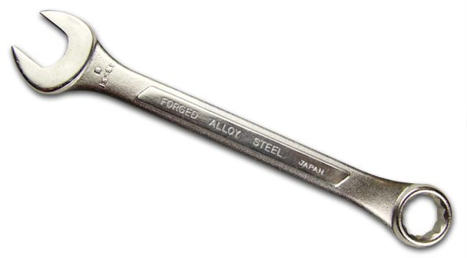
NEEDS ANALYSIS 4
 | Question | Always | Often | Sometimes | Rarely
Q.13 | Do you understand phrasal verbs when reading a technical manual? |  | 20 | 28 | 2
Q. 14 | Do you understand specific vocabulary when reading a technical manual? |  | 19 | 28 | 3
English Key = chiave inglese
ITALIAN AIRFORCE
14

Slide 15

ITALIAN AIRFORCE
15

Slide 16



NEEDS ANALYSIS 5
ITALIAN AIRFORCE
16

Slide 17
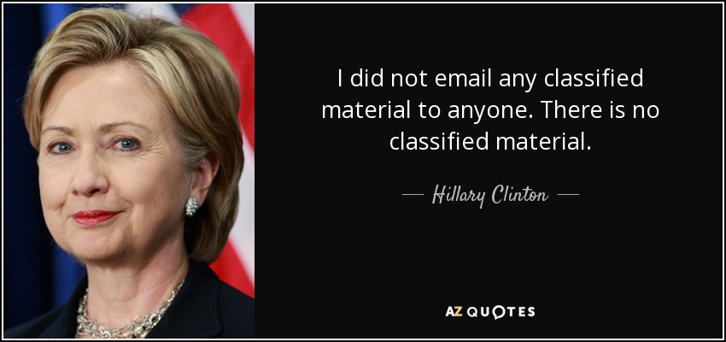
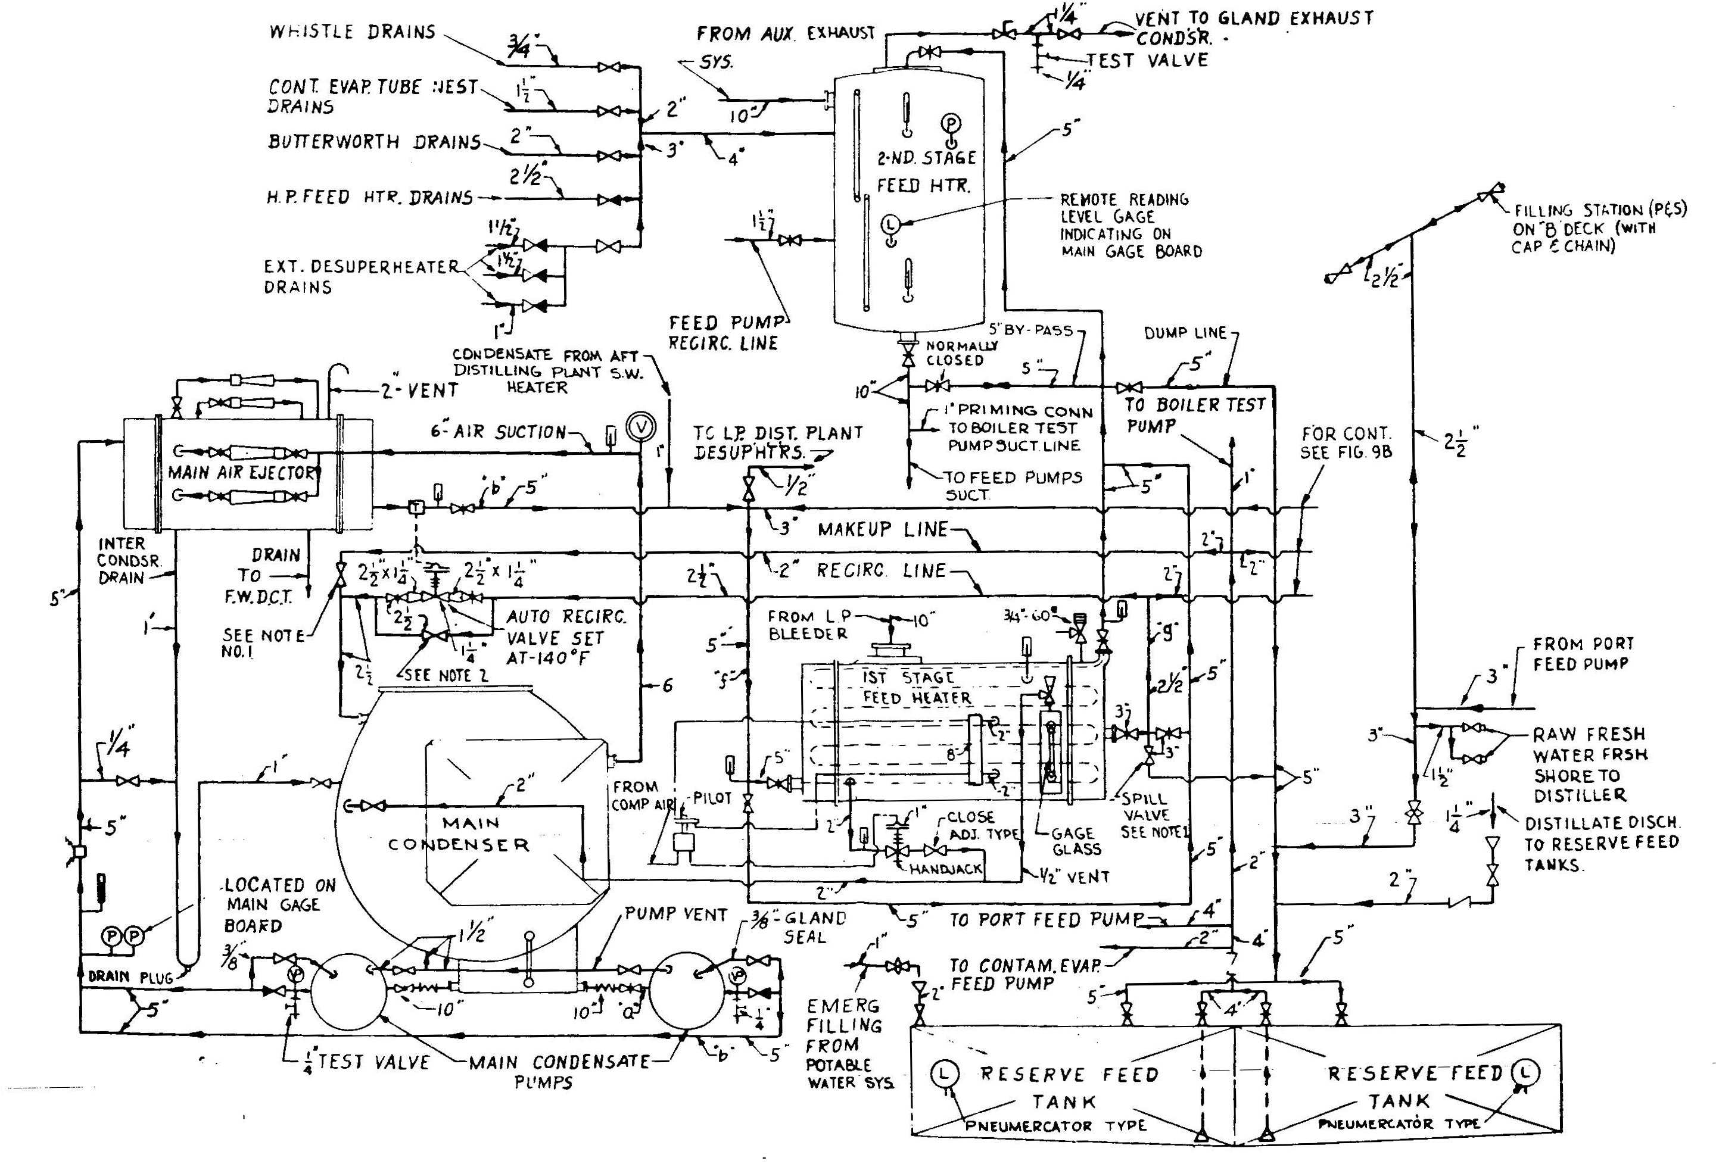


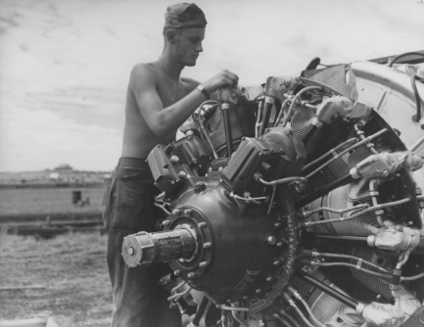
NEEDS ANALYSIS 6
ITALIAN AIRFORCE
17

Slide 18
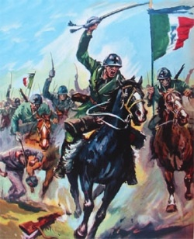
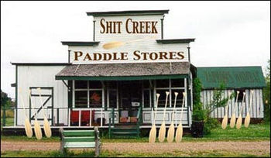

COURSE DESIGN 1
ITALIAN AIRFORCE
18

Slide 19
Italian Air Force
19

Slide 20
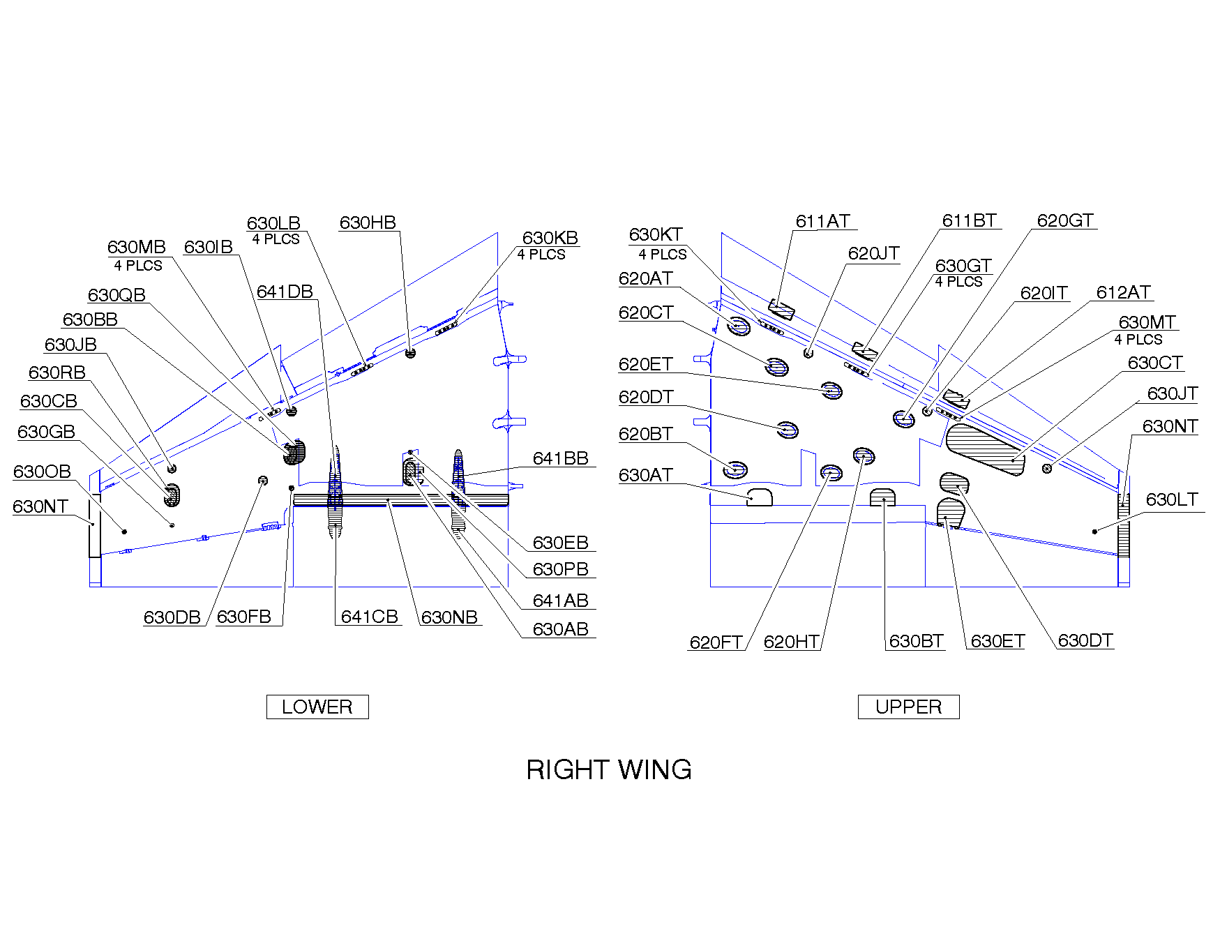
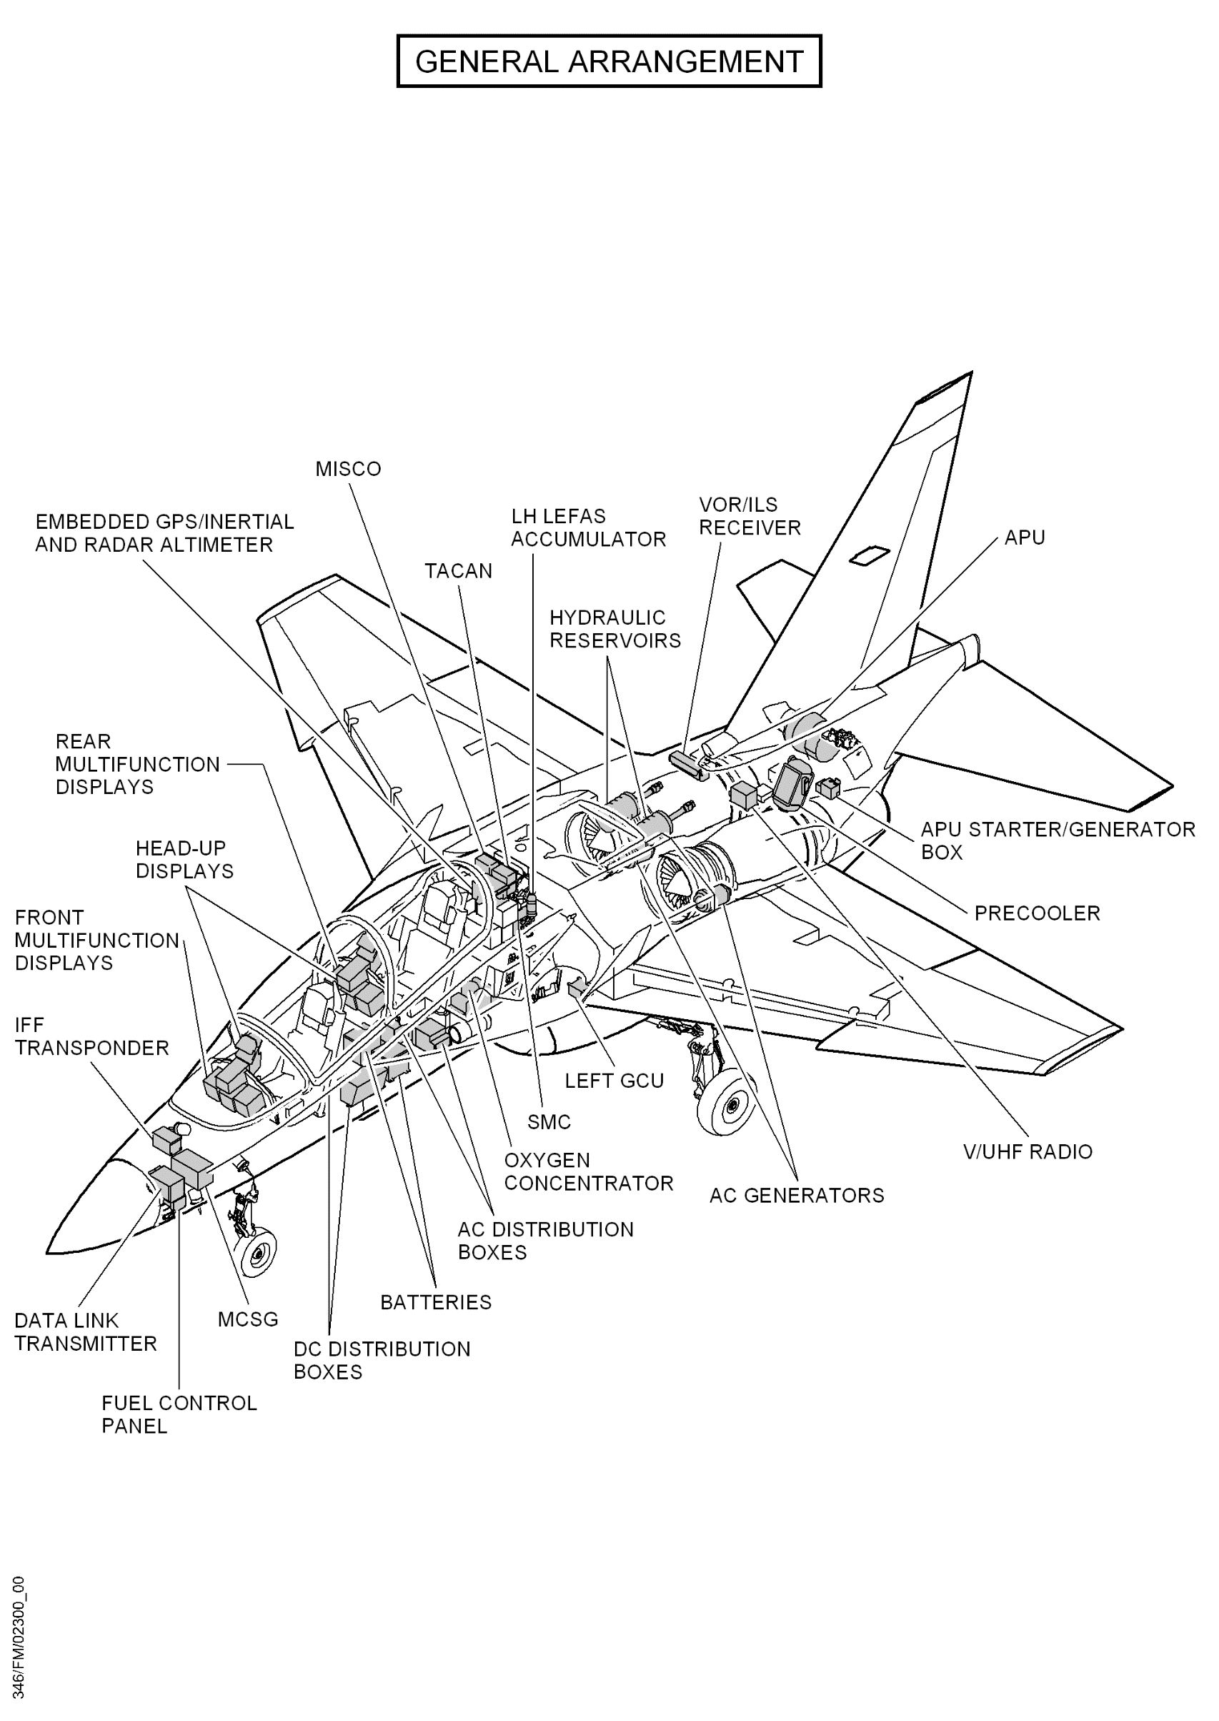
20

Slide 21
COURSE DESIGN 2
Starting SLP
Language learning needs (ECL)
Student concerns and areas of weakness
Access to material
ITALIAN AIRFORCE
21

Slide 22
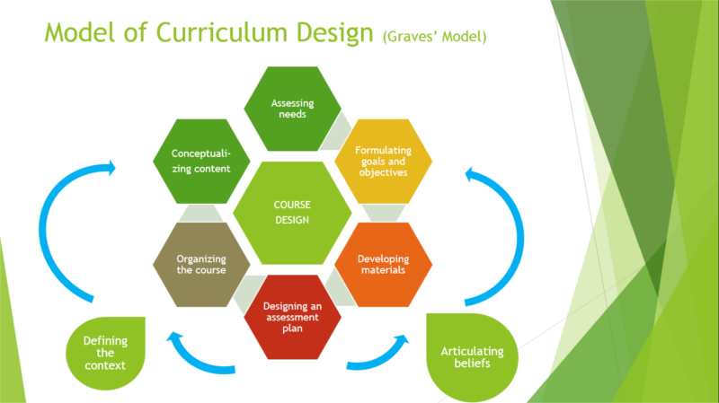
COURSE DESIGN 3
ITALIAN AIRFORCE
22

Slide 23
DOMAINS
LEXIS
GRAMMAR
FUNCTIONS
23
Notes:
13 areas (from Aircraft Maintenance to Non-Destructive testing )
Abbreviations
Adjectives
Dimensions and units of measure
Describing shapes
Equipment and tools
Types of materials
Countable and uncountables nouns
Phrasal verbs
Positions and prepositions
Comparatives
Consequences – describing cause/effect
Describing processes (First, then, after that)
Describing parts of things and how they are assembled
Troubleshooting – describing/identifying problems
Comparing and contrasting

Slide 24
COURSE DESIGN 4
ITALIAN AIRFORCE
24

Slide 25
COURSE DESIGN 5
Unit | Topic | Lexis | Grammar | Functions
1 | Aircraft structure & maintenance | Materials & tools | Phrasal verbs | Describing parts of things and how they are assembled
2 | Power plant & maintenance | Types of materials | Comparatives & superlatives | Comparing and contrasting
ITALIAN AIRFORCE
25

Slide 26

COURSE DESIGN 6
ITALIAN AIRFORCE
26

Slide 27
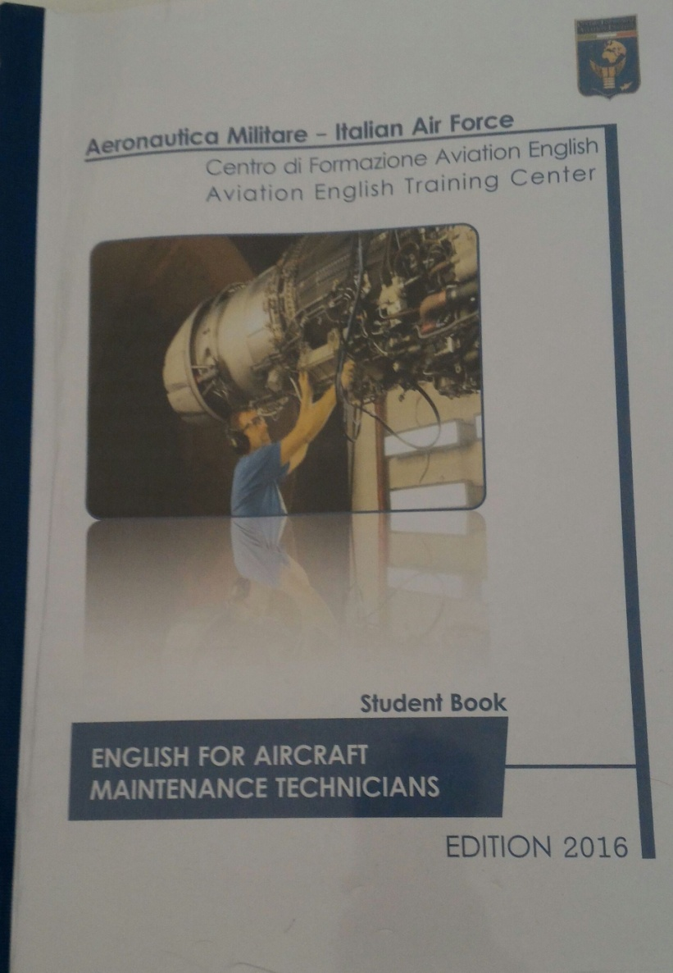

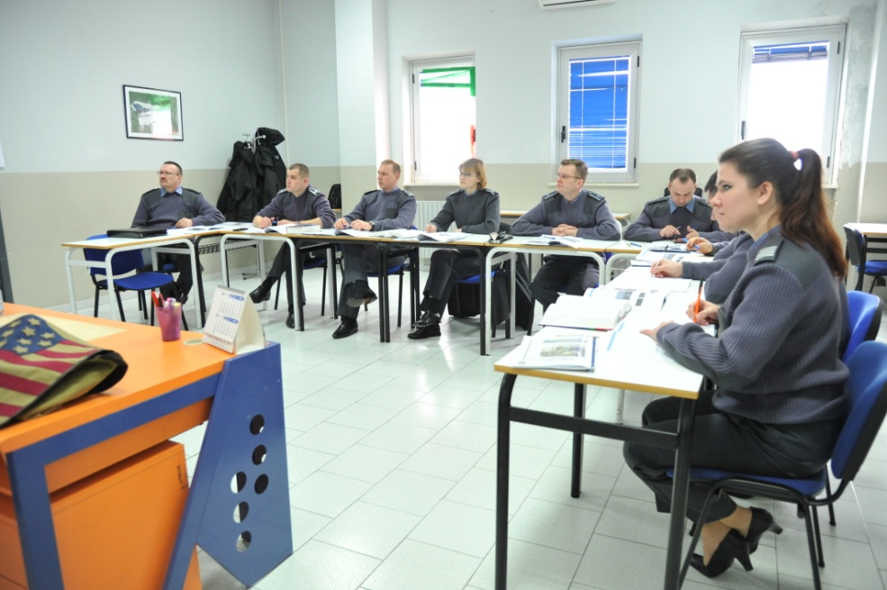

FUTURE DEVELOPMENTS
ITALIAN AIRFORCE
27

Slide 28
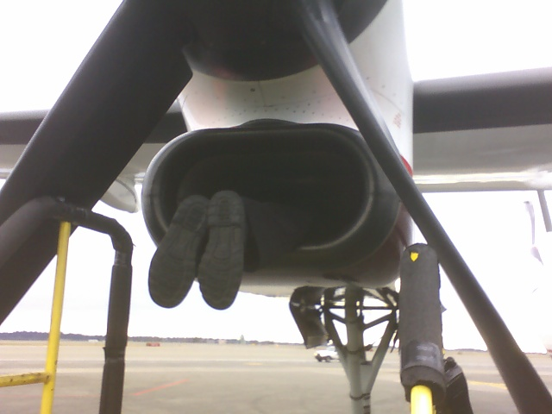
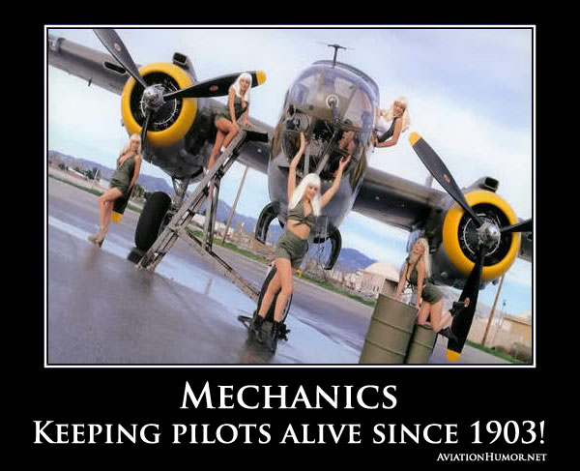
QUESTIONS will not be answered now!!!
ITALIAN AIRFORCE
28

