Slide 1

National Defense Academy
Language Training School
2017

Slide 2
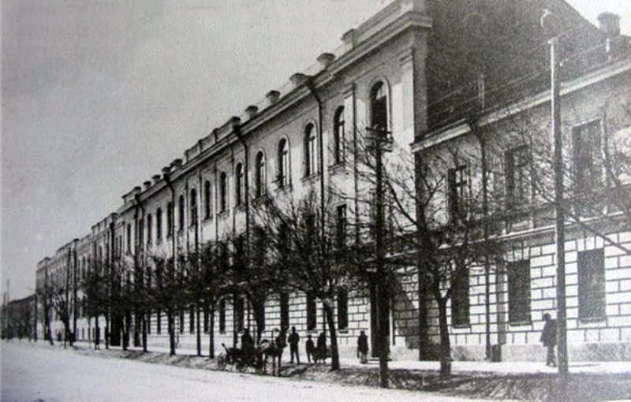
National Defense Academy
1862

Slide 3
School Structure
Chief of School
Deputy Chief of School
Language Departments
3 Testing Specialists
3 Administrative Support Specialists
School Sergeant
Librarian
English Language Course
2 Senior Teachers
German Language Course
Russian Language Course
Turkish Language Course
French language Course
Persian Language Course

Slide 4


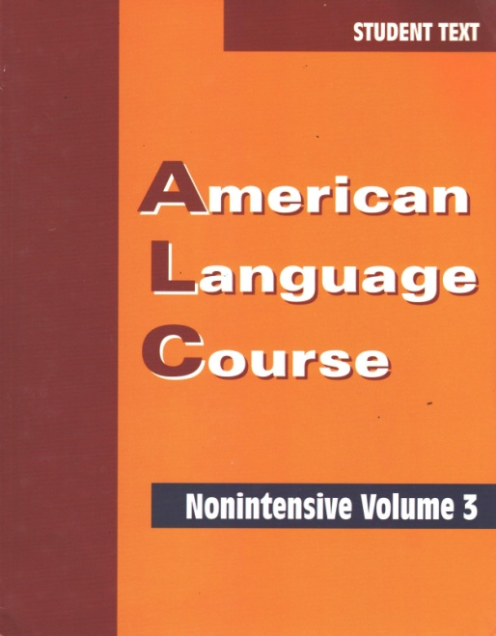
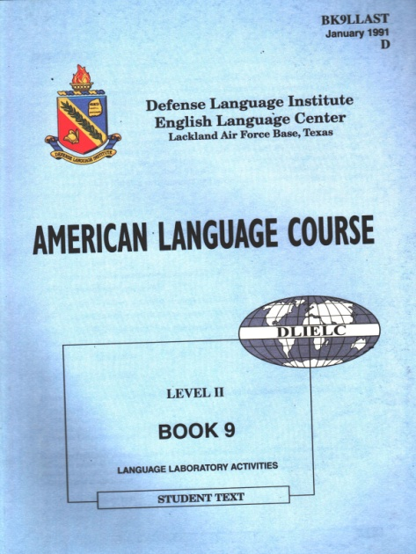
Previously Implemented English Language programs
American Language Course –Intensive Course
American Language Course–Non -Intensive Course

Slide 5


Ongoing English Language programs
American Language Semi-Intensive Course
(ALC Intensive Course Book 1 through Book 20)
  Duration - 52 training weeks
  Contact hours -802 (15 hours per week)
  Tests : Book Quizzes
    Final exam (ALCPT Test; Speaking Exam)
Resolute Support Mission Intensive Course
(Campaign 1, 2; Command &Control)
  Duration – 28 training weeks
  Contact hours -534 (20 hours per week)
  Tests : Campaign quick and midterm tests
    Final exam –Campaign End-of –Course Test (4 skills)

Slide 6



Revamping Programs
Intensive English Language Course-Level I
(American Language Course + Skillful)
Intensive Courses
Intensive English Language Course-Level II
(American Language Course + Skillful)

Slide 7

Revamping Programs
Intensive English Language Course-Level I
ALC (Book 1 through Book 18)/Skillful Foundation; Level 1
Duration -36 training weeks
Contact hours -870 25 hours per week:
Tests &Quizzes -30 hours
  18 hours - ALC book quizzes
  7 hours – Skillful speaking/writing tests
  1 hour – Midterm ALCPT test
  4 hours – Final exam
20 hours –ALC
5 hours - Skillful
Intensive English Language Course-Level II
ALC (Book 13 through Book 30)/Skillful Level 1; Level 2
Duration -36 training weeks
Contact hours -868 25 hours per week:
Tests &Quizzes -32 hours
  18 hours - ALC book quizzes
  8 hours – Skillful speaking/writing tests
  1 hour – Midterm ALCPT test
  5 hours – Final exam
20 hours –ALC
5 hours – Skillful

Slide 8
Pre-Launching Phase
Consultations with National Defense Academy Administration Representatives and Quality Management Department
4 Day Skillful Training Conducted by English Book in Georgia
Optimizing Infrastructural Resources of the Language Training School

Slide 9

Q u e s t i o n s

