Slide 1
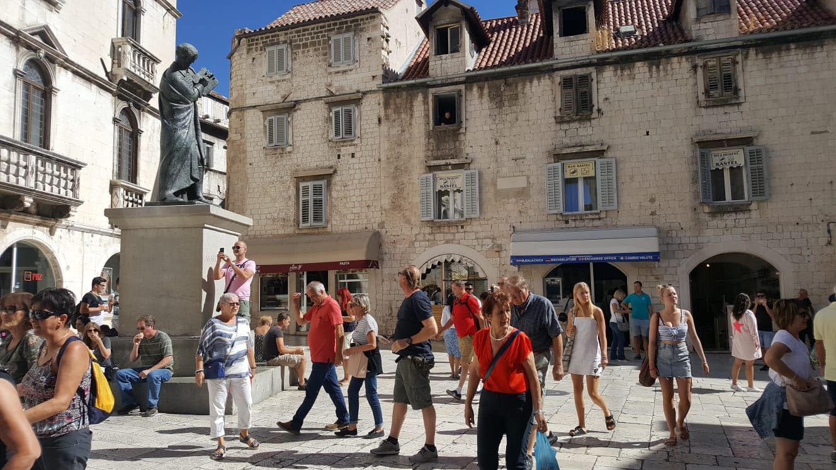
Fruit square

Slide 2
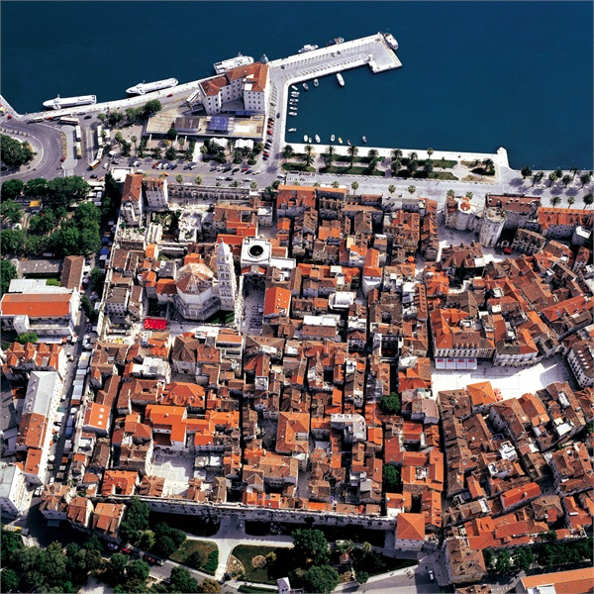
Fruit square - location
Near Diocletian’s Palace - west
It was market where women from the surrounding villages came to sell their fruit
Square of the Radić brothers

Slide 3
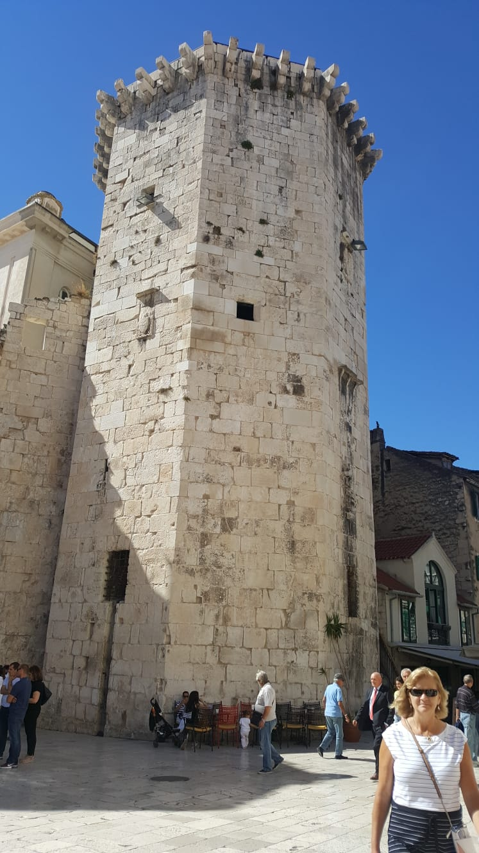
Fruit square - famous buildings and monuments
The biggest is the octagonal Venetian tower
It was built in the 15th century for the defense of the Split

Slide 4
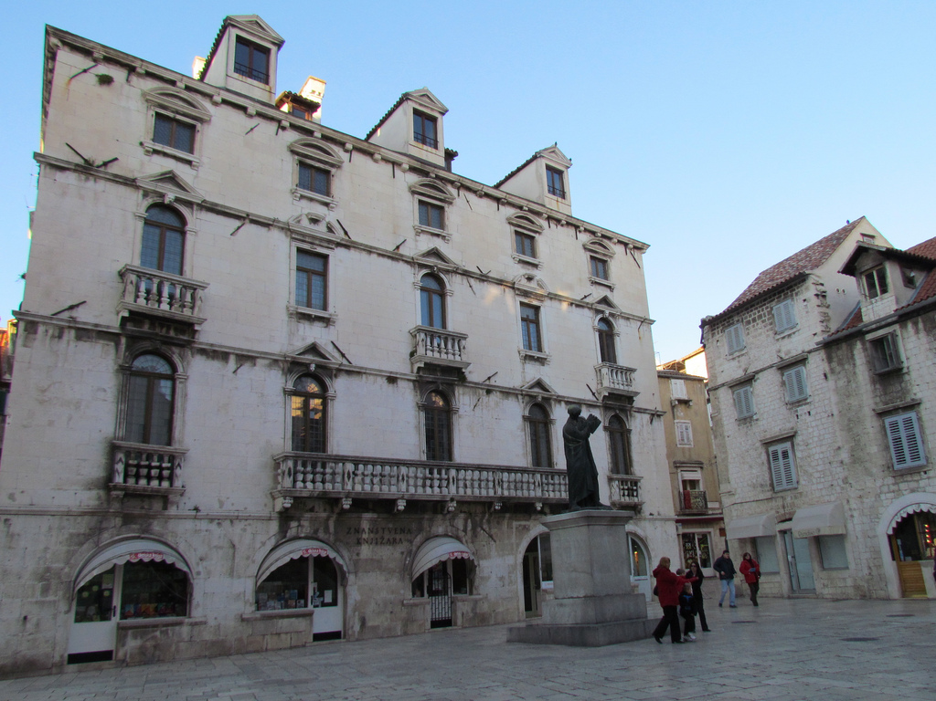
Fruit square - famous buildings and monuments
Palace of the old family Milesi from the 17th century with a Baroque facade
It’s one of the best examples of that style in the whole of Dalmatia

Slide 5
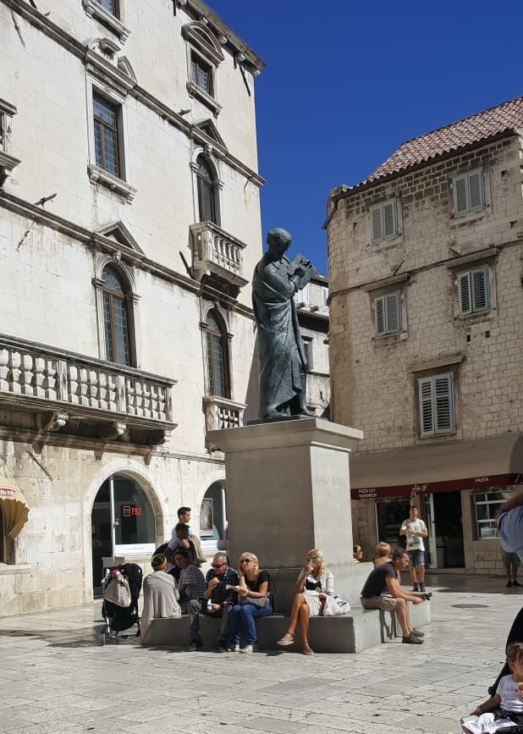
Fruit square - famous buildings and monuments
Statue of Marko Marulić
MM is father of the Croatian literature, the citizen of Split
He was one of the most important philosophers and intellectuals of the 15th century
Judita
The monument is a work of famous sculptor Ivan Mestrovic

Slide 6
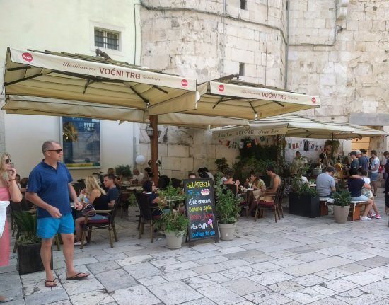
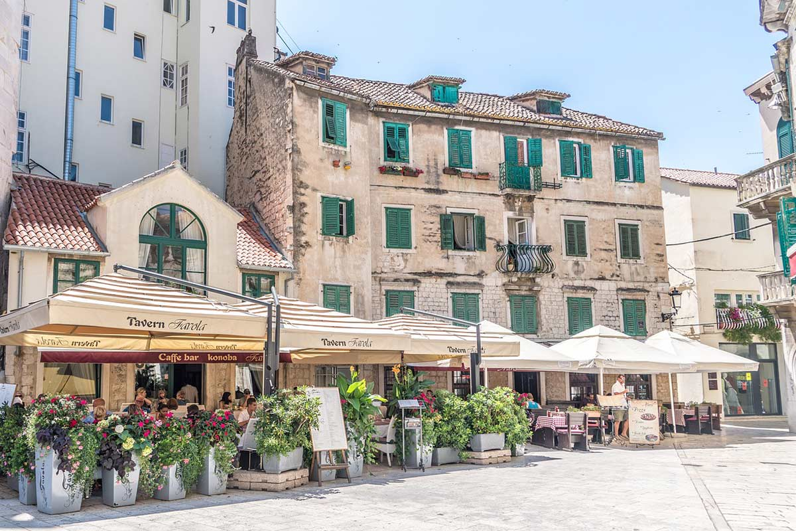
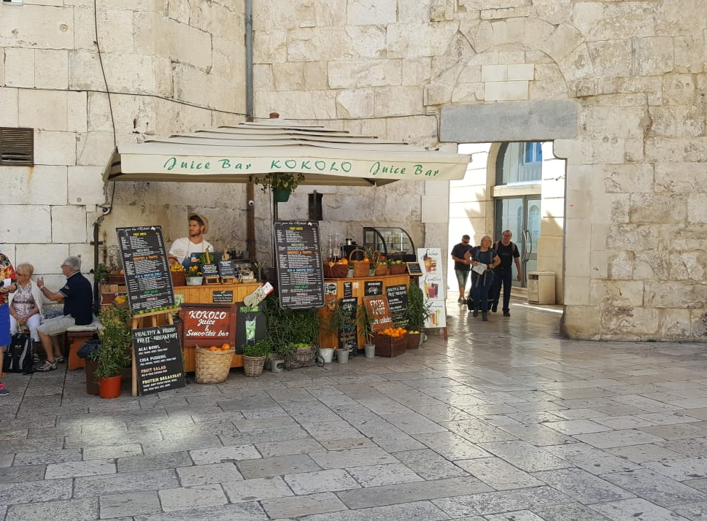
Fruit square today

Slide 7
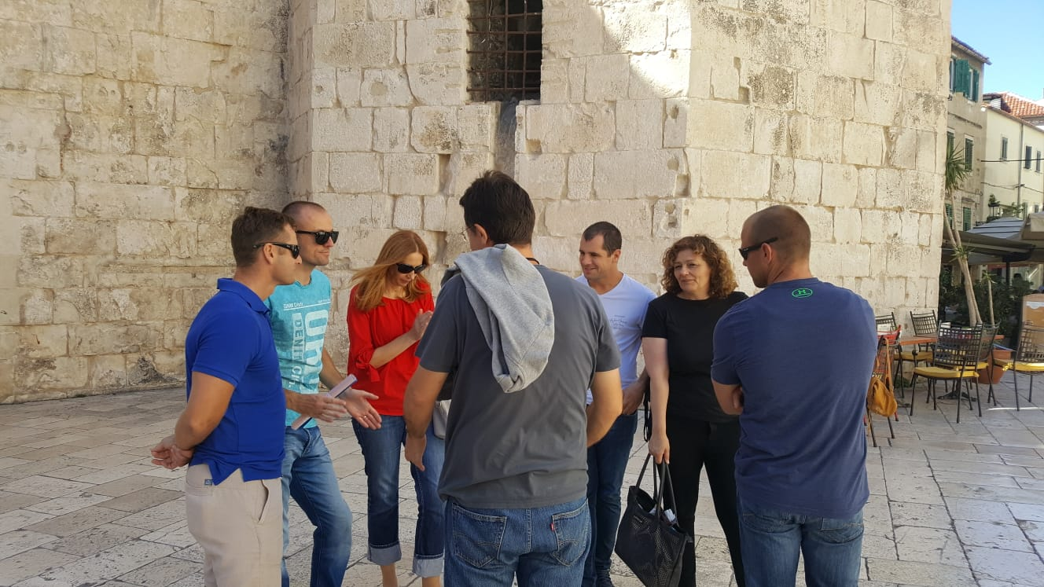
Thank you for your attention

