Slide 1


LEVEL 4 READING PROFICIENCY
A Prototype Test
Jana Vasilj-Begovic
Associate BILC Secretary, Canada
Dr. Dugald Sturges
Head of English Language Instruction, Federal Office of Languages, Hürth, Germany
Mary Jo Di Biase, in absentia
Language Testing and Assessment Specialist - Yale University, USA
Helsinki, October 2015

Slide 2

Scope of Presentation
Introduction and Background
Tutorial on Level 4 Reading Proficiency
Test Model/Prototype
Piloting Phase
Samples of Performances
Challenges and Way Ahead

Slide 3

“He who speaks at level 4 at all times has no friends.”
Dr. Dugald Sturges

Slide 4
Introduction and Background
Formation of Working Group on Level 4
Work accomplished:
Paper: “A Conceptual Model and Implications for Testing”
Article: “Defining and Assessing Level 4 Proficiency” Chapter 10 in “Language in Uniform”, Cambridge Scholars 2015

Slide 5
Working Group Members
J.Vasilj-Begovic – Leader (CAN)
G. Seinhorst – Co-leader (NLD)
Members:
P.Georgieva- BGR
N. Powers & M. Tan - CAN
K. Kildevang & A. Juhl Christiansen - DNK
Dr. D. Sturges – GER
M. Adubato- SHAPE
A. Nolan & K. Farr - SWE
P. Garza, David Oglesby and Dr. R. Clifford, USA
Special Consultants:
Mary Jo Di Biase, Dr. M. Herzog, USA

Slide 6

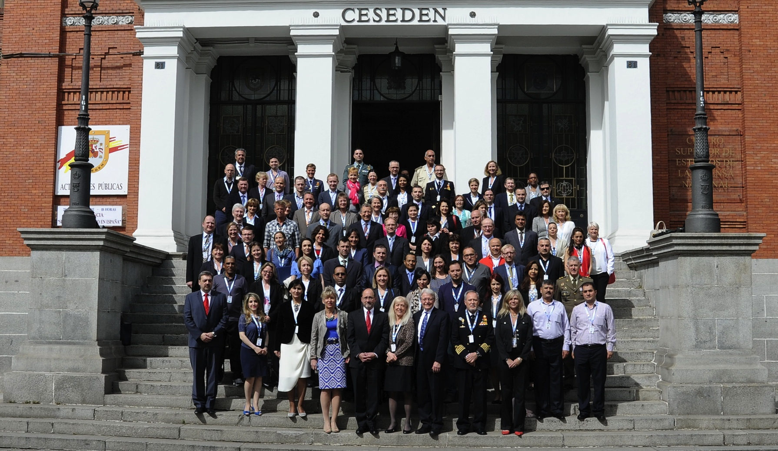





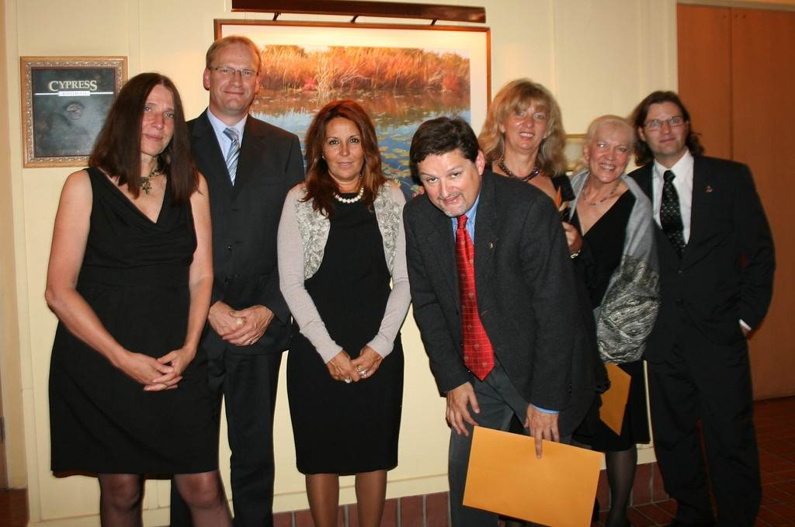
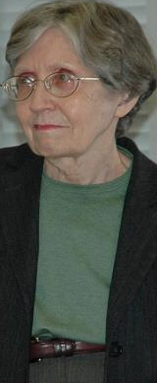


Slide 7
Tutorial on Level 4 Reading Proficiency
INTRODUCTION
LEVEL 4 PROFICIENCY AND ITS INTERPRETATION
PRINCIPLES OF TEXT RATING
SAMPLE TEXTS
TEST DEVELOPMENT PROCEDURES
SAMPLE ITEM DEVELOPMENT PROCEDURES

Slide 8
Tutorial on Level 4 Proficiency
Descriptor IAW STANAG 6001
Demonstrates strong competence in reading all styles and forms of the written language used for professional purposes, including texts from unfamiliar general and professional-specialist areas. Contexts include newspapers, magazines, and professional literature written for the well-educated reader and may contain topics from such areas as economics, culture, science, and technology, as well as from the reader’s own field. Can readily follow unpredictable turns of thought on any subject matter addressed to the general reader. Shows both global and detailed understanding of texts including highly abstract concepts. Can understand almost all cultural references and can relate a specific text to other written materials within the culture. Demonstrates a firm grasp of stylistic nuances, irony, and humour. Reading speed is similar to that of a native reader. Can read reasonably legible handwriting without difficulty.

Slide 9
Tutorial on level 4 Proficiency
Text Rating
Author Purpose | Typical Text Type | Reader Purpose
Project lines of thought beyond the expected, connect previously unrelated ideas or concepts, and present complex ideas with nuanced precision and virtuosity – often with the goal of propelling the reader into the author’s world of thought | Extended discourse that is tailored for the message being sent and for the intended audience. Texts are highly individualized, abstract, innovative and culturally dense, and may contain abstract metaphors and symbolism, and unpredictable shifts in thought, tone and register. To achieve the desired tone and precision of thought, the author will often demonstrate the skillful use of low-frequency, subtle and nuanced vocabulary, cultural and historical concepts, and an understanding of the audience. Examples: articles from the fields of military philosophy/ethics, literary criticism, treaties, policies, professional literature, politics, economics, etc. | Read “beyond the lines”, to understand the author’s sociolinguistic and cultural references, follow innovative turns of thought, and interpret the text in view of its wider cultural, societal, and political setting.

Slide 10
Level 4 texts…
(Child: 1998)
Share little background or information
Novel or creative approach to rethinking and verbalizing solutions
Highly individualized texts
Belles-lettristic material, think pieces, philosophical discourses, technical papers, etc.
Reflect unfamiliar cultural values or highly idiosyncratic language behavior
“Op-ed” columns … sophisticated humor occasionally found in the media…”

Slide 11
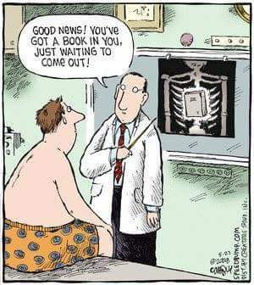
Giving the Author His Purpose

Slide 12
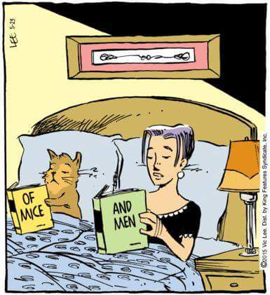
Giving the Readers Their Purpose

Slide 13
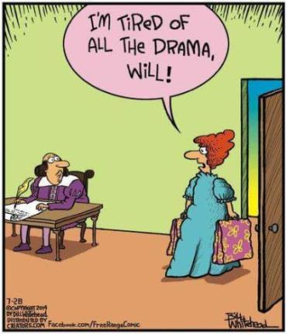
Author Purpose Misunderstood

Slide 14
4
Highly individualized, abstract,
innovative and culturally dense
3
Multiple-paragraph texts on abstract subjects or arguing a point of view
2
Factual paragraph-length texts with a predictable organization

Slide 15
Tutorial on Level 4 Proficiency
What the Reader Can Do
Level 3 | Level 4
Understands formal and informal language, for most everyday social and work-related situations Understands language relating to abstract concepts and hypotheses Can understand literal and figurative meaning, and implied meaning (“between the lines”) Understands the author’s tone and intent, including humour and irony, but may not fully understand some allusions, as well as implications of many nuances and idioms | Understands highly sophisticated language appropriate for almost all topics and social as well as professional situations Shows a firm grasp of various levels of style and understands subtle nuances and shades of meaning. Understands meaning, “beyond the lines”. Follows innovative turns of thought Understands the author’s socio-linguistic and cultural references. Understands idiomatic expressions, figures of speech and colloquialisms

Slide 16
Tutorial on Level 4 Proficiency
Text Modes
LEVEL 3 – EVALUATIVE MODE | LEVEL 4 – PROJECTIVE MODE
Texts often contain facts used to provide analysis, commentary, personal views, apologies, justification, advocating a course of action, arguing a side of issue, for example editorials in newspapers for educated readers are often written at this level Analysis and evaluation of issues take place against a backdrop of shared information Tone | Texts are abstract and culturally dense; syntax used with virtuosity; rhetorical devices apparent Novel approach to treating topics/issues Individualized or culture-specific forms of discourse, abstract metaphors, and symbolism Unpredictable turns of thought; author’s approach to shared knowledge is unique Tone

Slide 17
Tutorial on Level 4 Proficiency
Higher Order Thinking Skills
Synthesizing
&
Analyzing
Inferring
Evaluating
& Appreciating

Slide 18
Tutorial on Level 4 Proficiency
Sample Paragraphs
For one thing, the posture of the literary mind seems these days to be dry, angry, smart, jeering, cynical; as though once people had discovered the sneaky joys of irreverence they were quite unable to stop. This is one typical process of Shakespeare’s tragedies, where the intelligent and crafty young destroy the stupid old and, with them, the sacred something that these complacent dodos by some accident had in their charge, and the intelligent and crafty young, at last, as Ulysses says, eat up themselves. This symptom in itself is perhaps not much. Literary quarrels have usually been acrimonious, indeed are less personally spiteful now than in the Age of Pope. The world has always been as full of people plugging their friends as of people unplugging their enemies. Yet the public discussion, the criticism that attends on poetry, has appeared to me as coming close to the point at which a smart shallowness and verbal facility will jettison meaning altogether; the same thing has been happening in poetry itself. I shall not now give examples, but I ask you to consider whether it is not as I have said. Not only the terms of abuse, but more importantly the terms of praise, appear in a language whose vagueness of sense is closely related to the extravagance of its claims.

Slide 19
Tutorial on Level 4 Proficiency
Sample Question/Response
Q: According to the author, what are the ramifications of the “sneaky joys of irreverence?
R: The author has noticed a change in the nature of what he calls the “literary mind”. These changes are reflected in a display of negative attitudes toward literary works, especially poetry. Even though, literary fights have always existed, the poetry critics are using such vacuous language that their criticism of poetry obliterates its very meaning.

Slide 20
Test Model/Prototype
Reading is tested via speaking
Format: two texts of ca.1400 words ea.
Several questions per text: scripted Core and Follow-up questions
Administration: face to face or telephonic (ideally 2 testers)

Slide 21
Administration Protocol and Rating Procedure
Twenty min. per text (changed to 30 min)
Texts are broken down into paragraphs to facilitate reading
Examinees see Core but not Follow-up questions
Note-taking allowed, but not dictionaries
Responses are oral and are recorded
Testers ask follow-up questions at their discretion
Not all follow-up questions are scripted
Testers rate independently
Responses are rated as Successful/Partial/ Unsuccessful
21/40
Notes:
Reading time given to examines increased from 20 to 30min.
Some Follow up questions are scripted and some are spontaneous used by testers as encouragers to probe for more evidence of L4 comprehension

Slide 22
Rating Criteria
SUCCESSFUL: The examinee addressed the task and in his/her answer captured the ideas expressed in the Sample Response. The answer was elaborate and reflected the speech consistent with Level 3/Level 4 speaking descriptor IAW STANAG 6001. Using abstract and precise language, the examinee provided an answer that fully or almost fully corresponded to the ideas expressed in the Sample Response.
PARTIAL: The examinee’s answer did not fully address the task or capture the ideas conveyed in the Sample Response. Even though the answer was delivered with Level 3/Level 4 language, its content only partially corresponded to that given in the Sample Response.
UNSUCCESSFUL: The examinee’s answer deviated in most parts from the information contained in the Sample Response showing a lack of comprehension of the text. In spite of the follow-up questions, the answer was not satisfactory in demonstrating comprehension.
NOTE: An answer delivered with Level 2 language is automatically considered UNSUCCESSFUL.

Slide 23
Piloting Phase
Eight trial tests administered:
One Danish officer
Two civilians (1 Mongolian, 1 Portuguese-Canadian)
Three officers at ACT, Norfolk (1 Czech, 2 Germans)
Two officers at BSprA, Germany
Ratings (7 raters):
Four considered PASS (representative of Level 4 proficiency)
23/40

Slide 24
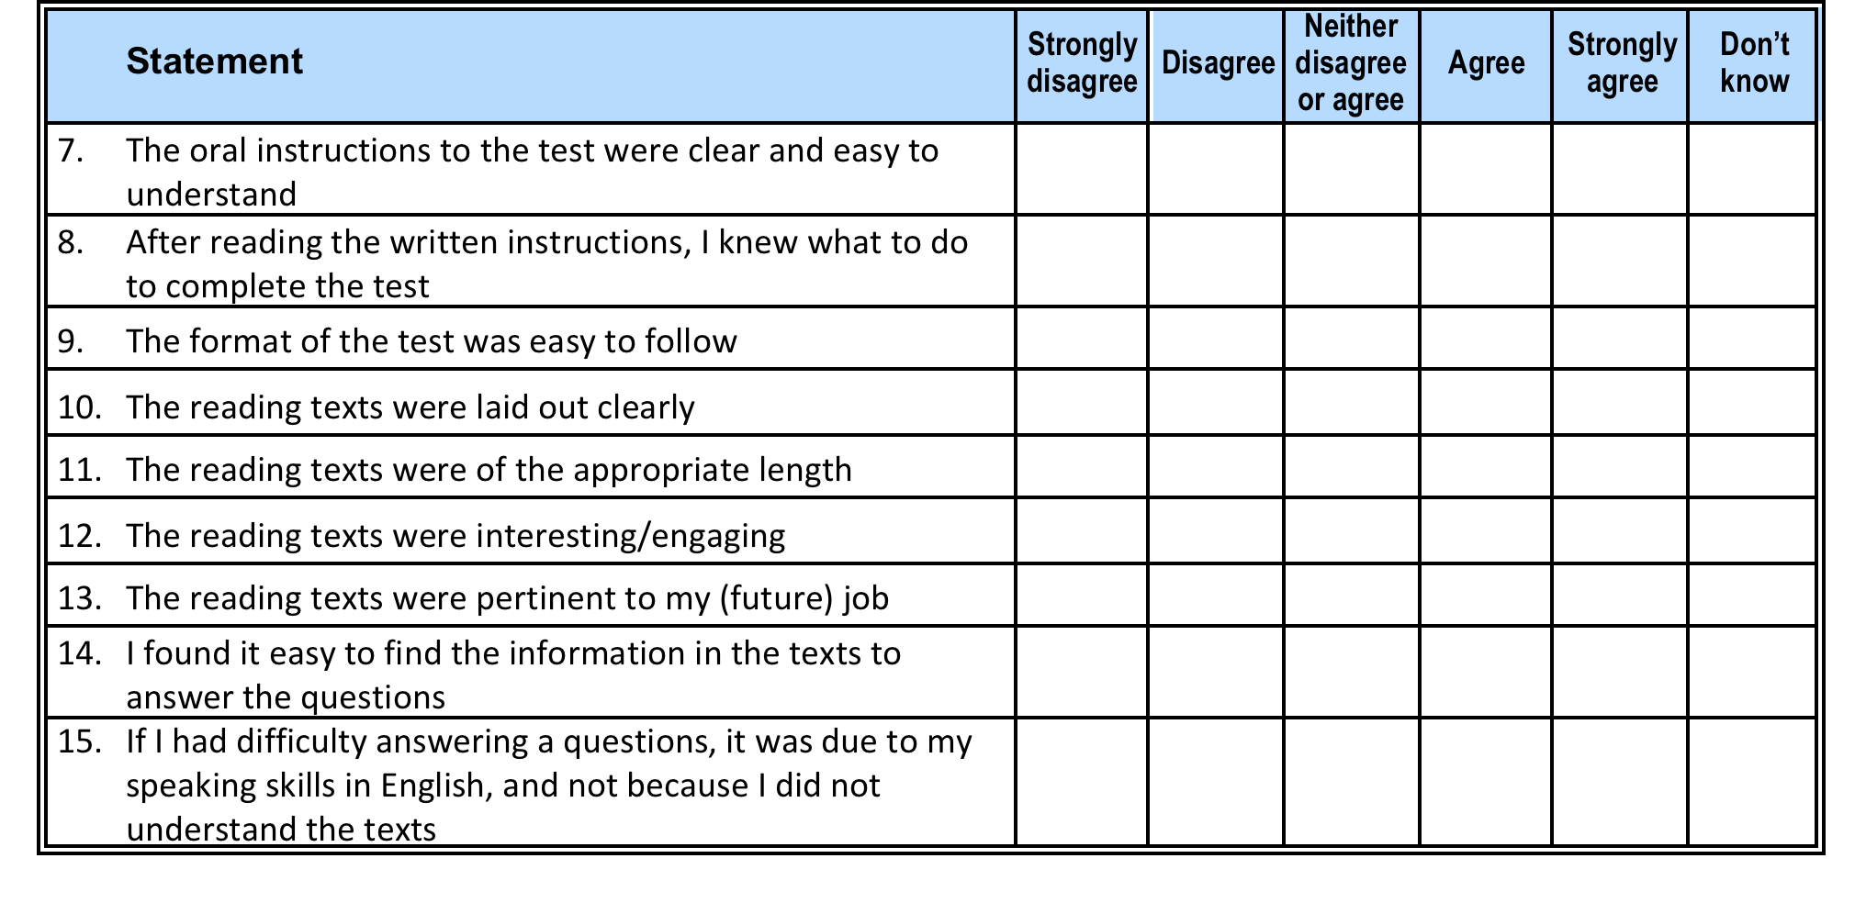
Feedback questionnaire
Notes:
Along with biodata questions to collect profile information about candidates and their proficiency as well as feedback on the test.

Slide 25
PERFORMANCE SAMPLES
Excerpt from Text
The word “norm” seems to have crawled out of the swamps of sociologese, and into the public conversation, almost becoming the word of the week. Right now, it’s a way of saying that following (or fixing) a law isn’t enough: to do the right thing you have also to follow the unwritten rules, the accepted underlying practices, the norms, of societies and institutions. The Times’s David Brooks, in praise of a new book by the Harvard professor Robert Putnam, wrote a column recently arguing that we can’t solve the problem of poverty with cash handouts and good government alone – the social norms of the poor have to change, or be changed, first. Those social norms, like the expectation that, having made a woman pregnant, a man should marry and support her, are, Brooks writes, more important than any other element in making poor people rich, or at least richer.
25/40
Notes:
Dugald reads aloud

Slide 26
Performance Samples
Test Item
Task: To read beyond the lines and to relate ideas from the text to a wider social, cultural and historical context
Prelude Q: To what extent does the concept of the social contract inform this author’s discussion? Explain.

Slide 27
Performance Samples
A Sample Response
The social contract is an implicit agreement between members of a society to cooperate for benefit or welfare, security etc. of the whole society. The role of codified laws as well as unwritten norms the author discusses fits within the concept of the social contract, that is, a society members’ willingness to observe not only the written rule of law, but also the unspoken or unwritten practices in order to contribute to the stability and welfare of society. This contract can be breached not only by violating the law, but also by disrespecting the customs that a society considers as moral and expected behavior of its members.

Slide 28

PERFORMANCE SAMPLES
Examinee Response
Q: To what extent does the concept of the social contract inform this author’s discussion? Explain.
28/40

Slide 29
PERFORMANCE SAMPLES
Excerpt from Text
Conceptual trinities are inherently problematic, but especially in the context of contemporary American politics and policy. It is difficult enough to convey the meaning and implications of any single idea. But the world in which we actually operate is, despite what partisans and fundamentalists of various stripes like to pretend, never the simple unfolding of any one concept or force. Unfortunately, expanding a discussion even to two coexisting or contending ideas requires a philosophical leap into the obscure realm of “dialectical thinking”– especially if one’s purpose is more sophisticated than seeking merely to eliminate one of the two options or to split the difference. Attempting to adjust to the complex situation routinely created by the ongoing collision of two real-world facts thus makes one, in modern parlance, a “hopeless flip-flopper.” Juggling the meaning and implications of three interacting realities makes even splitting the difference obnoxiously difficult and is utterly beyond the pale of acceptable political analysis. As famed political strategist James Carville notes, “If you say three things, you say nothing.” This contemporary reality makes sensible thought impossible, so we will ignore it in this paper.
29/40

Slide 30
Performance Samples
Test Item
Task: To understand an aspect of the author’s argumentation
Q: What argument does the author want to illustrate, and I quote again, by mentioning, “the obscure realm of dialectical thinking”?

Slide 31
Performance Samples
Sample Response
The author emphasizes the inherent challenge of discussing any conceptual trinity in light of the fact that even a discussion of two contending or conflicting ideas is already riddled with difficulties and represents a huge leap into the dialectical thinking, especially if the goal is not merely to obliterate one idea over the other. In the light of that juggling, as he says, discussing three concepts at the same time in order to analyze or explain phenomena becomes a very complex endeavor.

Slide 32

PERFORMANCE SAMPLES
Examinee Response
Q: What argument does the author want to illustrate, and I quote again, by mentioning, “the obscure realm of dialectical thinking”?

Slide 33
CHALLENGES AND THE WAY AHEAD
Test development
Validity argument (construct and face validity, reliability?)
Parallel versions (texts and questions)
Sources of suitable texts
Online collaboration

Slide 34
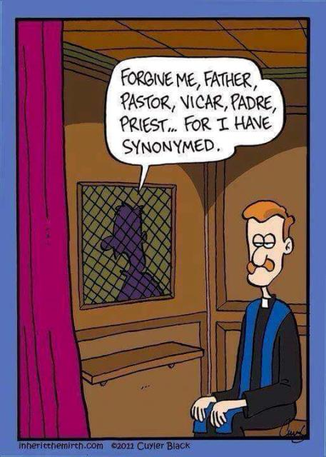
Notes:
If you laugh, we know you are still awake.

Slide 35
CHALLENGES AND THE WAY AHEAD
Piloting Phase
Trialling via writing?
Correlating results?
Finding enough candidates for statistically significant samples
Constructing questions that do not test background knowledge
Resolving weaknesses in the rating/scoring procedure

Slide 36
CHALLENGES AND THE WAY AHEAD
Scoring Criteria
Interpreting/Comparing examinee responses to sample ones
Revising the scoring criteria (e.g. what do partial responses mean and how to treat them)
Establishing cut-off scores through angoffing

Slide 37
CHALLENGES AND THE WAY AHEAD
Practicality and Other Issues
Mode of administration?
Use of dictionaries to reflect authentic language use situation?
Number of texts? Questions?
Choice of topical areas?
Rater norming?
Angoff model? Which version?

Slide 38
Way Ahead
Developing more items
Continuing trials
Conducting a norming session at PLTCE, Germany (2016):
  Applying Retrodictive Modelling Approach (RMA)
  Angoffing texts and items
  Assembling more test versions
Releasing the Tutorial and the test to nations
Developing a Prototype test in the listening skill.

Slide 39
References
1. Alschuler, C. and N. Moussa. Testing Reading at ILR Levels 4, 4+ and 5: A Tester Training Model (unpublished paper).
2. Child, J.R. (1998) Language Proficiency and the Typology of Texts, Foreign Language Annals. 31:3, pp. 381-391.
3. Lowe, Pardee, Jr. (1988) The Unassimilated History In Lowe, P. & Stansfield, C.W. (Eds) Second Language Proficiency Assessment: Current Issues. Englewood Cliffs, NJ: Prentice Hall Regents.

Slide 40
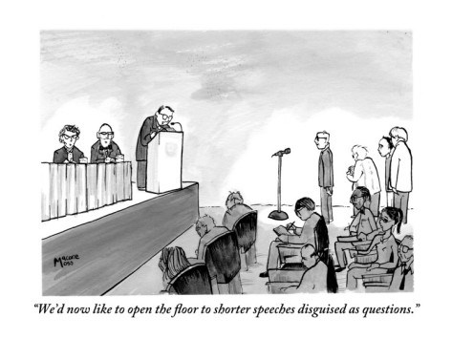
Thank you!

