Slide 1




Partner Language Training Center Europe
(PLTCE) at
George C. Marshall European Center for Security Studies
Standardized Interpretation Techniques Training
David Oglesby
Tbilisi
October 2017
www.marshallcenter.org

Slide 2
What is the Applied Consecutive Interpretation Techniques Workshop?
Applied Consecutive Interpretation Techniques (ACIT) is a two-week workshop designed, primarily, for partner-nation English-language teachers who are occasionally required to act as consecutive interpreters for their organizations. Integrating theory, principles, and concepts of consecutive interpreting with practical application and skills development, the workshop aims to assist individuals in developing introductory-level competencies, skills, knowledge, and attitudes required of informal (lay) interpreters.

Slide 3
Why Develop ACIT?
Language professionals (especially language teachers) are called upon from time to time to interpret for a supervisor, manager, or senior leader within his/her organization.
  The need can arise at any time and at a moment’s notice.
  Settings could include working lunches, small groups, and field trips.
The organization can have greater confidence in the ad hoc interpreter’s abilities
The ad hoc interpreter can have greater confidence in his or her own abilities

Slide 4
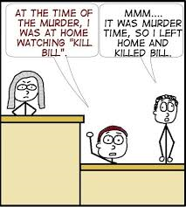
Intended Message?

Slide 5
ACIT Instructional Design
Analysis: determine target audience; review desired outcomes; & consider training setting/context
Design: combine theory, concepts & practical application; focus on skills essential for effective interpreting; use scenarios for interpreting exercises; engage 4 same-language participant pairs
Development: Danish team developed subject-matter presentations & memory-improvement exercises; Finnish team developed realistic scenarios with a variety of simulated events
Implementation: Pilot version of the workshop 8 – 17 August 2017; facilitators organized materials & prepared teaching notes
Evaluation: participants benefit from peer & facilitator feedback, as well as self-assessment; end-of-course questionnaire for workshop improvement
Notes:
Systems Approach to Training

Slide 6
Survey Monkey: A Needs Analysis
A December 2016 survey of stakeholders yielded some preliminary findings:
Language teachers are regularly called upon to interpret (85%)
The Applied Consecutive Interpretation Techniques course should be 2-3 weeks in length (65%)
The best time of year for training would be 3rd quarter (60%) or 1st quarter (40%)
Language teachers interpret consecutively, including whispering method (90%)
Survey respondents consider such a course worthwhile (95%)
Organizations support sending two participants at a time (70%)
Few countries have potential facilitators for the course

Slide 7


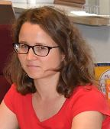
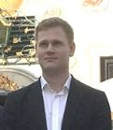
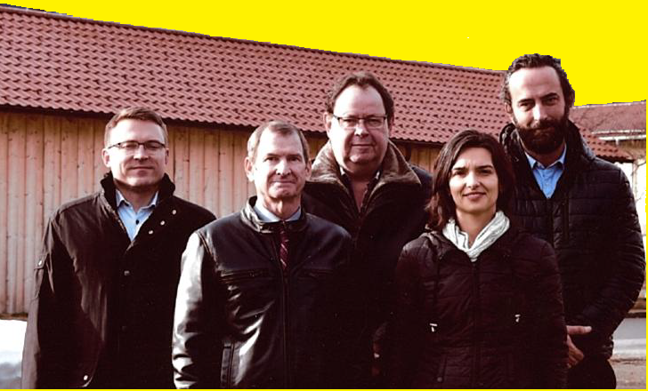
Who Developed ACIT?
Laura Murto
(FIN)
Capt Benjamin Rømer
(DEN)
Jari Nummenpää (FIN), David Oglesby (PLTCE), Claus Mathiesen (DEN), Daniela Velikova-Alieva (BUL), Armend Berlajolli (KFOR)

Slide 8

Theories & Concepts
Interpretation is more than just the sum of listening, analysis & production
A good memory & effective note-taking are an interpreter’s best friends
Interpreting is not the same as translating
Interpreters prefer to work from target to native language (or not)
Despite the visual aid, sight translation can be quite stressful

Slide 9
Skill Building
ACIT participants practice memory-improvement techniques on a daily basis.
  Short-term memory drills focused on the quantity of elements memorized and the quality of information recalled
  Long-term memory improvement strategies included mental archiving and mind mapping to help create order, relieve stress & strengthen concentration
Workshop participants develop individualized note-taking techniques
  What to annotate: rheme, numbers, names, sequences…
  How to annotate: vertically on notepad, use symbols/abbrs/few words
  Why annotate: fewer omissions from source/fewer additions to source
  When/where to annotate: almost always & almost anywhere

Slide 10
Scenario-Based Practical Application of Interpreting Skills
Activities designed to reflect real-world interpreting tasks
Scenario tracks an envisaged visit of a partner-nation military delegation to the interpreter’s home organization
Six-day visit includes a variety of events:
  Arrival, greetings & introductions
  Structure of military organization
  Visit to a military academy
  Dinner with speech & small talk
  Attendance at a local cultural event
  Regional security briefing
  Visit to a military unit
  Visit to a military museum/memorial
  Equipment display
  Formal lunch with speeches
  Farewell ceremony with discussion of future cooperation

Slide 11
Ethics of Interpretation
Observe norms of professional conduct & dress
Accept assignments according to competence
Act as a bridge for intercultural discussions
Respect the confidentiality of clients
Maintain a position of neutrality
Render accuracy & complete interpretations
Mind the role boundaries of an interpreter

Slide 12
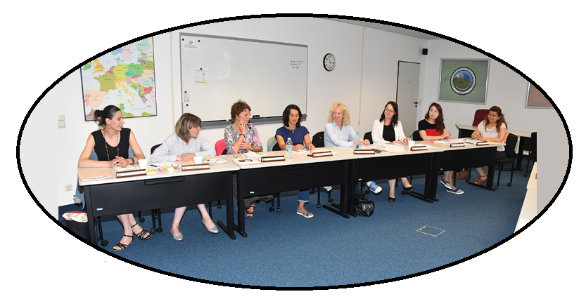

Pilot Participants in Language Pairs
საქართველო
Teona & Maya
Slovenija
Tamara & Vlasta
България
Bilyana & Daniela
Azərbaycan
Gulnar & Zamina

Slide 13
Workshop Program – Week 1
Ses-sion | Tuesday 8 August | Wednesday 9 August | Thursday 10 August | Friday 11 August
1 | A1 Introduction A2 Administrative Remarks A3 Get-to-know activity | SM3 Differences between translation & interpretation SM4 Note taking | SM5 Stages of interpretation SM6 Direction of interpretation WU1 Memory building & Note taking | SM7 Difficult elements of speech/lexicon SM8 Techniques for dealing with them WU2 Memory building & Note taking
2 | SM1 General introduction to interpreting | GS1 Arrival; introductions; administrative remarks; program outline | MS2 Visit to military academy; military educational system; career & benefits | GS3 Civilian museum/cultural event
3 | SM2 Short Memory training - Text repetition - Sight translation A4 Guidance for peer feedback | MS1 Structure of Institutions | GS2 Dinner; speech; food; small talk; humor; hobbies, etc. | MS3 Regional security briefing & talks on current events

Slide 14
Workshop Program – Week 2
Ses-sion | Monday 14 August | Tuesday 15 August | Wednesday 16 August | Thursday 17 August
1 | SM9 Methods of preparation WU3: Memory building & Note taking | SM10 Interaction with client SM11 Cultural aspects WU4: Memory building & Note taking | SM12 Simultaneous Interpreting & Whispering Method WU5: Memory building & Note taking | SM13 Ethics SM14 Performance issues SM15 A Perfect Interpreter?
2 | MS4 Specific military technical topic | GS4 Visit to military museum & memorial | GS5 Formal lunch; speeches | A5 Guidelines for self-development A6 Course summary A7 Feedback
3 | MS5 Visit to military unit; structure; training; safety | MS6 Equipment | MS7 Further cooperation & farewell ceremony | A8 Administration (outprocessing) A9 Final wrap up A10 Graduation

Slide 15

Upcoming ACIT Workshops
2018 Schedule
Hosted by the Partner Language Training Center Europe (PLTCE)
Garmisch-Partenkirchen, Germany
13-23 February 2018
21-31 August 2018
Frequency of course offerings depends on demand and facilitator support

Slide 16
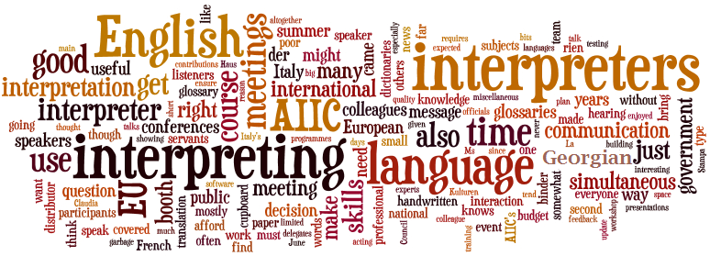
არსებობს შეკითხვები?
Are there any questions?

