Slide 1
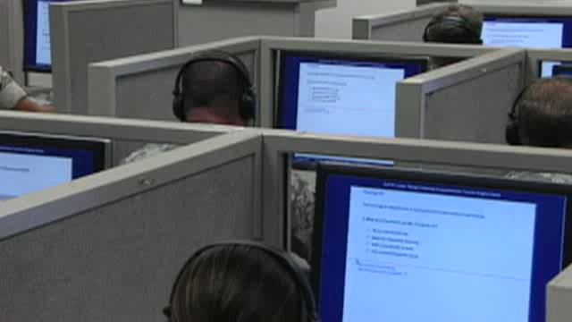
Linguistic Testing
Notes:
(Video file: 20150623_PPS5_Testing.wmv)

