Slide 1
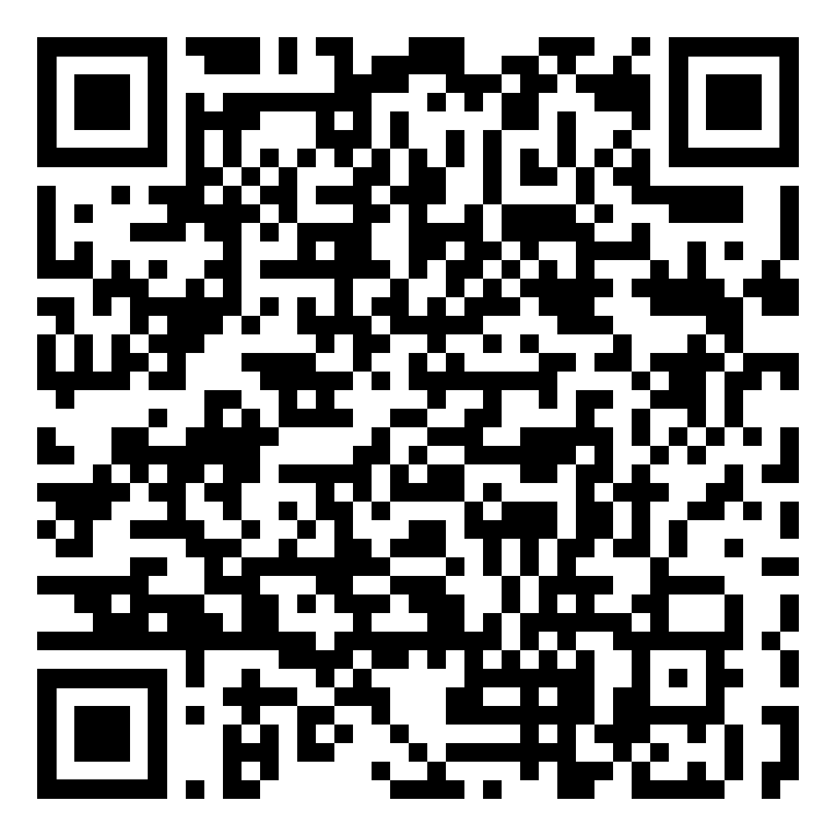
Using Debate to Teach Level 3 Language
Jennifer Bown, Department of German and Russian
Nieves Knapp, Department of Spanish and Portuguese

Slide 2
Overview
Why debate?
Characteristics of students at the 2/3 threshold
Language Proficiency and Cognition
Materials
A Tale of Two Classes
  Spanish 411
  Russian 422
Resources
Challenges of Teaching Debate
Alternatives to Debate
Practice Group Discussion with Roles

Slide 3
Why debate?
 | Functions/Tasks | Accuracy | Context/Content | Text Type
5 | All expected of an educated NS | Accepted as an educated NS | All subjects | (book)
4 | Tailor language, counsel, motivate, persuade, negotiate | Extensive, precise, and appropriate | Wide range of professional needs | (article, chapter)
3 | Support opinions, hypothesize, explain, deal with unfamiliar topics | Errors never interfere with communication & rarely disturb | Practical, abstract, special interests | Extended discourse (essay)
2 | Narrate, describe, give directions | Intelligible even if not used to dealing with non-NS | Concrete, real-world, factual | Paragraphs

Slide 4
Characteristics of Learners at 2
Imprecise vocabulary
  Calques from English
  Resort to circumlocution
Discourse reflects oral paragraph structure
  Run-on sentences
Cannot always handle abstractions and hypotheses
Have difficulty elaborating
(Not well informed)

Slide 5
Language Proficiency and Cognition
  Creation through refined use of professional, literary, and rhetorical skills.
4/5
  Evaluation and synthesis of concepts needed to produce and understand abstract ideas, complex arguments, and hypothetical discussions.
3
  Analysis and explanation of real-world relationships using paragraph-length communications.
2
  Application of language skills to routine interpersonal communication scenarios.
1
  Memorization / Comprehension of disjointed words and phrases.
0

Slide 6
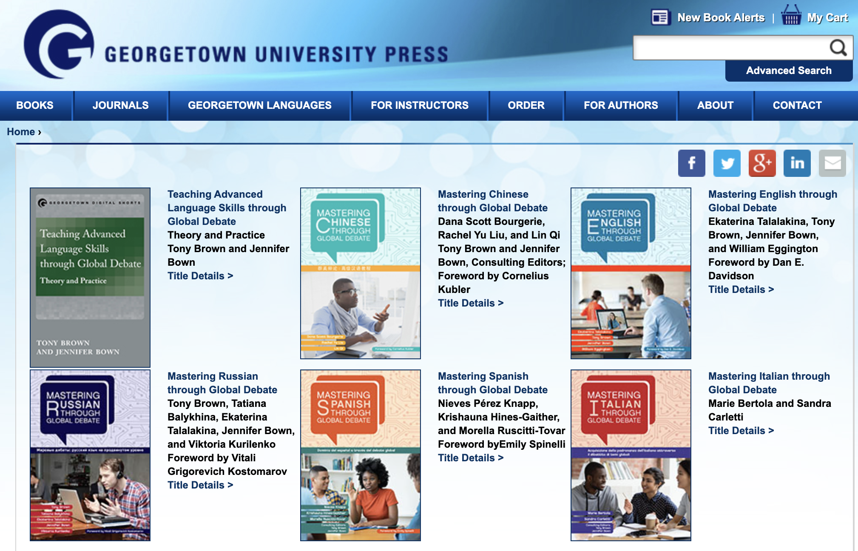
Materials
Mastering Languages through Global Debate
English
Russian
Chinese
Italian (2023)
Spanish (2023)
Arabic (forthcoming)
French (forthcoming)
German (forthcoming)

Slide 7
Materials
Mastering Languages through Global Debate
Topics:
1. Environment vs. Economy
2. Interventionism vs. Isolationism
3. Wealth Redistribution vs. Self-Reliance
4. Cultural Preservation vs. Diversity
5. Security vs. Freedom
6. Education vs. Field Experience

Slide 8
Rhetorical Strategies
Conjecture Argument (What if...? questions): What would happen if we gave top priority to economic development all the time in all situations?
Definition questions: What does “environment” mean? Are humans as much a part of the “environment” as animals and the weather?
Cause and consequence questions: What are the likely results of an increase in global temperatures?
Value questions: Do human beings have a responsibility to protect the environment, such as the Brazilian rainforest, even at the expense of improving human life?
Procedural questions: How do we develop an approach to sustainability that both protects the environment and helps nations develop economically?
Source: Mastering English through Global Debate, p. 25

Slide 9


A Tale of Two Classes
Russian 422
Spanish 411

Slide 10
Russian 422
Characteristics of the students
  Majors: Russian (secondary major), various: Business, Engineering, Psychology, etc.
Supporting Assignments
  Recreating oral texts, Monologues, Personalized Goals, LASER, Argument summaries, Skeleton texts, Translations

Slide 11
Russian 422
Weekly homework structure
  Mondays–oral exercises (recorded using Extempore)
  Wednesdays–written exercises: translations, skeleton texts
  Fridays–debate preparation, one-on-one conversations

Slide 12

Spanish conversation classes
we offer

Slide 13
Spanish 411
Characteristics of the students
  Majors: Spanish, Latin American Studies, Spanish Translation, others (Journalism, Political Science…)
Supporting Assignments
  Newspaper Articles, Monologues, Written Summary of Both Positions, Personalized Goals, and OPIc.

Slide 14
Typical day of class
  10 minutes work in pairs - practice moving from level 2 to 3
  Textbook exercises - preparation for each topic debate or scenario
Some results
  Development of oral and presentational skills
  Use of connectors to develop paragraph length speech
  Great improvement in use of formal Spanish
  Increase knowledge of current events
  Reduction or elimination of fillers and some discursive calques of English

Slide 15
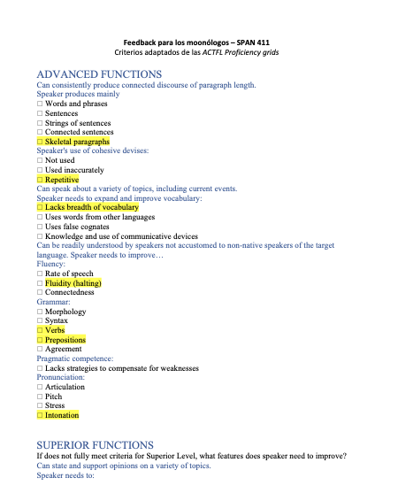
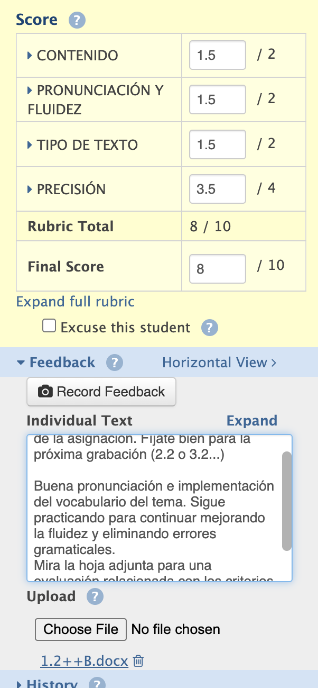
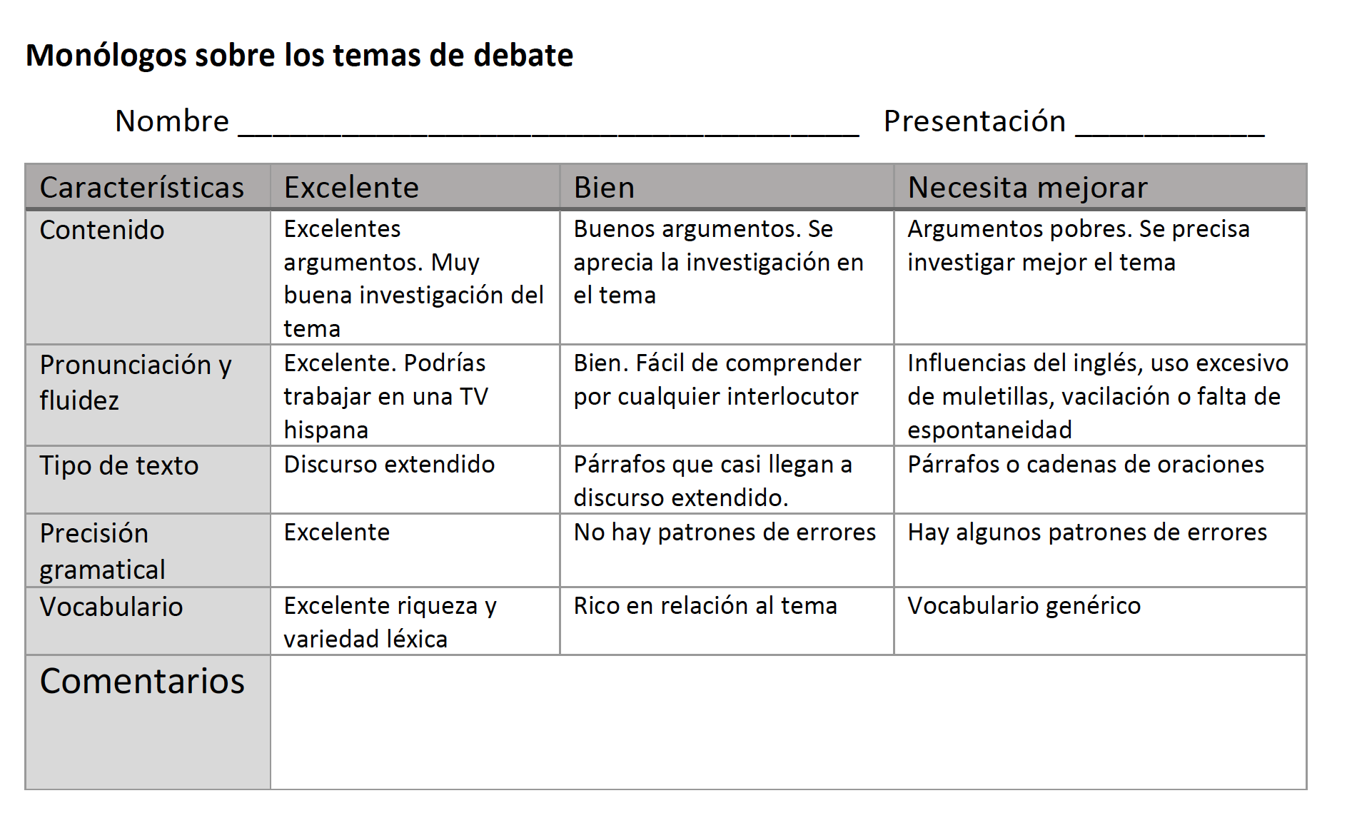
Assessments

Slide 16
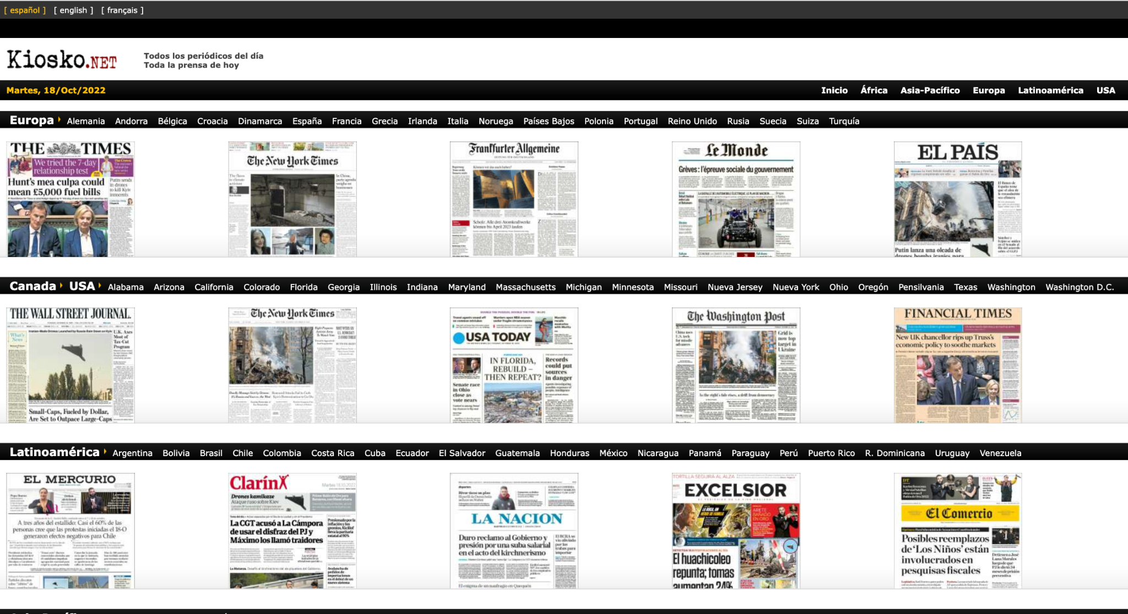
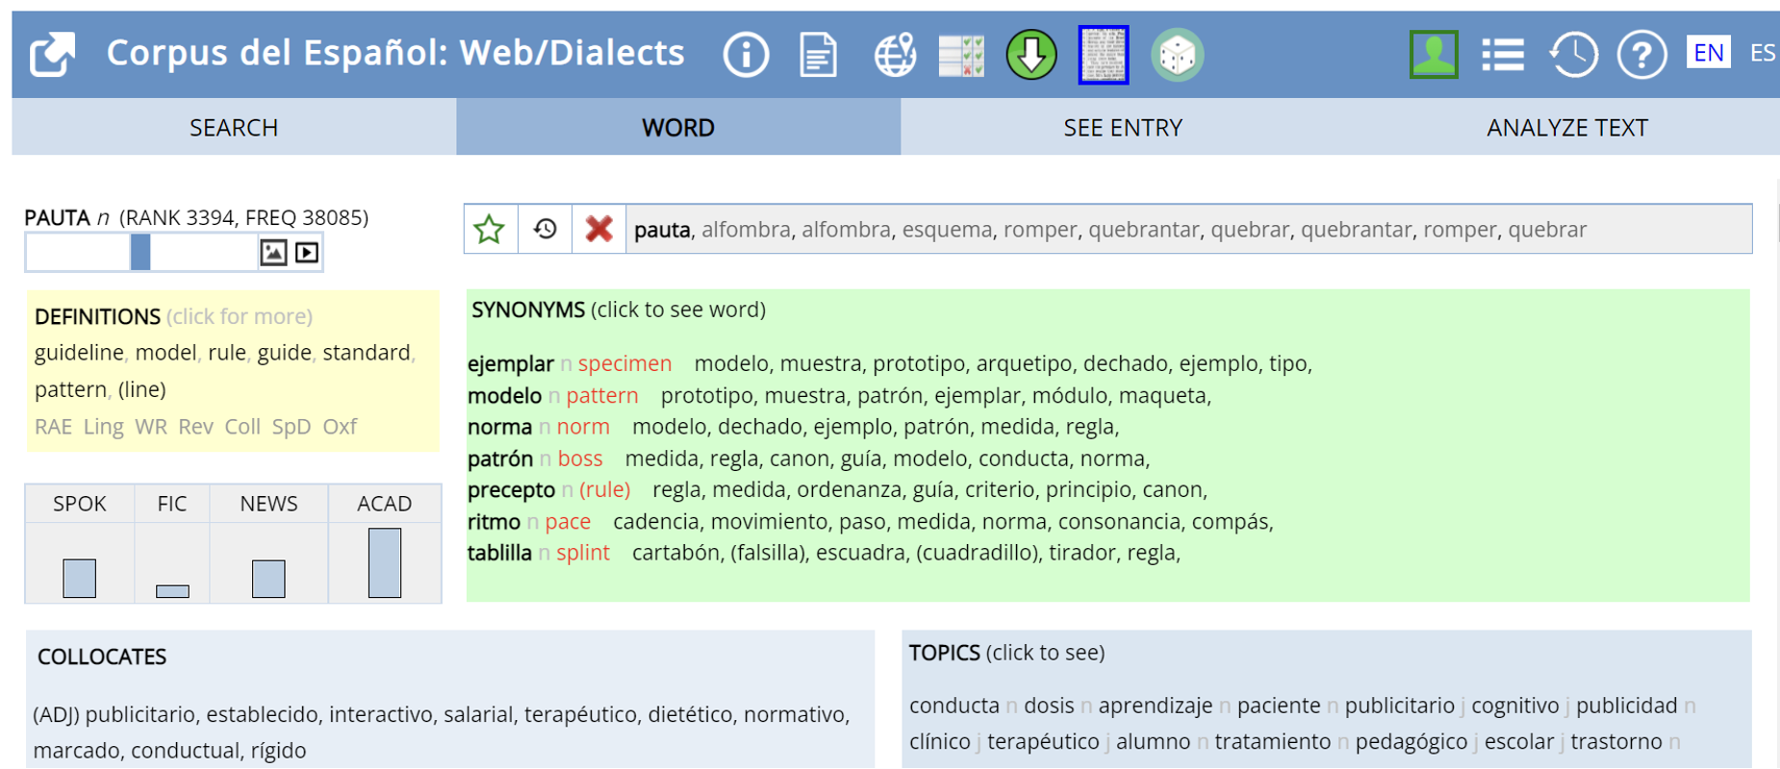
Some Linguistic Resources - Spanish
World Newspapers
https://es.kiosko.net/
Corpus del español https://www.corpusdelespanol.org/

Slide 17
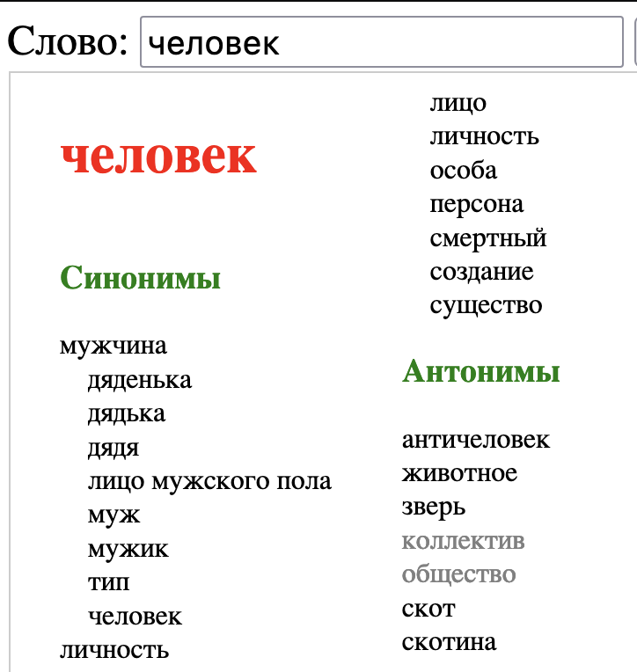
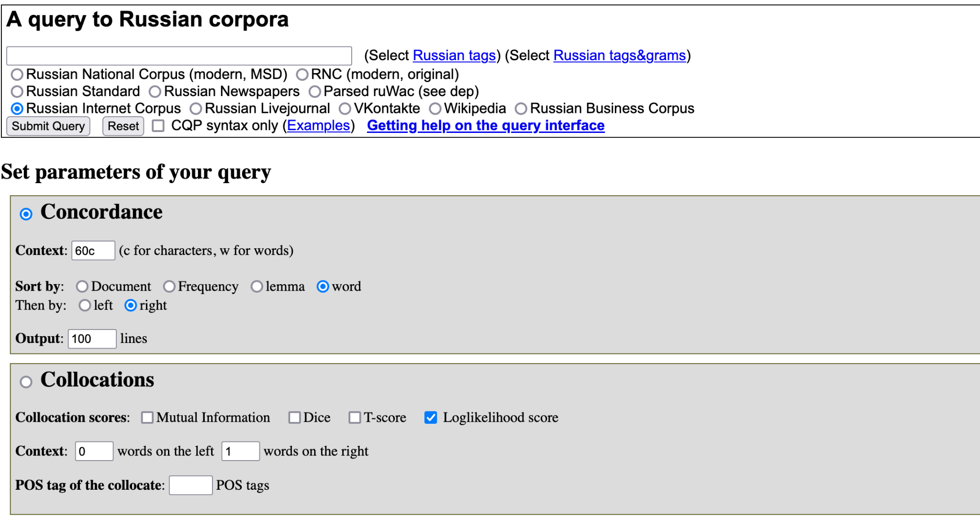
Some Linguistic Resources - Russian
Russian National Corpus
http://corpus.leeds.ac.uk/ruscorpora.html
Concordancer: CrossLexica
http://www.xl.gelbukh.com/

Slide 18
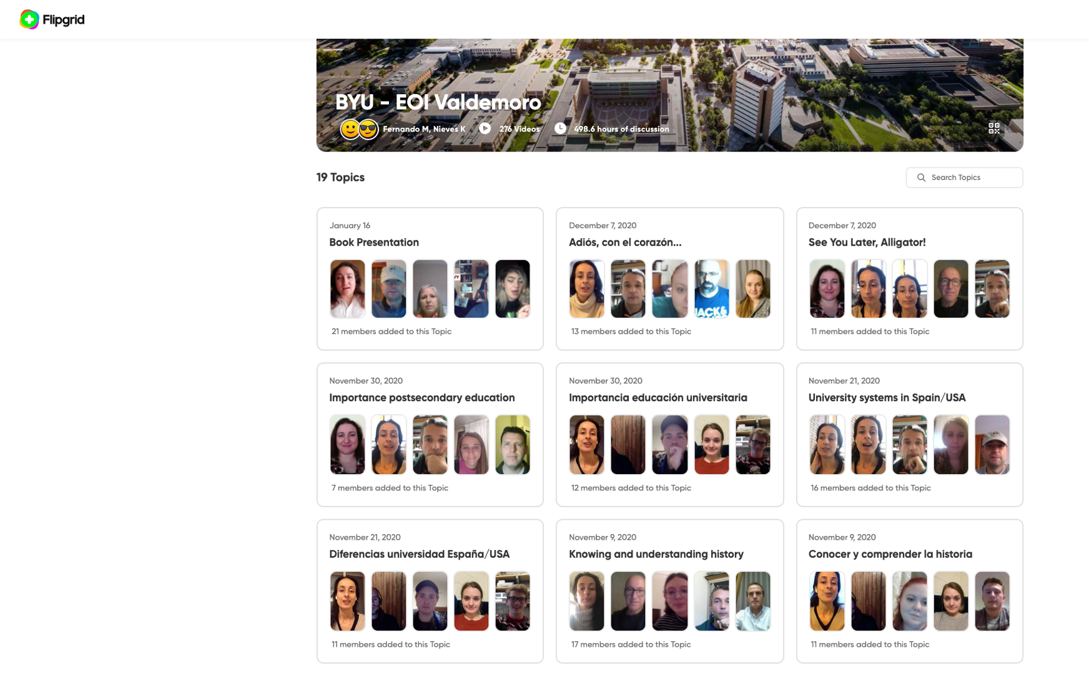
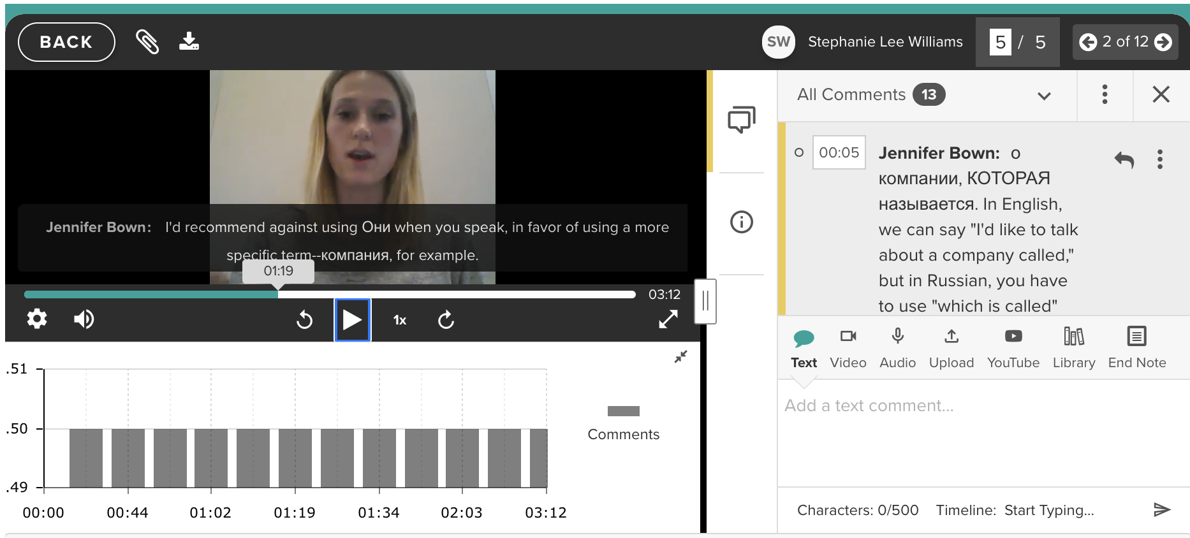
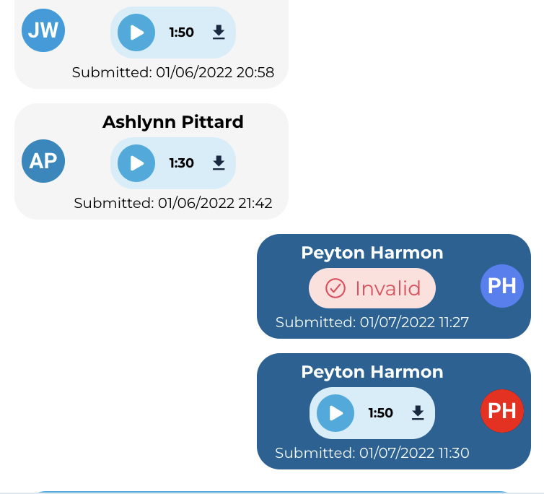
Speaking Resources
GoReact
Flipgrid
Extempore

Slide 19
Challenges of Teaching Debate
Culture
  Debate is an Anglo-American tradition
Students
  Lack of interest (in topic and in debate)
  Dislike confrontation
Instructors
  Lack of training
  Don’t mind the mean as long as proficiency is developed

Slide 20
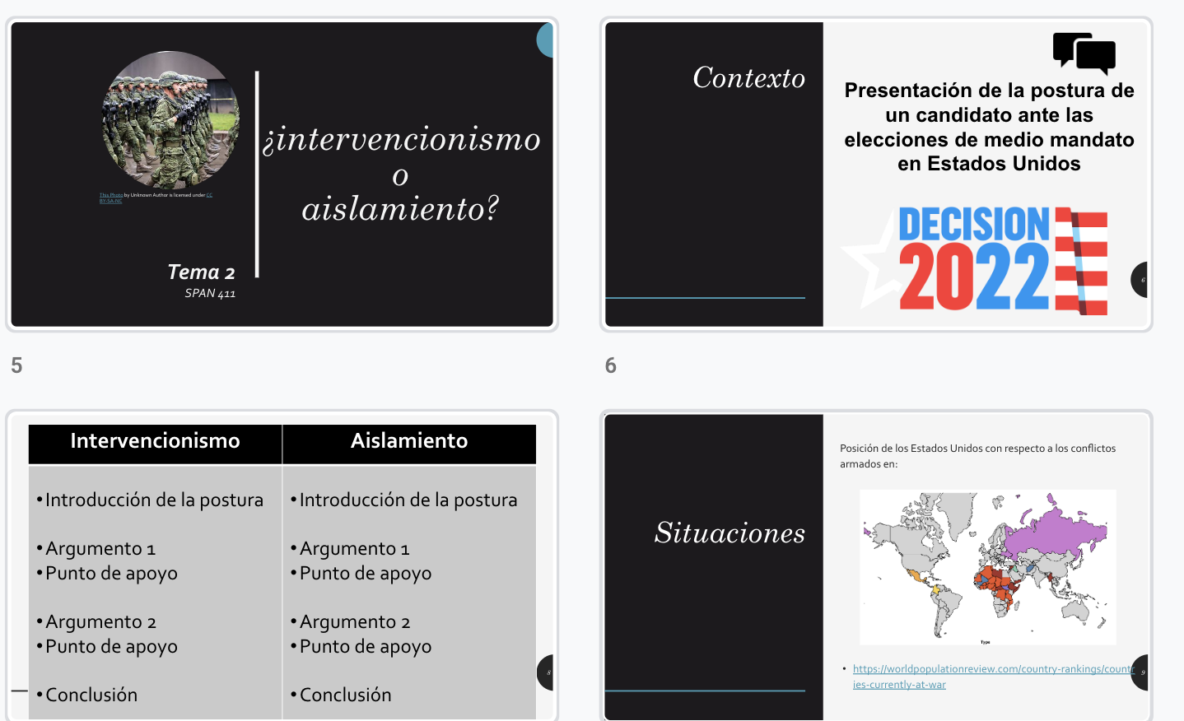
Alternatives to Debate
Fence Sitters
Tag Team Debates
Role plays / Scenarios
Group Discussions
“Token” Debates or Discussions
Structured Academic Controversy
Your ideas?

Slide 21


Group Discussion
What is your opinion on using debate to teach higher-level language skills?

Slide 22
Questions?
jennifer_bown@byu.edu
nieves_knapp@byu.edu

