Slide 1
BILC Conference 2013, Tbilisi
INTERCULTURAL TRAINING: THE CASE OF TEACHING PERSIAN CULTURE TO BRITISH STUDENTS
Chista Crowther,
MA (Cantab), MSc(SOAS), PGCE
DSL Chicksands, UK
Notes:
Who I am
Chicksands
Students: welfare needs, little life experience: can hinder language learning

Slide 2
Humanising the Image of Iran
Iran is portrayed negatively in Western media.
Notes:
Violent, black-clad mobs, burning flags, nuclear programme etc
Students often have very little knowledge Iran and usually just a negative image

Slide 3
President Obama’s Address
بنی آدم اعضای يکديگرند که در آفرينش ز يک گوهرند
‘The children of Adam are limbs to each other, having been created of the same essence.’ Sa’di Shirazi 13th Century AD
Notes:
President Obama’s address to the Iranian people on the occasion of the Persian New Year 20 March 2009
Passage appears above the entrance to the United Nations

Slide 4
The Role of High Culture:
History, Poetry and the Arts
Guides students towards understanding the ‘spirit’ of the language and of the people.
Positive emotional links lead to greater motivation for learning the language.
Their realistic image of Iran could affect their decision making in future postings.
Notes:
Spirit of the people is embodied in high culture: especially in languages of ancient & proud civilisations.
Angry mobs are not going to inspire a need for communication
Teachers dual nationals: military language training carries high stakes and high costs
No one is more acutely aware of this than the Persian teaching team
Wars have to be fought but it is best that they are fought by both sides with a sense of responsibility towards the civilian population.

Slide 5
Timetable Management
Structure of the course – No ICLT
Areas of focus for cultural awareness training
Time spent on Cultural Awareness training
Notes:
Foundation training, 120 words per week, language is a priority: first six months
40 minutes per week including low culture + special outings, exercises etc: no ICLT
Ancient and Medieval as well as modern History, Poetry & Fine Arts including calligraphy
initially teacher led and in English, later on students lead the classes with presentations and debates.

Slide 6
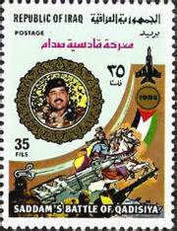
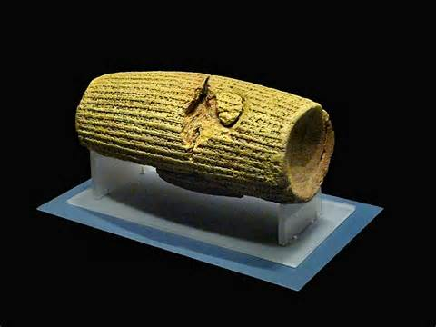
Ancient History?
The Cyrus Cylinder
The Arab Invasion

Slide 7
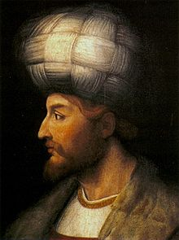
Medieval History
Shah Isma’il Safavi
Shi’ism as State Religion

Slide 8

Modern History
The coup of 1953
Revolution
US embassy hostages
War with Iraq
Teachers’ own life experiences inside Iran and abroad

Slide 9
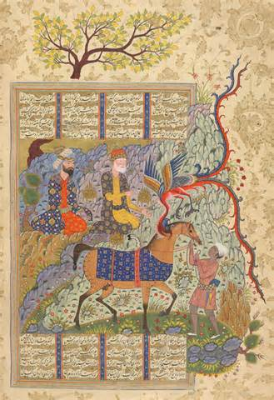
The Shahnameh
Notes:
The book that kept Persian alive
Relevant vocabulary
Opportunity to re-enact stories
The Kite Runner

Slide 10
What Do Students Think?
Course 1: week 16 of training
Course 2: week 52 of training

Slide 11
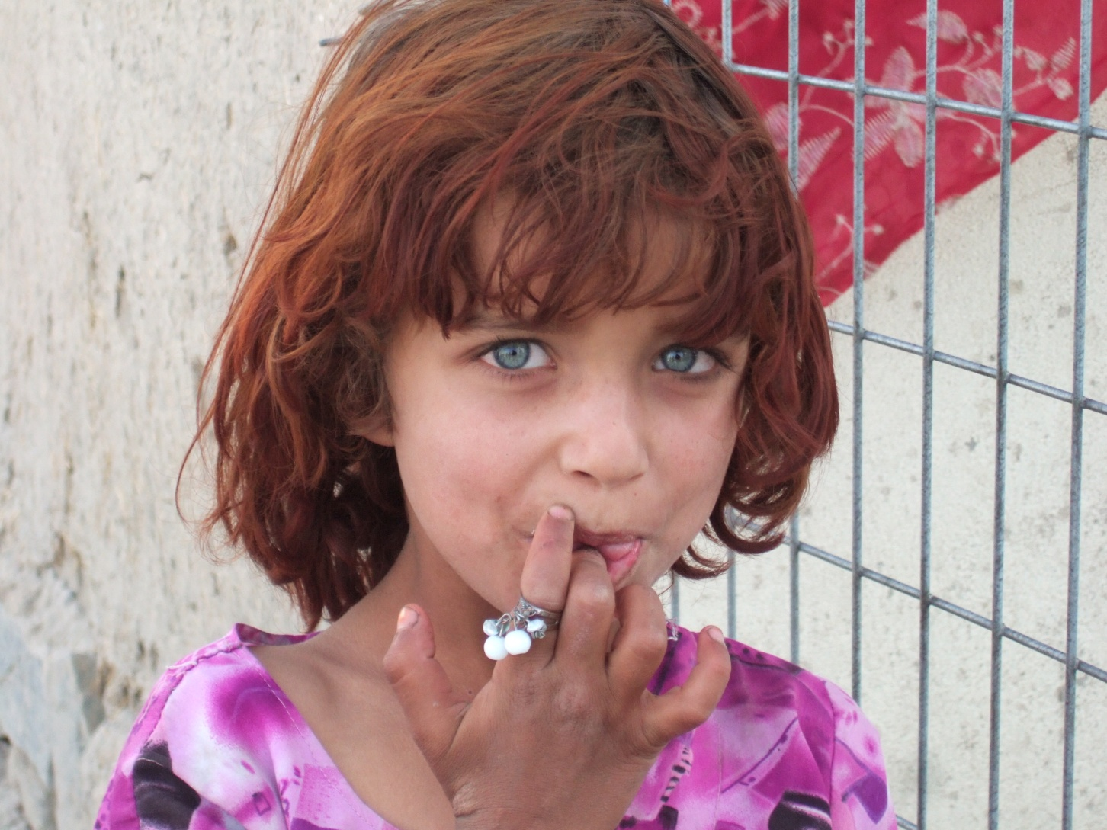
Questions?

