Slide 1
Initial Fumblings of the NORDEFCO Joint Venture English Language Testing
Hege Kristine Skilleås, Norway
Christine Worm Marshall, Denmark

Slide 2
NORDEFCO
”The main aim and purpose of the Nordic Defence Cooperation (NORDEFCO) is to strengthen the participating nations’ national defence, explore common synergies and facilitate efficient common solutions.”

Slide 3
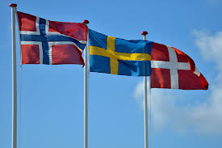
The background
Prague 2012 – NOR/SWE ”initial contact”
Copenhagen 2012 – NOR/DEN
Copenhagen 2013 – First meeting

Slide 4

Initial fumblings

Slide 6
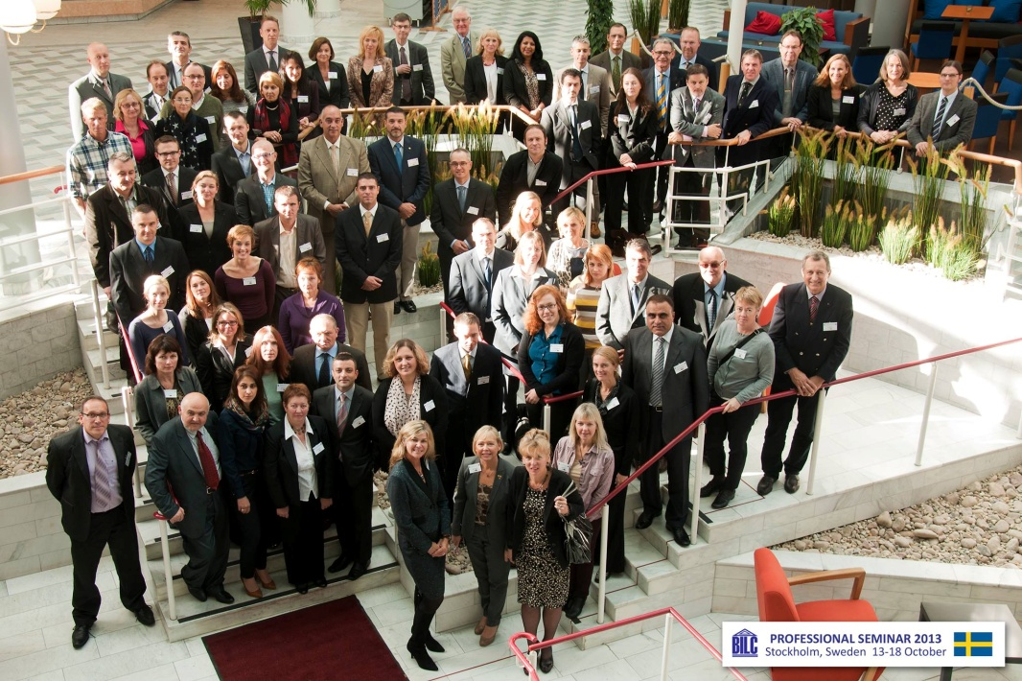
BILC - Stockholm
Face to face seems to help
Revisited ideas
New meeting finally scheduled

Slide 7

The Present
Stockholm 2014
– second meeting
”… explore common synergies…”
One step closer to ”facilitating efficient common solutions”

Slide 8
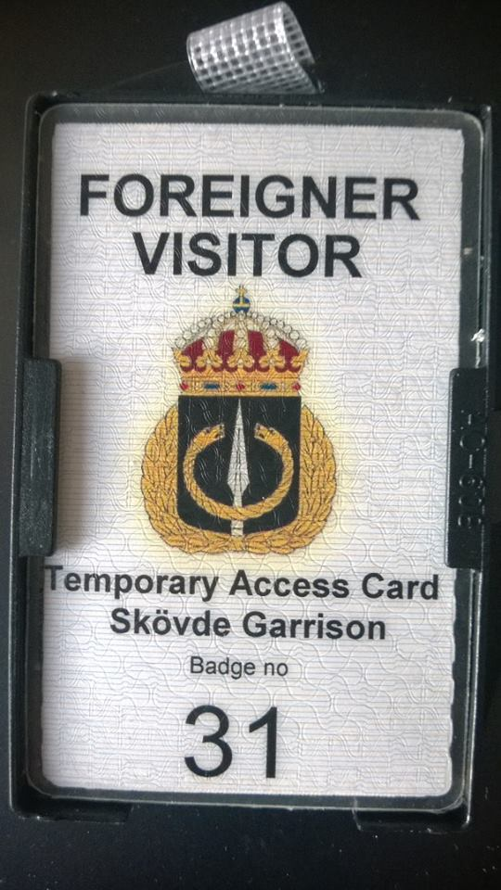
The pieces of the puzzle
Piloting (SWE/NOR – NOR/SWE)
Possibilities for teacher exchanges

Slide 9
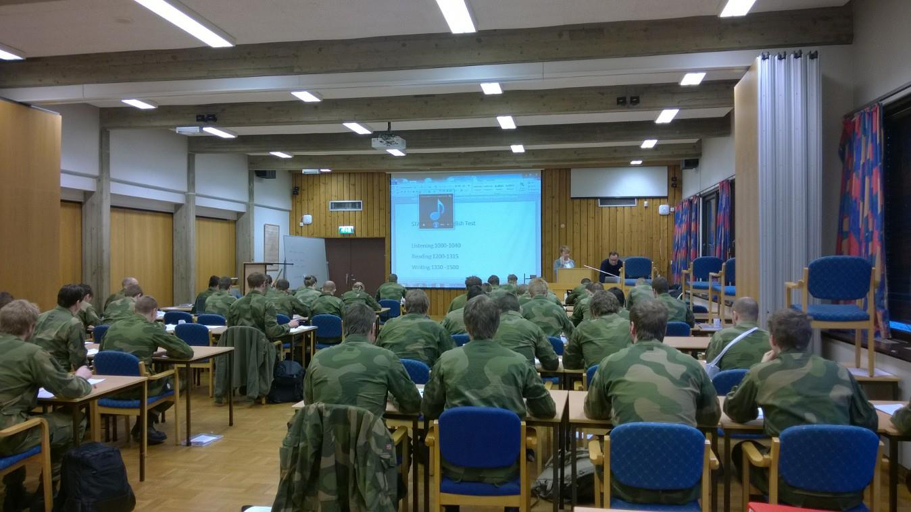

Slide 10

The Challenges
Differences in mandate
Different testing needs
Different testing practices and set-ups
Financial crisis & restructuring(s)

Slide 11
However…

Slide 12
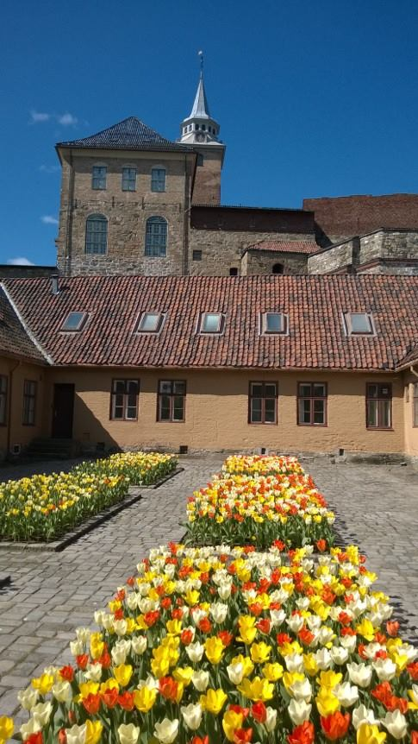
The Future
Currently planned events:
  NOR to observe paired OPIs
  DEN in Bergen for ”Operation Harvest”
  NORDEFCO workshop in Oslo in the autumn

Slide 13

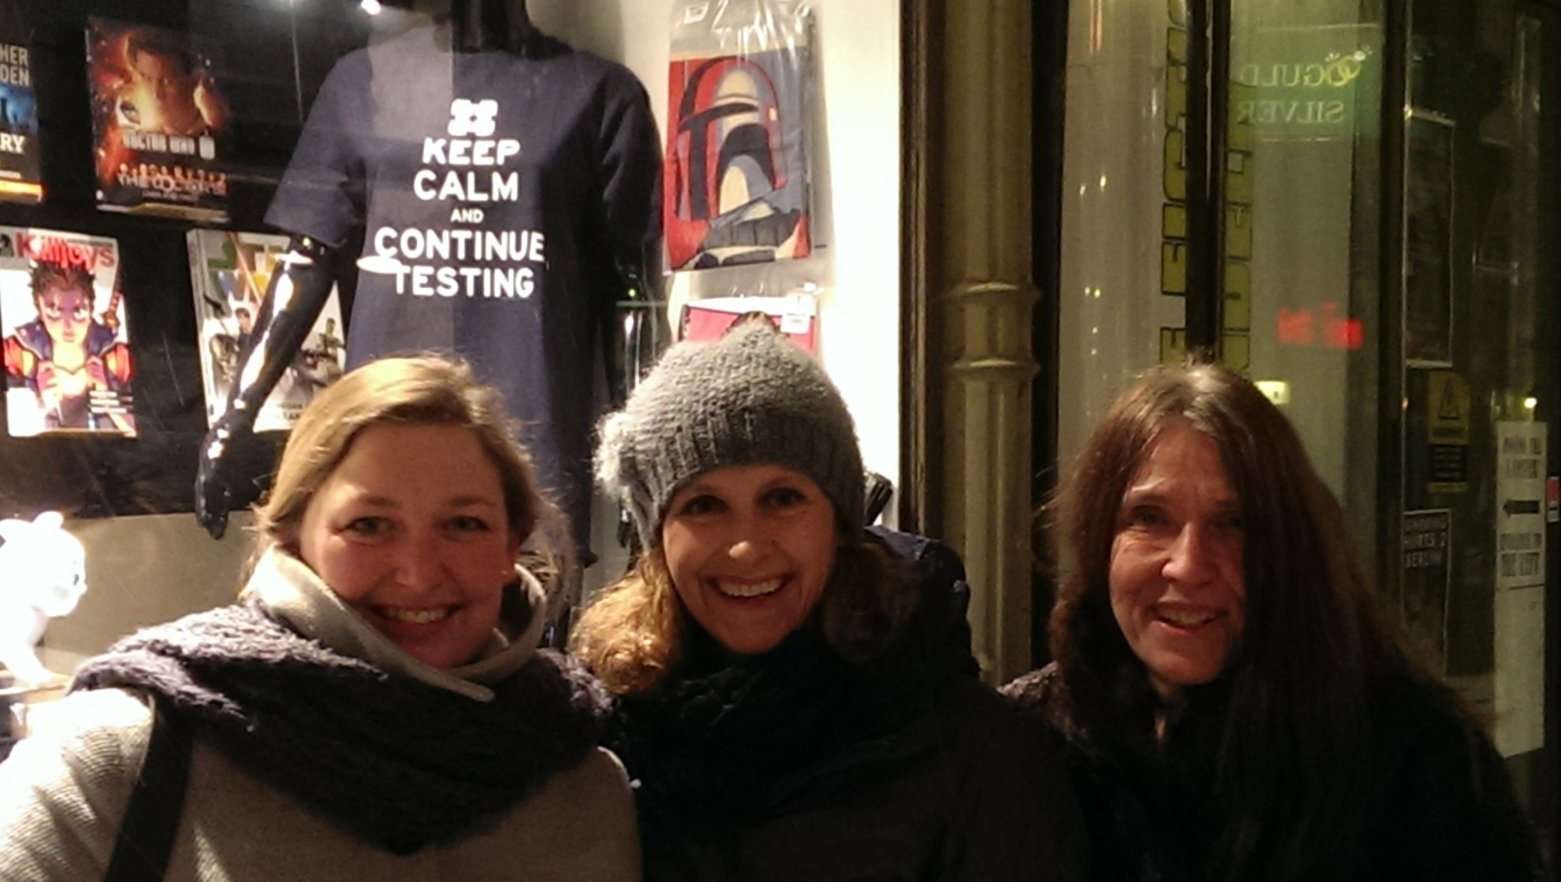
Questions?

