Slide 1
CALL FOR SHIFT IN (LANGUAGE) EDUCATION
Gabriella KISS PhD
Head of Centre
FLTC FMSOT LUPS

Slide 2
AGENDA
Challenges and Trends
Needs of New Techniques and Methods in a New Language Environment
Best Practices
Newly Designed System of Language Education at HDF
Step-by-Step Process in Building Coalition with Actors
Q and A

Slide 3
CHALLENGES AND TRENDS
Accelerated World – Information Boom
Digital World – Technology Boom; AI; „Virtual Reality”
Impact of Social Media
English is „taken for granted” – Internet
Different level of Creativity
Forms of Communication (or lack of?)

Slide 4


Slide 5
NEEDS OF NEW TECHNIQUES
AND METHODS
Is technology the New Solution? (AI, Chat GPT, Smart Phones…)
How can we approach the Gen-Z (later Gen-Alpha) population?
What is „Creative Learning and/or Teaching Programme”?
How to define New Objectives in language education?
Lifelong Learning – never more true! (updating, refreshing)
Open source of new tools, methods and techniqes – but student friendly?
Interdisciplinary of Sciences in Education

Slide 6
MANAGING NEW LANGUAGE ENVIRONMENT
Working Effectively with New Generations
Methods and Techniques introduced
Edutainment
The Psychology of Change
Motivation: Friend or Foe?
IQ, EQ, AQ

Slide 7
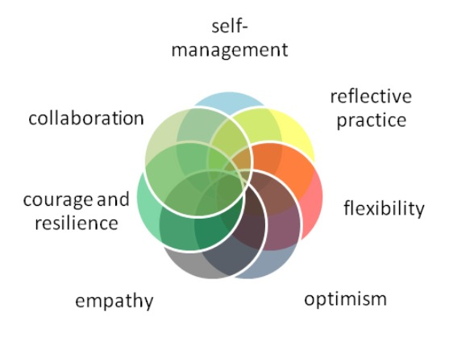
COMPETENCES TO SUPPORT

Slide 8
COACHING TEACHING
„Teaching aims to provide new knowledge and skills, while coaching aims to transfer responsibility for refining and developing knowledge and skills.”

Slide 9
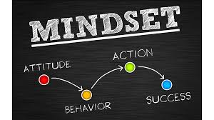
BEST PRACTICES
Innovative „best practices” – implimenting and sharing
Supporting creativity – advocating productivity and feeling of success
Urgent need of shifting approach, attitude, mindset – on all sides
„Mission” of a new type of Motivation and Incentives – „Everyone Matters”!
Hope and clear perception of Common Success (win-win situation)

Slide 10
NEWLY DESIGNED SYSTEM OF LANGUAGE EDUCATION AT HDF
Outdated, decentralised, unproductive functioning – no communication with actors
Call for forming and tailoring a new system – enhancing success and productivity
Needs Analysis – Objectives – Structure
Definition of Basic Elements and their Role in the System
Support in all fields and forms

Slide 11
STEPS TO BE MADE IN BUILDING COALITION
Tailored educational programme(-s)
Supporting unit-educators – „Mentor-Teacher” Programme
Refreshing courses – in- and out-
Newly designed studying materials, supplementary materials, tests…
„Internationalization Project” – guest lecturers and educators, exchange programmes
Regular Monitoring of Units and Elements of Education– „Advisory Board”
Regular contact with MoD/HDF representatives
Communication and Accessibility!

Slide 12

ANY QUESTIONS?

Slide 13

THANK YOU
FOR YOUR ATTENTION

