Slide 1


Leveraging Artificial Intelligence for Enhanced English Language Teaching
Lela Khubuluri
Head of the Language Training Department
National Defense Academy of Georgia
BILC Professional seminar
14-18 October, 2024

Slide 2
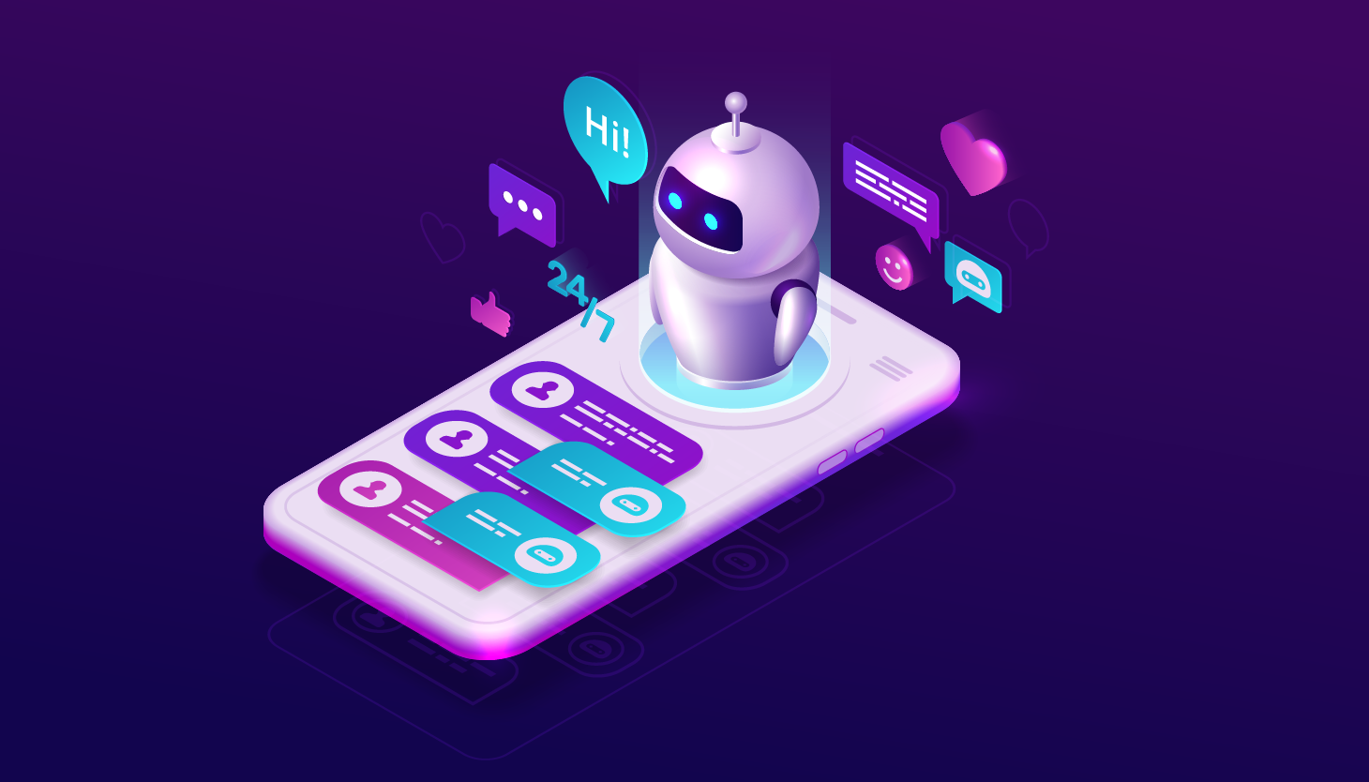
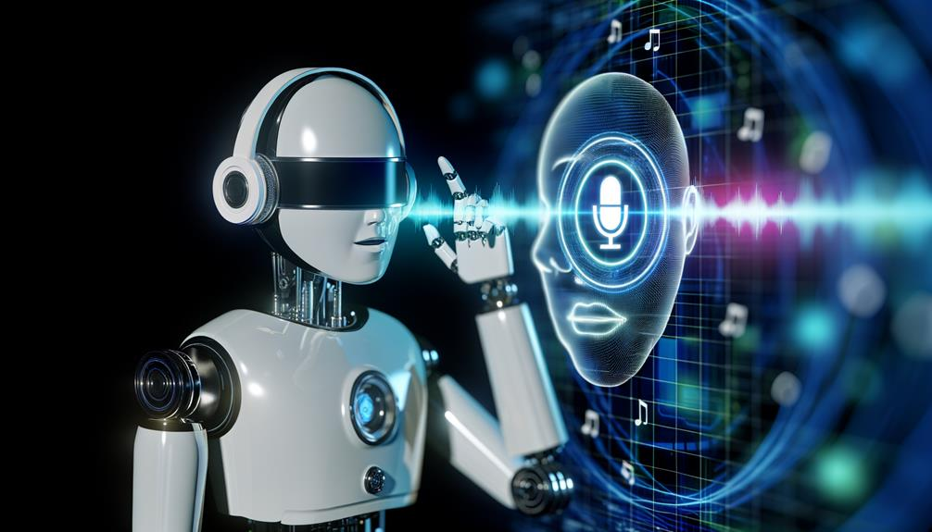
AI-Powered Tools for Learning a Language
AI Chatbots
Voice Recognition software

Slide 3

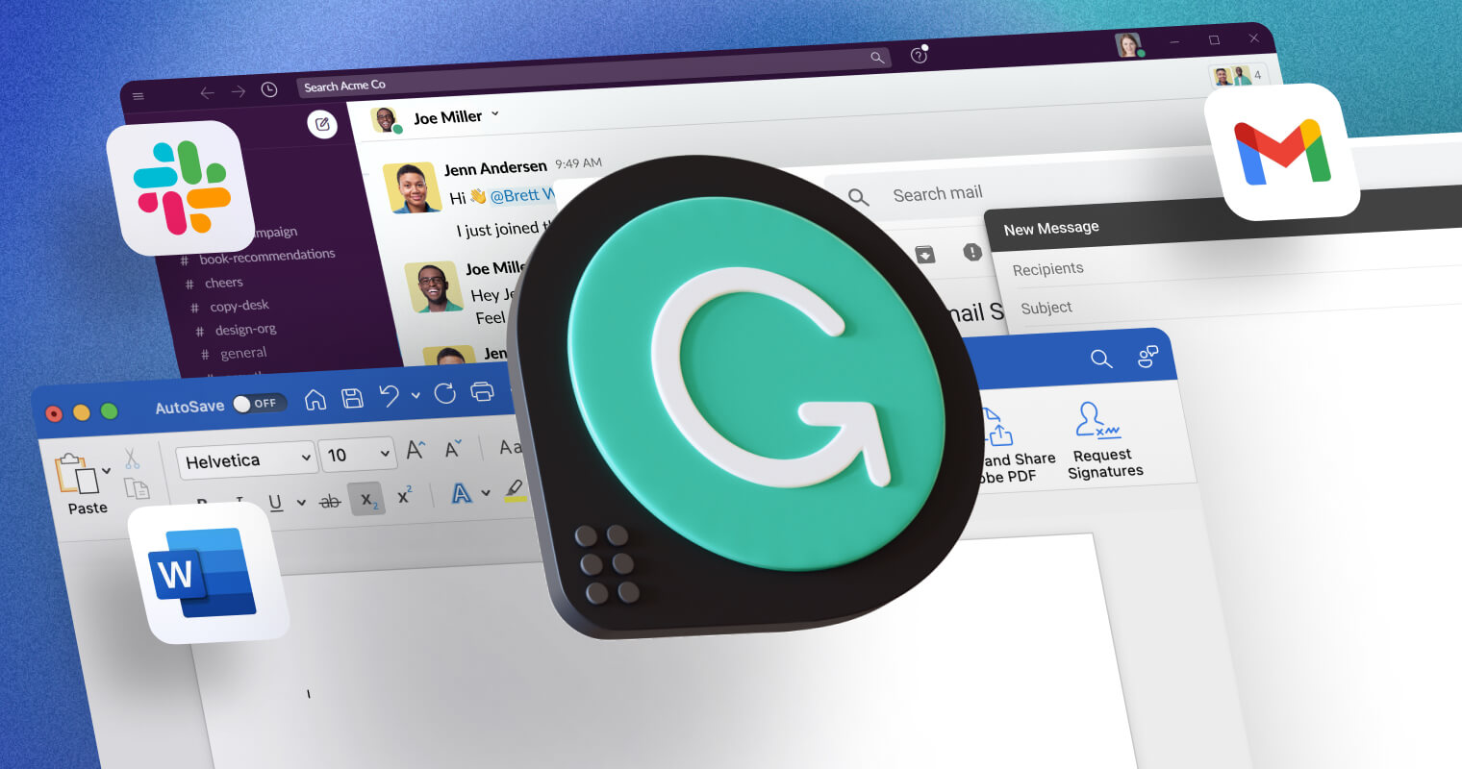
AI-Powered Tools for Learning a Language
Virtual Tutors
Writing Assistants

Slide 4
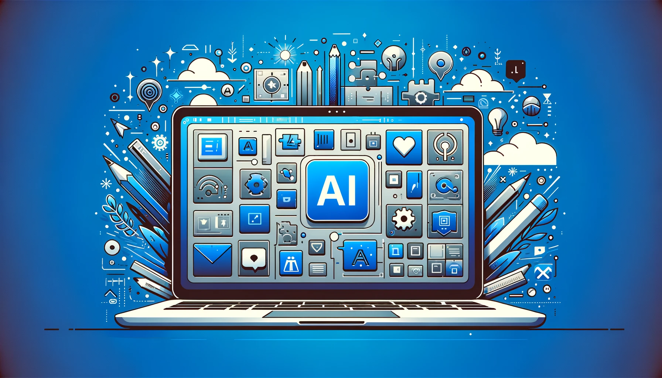
AI - Advantages and Opportunities
Personalized learning
Interactive learning
Real-time assessments
Assists teachers in:
creating more efficient and interactive lessons
tracking progress
Available 24/7

Slide 5
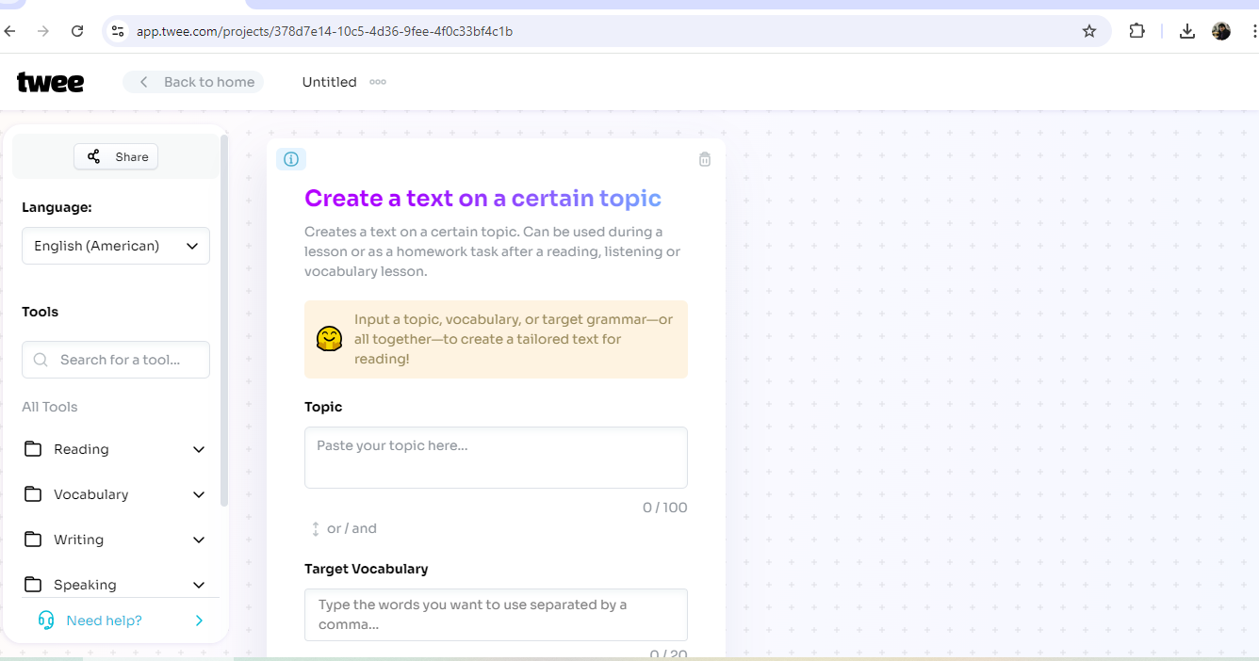

Slide 6
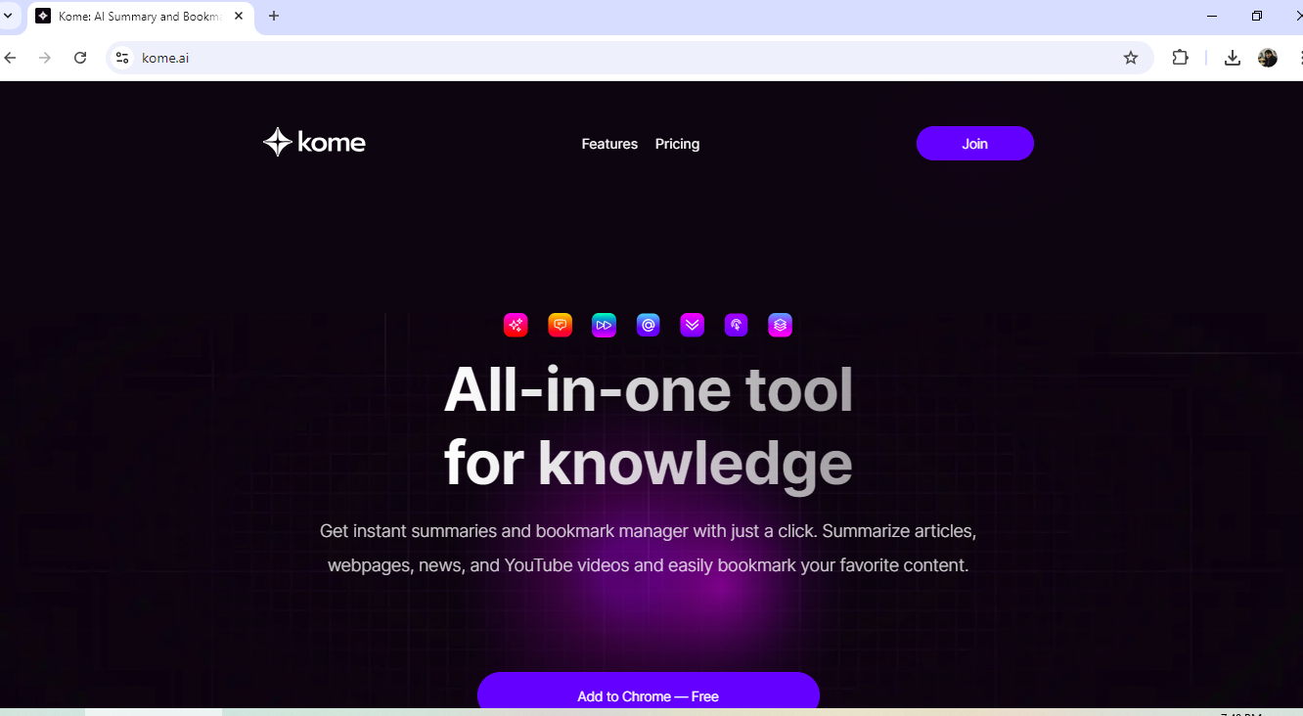

Slide 7
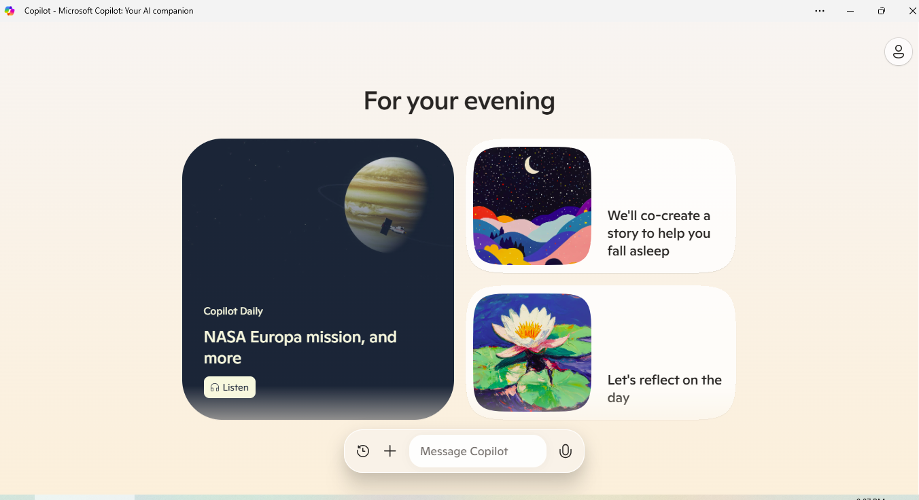

Slide 8


Slide 9
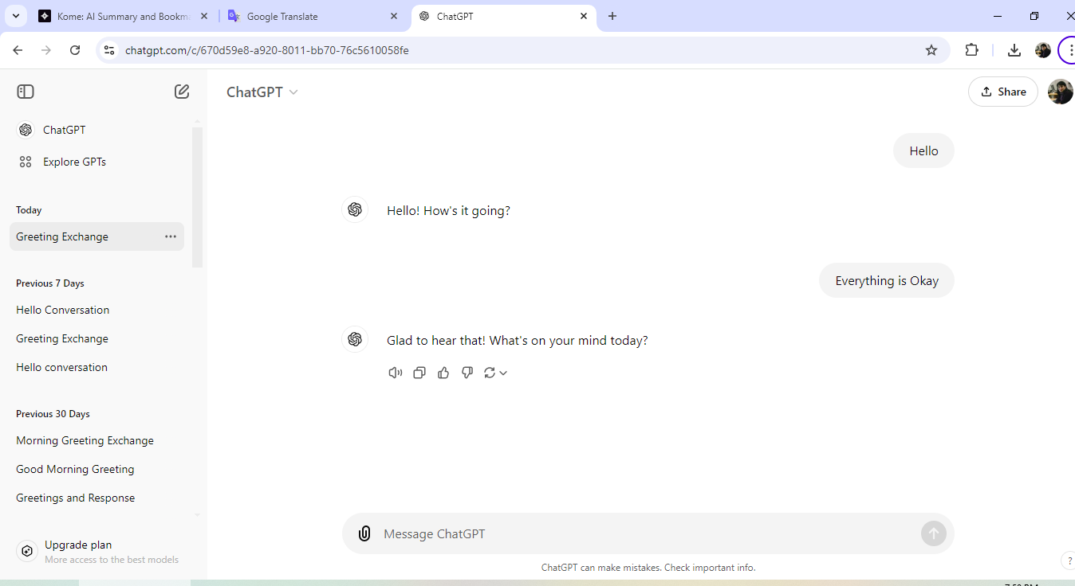


Slide 10
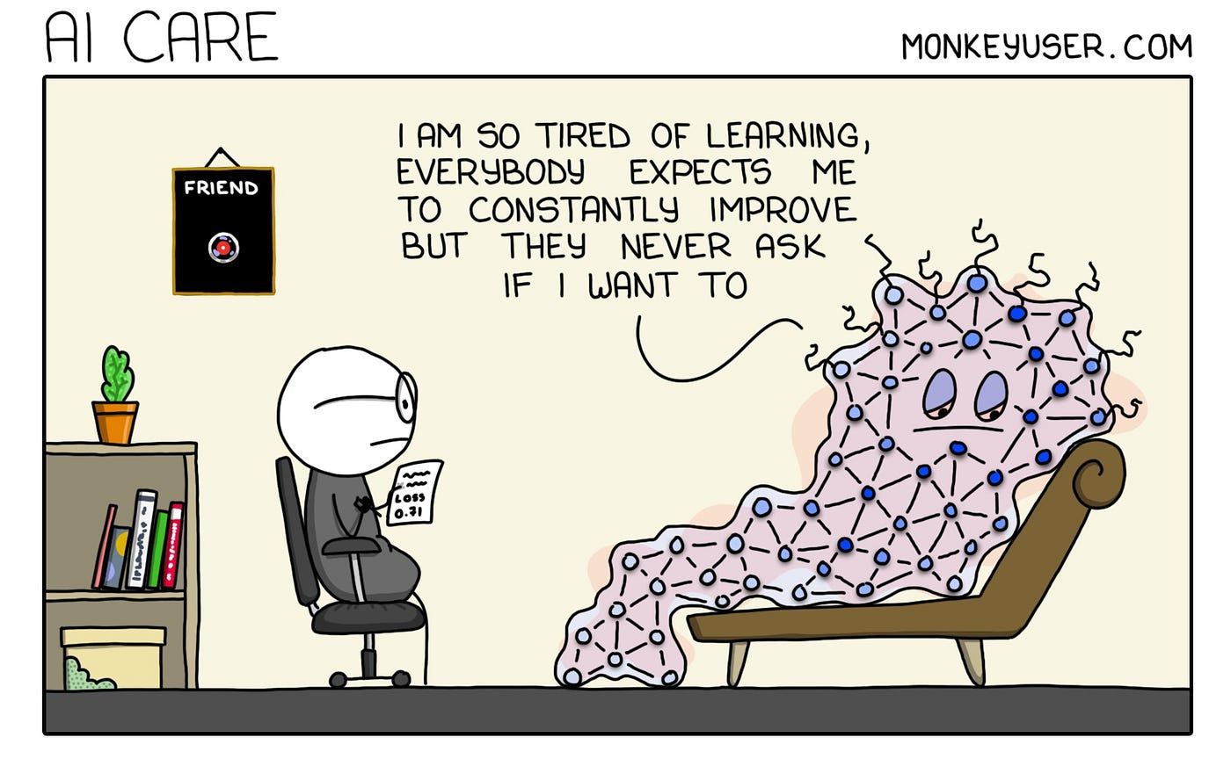
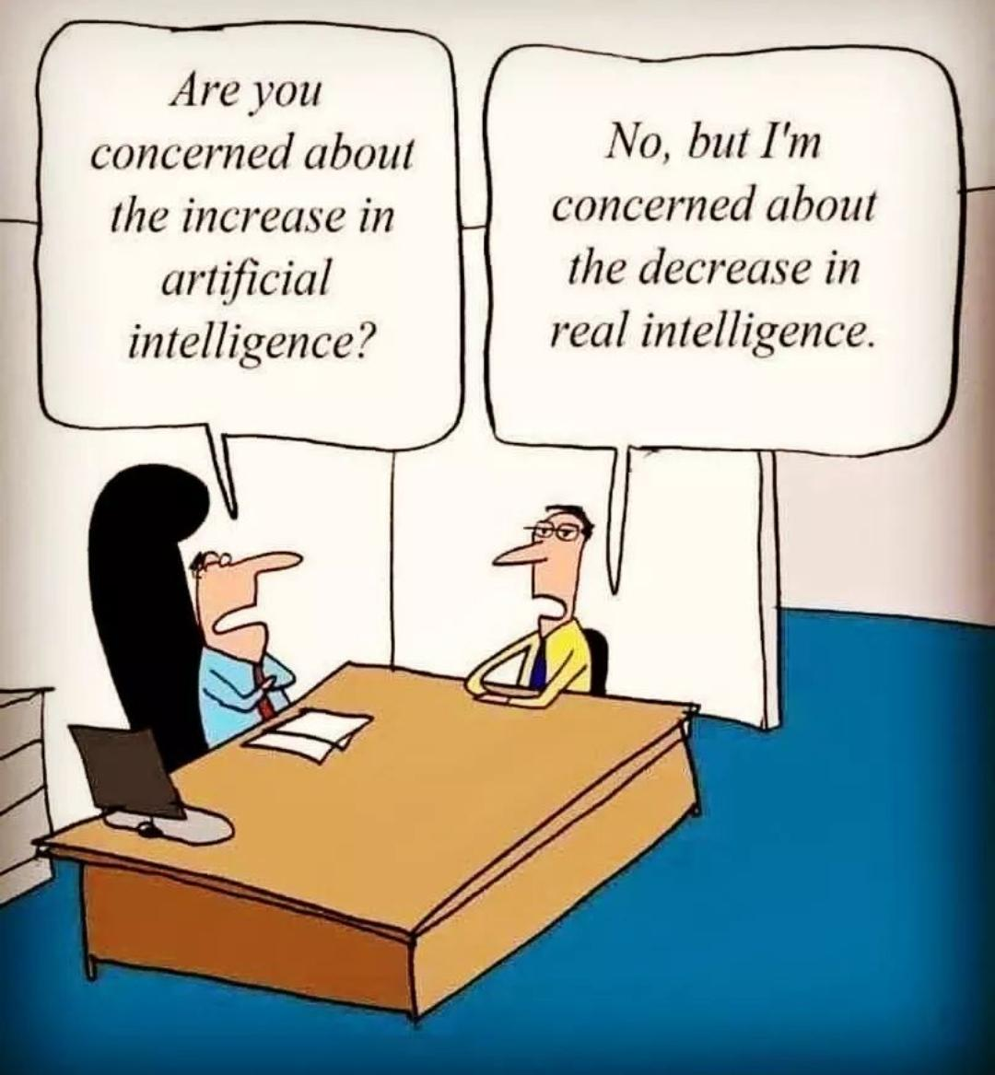
AI – Disadvantages and Drawbacks
Over-reliance on technology
Lack of human interaction
Limited creativity
Privacy and data Security
Cost and accessibility
Quality of AI content

Slide 11

Will AI replace language teachers?
Language learning can be challenging and requires motivation and encouragement. Human teachers can inspire, mentor, and provide emotional support in ways that AI cannot.

Slide 12

Thank you!

