Slide 1

Risk monitor 2024
“A world of disorder”
Brigadier General
Ronald Vartok
Military Policy Division
Directorate Defence Policy & International Relations

Slide 2
The Risk Monitor
The setting:
global security situation deteriorating
war in Ukraine – negative impacts on other regions
increased geopolitical tensions
multiple challenges to be faced
national resilience key

Slide 3
The Risk Monitor
published annually by the MoD
„environmental scenarios“ – outlook until 2032
„trend scenarios“ – outlook until 2027

Slide 4
62 Risks identified
Summarised in 5 levels:
o Global Strategic Level
o Military Strategic Level
o System EU
o Environment of the EU
o System Austria
Interconnection!
4

Slide 5
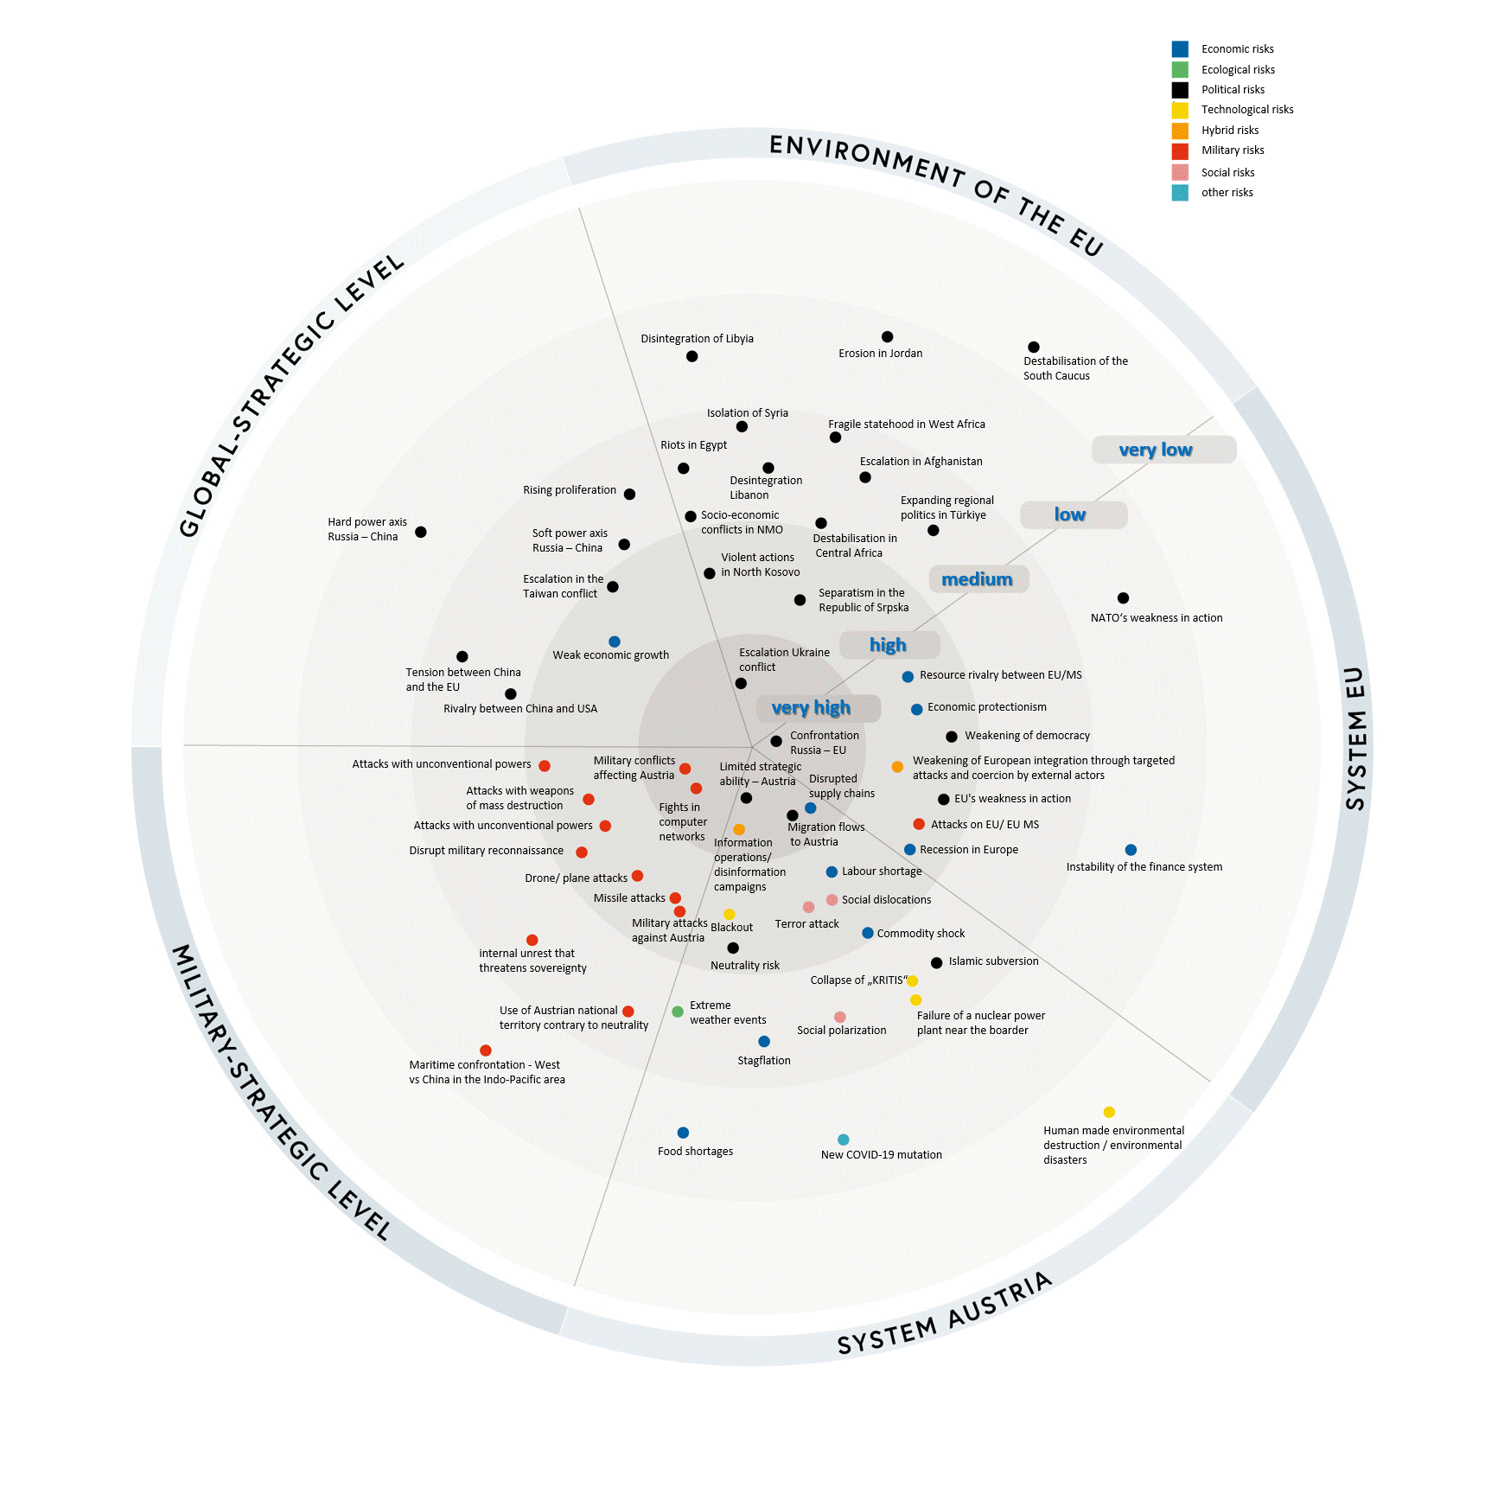

Slide 6
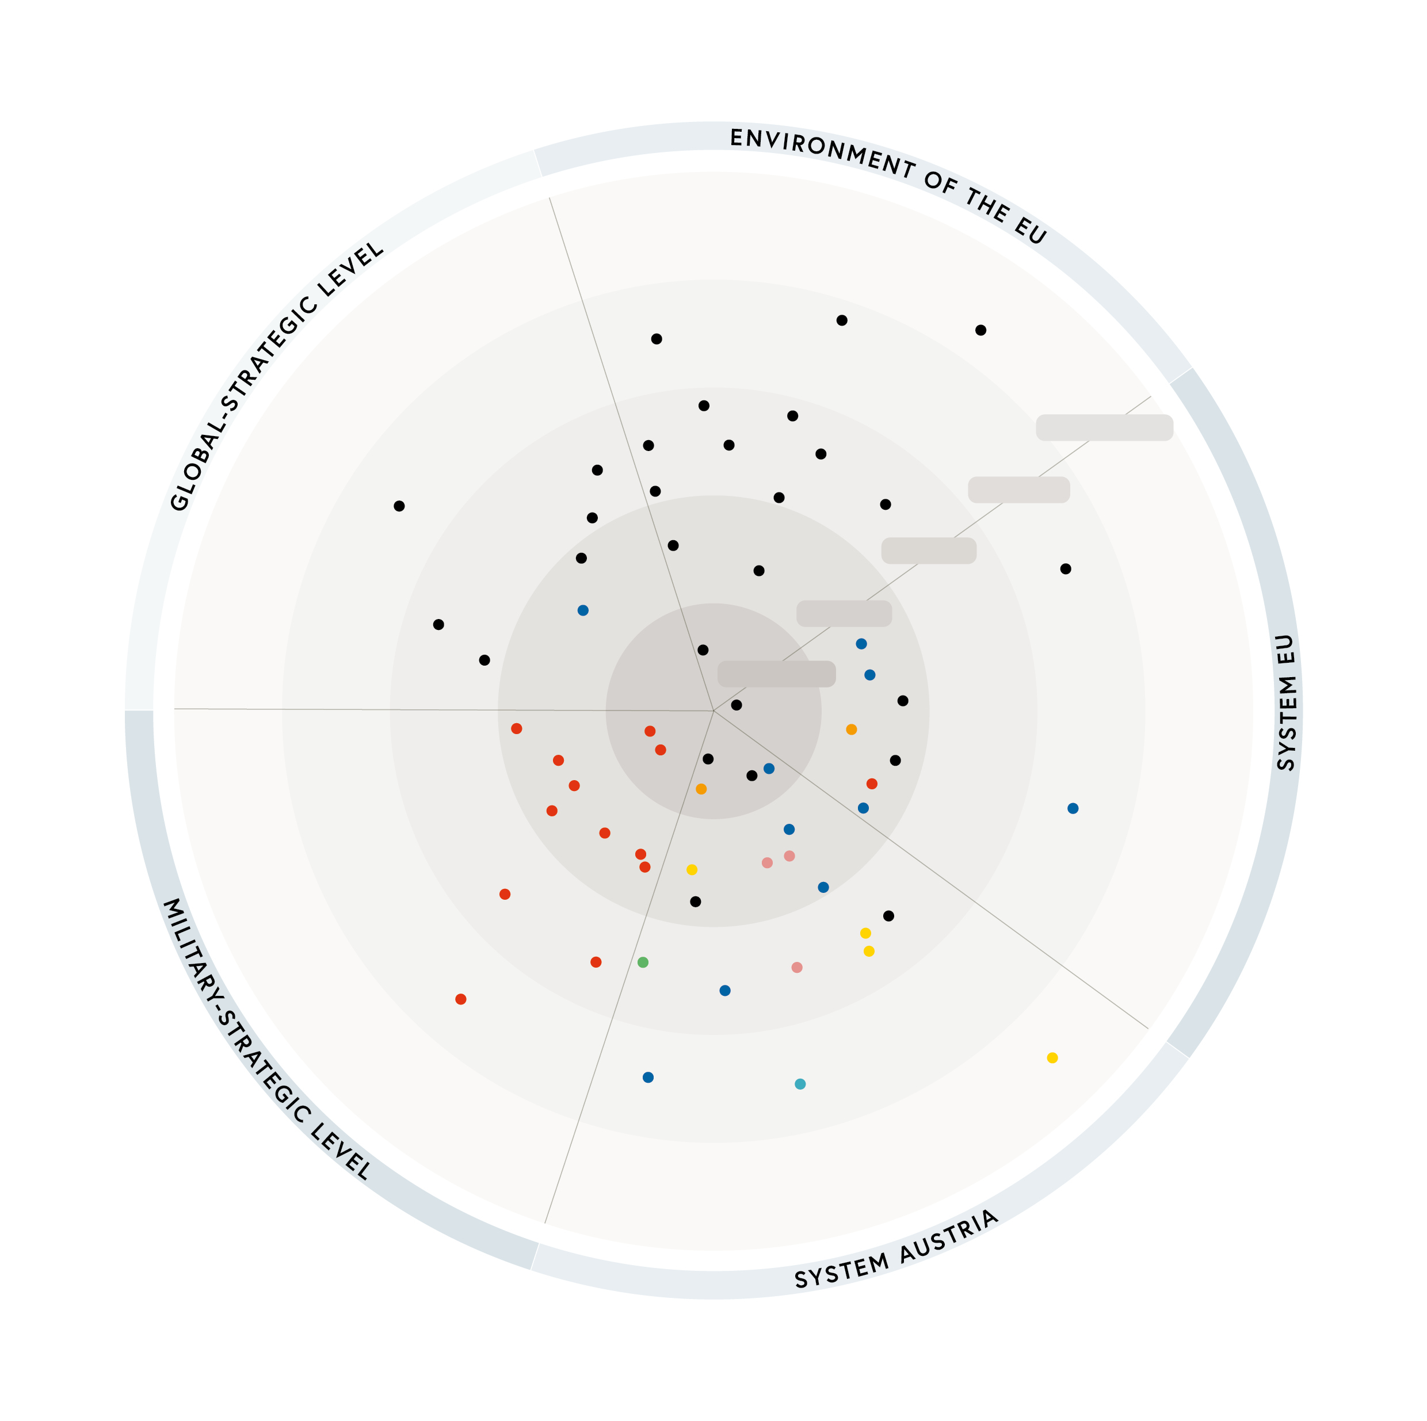
Disintegration of Libyia
Erosion in Jordan
Destabilisation of the
South Caucus
Isolation of Syria
Fragile statehood in West Africa
Riots in Egypt
very low
Escalation in Afghanistan
Rising proliferation
Desintegration
Libanon
Socio-economic
conflicts in NMO
Expanding regional
politics in Türkiye
low
Hard power axis
Russia – China
Soft power axis
Russia – China
Destabilisation in
Central Africa
Violent actions
in North Kosovo
medium
Escalation in the
Taiwan conflict
Separatism in the
Republic of Srpska
NATO‘s weakness in action
Weak economic growth
Escalation Ukraine
conflict
high
Tension between China
and the EU
Resource rivalry between EU/MS
Rivalry between China and USA
very high
Economic protectionism
Confrontation
Russia – EU
Weakening of democracy
Attacks with unconventional powers
Military conflicts
affecting Austria
Limited strategic
ability – Austria
Weakening of European integration through targeted
attacks and coercion by external actors
Attacks with weapons
of mass destruction
Disrupted
supply chains
Fights in
computer
networks
EU's weakness in action
Attacks with unconventional powers
Migration flows
to Austria
Attacks on EU/ EU MS
Disrupt military reconnaissance
Information
operations/
disinformation
campaigns
Recession in Europe
Drone/ plane attacks
Labour shortage
Instability of the finance system
Missile attacks
Social dislocations
Military attacks
against Austria
Blackout
Terror attack
Commodity shock
internal unrest that
threatens sovereignty
Neutrality risk
Islamic subversion
Collapse of „KRITIS“
Use of Austrian national territory contrary to neutrality
Extreme
weather events
Failure of a nuclear power
plant near the boarder
Social polarization
Maritime confrontation - West vs China in the Indo-Pacific area
Stagflation
Human made environmental destruction / environmental disasters
Food shortages
New COVID-19 mutation

Slide 7
Austria`s Security & Defence Policy Framework
  Austrian National Security Strategy is still valid (2013)
  Sub-Strategy on Defence Policy is still valid (2014)
  BUT: The Government Programme for the legislative period 2020-2024 underlines the need for modern, capable and flexibly deployable force able to address the present and emerging challenges and threats
  New Austrian National Security Strategy about to be published !

Slide 8
Thank you for your attention!
Brigadier Ronald VARTOK
Military Policy Division
Austrian MoD
ronald.vartok@bmlv.gv.at

