Slide 1
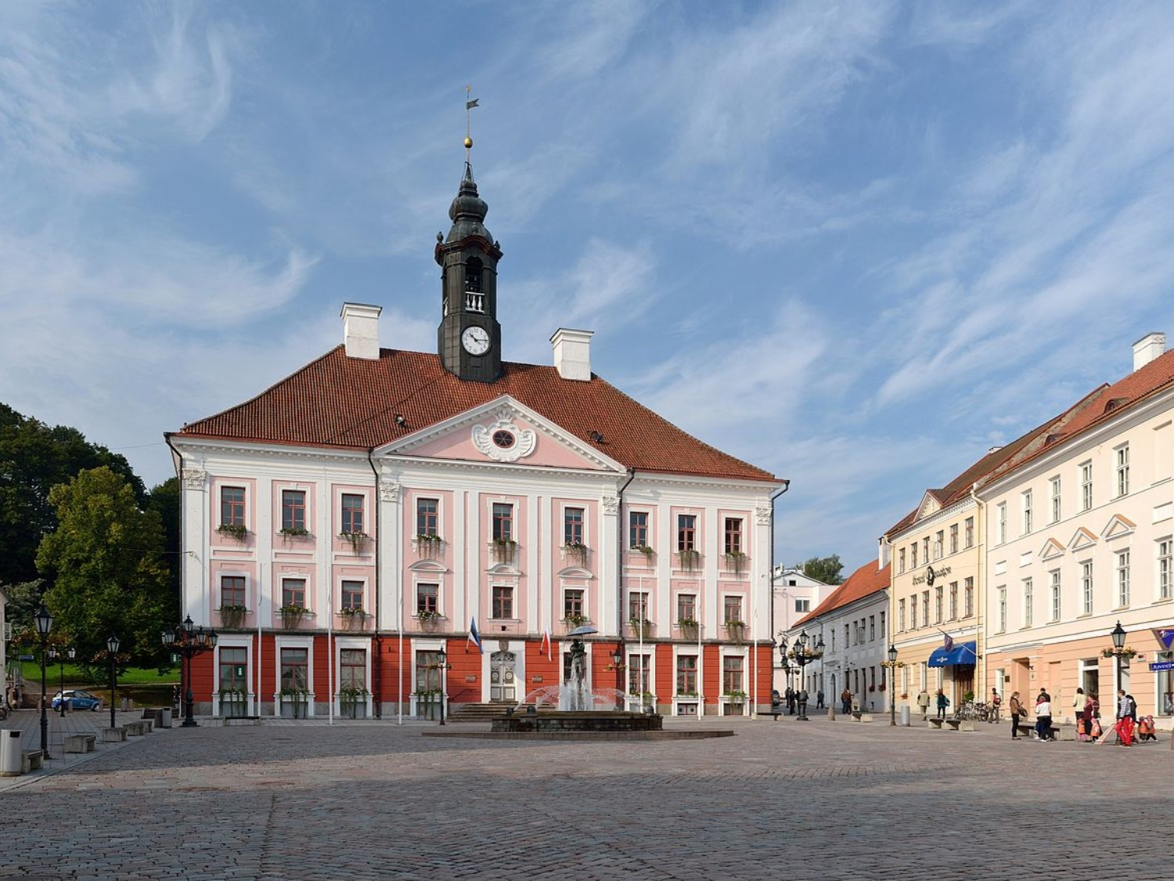
2019 BILC Conference
27-30 May, Tartu, Estonia
CLOSING REMARKS

Slide 2
2019 BILC Conference
27-30 May, Tartu, Estonia
87 participants
(3 VIP NATO representatives – ACT, IMS and SHAPE)
from 37 countries
4 continents

Slide 3
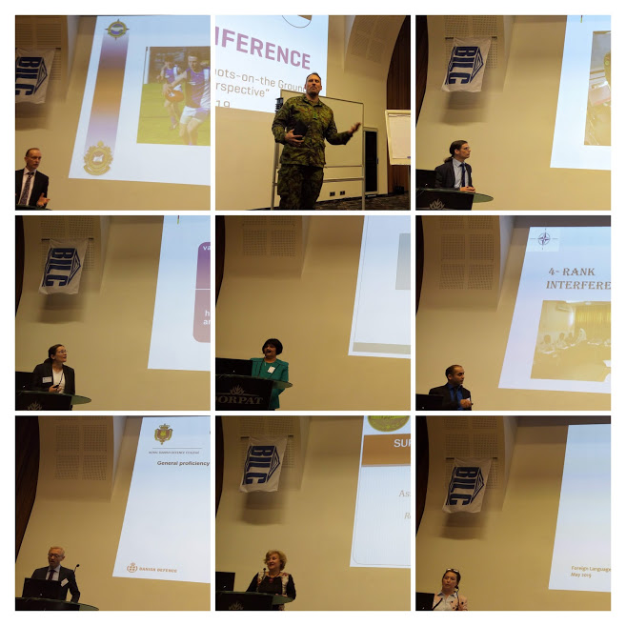
2019 BILC Conference
27-30 May, Tartu, Estonia
23 presentations + 4 guest speakers

Slide 4
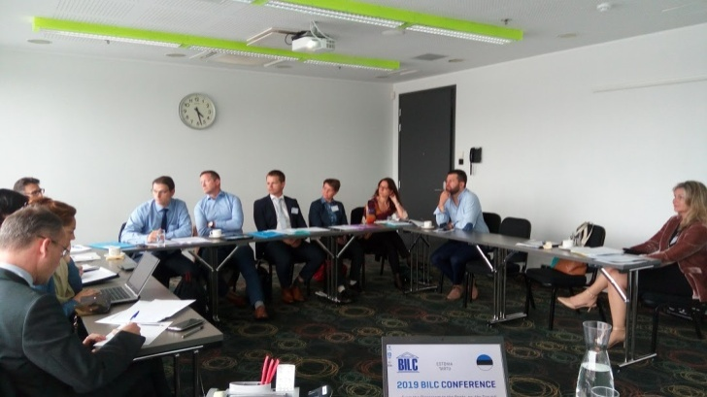
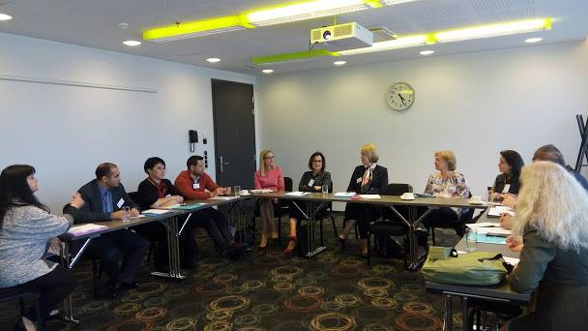
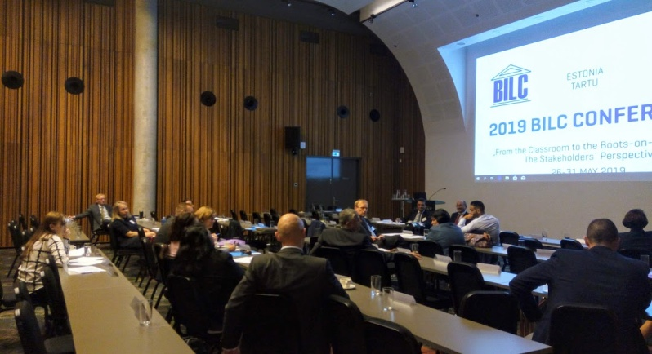
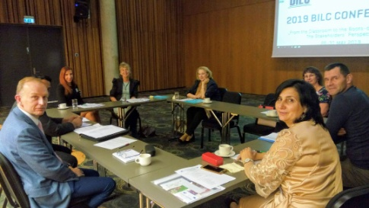
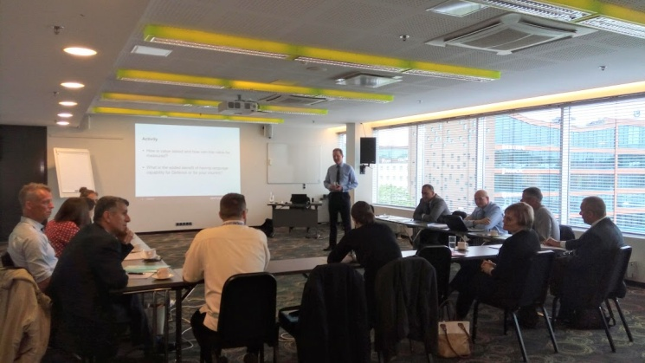
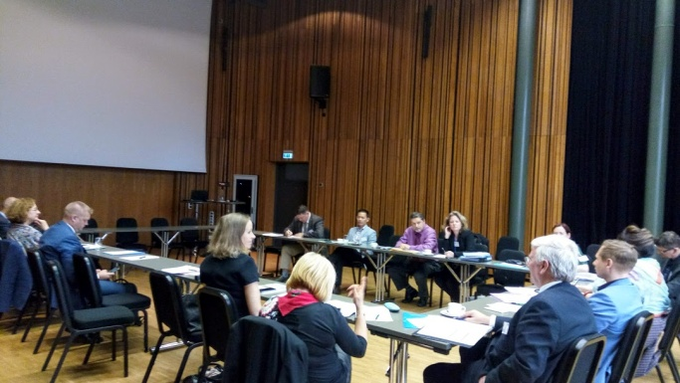
2019 BILC Conference
27-30 May, Tartu, Estonia
6 Study Groups

Slide 5
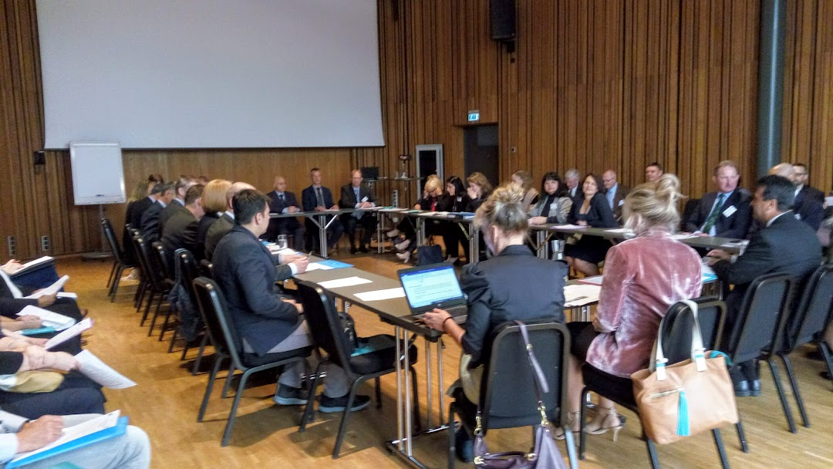
2019 BILC Conference
27-30 May, Tartu, Estonia
Steering Committee Meeting

Slide 6
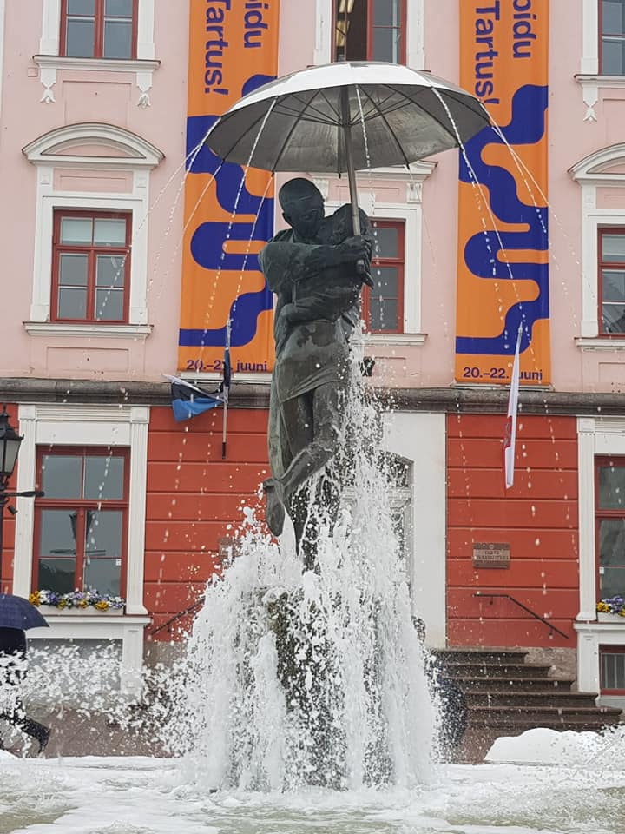
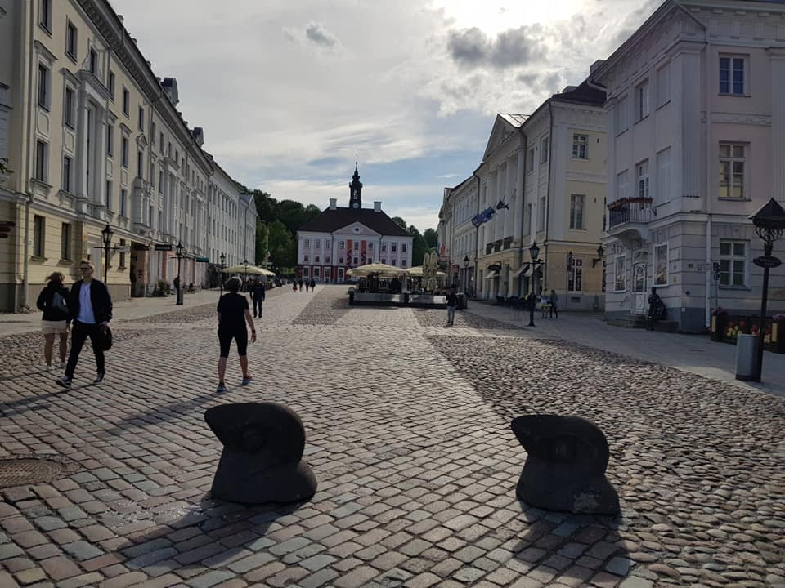
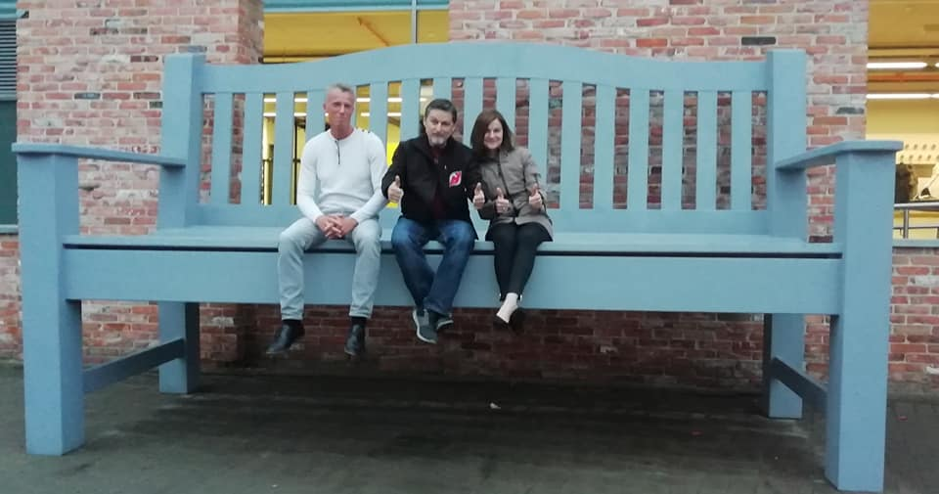
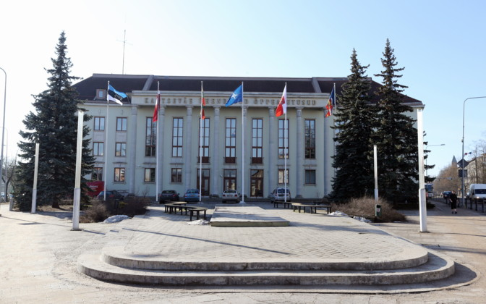
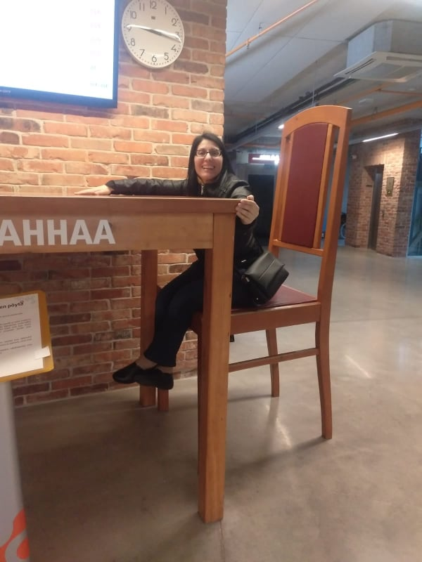
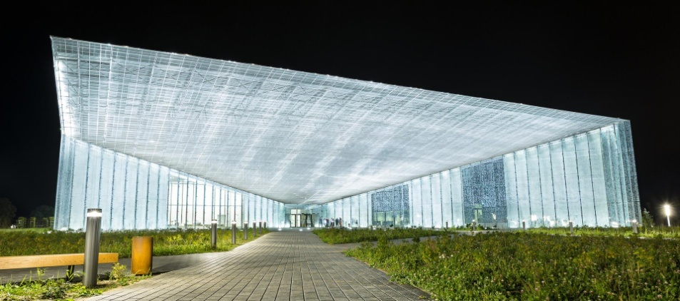
2019 BILC Conference
27-30 May, Tartu, Estonia
BILC motto
“Work Hard, Play Hard”

Slide 7

DEAR ALL,

