Slide 1




Bureau for International Language Co-ordination
GETTING CLOSER TO SLP THROUGH THE NET
LTC. (OF-4) LUIS ARIAS
ARMY WARFARE SCHOOL
FOREIGN LANGUAGES DPT. (DIEGE)
Notes:
Ladies and gentlemen, good morning. I am LtCol Luis Arias. I belong to the Spanish Army, and I am posted in the Foreign Languages Department (English Wing) within the Army Warfare School.
First things first, on behalf of all the Spanish delegation, I’d like to thank the BILC, and specially, Portugal as host nation, for this –once again-brilliant annual conference.
And let me focus this gratitude on one person, Lt Com. Gabriel, whose excellent work I know and has been vital for this event. Also, because she was the one encouraging me to be here today (maybe you will not thank her for that), when we were attending LSAS in Garmisch last December.
In that seminar I had the opportunity to show some initiatives and tools we are implementing in the Spanish Armed Forces. None of them can be considered “high-tech”, but they have a clear goal.. Actually, a double one: to support foreign language learners, and to make everyone acquainted with SLP, STANAG, and tests.

Slide 2
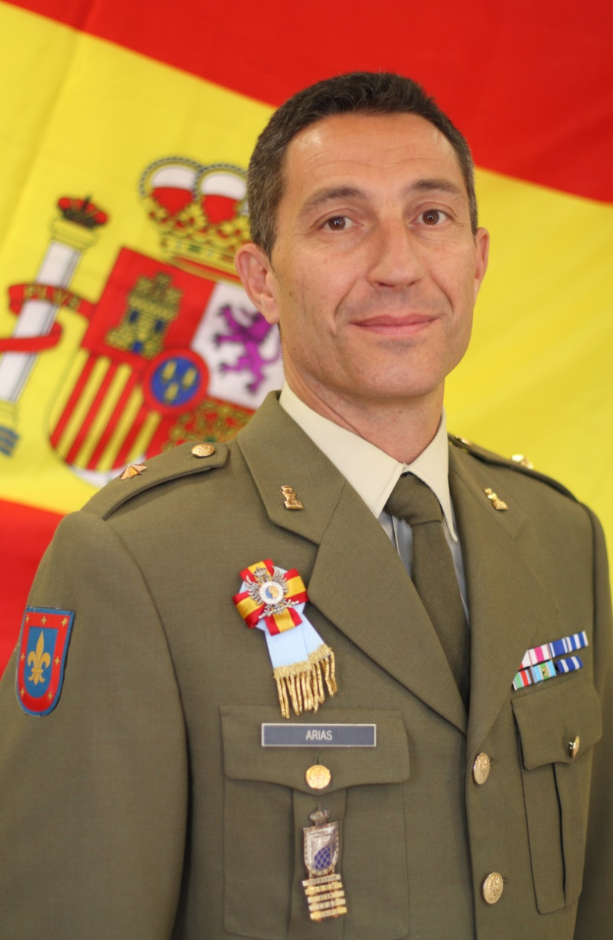


Slide 3
Introduction
What we do
What we need
What we have
Notes:
So, this is the agenda for my presentation. I’ll make a brief introduction to who we are and why we are here, and then we will see what we need and which solutions we are working out to that purpose.

Slide 4
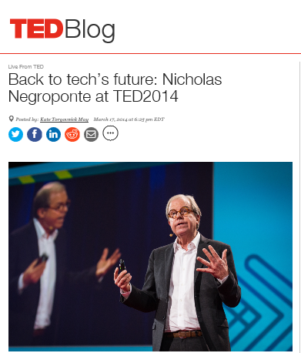
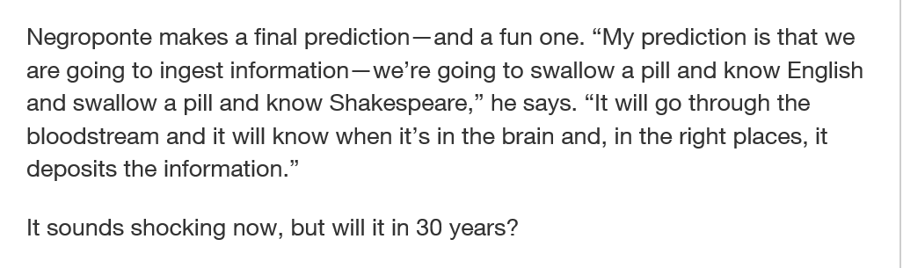

Introduction
Notes:
Everything we have been learning these past three days will be unnecessary when Mr Negroponte’s prediction becomes real… or not. There will always be someone who has to design, prepare and concoct the ingredients for the pill.
But meanwhile, we have to instil the knowledge the “classic” way, this is…by a learning process. The pill will be a passive way of learning, and we need active involvement.
Let’s have a look to some ways we are trying now in our Armed Forces.

Slide 5













Introduction
Military Language School
Notes:
First of all, let me explain something: I am a member of the Spanish Army. My colleagues here belong to the Mil. Lang School (that’s MoD) and Guardia Civil. What I am going to present in the next few minutes is what we do in the Army. We are aligned, we are on the same page, and we share information, but this is just a sample of some Army initiatives.

Slide 6
What do we do?
TESTING
We test students
We share expertise
We support language learners
We support language maintenance
We support deployed personnel
TRAINING
(TEACHERS&STUDENTS)
OPERATIONAL SUPPORT
Notes:
We need tools to test students (proficiency SLP tests, progress tests,…).
Also we need tools to share teaching materials and best practises as well as to provide students with resources to support them, either when they attend courses, or more important, for self-study. And we are making a big effort in telling everyone that the test is not the end of the road… Keep language alive, and not letting it go “rusty” is another of our goals.
Of course, the ultimate goal of language learning is using it. Our personnel is deployed in different missions, with different duties and tasks. Lingüistic support is always welcome.
Finally, there are different actors involved in the process. Not only mere students, but program managers, planners, staff officers and the whole chain of command should be aware about procedures, regulations, and so on. All of these actors need information and motivation. And it has to be available. We have to reach all of them.

Slide 7
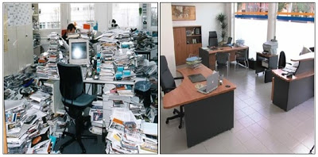
What do we need?
To organize/optimize information
To involve all stakeholders
To “spread the word”
VISIBILITY/ACCESSIBILITY/
AWARENESS/MOTIVATION
Notes:
Finally, there are different actors involved in the process. Not only mere students, but program managers, planners, staff officers and the whole chain of command should be aware about procedures, regulations, and so on. All of these actors need information and motivation. And it has to be available. We have to reach all of them.

Slide 8
What we DO/NEED
What do we HAVE?
TESTING
TRAINING
OPERATIONAL SUPPORT
VISIBILITY/ACCESSIBILITY/
AWARENESS/MOTIVATION
Notes:
For testing, we have Defence testing system, and Moodle, in a virtual Defence Campus. I think you may know about the former from previous conferences, and the latter is really a popular COTS.

Slide 9
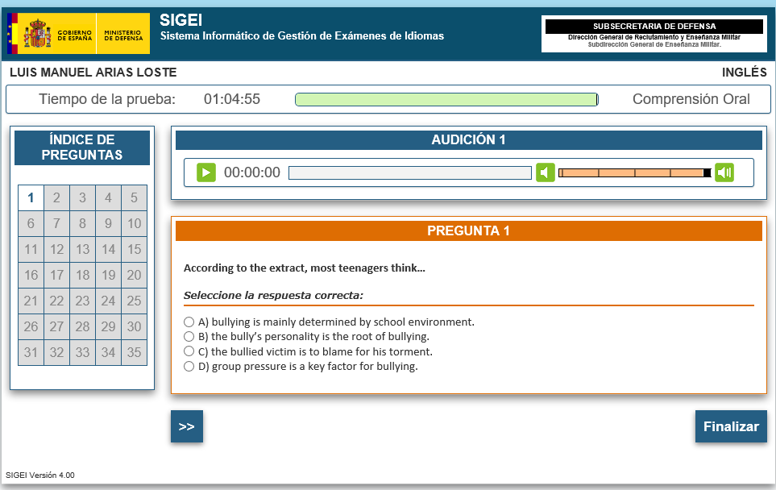
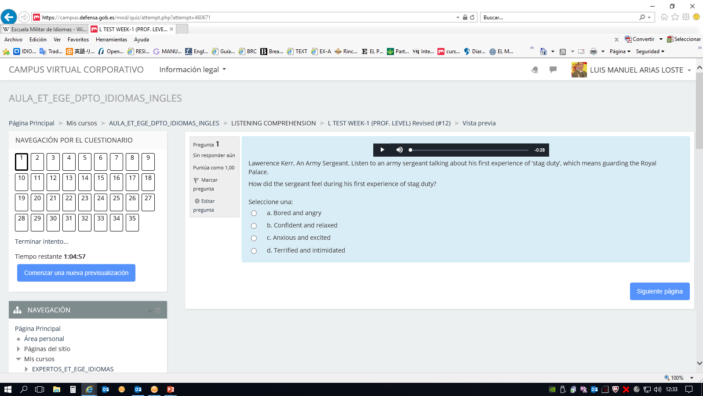
What we NEED
What do we HAVE?
TESTING
Notes:
For testing, we have Defence testing system, and Moodle, in a virtual Defence Campus. I think you may know about the former from previous conferences, and the latter is really a popular COTS.

Slide 10


What we DO/NEED
What do we HAVE?
TESTING

Slide 11
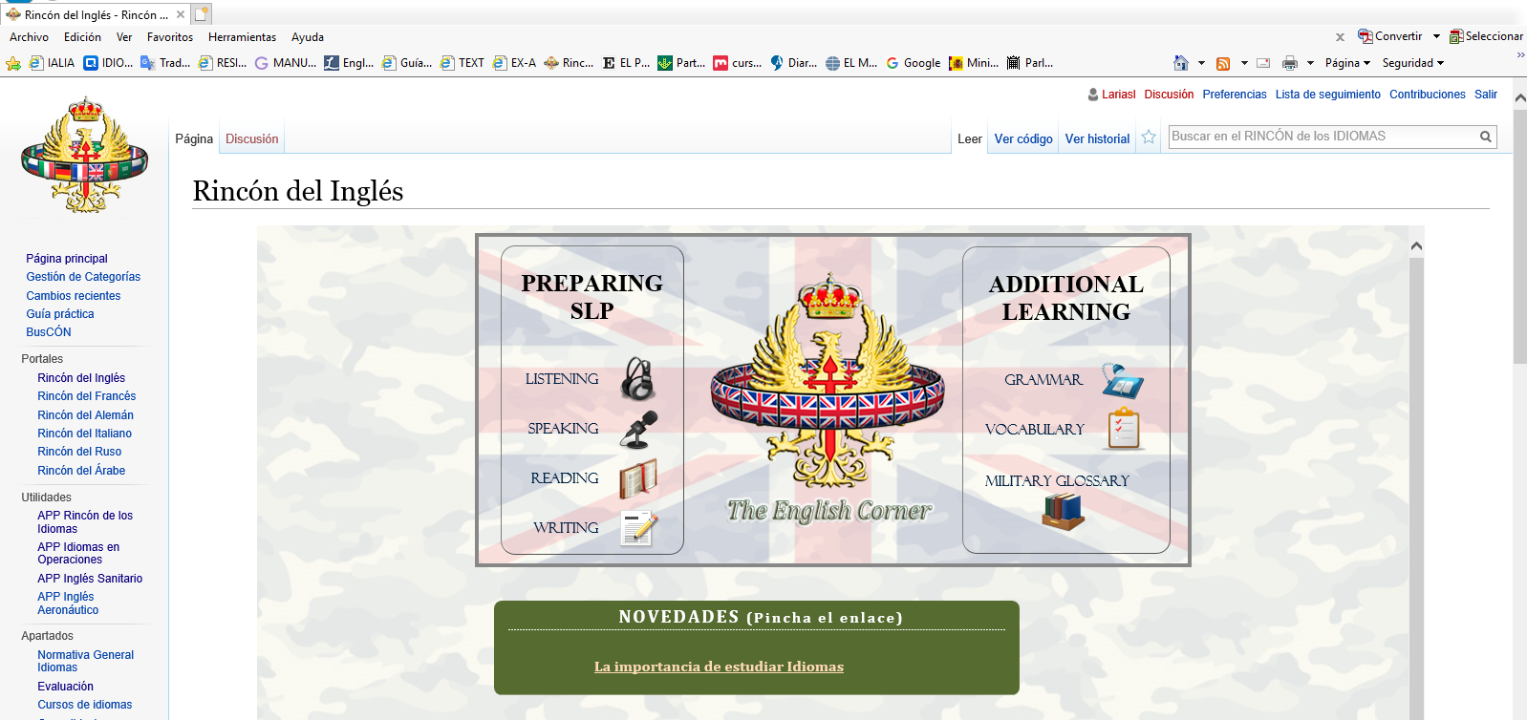
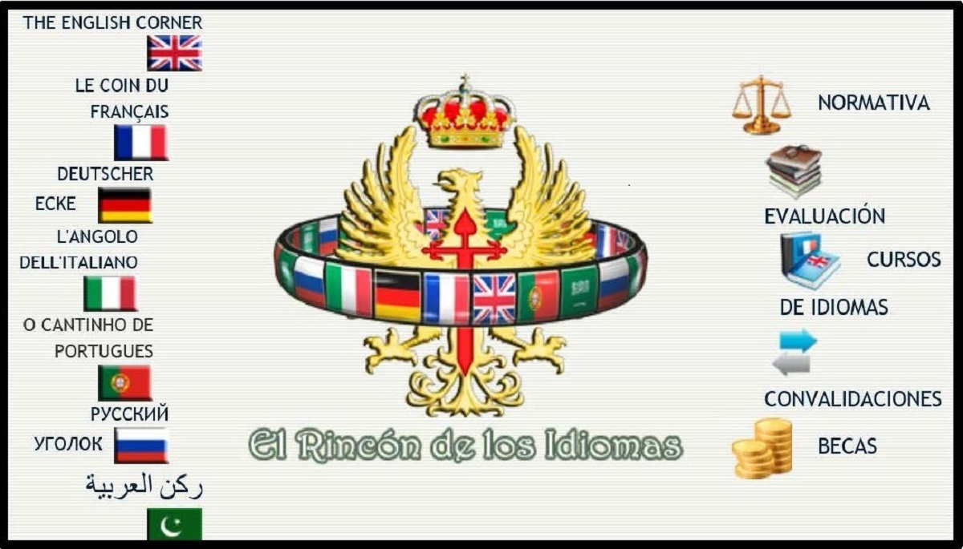
What we DO/NEED
What do we HAVE?
TESTING
TRAINING

Slide 12
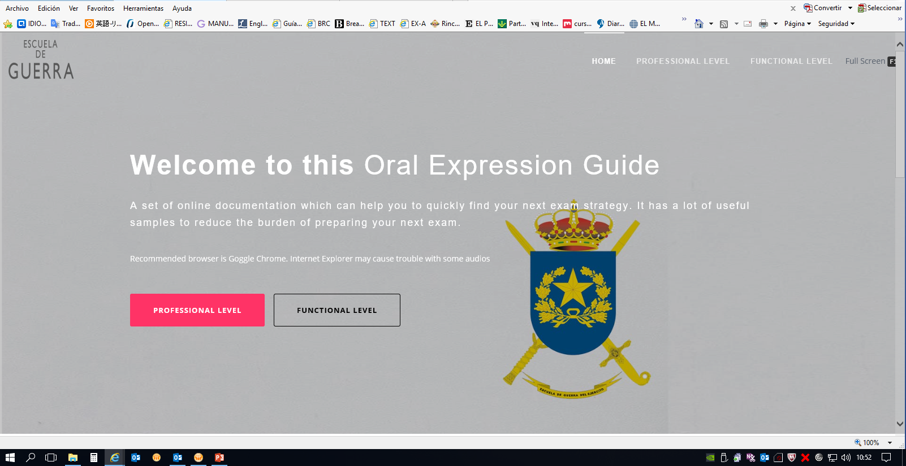
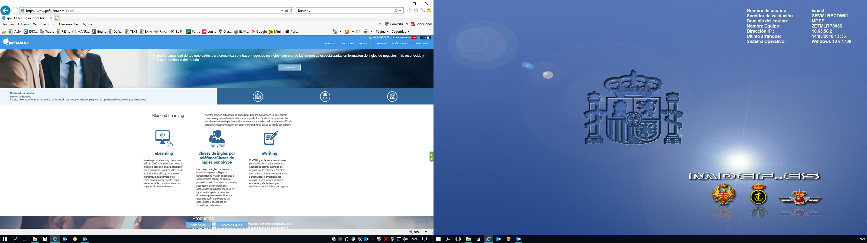
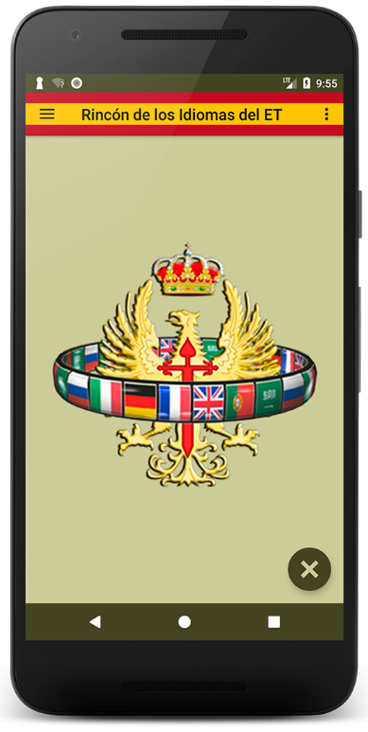
What we DO/NEED
What do we HAVE?
TESTING
TRAINING

Slide 13
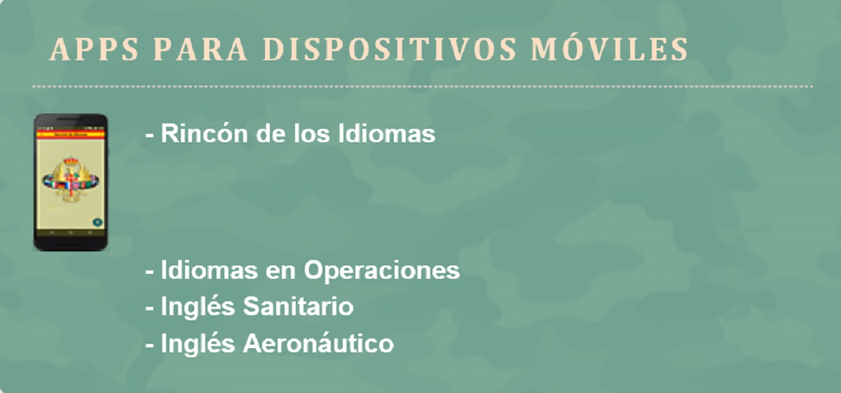
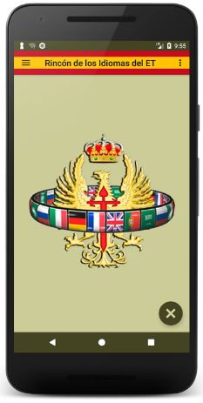
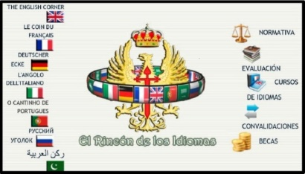
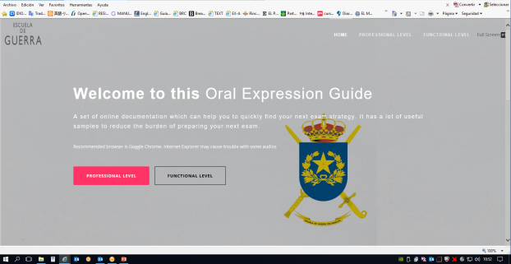

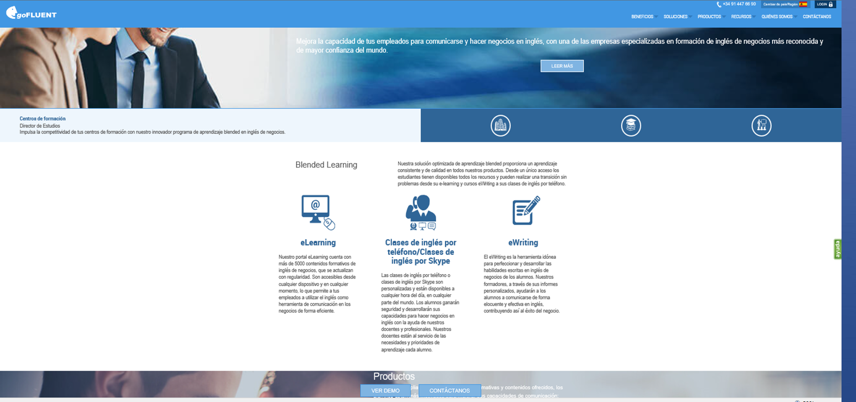
What we DO/NEED
What do we HAVE?
TESTING
TRAINING
OPERATIONAL SUPPORT

Slide 14
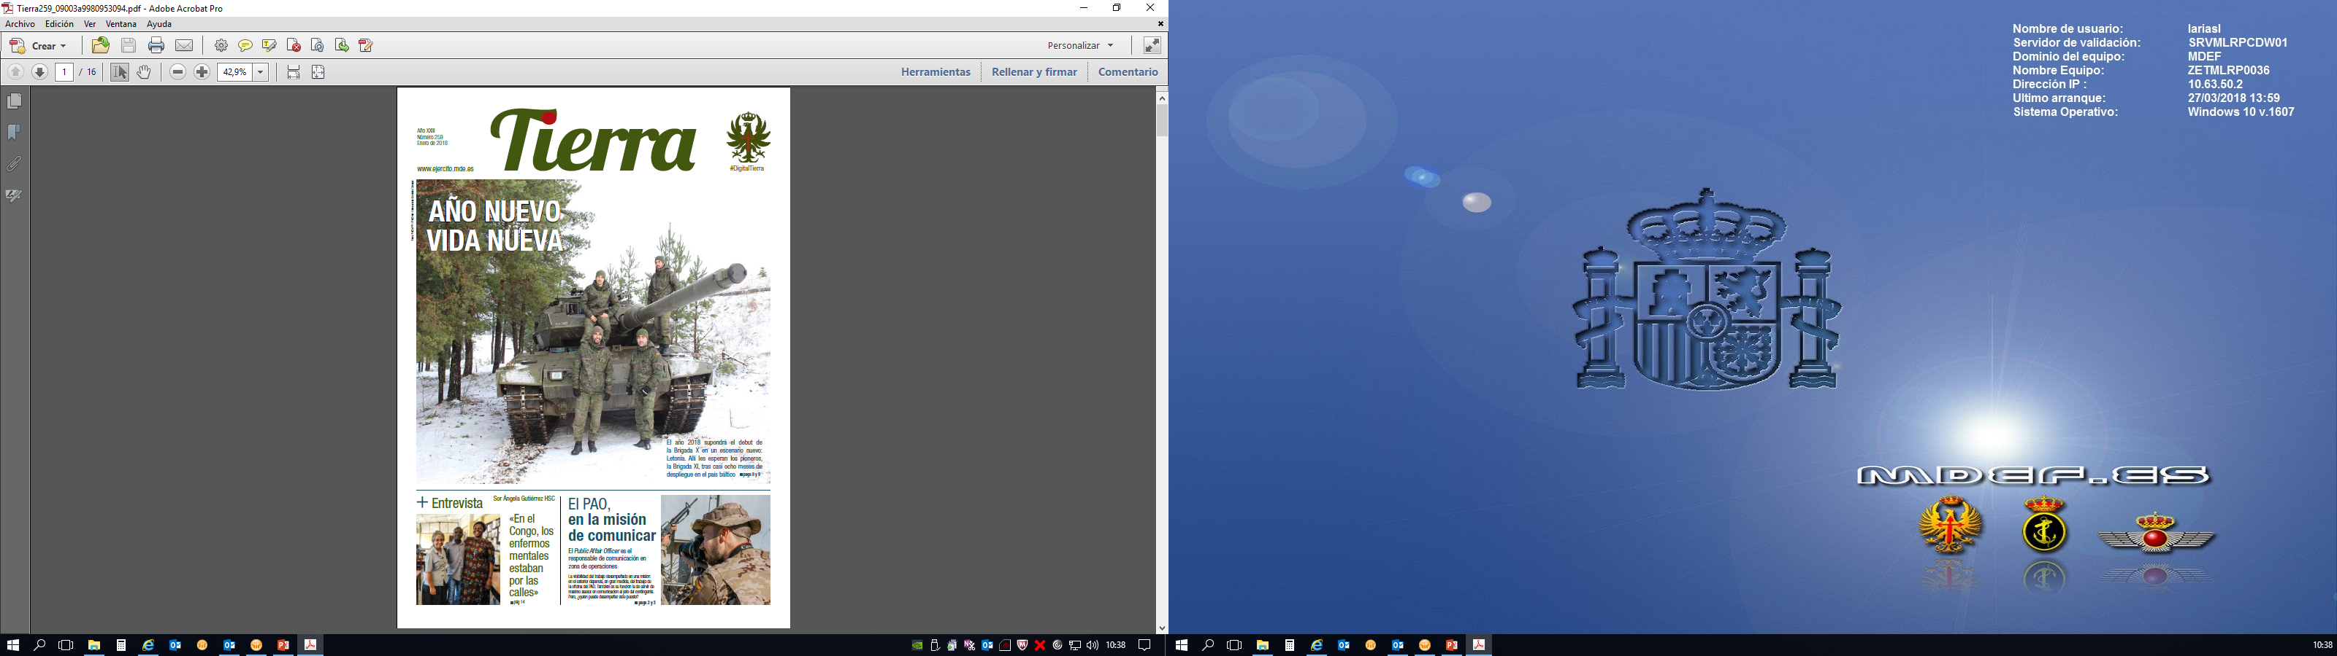
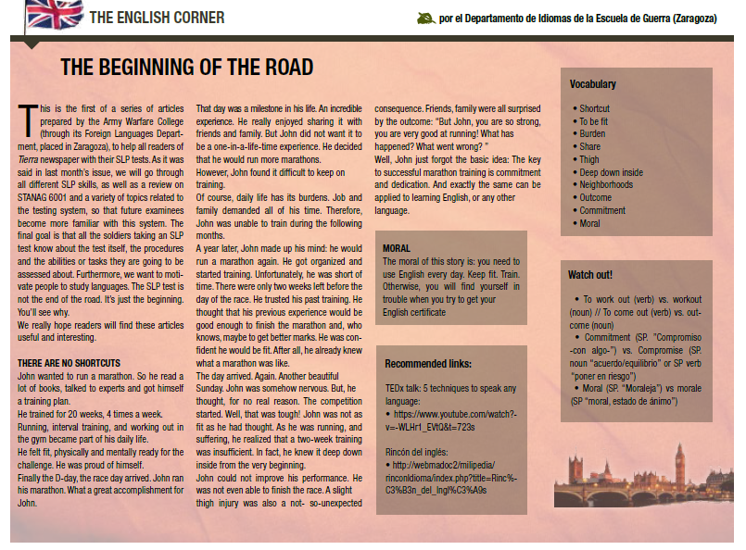
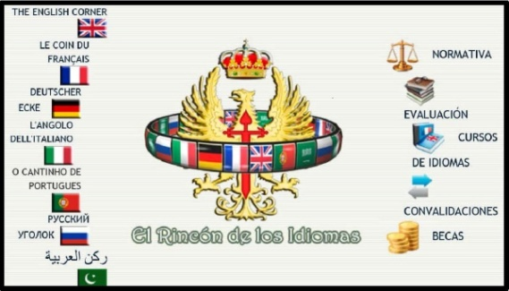

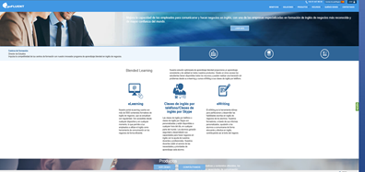
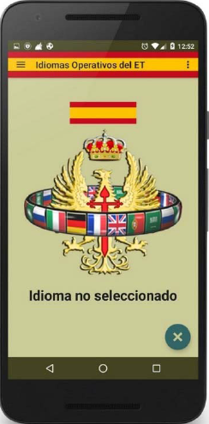
What do we NEED?
What do we HAVE?
TESTING
TRAINING
OPERATIONAL SUPPORT
VISIBILITY/ACCESSIBILTIY/
AWARENESS/MOTIVATION

Slide 15




What we DO/NEED
What do we HAVE?
TESTING
TRAINING
OPERATIONAL SUPPORT
VISIBILITY/ACCESSIBILITY/
AWARENESS/MOTIVATION

Slide 16
3. Students’ support tools: APP,s
Notes:
…our Educational Directorate has developed some smartphone APPs, to make it easier to reach this info. Not only for students, but also for different users (deployed personnel, for instance). As you see, some of them are “specific purpose”, and two of them we think are really useful for a general audience: Languages Corner, and Operational Languages.
If we have time, I’ll show you some of their most important features.

Slide 17
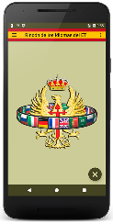
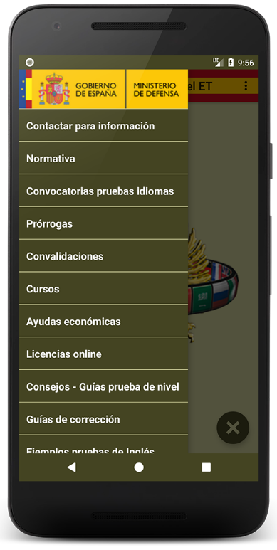
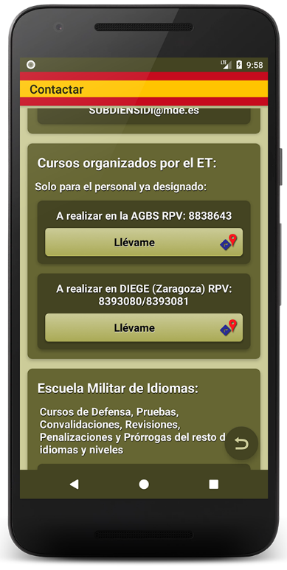
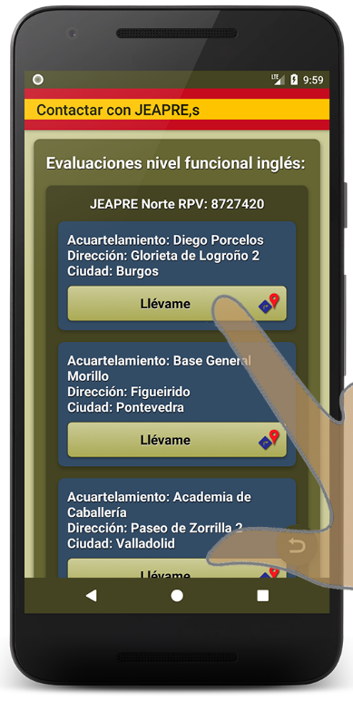
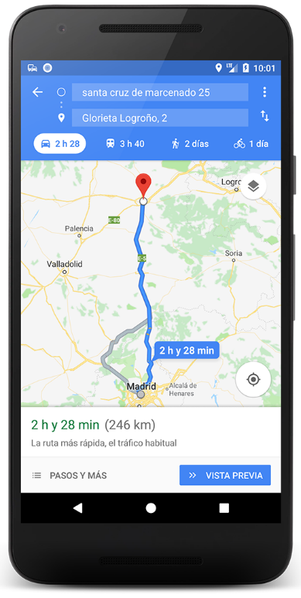
3. Students’ support tools: English corner
Notes:
…our Educational Directorate has developed some smartphone APPs, to make it easier to reach this info. Not only for students, but also for different users (deployed personnel, for instance). As you see, some of them are “specific purpose”, and two of them we think are really useful for a general audience: Languages Corner, and Operational Languages.
If we have time, I’ll show you some of their most important features.

Slide 18
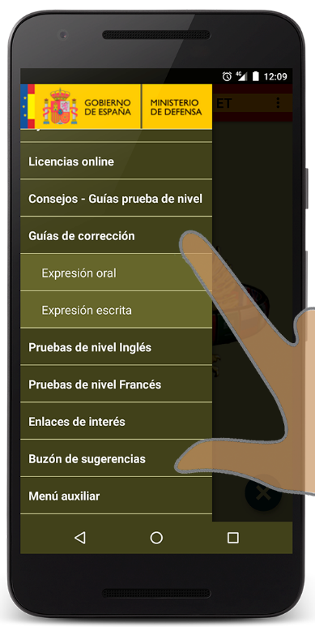
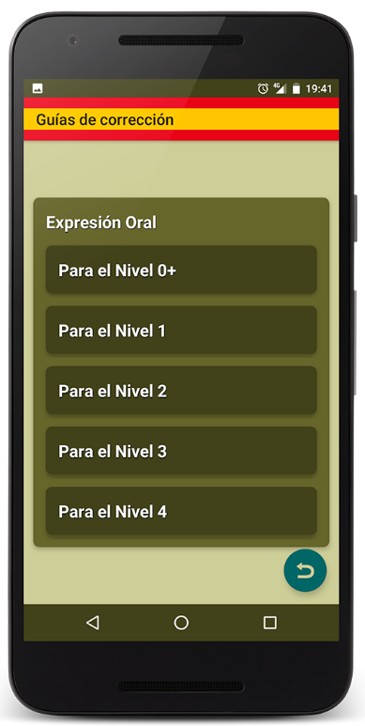
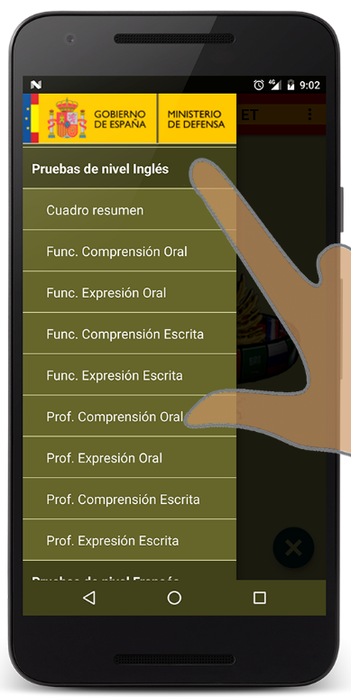
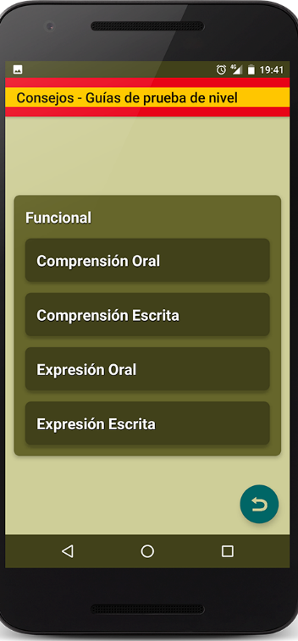
3. Students’ support tools: English corner
Notes:
…our Educational Directorate has developed some smartphone APPs, to make it easier to reach this info. Not only for students, but also for different users (deployed personnel, for instance). As you see, some of them are “specific purpose”, and two of them we think are really useful for a general audience: Languages Corner, and Operational Languages.
If we have time, I’ll show you some of their most important features.

Slide 19
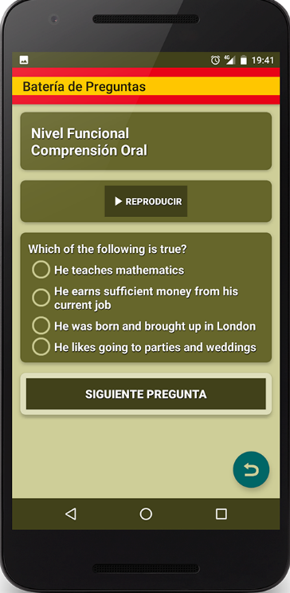
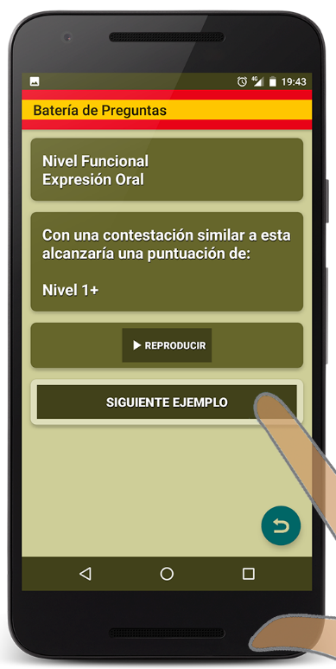
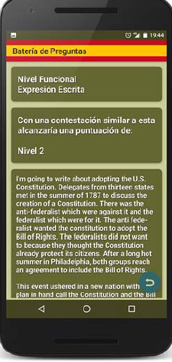
3. Students’ support tools: English corner
Notes:
…our Educational Directorate has developed some smartphone APPs, to make it easier to reach this info. Not only for students, but also for different users (deployed personnel, for instance). As you see, some of them are “specific purpose”, and two of them we think are really useful for a general audience: Languages Corner, and Operational Languages.
If we have time, I’ll show you some of their most important features.

Slide 20
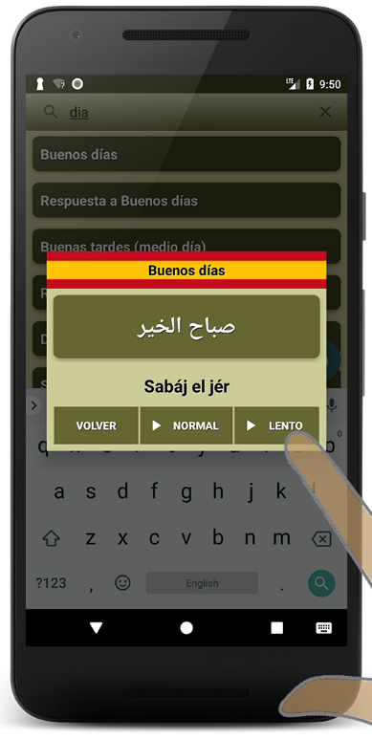
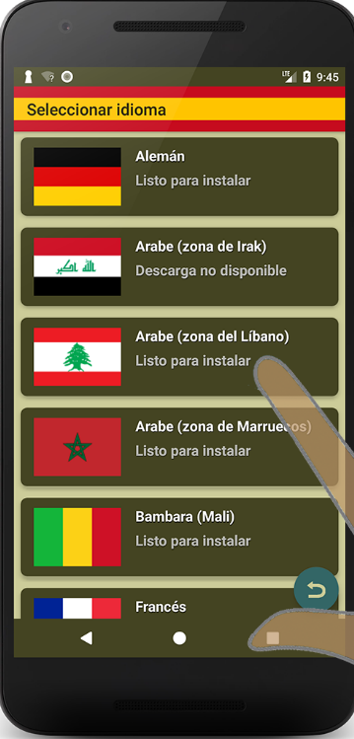
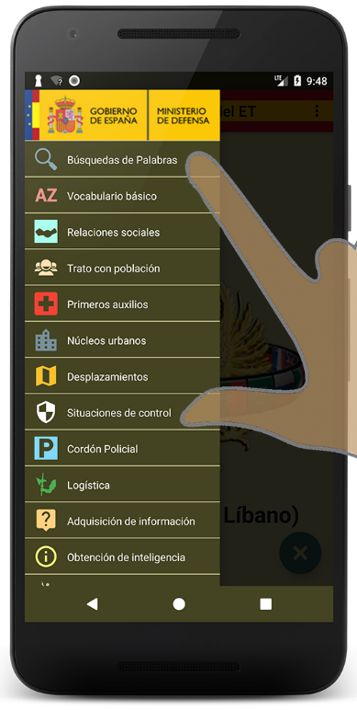
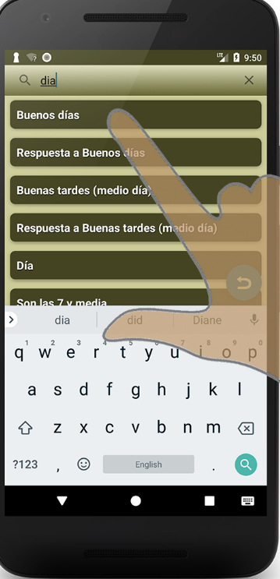
3. Students’ support tools: OPERATIONAL LANGUAGES
Notes:
…our Educational Directorate has developed some smartphone APPs, to make it easier to reach this info. Not only for students, but also for different users (deployed personnel, for instance). As you see, some of them are “specific purpose”, and two of them we think are really useful for a general audience: Languages Corner, and Operational Languages.
If we have time, I’ll show you some of their most important features.

Slide 21
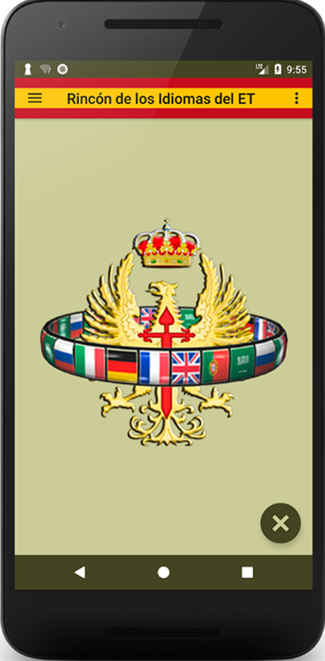

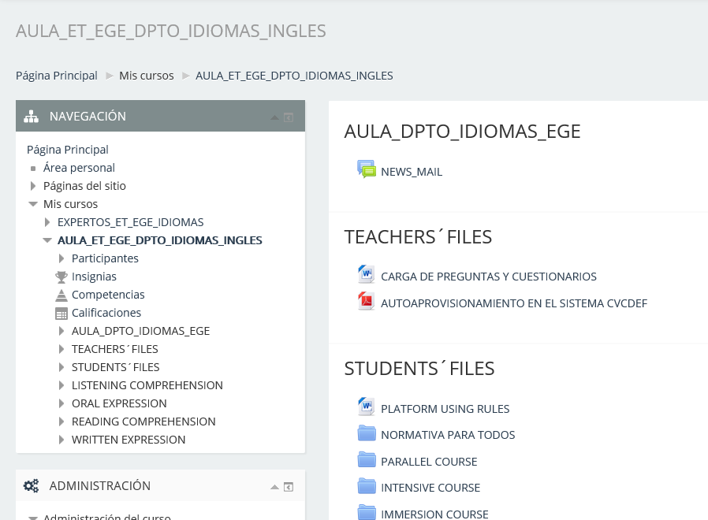
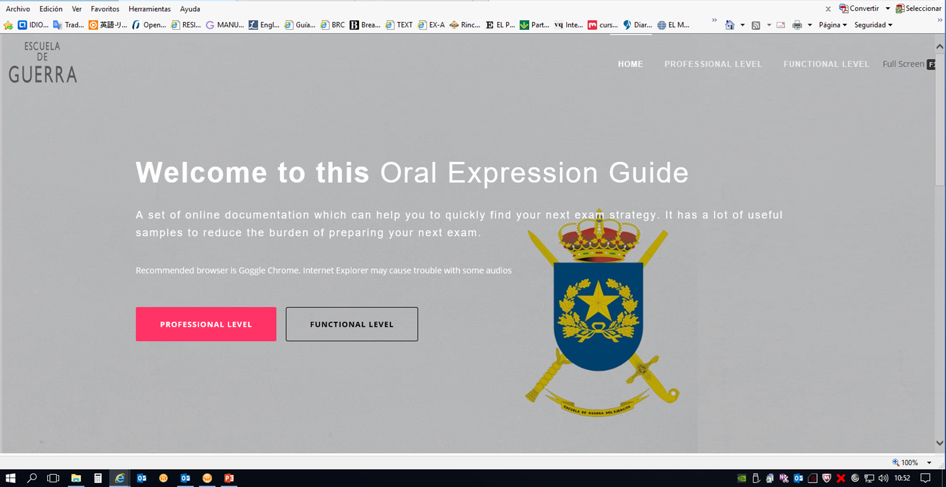
SO, ALL THIS… WHAT FOR?
Notes:
Bottom line, we have students, we have teachers, we have technology…

Slide 22
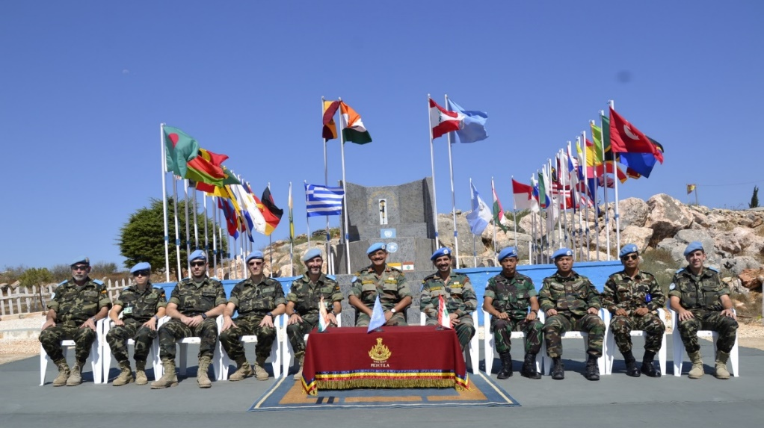
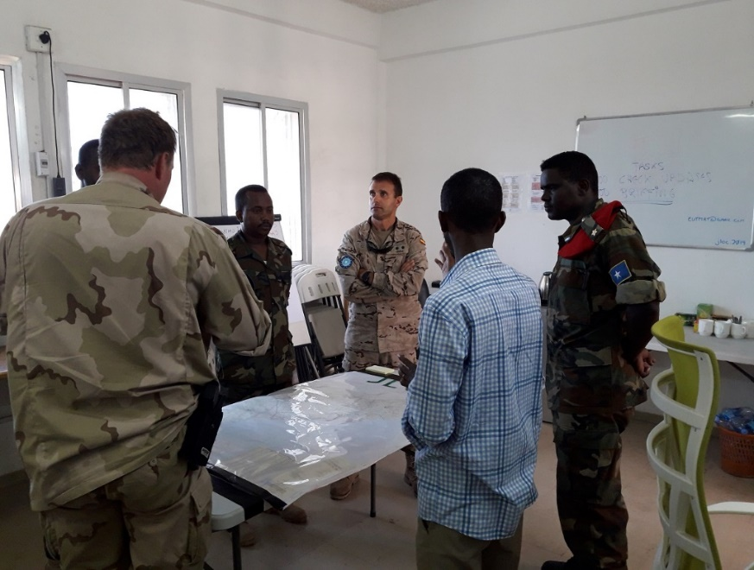
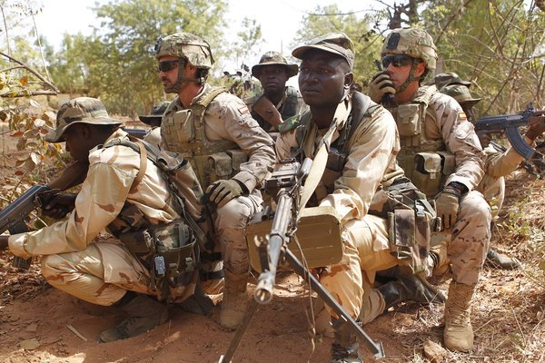
ORGANIZATION
MOTIVATION
INTEROPERABILITY
ENGAGEMENT
Notes:
Bottom line, we have students, we have teachers, we have technology… what for?
INTEROPERABILITY IS OUR GOAL.

Slide 23

QUESTIONS?
OBRIGADO
LTC. (OF-4) LUIS ARIAS
ARMY WARFARE SCHOOL
FOREIGN LANGUAGES DPT. (DIEGE)
lariasl@et.mde.es
+34 976 722 375

