Slide 1


Netherlands Defence Academy
Defence Language Centre
Colonel Peter Teeuw
Commander
Notes:
Dear colleagues,
It is an honour and a pleasure for us to be your guests here this week, and we are grateful to be able to learn more about your wonderful institute and your fields of expertise.
It goes without saying that we are also proud to give you a brief insight into our own institute, the Netherlands Defence Language Centre, or TCD. Intentionally brief, as I hope it will pique your interest and inspire you to honour us with a return visit.

Slide 2
This presentation
Who are we?
  Locations
  Organisation
Our mission statement and vision
Consequences of changed security situation in Europe on my task
Questions
Notes:
This presentation will cover the following topics: (See slide)

Slide 3
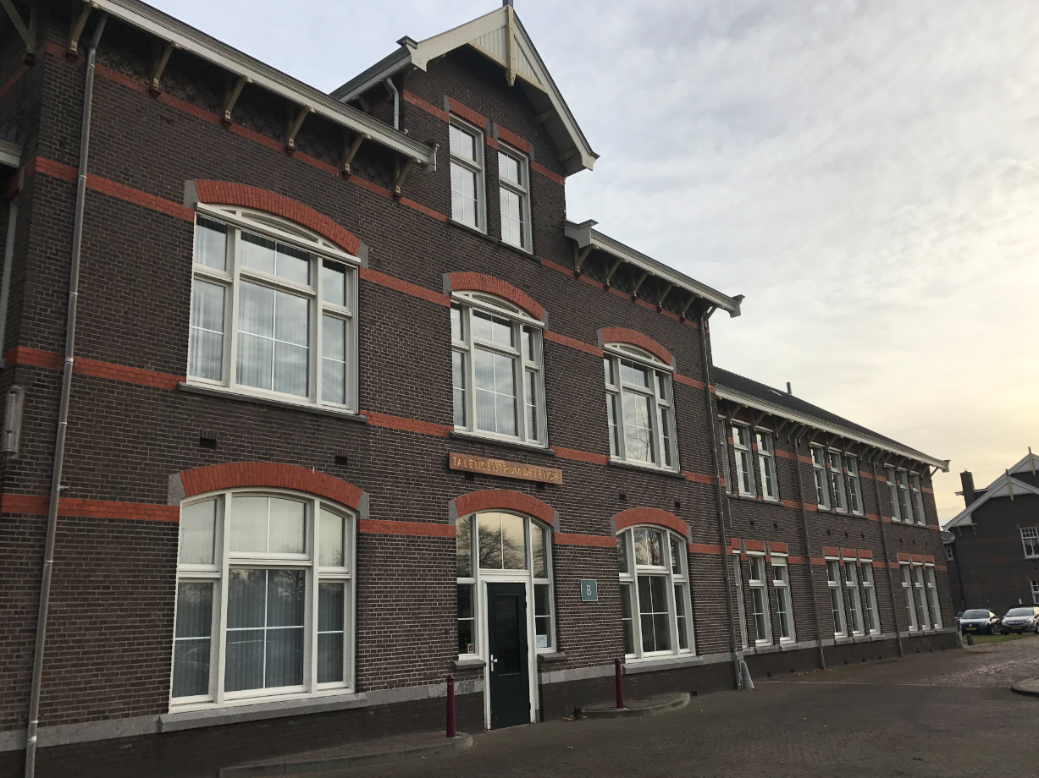
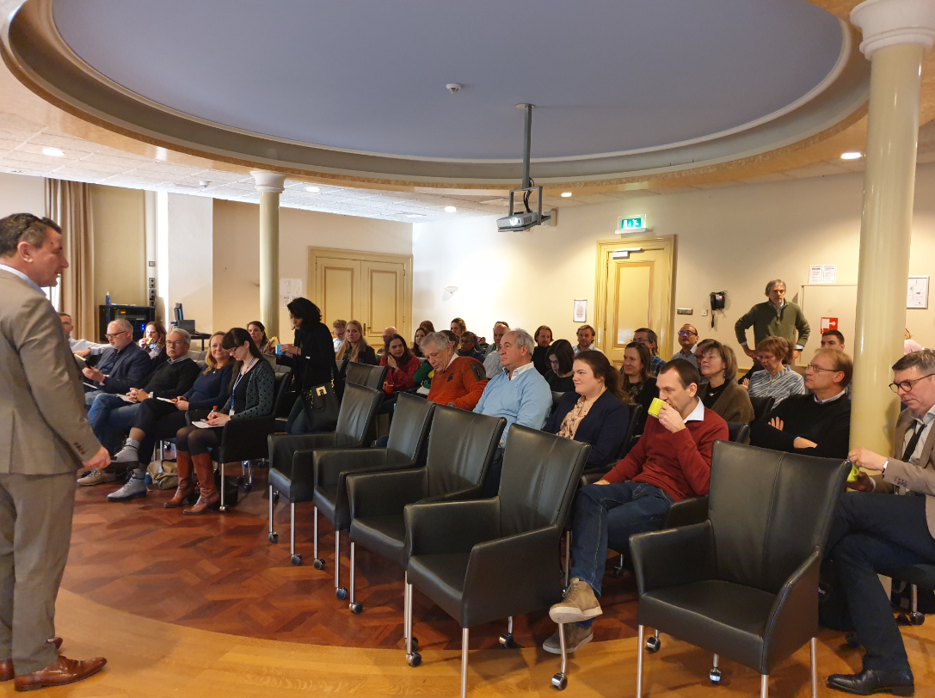
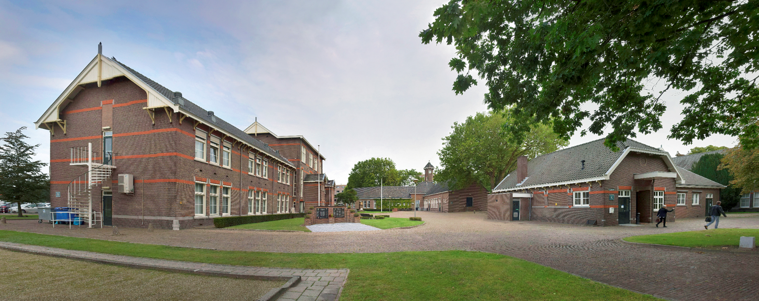
Who are we?
Notes:
Who are we?
We are a language institute full of enthusiastic professionals. Translators, teachers, interpreters, support staff and management. Mainly civilians with academic qualifications. We have a handful of military positions, including that of commandant, and a number of our civilian colleagues who also serve in the Netherlands reserve forces. A total of around 80 people, surrounded by a growing flexible network of other capabilities in the form of reservists, personnel with secondary assignments, framework partners, freelancers and so on. Our language centre, was established in 2014, bringing together existing capabilities that were up until that point scattered across the country.
The TCD is part of the Netherlands Defence Academy. Our main location is in Breda, in the South of the Netherlands.

Slide 4
TCD organisation
Operational interpreters: uniform – combatant - secret
Translation: from tweet to doctrine
Knowledge Centre: standardization – examination - innovation
Training & Education: education, training, incl. courses / tailored
C-TCD
Business
Support
1. Interpreting service
2. Translation service
3. Knowledge Centre
4.
Training &
Education

Slide 5

Our mission statement
'Armati cum lingua'
Armed with language
The Netherlands Defence Language Centre (TCD) supports and strengthens effective (intercultural) communication.
Notes:
Our mission statement is: (See slide)
Language is a form of communication, and to communicate effectively you have to be aware of your context.
The idea behind this mission statement is that the use of language, whether in writing or through speech, is a form of communication. The striking power of armed forces with an expeditionary task and a work force with a diversity of backgrounds, cultural and otherwise, is greatly increased if you improve people's capability for effective intercultural communication, enabling them to effectively communicate with each other and with national and international partners.

Slide 6
Training and Education department

Slide 7
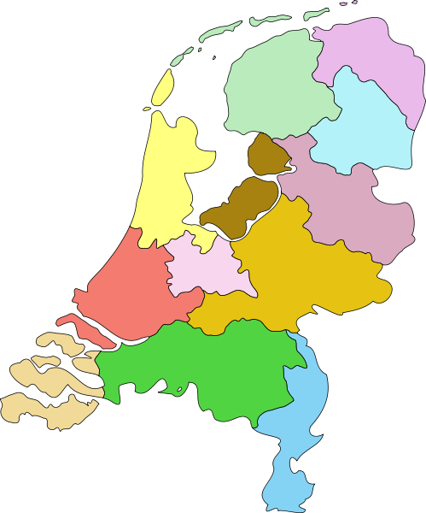















TCD locations
Training and Education:
NCO and Officer education all services: ENG & NLD
RUS, DUI, FRA: functional
ENG, NLD academic skills
NLD civilians working at MOD
Language training on request

Slide 8
Translation department

Slide 9

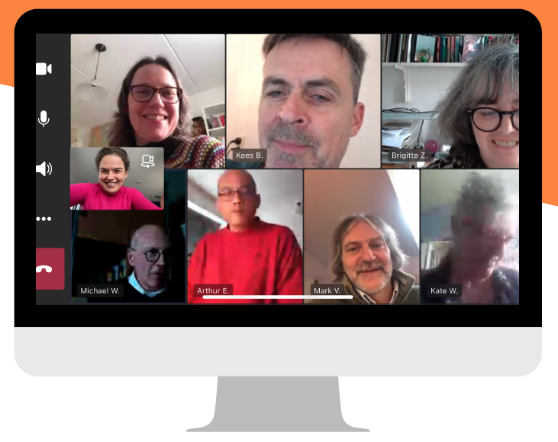
Translators:
English, French, German and vv
Terminology slows down machine translation
Translation and correction services for the entire Netherlands Ministry of Defence
From speech to SOP,
dinner invitation to doctrine publication
Notes:
Translation department:
Priority and USP: military-specific

Slide 10
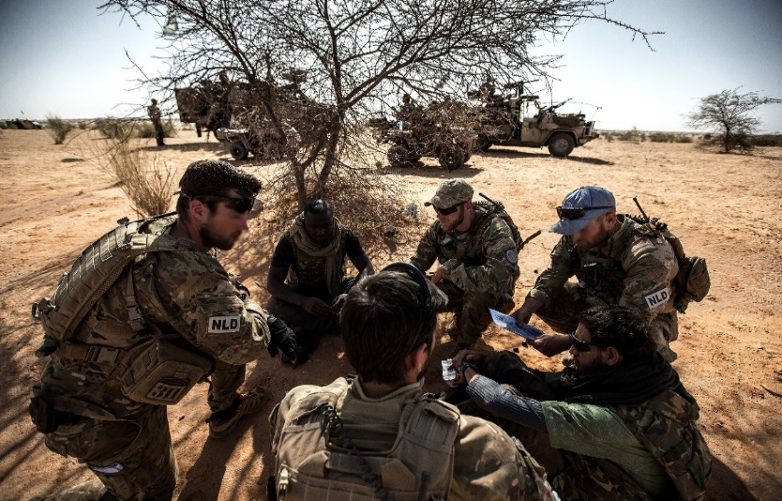
Military Interpreting Services department

Slide 11
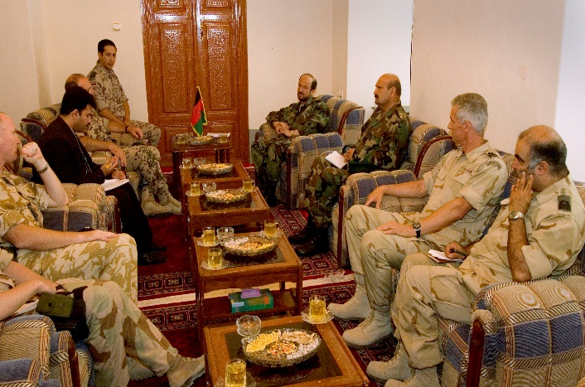
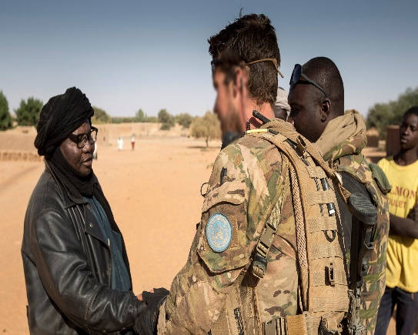
Provide military interpreters for the entire NLD Armed Forces
General information:
Two types military interpreters:
  Regular military personnel with sufficient language and interpreter skills (amateur)
  Reserve personnel with a civilian interpreter education (professional)
  Currently = not enough and not the required languages.
  As of summer 2024; select and train language supporters to become reserve personnel.

Slide 12
Generic changes
TCD-wide:
More More More
Intercultural communication
Military-specific
Innovation
Demand-driven
Context-aware
Flexible work force
Not-enough

Slide 13
Specific changes
From language education to language training.
More translations, use of AI around the corner.
Operational Interpreters become Language Supporters.
Implementation of ‘The Danish model’ (ownership and education of language supporters).
Enhanced requests for mil NLD language education for CIV staff.
Consequences of decreased language skills new generation military ≥ testing – own responsibility
Higher need for OEK interpreters.
The role of my unit in an armed conflict.
Strategic partnerships.

Slide 14
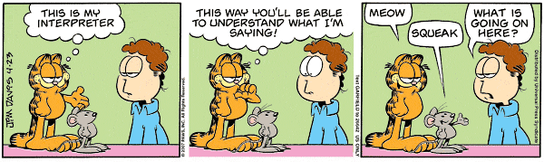
We’d be happy to answer them!
Thank you for
your attention
PYTANIA ?
FRAGEN?
BOΠPOC ?
PREGUNTAS ?
VRAGEN ?
QUESTIONS ?

