Slide 1

English Language Capacity Development in the
Georgian Defence Forces
Current strategies, policies and processes underpinning training and testing system
Joint presentation
Tamar Shavlakadze
Head of Foreign Language Testing Division
Maia Chomakhidze
Academic Manager of Language Training School
2024 NATO BILC Conference
May 12-17, 2024

Slide 2

Layout
Background information on the 16th initiative
Overview of the Foreign Language Testing Division
Overview of Language Training School
Conclusion

Slide 3

Background information on the16th initiative
NATO-Georgia Package (SNGP) the Wales Summit in 2014
Strengthening Georgia’s defence capabilities
- Developing closer security cooperation and interoperability with NATO Allies
- Contributing to the regional stability
Helping prepare Georgia for NATO membership
ELCD assessment report in 2018
ELCD was approved in 2020
ELCD Lead Nation Slovenia in 2022
ELCD Decision Making Body and
ELCD Advisory board were formed

Slide 4
Overview of Testing Division
Mission
Develop English Language Proficiency test NATO STANAG 6001
Conduct testing and evaluate candidates
Cooperate with national and international counterparts

Slide 5

Target audience
Military/civilian personnel of the MOD:
Rank/ job promotion
International positions
Personnel nominated to study abroad
Graduates of English language courses
Applicants for the positions of teachers and translators

Slide 6
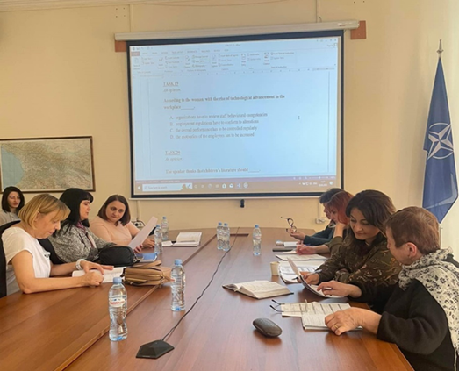
Cooperation with PLTCE; BILC; Deep
Different Workshops organized for the Georgian testers
LTS language testing Seminar (All the members)
ALTS Language Testing Seminar (All the members)
Annual BILC Conferences/Seminars/Testing workshops
DEEP / BILC STANAG 6001 testing workshops in 2023/ 2024
Piloting reading test for the shared item bank in 2022
BILC Benchmark Advisory Test (BAT 2) level 2&3 – 2019
Participation in Writing Assessment Research (ongoing 2024)

Slide 7
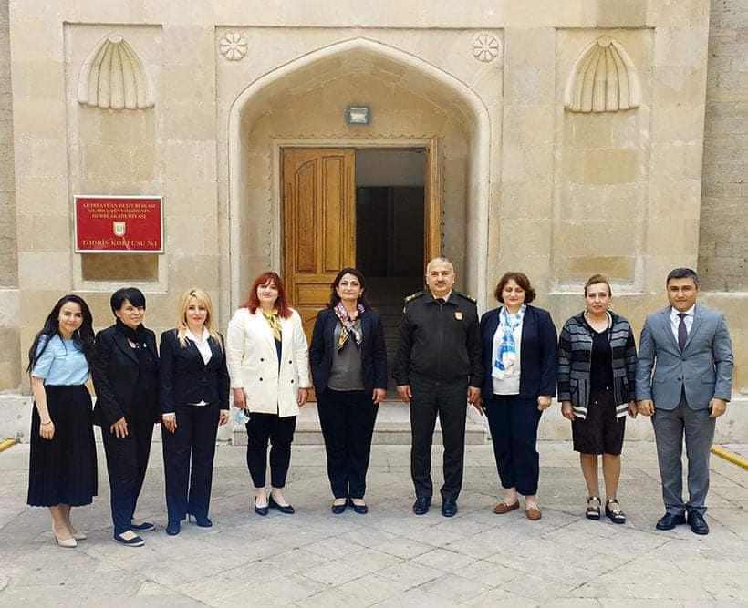
Bi-lateral Cooperation
Bi-lateral cooperation:
Lithuania
Czech Republic
Azerbaijan
Bulgaria
Romania
Purpose: facilitate standardization; conduct pre-testing;
review testing items; share experience;
have peer to peer conversation

Slide 8

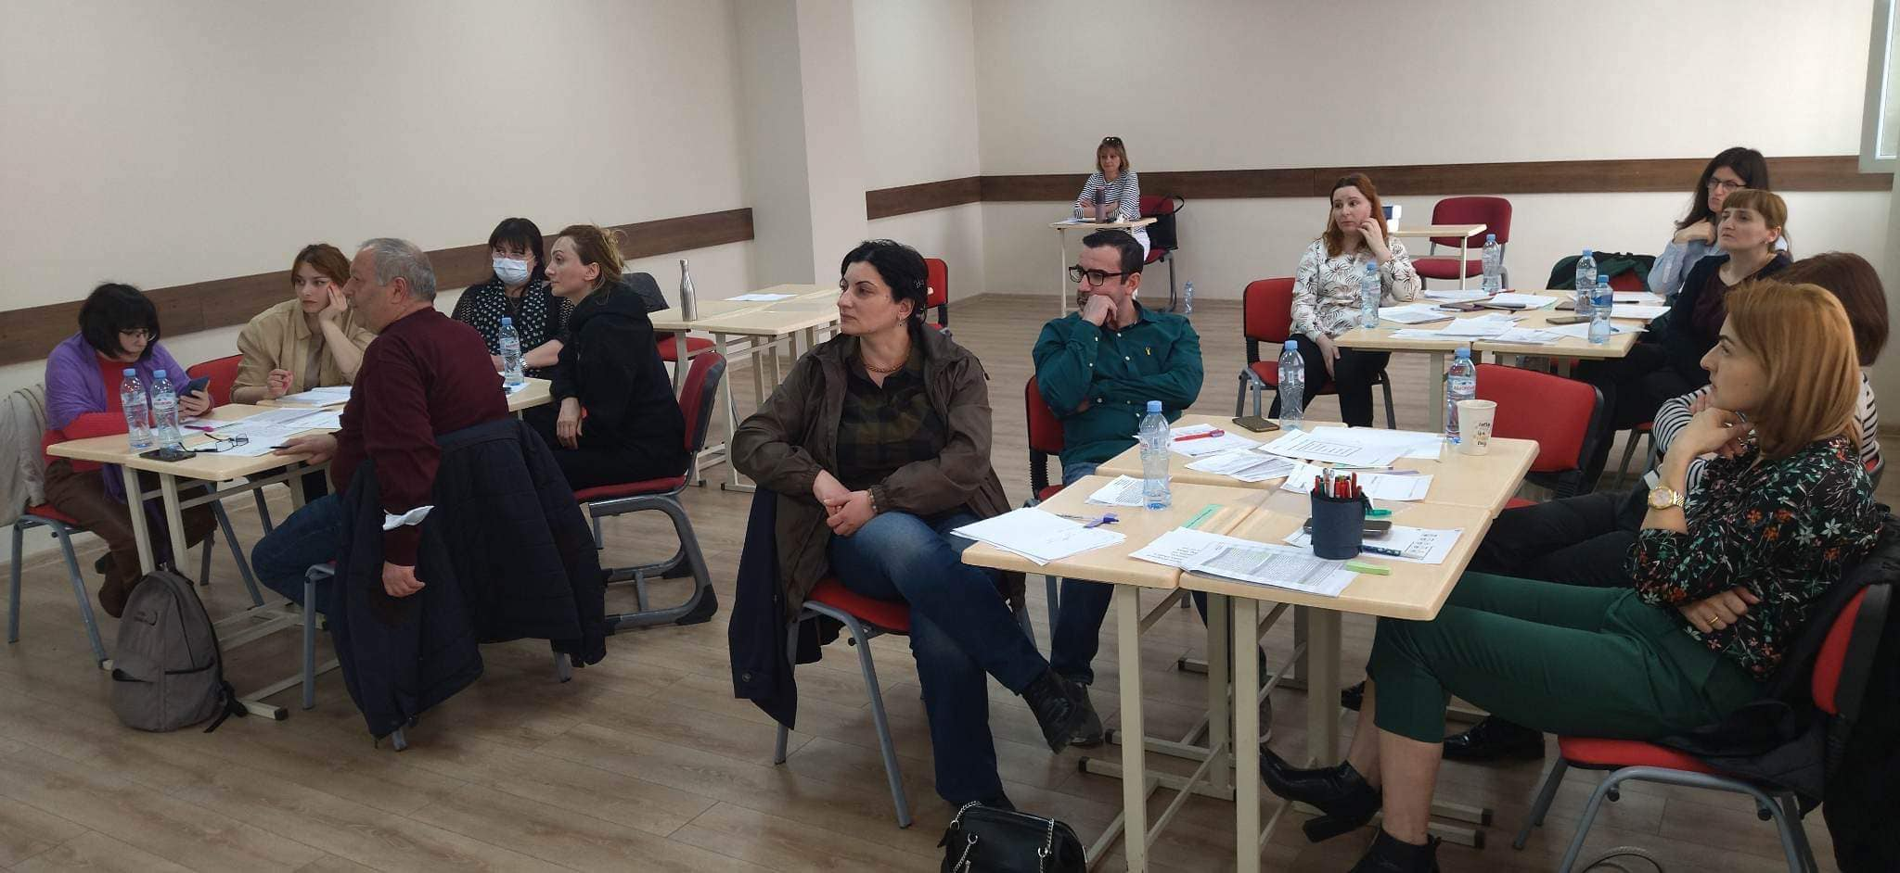
“
Current Strategies, Policies and Processes
English language capacity development policy and strategy approved in 2022
Policy document for Testing and Evaluation of English language according to STANAG 6001 signed by the Minister in 2022.
Structural change
Planned Testing Sessions
Results valid for 3 years
STANAG 6001 testing guidebook for the candidates in 2003
Computer Assisted Testing
Closer cooperation with Language Training School.

Slide 9
Language Training School
Layout
Background information
Overview of the LTS
Organization of the School
Improving Learning Conditions
Raising Quality of Teaching
Trainings, Workshops, and Other Events Planned by DEEP in 2024

Slide 10
Background information
The Language Center was established in the National Defence Academy of Georgia, in October, 2001
The Language Center transformed into Language Training School (LTS)– 2011
Every year the LTS offers various courses to its students - English, German, French, Turkish, and Russian
  The School operates under authority of the TMEC– 2021

Slide 11

Overview of Language Training School
Teaching foreign languages to military/civilian personnel to:
Improve their language skills
Improve their English skills for STANAG 6001
Familiarize students with various job-related educational courses overseas
Develop transferrable skills, like:
Communication
Making a presentation
Working in pairs/groups
Time management
Learning techniques.

Slide 12

Overview of Language Training School
Target Audience
Military personnel of the Defence Forces of Georgia
Civilian personnel of the Defence Forces of Georgia
Participants of International Military Education and Training Program (IMET)
Candidates for exchange programs

Slide 13
Organogram
Head of the School
Teaching Department (AM)
Administration
Planning
English Division
GE
FR
TUR
RUS
Tbilisi
Kutaisi

Slide 14

New textbooks have been purchased and used for the English Language intensive courses
New syllabi have been developed and implemented
Testing practices have been improved (developing testing specifications, defining testing procedures)
Course reports have been written
General military English handouts have been collated and used for the basic course
Assessment Rubrics for speaking and writing have been updated and created.
Student course evaluation survey has been conducted
.

Slide 15
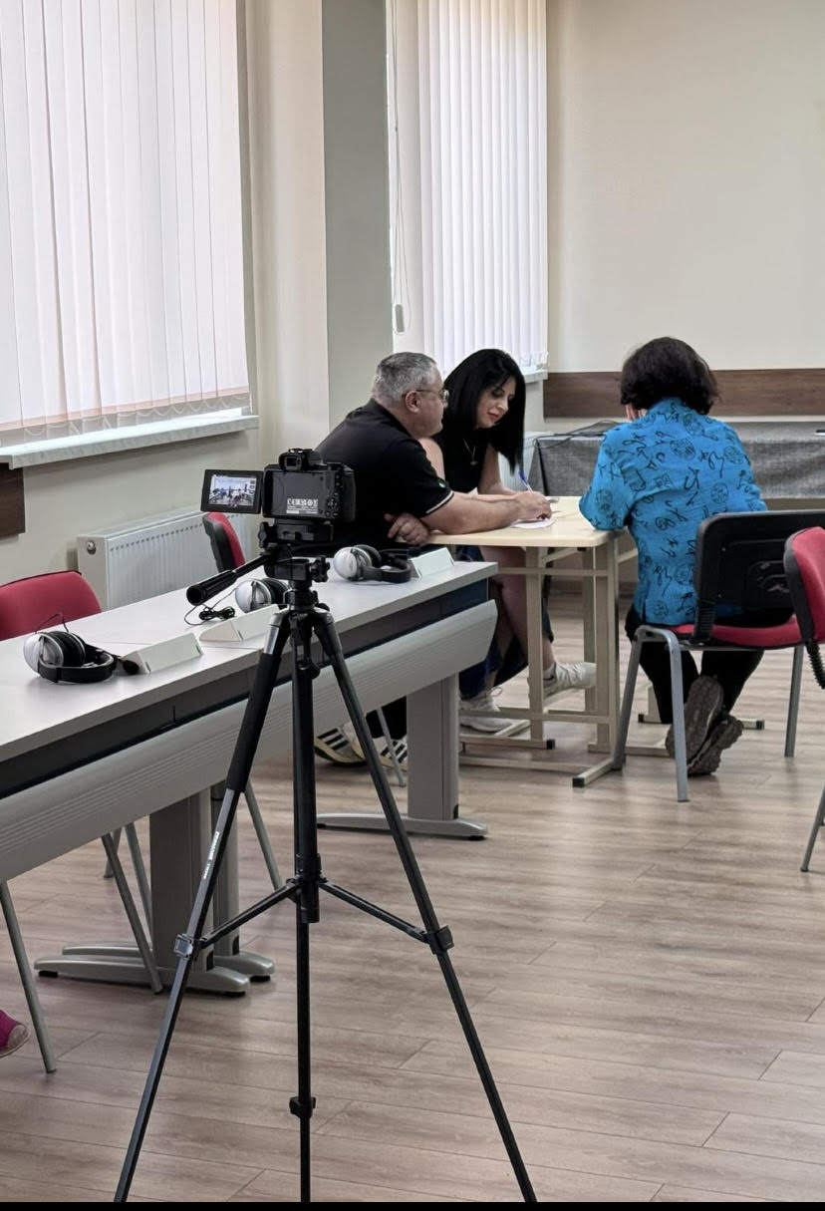
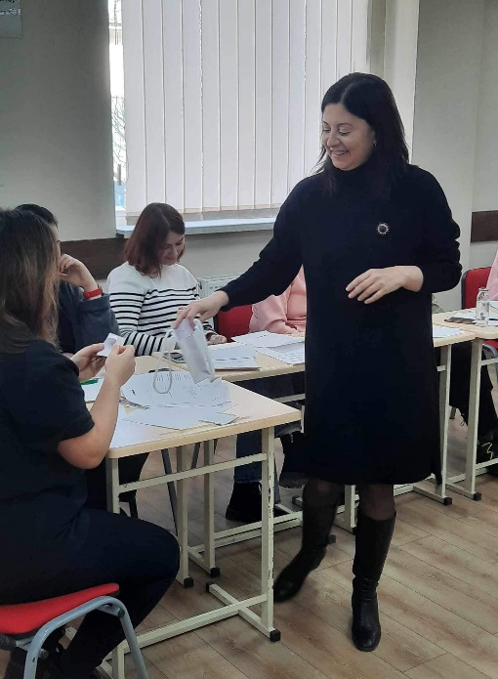
.
Raising The Quality of Teaching
CPD policy
Observation policy
Induction Policy
Teachers’ annual appraisal form
LTS code of conduct and classroom rules
Regular Inset sessions

Slide 16
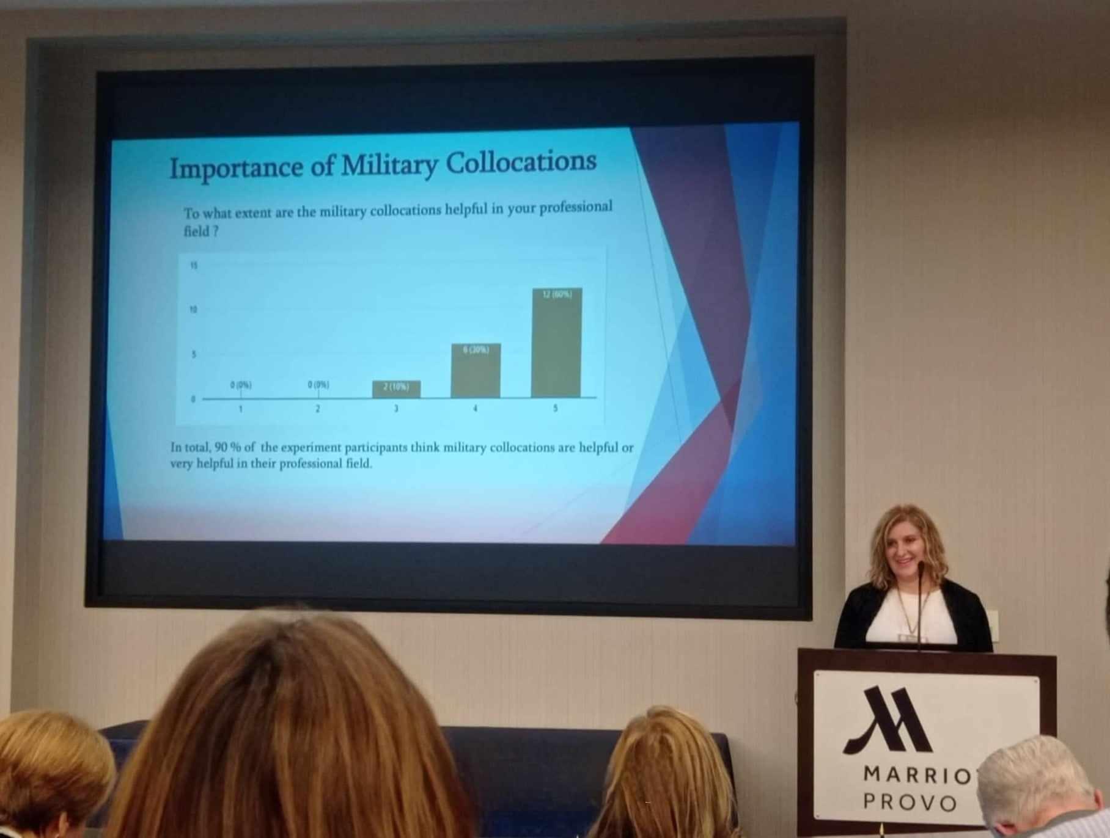

Future Plans
Developing management processes and procedures by developing school policy documents and relating SOPs.
Training of Teachers and Testers
Refining Teaching Methods
Updating Curriculum

Slide 17
Conclusion
Necessary policies, strategies and documents
- created more transparency
- Increased operational efficiency
- contributed to developing NATO compatible system
Further Investment in training and professional development
Further Cooperation with national and international counterparts

Slide 18
Thank you

