Slide 1
BILC PROFESSIONAL SEMINAR
06-11 OCT 2019
COPENHAGEN

Slide 2
Seminar theme
SETTING AND ACHIEVING PROFICIENCY TARGETS: THE “WHATS” AND “HOWS” OF EFFECTIVE TEACHING AND TRAINING

Slide 3
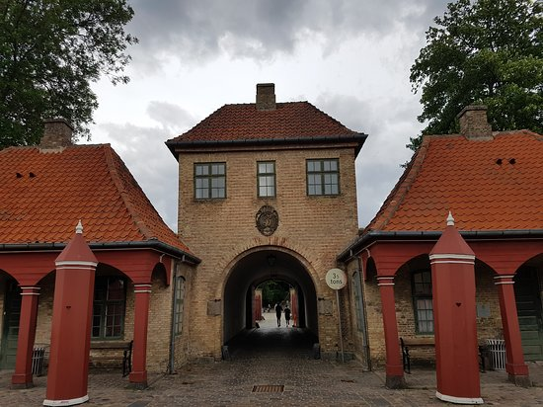
The WARM-UP

Slide 4
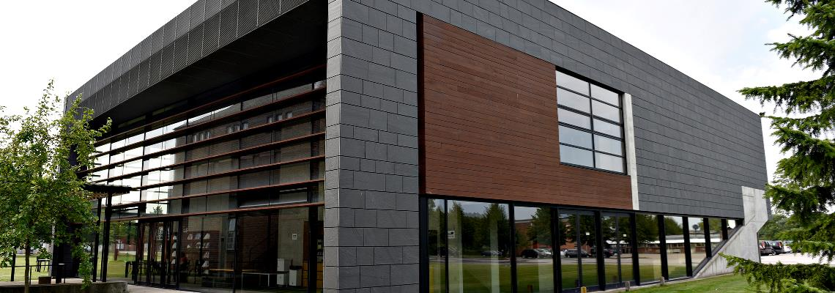
The venue
Royal Danish Defence College

Slide 5

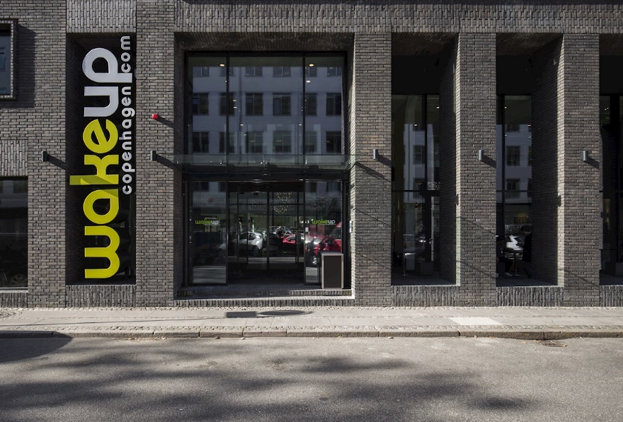
ACCOMMODATION

Slide 6

THE PARTY SCENE

Slide 7
The city
Four days in Copenhagen
A little something about Estonian-Danish relations

Slide 8
PRACTICAL STUFF
Invitations to go out by late June
Presentations and workshops
Deadline for registration SEP 05
Seminar fee of 250 Euros
Hope to see you there….

