Slide 1

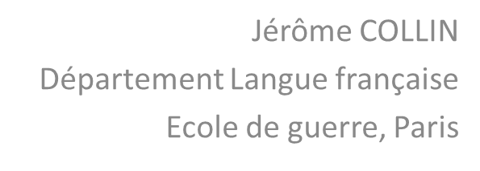
Military decision-maker and head of language classes: two commanders on the same boat

Slide 2
SENDER
OBJECT
RECEIVER
HELPER
SUBJECT
OPPONENT

Slide 3
SENDER
OBJECT
RECEIVER
HELPER
SUBJECT
OPPONENT

Slide 4
Linguistic
competency
Military
learner
∪
SENDER
OBJECT
RECEIVER
HELPER
SUBJECT
OPPONENT

Slide 5
Linguistic
competency
Military
learner
∪
SENDER
OBJECT
RECEIVER
HELPER
SUBJECT
OPPONENT

Slide 6


Slide 7
PRINCESS ∪ FREEDOM
SENDER
OBJECT
RECEIVER
KING
HELPER
SUBJECT
OPPONENT
KNIGHT

Slide 8
linguistic
competency
military
learner
∪
SENDER
OBJECT
RECEIVER
HEAD OF THE LANGUAGE CLASS
HELPER
SUBJECT
OPPONENT
mission & pedagogical material
psycholinguistic
difficulties
PROFESSOR

Slide 9
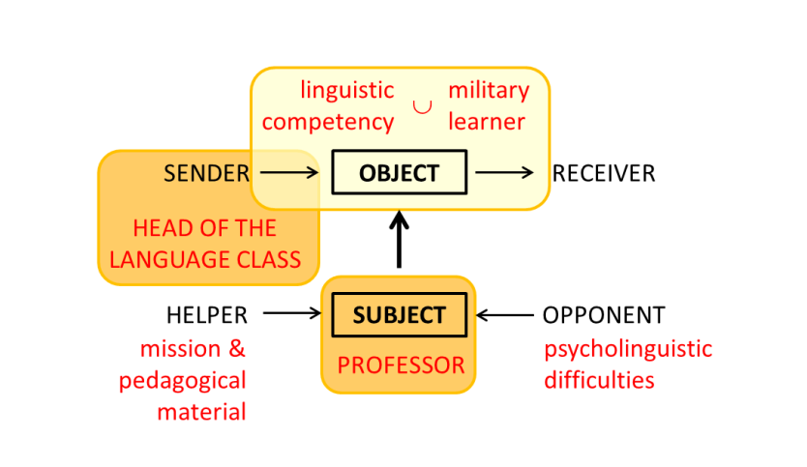
linguistic
competency
military
learner
∪
SENDER
OBJECT
RECEIVER
MILITARY HIERARCHY
HELPER
SUBJECT
OPPONENT
professor
mission
poorly defined
HEAD OF THE LANGUAGE CLASS

Slide 10
(academic profile + starting level)
pedagogy used
= length of training

Slide 11
Officer 1 | Officer 2
Asian | European
30 years old | 45 years old
continued higher education | high school education
daily use of English (professional and academic) | survival English (occasional professional)
Very recent French language learning in private lessons | French learned at school
beginner French level | intermediate French level
no French practice | occasional French practice

Slide 12
Officer 1 | Officer 2
Asian | European
30 years old | 45 years old
continued higher education | high school education
daily use of English (professional and academic) | survival English (occasional professional)
Very recent French language learning in private lessons | French learned at school
beginner French level | intermediate French level
no French practice | occasional French practice

Slide 13
Officer 1 | Officer 2
Asian | European
30 years old | 45 years old
continued higher education | high school education
daily use of English (professional and academic) | survival English (occasional professional)
Very recent French language learning in private lessons | French learned at school
beginner French level | intermediate French level
no French practice | occasional French practice

Slide 14
linguistic
competency
military
learner
∪
SENDER
OBJECT
RECEIVER
MILITARY HIERARCHY
HELPER
SUBJECT
OPPONENT
professor
mission
poorly defined
HEAD OF THE LANGUAGE CLASS

Slide 15
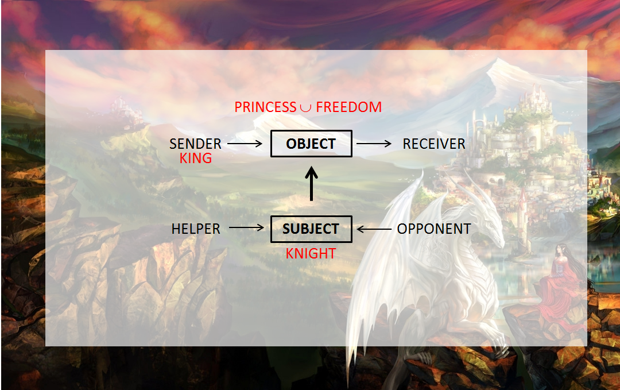
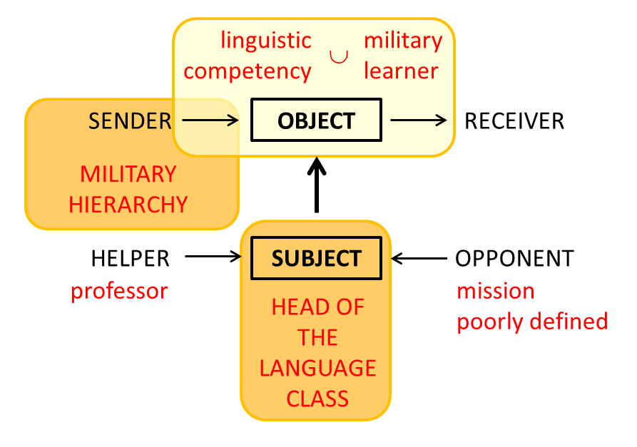
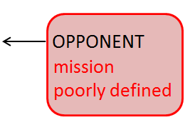

Slide 16
linguistic
competency
military
learner
inter-allied communication
∪
SENDER
OBJECT
RECEIVER
MILITARY HIERARCHY
HELPER
SUBJECT
OPPONENT
professor
mission
poorly defined
HEAD OF THE LANGUAGE CLASS

Slide 17
three ways of better identifying the aim of our work
contact with the professional future of the learners we train:
a brainstorming session where the former officers from the program compare what they learned during their training with their real needs during their schooling at the Ecole de guerre
an external perspective:
Master students each year do an internship study on adequacy of the pedagogical methods, course content, and the general organization of the program with the real needs of the officers
the long term:
contact with officers who, in general 5 or 10 years after studying at the Ecole de guerre, return to Paris as Defense Attaché

Slide 18
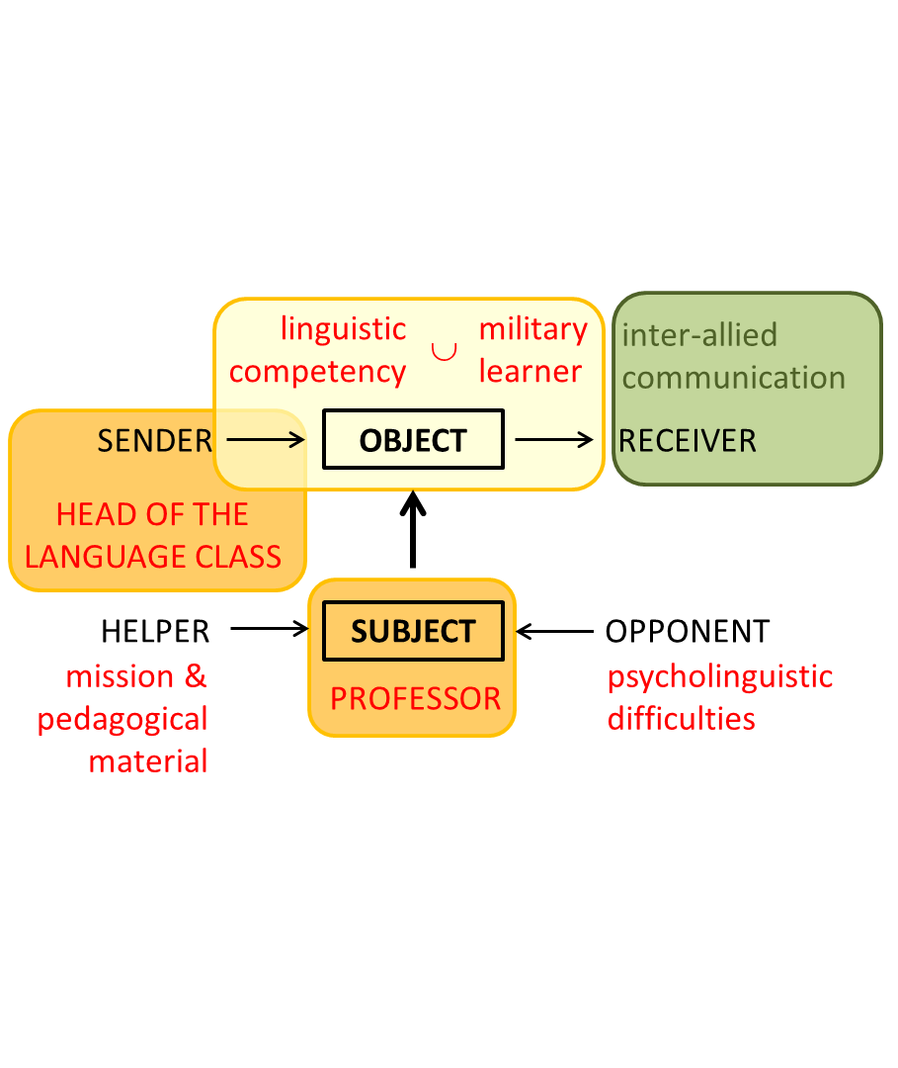
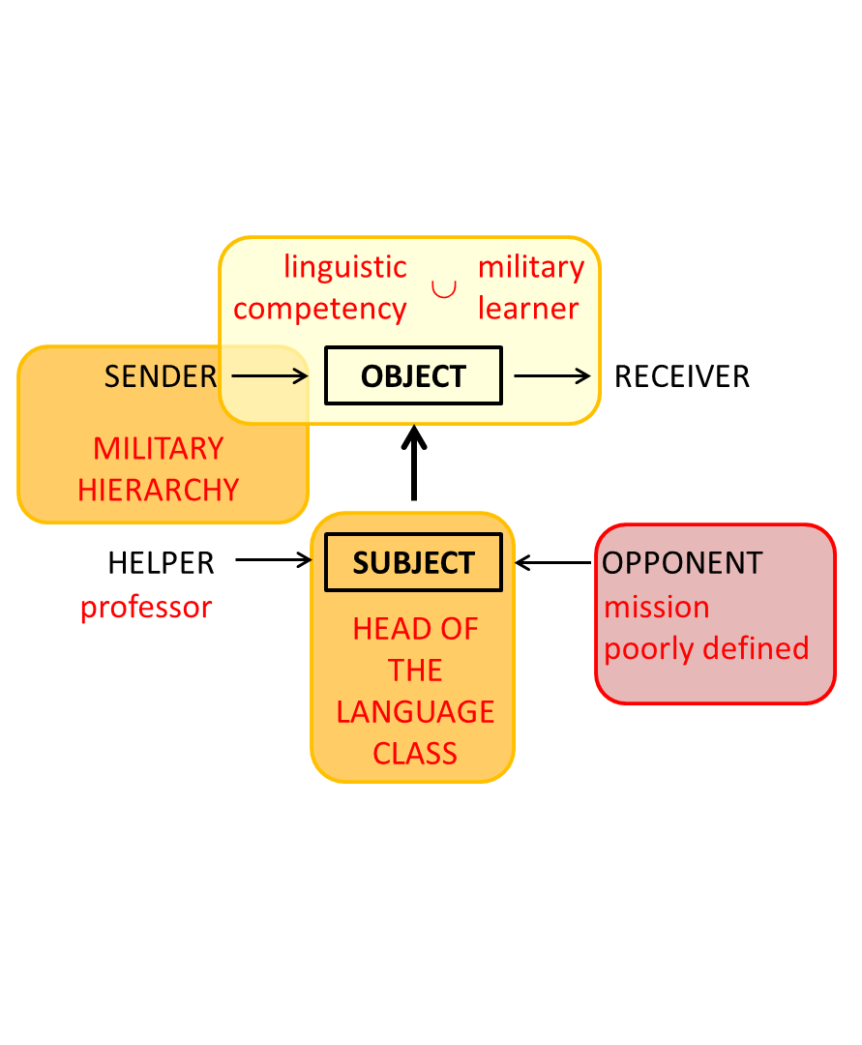
upstream
downstream

