Slide 1
No Battle Is Won Alone; aka
On the Way to Turn a Trabant into an Infantry Fighting Vehicle
Maia Boltovsky, Aigi Piirimees
Vienna, 2017

Slide 2
THE HOW AND WHAT OF OUR WAY
Bumpy beginnings
Reorganizing the curriculum
Specialist language – maps & terrain, weapons and vehicles, radio comms, 9-liner and MIST, OpOrd
5-paragraph order
Students assume responsibility
Exercise Thunder
- HWU, AAR

Slide 3
Use of English – Ex THUNDER
 | STRENGTHS | AREAS of IMPROVEMENT | RECOMMENDATIONS
FUNCTIONING | Manage well | Everyday language | Confidence Do not translate! Use every opportunity to practice
TERMINOLOGY and VOCABULARY | Know specialist vocabulary | Pronunciation Consistency Precision | Use every opportunity to practice Learn, learn, learn (V.I.Lenin)
GAMMAR | Quite good | Question formation Word order Prepositions – articles ☺ | Confidence Use every opportunity to practice

Slide 4
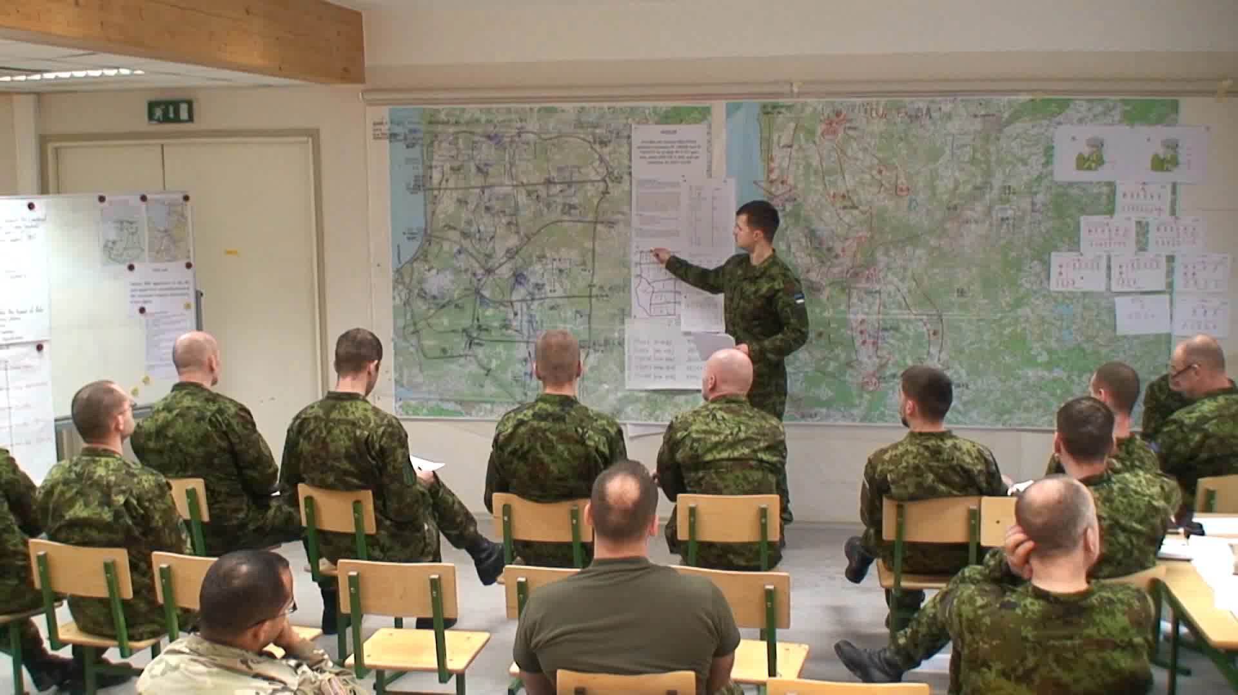

Slide 5
