Slide 1

BILC ANNUAL CONFERENCE 2018
FORÇAS ARMADAS
PORTUGUESAS
CTEN Marta Gabriel| 21 May 2018

Slide 2

BILC ANNUAL CONFERENCE 2018
Language Training and Testing
in the Portuguese Armed Forces:
Past, Present and e-Future
FORÇAS ARMADAS
PORTUGUESAS
LtCmdr Marta Gabriel| 21 May 2018

Slide 3
AGENDA
1. PAST
2. PRESENT
3. e-FUTURE

Slide 4
PAST
- Portugal joined BILC in 1978
The Armed Forces developed their training and testing teams and implemented curricula
Most of the faculty members were DLIELC graduates
  training facilities improved (language labs)
  Curricula, training and testing materials – ALC
  No joining or combined effort or sharing was promoted

Slide 5
PRESENT
Who are we?
Facility | Location | Staff
Portuguese Armed Forces Defence Staff HQ Languages Lab | Defence Staff HQ/MoD Lisbon | 1 officer 1 civilian
NAVY English Language Department | School of Naval Technologies Naval Base Almada | 4 officers 4 NCO
ARMY Army Language Center | Army Technical School Caldas da Rainha | 4 officers 9 civilians
AIR FORCE Air Force Language Center | Air Force Technical School Air Force Base Ota - Alenquer | 4 officers 1 NCO

Slide 6
PRESENT
What is our business?
Facility | Language Training Programs | Target population | Resources and Methods
PT Armed Forces Defence Staff HQ Language Lab | English - upon request (Different levels) | Officers, NCO, Enlisted and Civilians posted at the PT Armed Forces HQ and the MoD | Tailored authentic material SLP oriented material Language lab On-site
Navy, Army and Air Force’s respective Language Training facilities | General English (all levels) English for Specific Purposes: Focused on Productive skills Focused on specific vocab areas (naval ships, mechanics, eletronics...) French – upon request | Enlisted and NCO attending technical courses Officers and NCO applying to posts abroad Anyone trying to improve in a certain skill/area Anyone assigned to a mission where French is required in the JD | ALC (manuals, audio-visual materials, quizzes) Language Lab On-site (Navy and Army) b-learning (Air Force) Various Language Lab On-site and and b-learning Tailored Language Lab On-site

Slide 7
PRESENT
What is our business?
Facility | SLP type tests | Other tests
PT Armed Forces Defence Staff HQ Language Lab | English and French Officers and NCO applying to a position abroad | NA
NAVY English Language Department | English Officers and NCO preparing for a position abroad | ALCPT Quizzes
ARMY Army Language Center | English and French Officers and NCO preparing for a position abroad People applying for the Army | ALCPT Quizzes
AIR FORCE Air Force Language Center | English and French Officers and NCO preparing for a position abroad | ALCPT Quizzes

Slide 8
PRESENT
What are our challenges?
Retention of personnel (contract)
Training of specialized personnel - not a priority
Alignment – interpretation of STANAG 6001 descriptors/levels (new members)
Improvement of national regulation as a combined joined task
Set curriculum vs tailored training

Slide 9

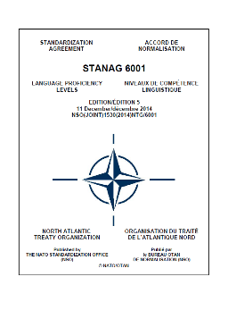



FUTURE
How “e-” can help us improve?

Slide 10
FUTURE
How “e-” can help us improve?
  What?
  Development of National Regulation on:
  test specifications (on going task);
  test development;
  test administration.
How?
  Encouraging combined effort - joint task;
  Coordinating item developing and piloting;
  Developing a common data base.

Slide 11
FUTURE
How “e-” can help us improve?
What?
  Faculty development regarding :
  teachers;
  testers;
  developers (tests and curricula).
How?
  Promoting meetings on a regular basis (on-site and distance)
  Conducting workshops focused on specific areas (Webinars)

Slide 12

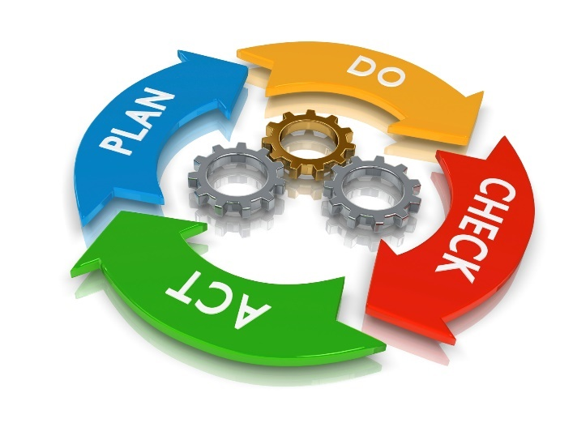
FUTURE
Invigorating Training through Technology
TECNOLOGY
ENABLES
COMMUNICATION
CHANNELS AND OFFERS
NEW
OPPORTUNITIES
LEADING TO
INTEROPERABILITY
AMONG
EVERY NATION
Notes:
Standardization is a SYSTEM
That, in this case, applies to language TRAINING and TESTING
For that to happen there should be ALIGNMENT with
STANAG 6001 and
Clear and objective DIRECTIVES
Both INTERNATIONAL and NATIONAL
That will enhance RELIABILITY
And VALIDITY of the testing system
Standardization should be a COMBINED and COMMON effort
Especially because sometimes we find GRAY ZONES to deal with
That is why we should promote ASSESSMENT regularly
So we can maintain our OBJECTIVITY
And INTEROPERABILITY
Standardization will help us keep a line of COMMUNICATION and
Improve our LANGUAGE proficiency skills.

Slide 13
Obrigado
Thank you

