Slide 1
Study Group 1
Activities for Building Cultural Mastery Blocks

Slide 2
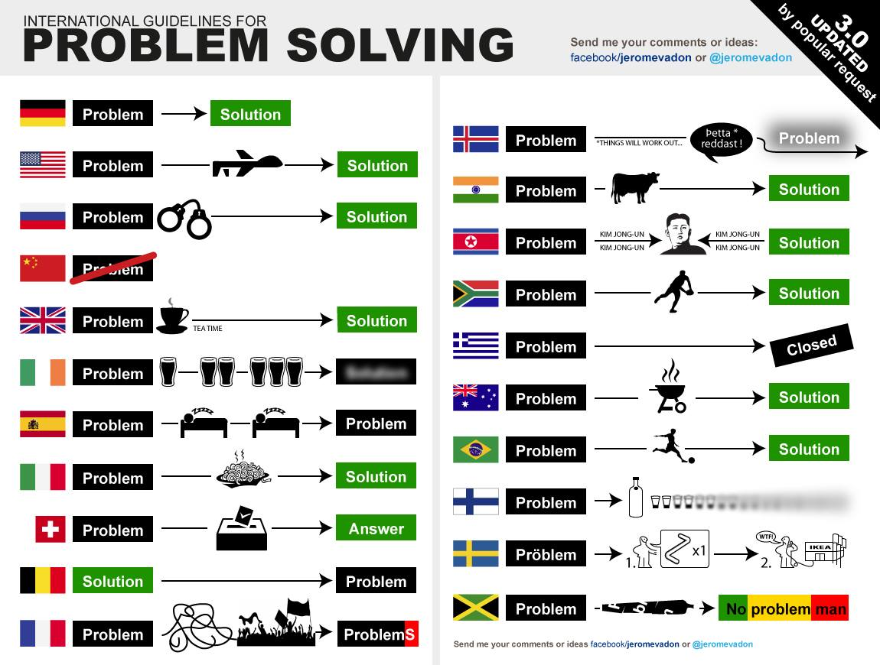

Slide 3
Understanding Culture (UK practice)
Social
Political
Economic
Values/Norms
Beliefs/Values
Physical Environment
Communication and Interpersonal Skills

Slide 4
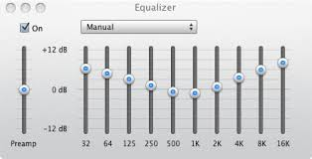
Other
Self

Slide 5
Cultural Mastery
Not achievable and unrealistic
Rather, focus on awareness and practice through the development of knowledge, skills, attitudes appropriate for the situation.

Slide 6
Activities
  DLI:
    Dliflc.edu/resources . . . (cultural orientation pages and exercises)
CIA
National Foreign Affairs sites
Any other that YOU might share

