Slide 1
QUALITY ASSURANCE OF EDUCATION AND
TRAINING IN THE SWEDISH ARMED FORCES
SWEDISH ARMED FORCES HEADQUARTERS
DIRECTOR OF FOREIGN LANGUAGES
MARIAMMA MARTIN

Slide 2
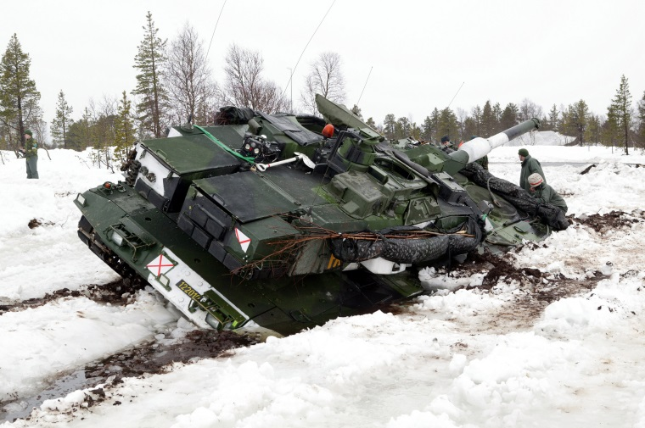
TABLE OF CONTENTS
DEFINITION OF QUALITY ASSURANCE (QA)
QUALITY ASSURANCE - SWEDISH ARMED FORCES(SwAF)
SWEDISH INSTITUTE FOR QUALITY - SIQ
SIQ CORE VALUES ADAPTED BY THE SWEDISH ARMED FORCES
QUALITY ASSURANCE - QA?
WHO? WHAT? WHEN? WHERE? WHY? AND HOW? IN THE SWEDISH ARMED FORCES
INSPECTION AS A METHOD FOR QA
INSPECTION PROCESS
PARTICIPANTS IN THE INSPECTION
STAKEHOLDERS
SELF ASSESSMENT FORM
FOCUS AREAS 2019
COLLOBORATIVE WORKSPACE ON INTRANET
THE INSPECTION JOURNEY
INITIAL SITE VISIT
INSPECTION

Slide 3


Slide 4
DEFINITION OF QUALITY ASSURANCE (QA)
Quality assurance has been defined as a program for the systematic monitoring and evaluation of the various aspects of a project, service or facility to ensure that standards of quality are being met - Merriam Webster

Slide 5
QA - SWEDISH ARMED FORCES (SwAF)
The standards for quality assurance in education and training is based on core values adapted from the Swedish Institute for Quality (SIQ) and from NATO
Systems Approach to Training (SAT)

Slide 6
SWEDISH INSTITUTE FOR QUALITY (SIQ)
National center for quality and business excellence in Sweden
Non-profit organization
SIQ mission statement
To promote quality development by creating, gathering and spreading knowledge within the field of quality and excellence
How does SIQ promote quality management
Run several activities focused on education, research and development
SIQ international partners
EFQM - European Foundation for Quality Management
GBN - Global Benchmarking Network
ASQ - American Society for Quality

Slide 7
SIQ CORE VALUES ADAPTED BY THE SWEDISH ARMED FORCES
DEDICATED LEADERSHIP
FACT BASED DECISION MAKING
PROCESS BASED
PARTCIPATION BY ALL
PROFESSIONAL DEVELOPMENT
LONG TERM PLANNING
COOPERATION
PREVENTIVE MEASURES
LEARNING FROM OTHERS
CONTINUOUS IMPROVEMENT

Slide 8
SWEDISH ARMED FORCES REGULATIONS FOR EDUCATION AND TRAINING
According to chapter 6 in the Swedish Armed Forces Regulations for Education and Training, “Inspections are executed by the Military Command for the Directorate of Education and Training.
The purpose of the inspection is to safeguard the standards and to
ensure quality assurance in education and training. It should be
instructive and useful for all parties. Inspections should therefore be
based on the internal quality assurance policies and procedures
that are part of an on going process”.
.

Slide 9

QUALITY ASSURANCE – QA?

Slide 10
WHO? WHAT? WHEN? WHERE? WHY? AND HOW? IN THE SWEDISH ARMED FORCES
Who will ensure QA?
Military Command for the Directorate of Education and Training together with quality assurance
experts
What will be the focus?
Education and training
When will it be done?
In a given time slot
Where will it be done?
At the school or centre for education and training
Why will it be done?
To safeguard the standards and to ensure quality assurance in education and training within
the Swedish Armed Forces
How will it be done?
Using inspection as the method

Slide 11
INSPECTION AS THE METHOD FOR QA
To safeguard the standards and to ensure quality assurance in education and training
Quality assurance is not a static process but a dynamic one and it is continuous
Inspection cycle is clearly defined in the HQ directive and is a three year cycle
Structured follow up with the purpose of warranting that identified areas for improvement are dealt with and further enhancement takes place
Inspection is carried out in close coperation between the inspected and Headquarters

Slide 12
INSPECTION PROCESS
DIRECTIVE
INSPECTION PROG. FINALISED
COMMUNICATION AND ACTIVE PARTCIPATION
INITIAL SITE VISIT PROG. FINALISED
INITIAL
VTC
COMMUNICATION WITH SCHOOL
SELF ASSESSMENT REPORT BY SCHOOL/CENTER
INSPECTION
FIRST IMPRESSIONS (FIR) ON SITE
MEETING 2
via VTC
INITIAL SITE VISIT BY
INSPECTION GROUP
MEETING 3
via VTC
REPORT SENT TO THE SCHOOL
STAKEHOLDERS INPUT
FOLLOW UP
FINAL INSPECTION REPORT WITH ANALYSIS OF FINDINGS

Slide 13
PARTICIPANTS IN THE INSPECTION
SCHOOL/CENTER TO BE INSPECTED
Management
HEADQUARTERS
Military Command for the Directorate of
Education and Training
Chief of Staff for:
Army
Navy
Airforce
Logistics
Home Guard
Head of the Department of Education
Quality Assurance section
STAKEHOLDERS
OTHERS
Representatives for Officer training with specific competence
(engineers, medical personnel & meterolorogist)
Representatives for specific areas of competence
Swedish Defence University

Slide 14
STAKEHOLDERS
Head of Non-Commissioned Officer Training
Head of Officer program (AF domain)
Head of Leadership and Pedagogics
Head of Physical Training and Development
Representatives from Education & Training section
Process Leader
Director of Foreign Languages

Slide 15
SELF ASSESSMENT REPORT
  Management board
  Quality assurance procedures
  Knowledge management
  Teacher competence and professional devlopment
  International perspective
  Student partcipation
  Evaluation
  Documentation
  Infra structure and IT resources
  Generic questions from the stakeholders

Slide 16
Quality assurance procedures
International
perspective
Teacher competence
and
Professional
development
Management
board
Knowledge management
Documentation
Infrastructure
and
IT resources
Evaluation
Student
participation

Slide 17
FOCUS AREAS 2019
Possibilities for growth and ways to increase numbers
Work towards improving gender equality
Student satisfaction
Development of pedagogics and new methods/technology for learning
The role of the school in readiness

Slide 18
COLLOBORATIVE WORKSPACE ON
INTRANET
Self assessment report
Input from the stakeholders
Questions
Program for the initial visit and the inspection
Time schedules

Slide 19
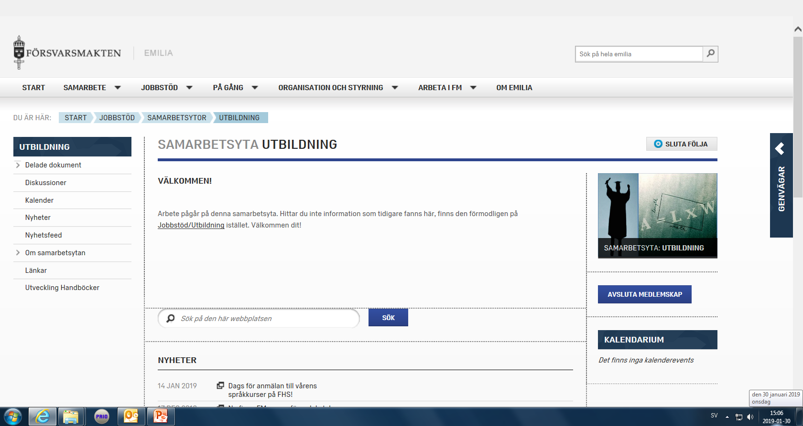

Slide 20
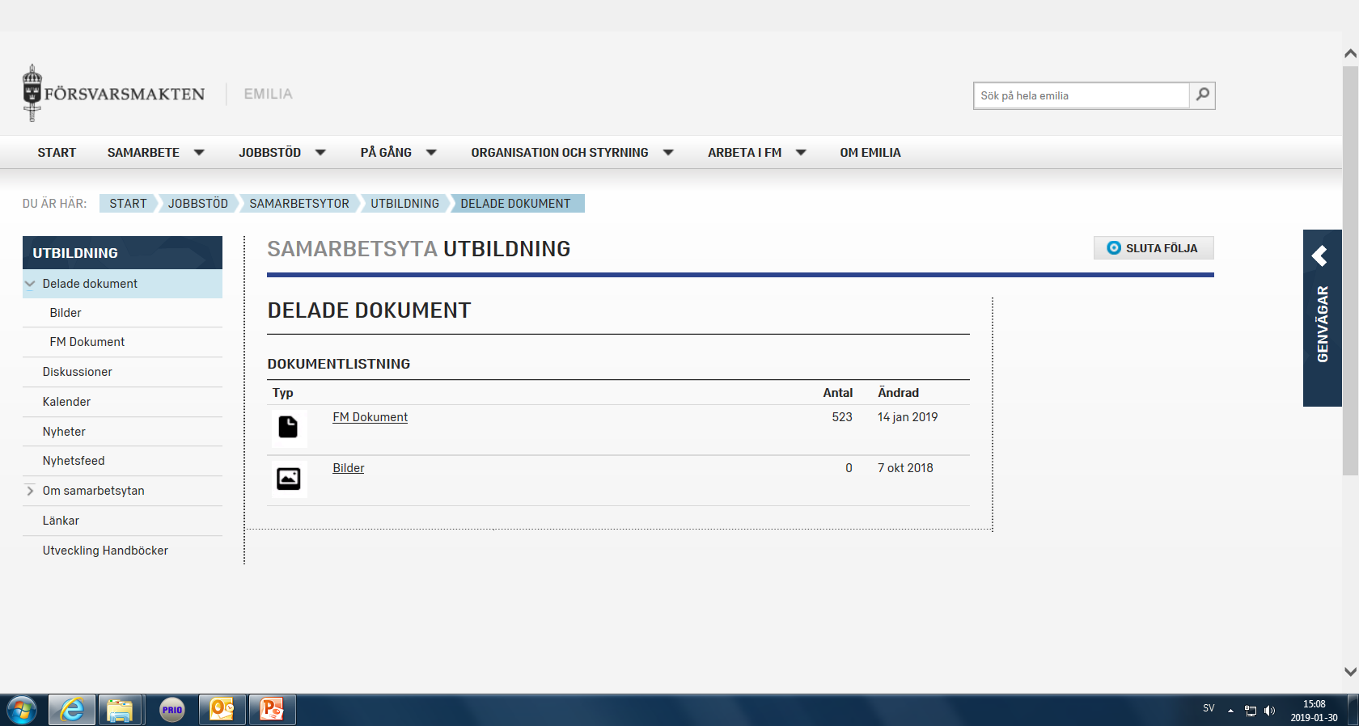

Slide 21
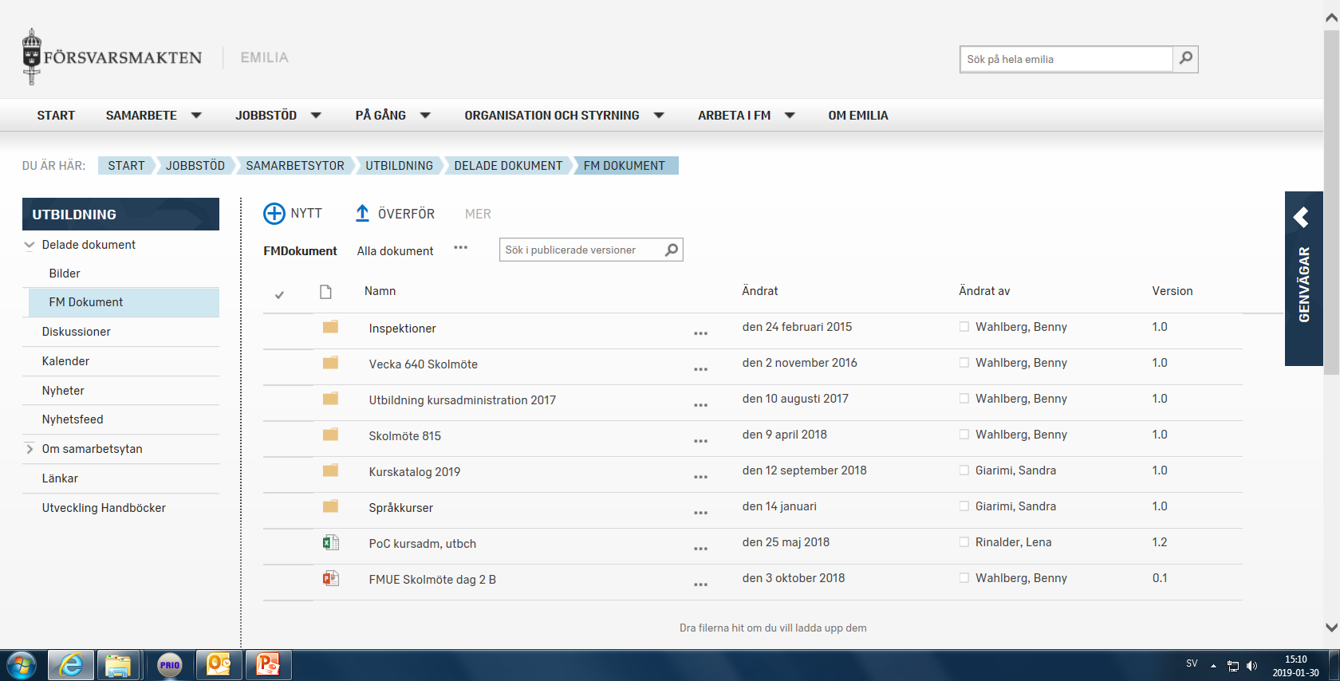

Slide 22
THE INSPECTION JOURNEY
DEPT. OF EDUCATION:
LEADS VTC 1
Preliminary plan
Tentative dates and timings
for visits
Questions, focus areas
Tasks for the school/center:
  Self assessment report
  Stakeholders questions
DEPT. OF EDUCATION:
LEADS VTC 2
Review the documents
that have come in
Work with the agenda
for the initial site visit
and the inspection
Develop focus areas
I=INSPECTION
DEPT. OF EDUCATION:
Self assessment report
Focus areas
Meet students
Visit to the
school/center
Discuss the details
for the up coming insp.
DEPT. OF EDUCATION:
Inspection report approved
by Mil. Command for the
Directorate of Edu.
and Training and sent to
the school/center
School/Center:
Acknowledge
the tasks
Check if the
dates and
timings work
Before VTC 2
School/Center:
Send in the
requested
documents
School/Center:
Presents the prog.
for the initial site visit
Answer the questions
that were posed
DEPT. OF EDUCATION/INSPECTED:
Decide the prog. for the insp.
Decide on the questions to be
addressed & focus areas
Prel. Report
Mil. Command for the Directorate
of Edu. and Training + Insp.com.
inspect school/center
INITIAL SITE
VISIT
VTC 1
VTC 2
VTC 3
I-10w
I-8w
I-4w
I-3w
I-1w
INSPECTION
I+8w

Slide 23
INITIAL SITE VISIT
A two day visit by the Inspection Committee
Day 1: 0800-1630
Day 2: 0800-1500
Discussion in groups addressing relevant questions
Meeting with the students/course partcipants
Visit of the school/center
Questions for the inspection will be identified along with the focus areas
The latter part of the second day will be used to plan the upcoming inspection
Discussion between the Inspection Committee and the school/centre regarding
outcomes and the execution of the visit
The Inspection Committee will share their reflections and points of view

Slide 24
INSPECTION DAY
Guard of Honour and welcome ceremony
Short speech about the Inspection by Mil. Command for the Directorate of Education and Training and introduction of the Inspection Committee
The Head of the School/Centre welcomes the Mil. Command for the Directorate of Education and Training and the Inspection Committee and gives a presentation of the school/centre
Introduction of the staff
The head of the Inspection Committee presents the agenda for the inspection
Work in groups with different agenda points
Meeting with the students/course partcipants
Visit of the school/center
The Inspection Committee will come togther, share their reflections and write a First Impressions Report (FIR)
The Inspection Committee will deliver the report to the school/center

Slide 25
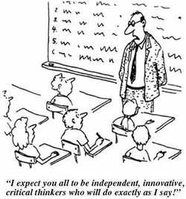
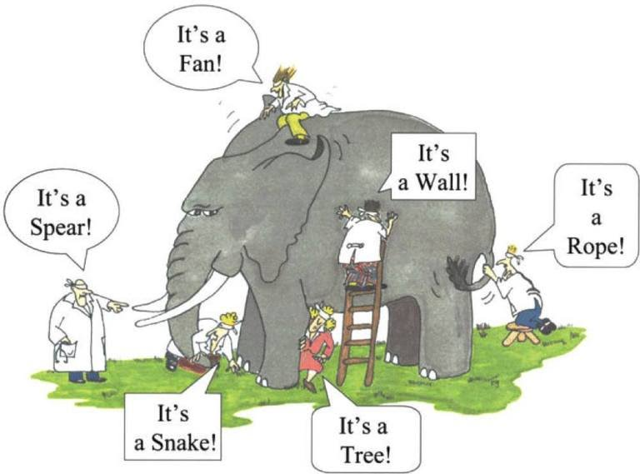
PERSPECTIVES ON QUALITY ASSURANCE

Slide 26
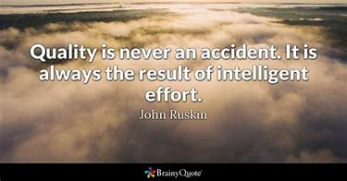

Slide 27


