Slide 1

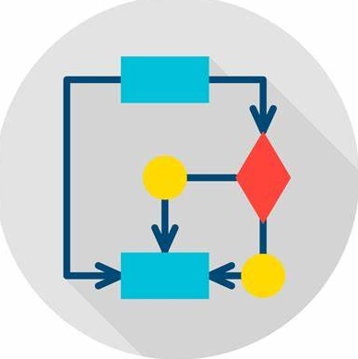






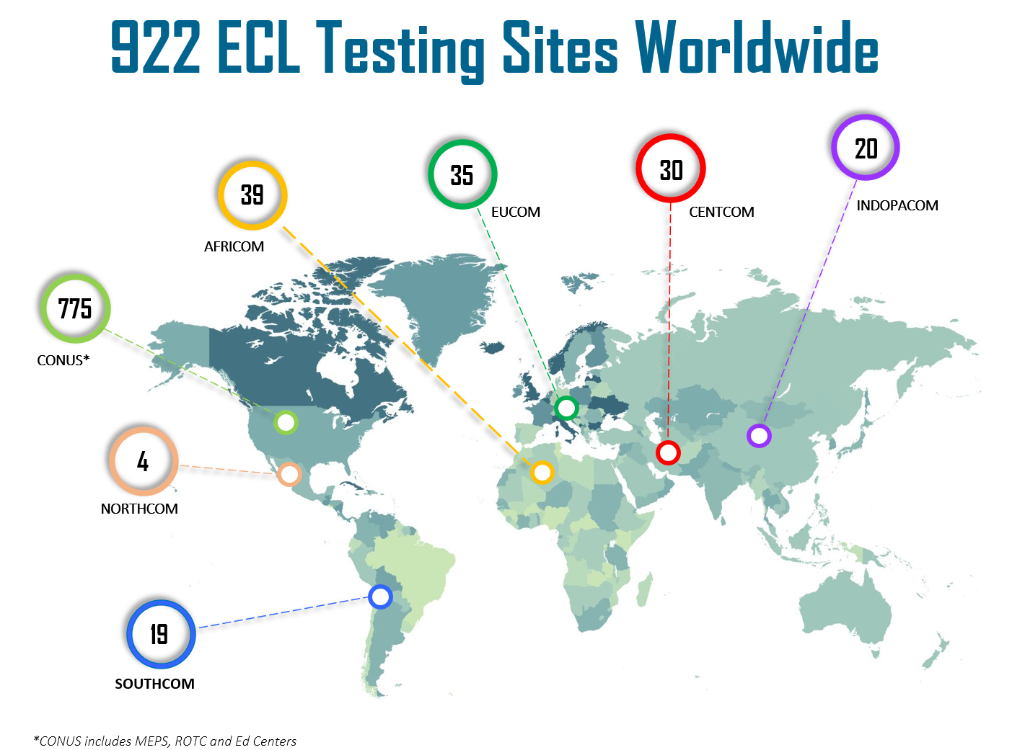
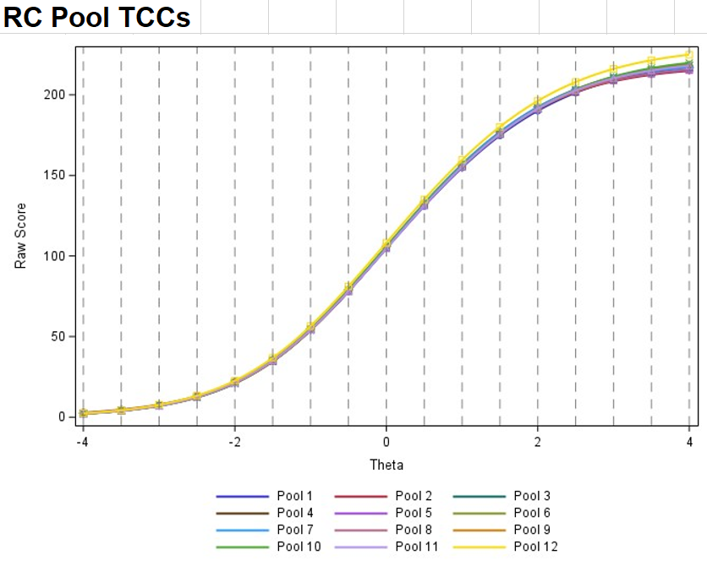
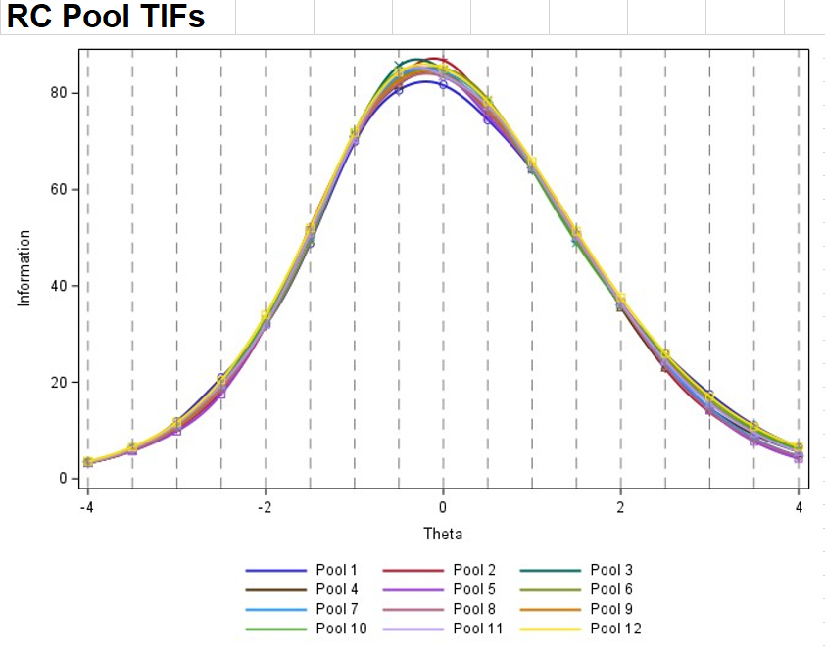
Changes to the
English Comprehension Level (ECL) Test
Petia Alexieva, Ph.D.
ECL Program Manager
DLIELC, San Antonio (USA)
What is the ECL?
ECL 1.0
→
ECL 2.0
Why Change?
Official English language proficiency test for US Department of Defense.
Norm-referenced reading and listening multiple-choice test scored on a scale 0-100.
Improve test reliability.
Improve content validity by aligning listening and reading items with the ILR descriptors, thus improving the ECL’s ability to prescreen for the OPI.
Rasch Algorithm
(Difficulty)
2PL Algorithm
(Discrimination + Difficulty)
ALGORITHM
SEM greater than 5
SEM less than 2
CONTENT CHANGES
SCORE PRECISION
Introduce new listening and reading comprehension items aligned with the ILR scale.
Replace 25% of discrete point vocabulary and grammar items with ILR-aligned items.
Map current grammar and vocabulary categories to ILR levels.
Who Takes the ECL?
Combined Score
Combined Score + Separate Reading & Listening Scores
Candidates for:
  Security Cooperation training
  Military accessions
  US-sponsored exercises
Most candidates take the ECL in-country and go directly to their Follow-on-Training.
Stand-alone Test
DLIELC campus only
200+ responses
SCORE REPORTING
Dynamic Seeding
All CAT ECL sites worldwide
# responses TBD
ITEM TRIALING
Fixed length (20L/20R Opernl
+ 6L/6R Seeded = 26L/26R)
Max 60 min
Variable length
Max 45 min
CAT VERSION
ACKNOWLEDGEMENTS
How & where?
64 L/36 R items
(Both PP ECL & ALCPT)
50 L/50 R items
(Both PP ECL & ALCPT)
These improvements would have been impossible without:
The psychometric support of HumRRO (Alexandria, VA).
The knowledge acquired during the LTS and ALTS at PLTCE (George Marshall Center).
Manual
16 pools: 800+ items each
Underexposed items
PP VERSION
Automatic
12 pools: 460 items each
Item exposure parameter
Available in 2 modes of delivery:
  Computer Adaptive (CAT)
  Paper & Pencil (PP)
Available worldwide:
CAT POOL ASSEMBLY
New item pools parallel in difficulty (TCC) and precision (tif)
MOVING TO ECL 3.0
Continue working with HumRRO and A9.
Consult Drs. Ray Clifford, Troy Cox and Matthew Wilcox (BYU).
CONTACT
DLI.Testing@us.af.mil

