Slide 1


BALANCING ADAPTATION AND STANDARDIZATION TO MAXIMIZE RESULTS
by Sophie Normandin, Language Programs Manager
Canadian Defence Academy
As of 01 Oct 21

Slide 2
oVERVIEW
The Canadian Defence Academy (CDA)
The Official Languages Act and its 2005 Review and Audit
Individual Training and Education Framework (IT&E Framework) and Second Official Language Education and Training (SOLET)
Language Programs (LP) and the Military Second Language Training Program (MSLTP)
Language Course Options
Monitoring SOLET
Summary: Standardization and Flexibility

Slide 3
The canadian defence academy
Dedicated to promoting lifelong learning and professional development amongst the CAF members.
MISSION
Providing continuing education
Enhancing the Profession of Arms
Contributing to the defence diplomacy objectives by creating strategic educational opportunities through effective engagements and partnerships
UNITS AND DIRECTORATES
Royal Military College of Canada
Collège militaire royal de Saint-Jean
Canadian Forces College
Chief Warrant Officer Robert Osside Profession of Arms Institute
Dallaire Center of Excellence for Peace and Security
Canadian Military Journal
Directoral of Profesionnal Development
Directorate of Individual Training and Education

Slide 4
The Official languages act
And the Defence Administrative Orders and Directives
KEY COMPONENTS
Communication and Services
Language of Work
Participation
Advancement of Equality
Commissionner of Official Languages
REQUIREMENTS FOR DND AND CAF
Communication with the public in both OLs.
Work Environment conducive to the effective use of both OLs.
Equal opportunity for employment and carreer advancement.
Vitality of OL minority communities promoted by supporting their development.
Language requirements of DND and CAF positions are determined based on the functions to be performed.
Language Training and Certification.

Slide 5
2005 Review and audit
Language training is centralized and inflexible
Response by DND:
Review of the training model
Moving toward decentralized training
Integration of language learning into operational schedules
Use of technology and blended learning
Need for core military common language
Standardization required due to decentralization

Slide 6
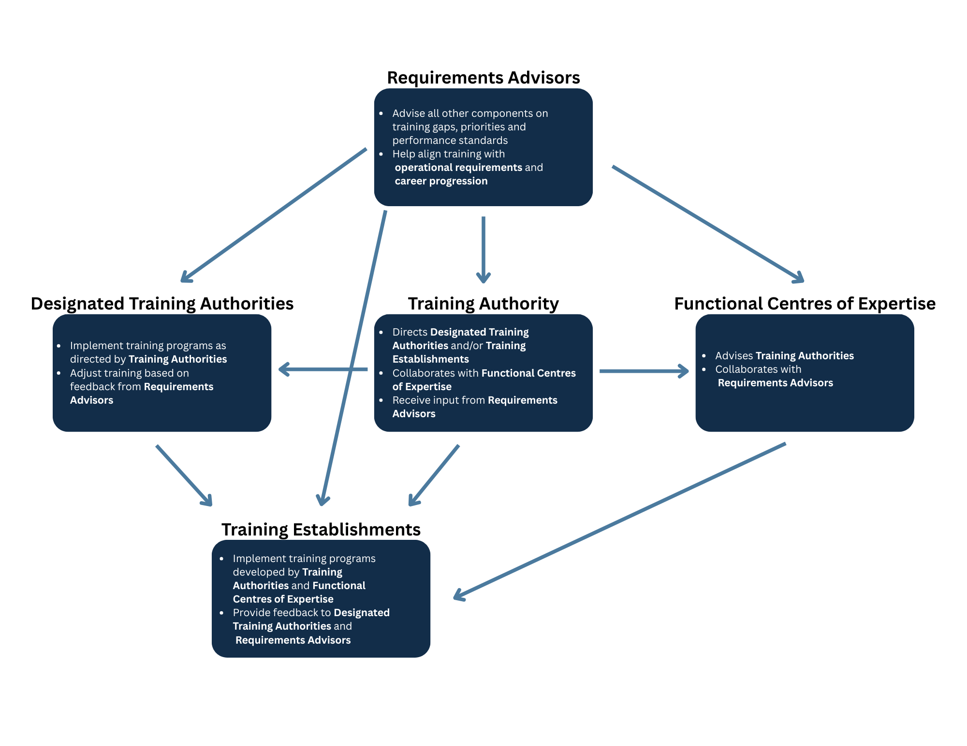
Individual Training and Education Framework

Slide 7
The SOLET ecosystem
Canadian Defence Academy
Canadian Army
Royal Canadian Navy
Royal Canadian Air Force
Canadian Forces Language School
Royal Military College of Canada
Collège militaire royal de Saint-Jean
15 Delivery Centers
4 Delivery Centers
8 Delivery Centers
3 Delivery Centers
SOLET Committee
National Standards Committee

Slide 8
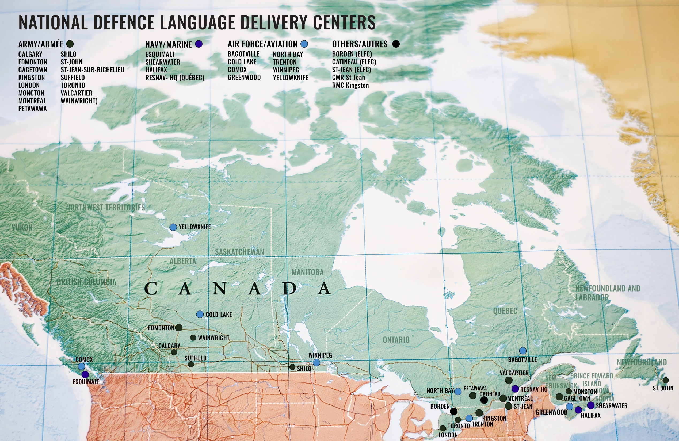

Slide 9
Second official language training and education (SOLET)
Canadian Forces Individual Training and Education System
Qualification Standard
Training Plan
Military Second Language Training Programme
Curricula and Tests

Slide 10
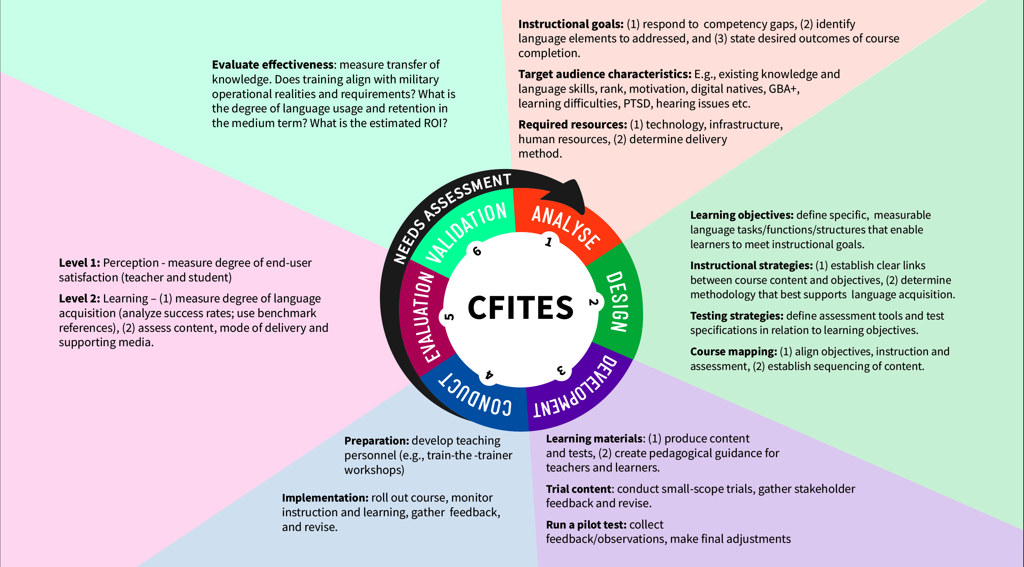

Slide 11
CFITES phases
ANALYSIS:
Analyse CAF members’ tasks to determine which ones involve a language component and to prioritize and organize tasks selected for instruction.
DESIGN:
Define the characteristics of the student population, specifying the enabling objectives and teaching points, developing tests, and writing the Training Plan.
DEVELOPMENT:
Produce instructional and learning materials in accordance with the decisions made at the design phase.
CONDUCT:
Implement the TP and the accompanying curriculum by monitoring learning and instruction and by taking corrective action as required.
EVALUATION:
Ensure the efficiency and effectiveness of the training. Course content and delivery is evaluated through feedback.
VALIDATION:
Verifiy that the programme has adequately prepared CAF members to perform their tasks in their second language.

Slide 12
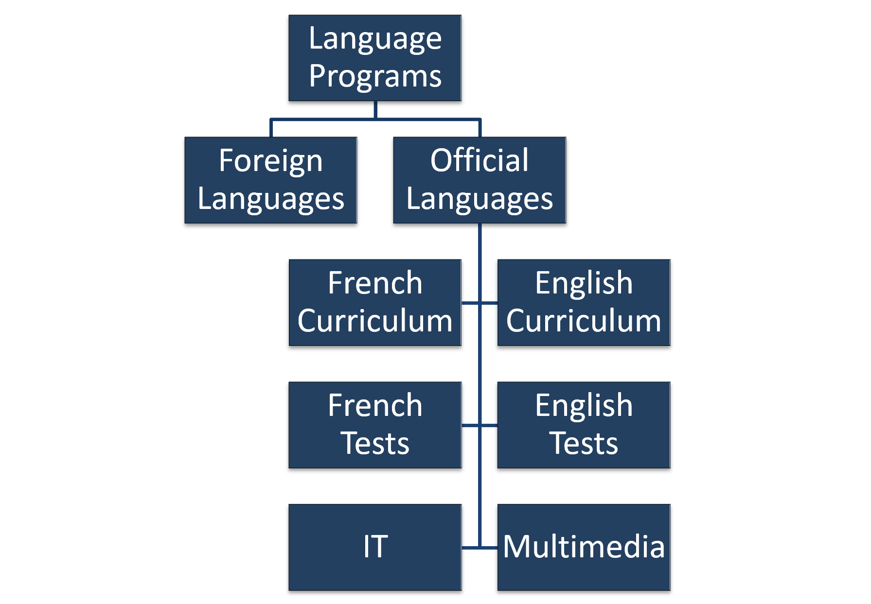
Language programs

Slide 13

Military Second language training programme
Objectives:
Exercise leadership in both OLs;
Meet the language requirements for duties and functions;
Fulfill current and future CAF operational requirements; and
Improve or maintain their SOL proficiency.

Slide 14
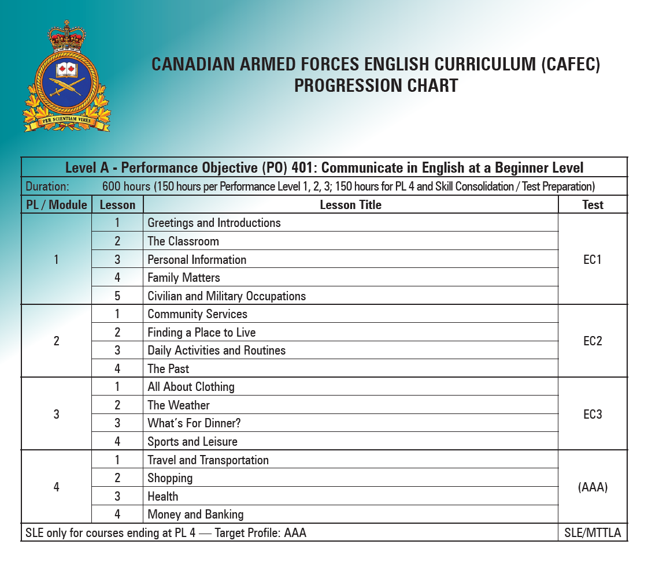
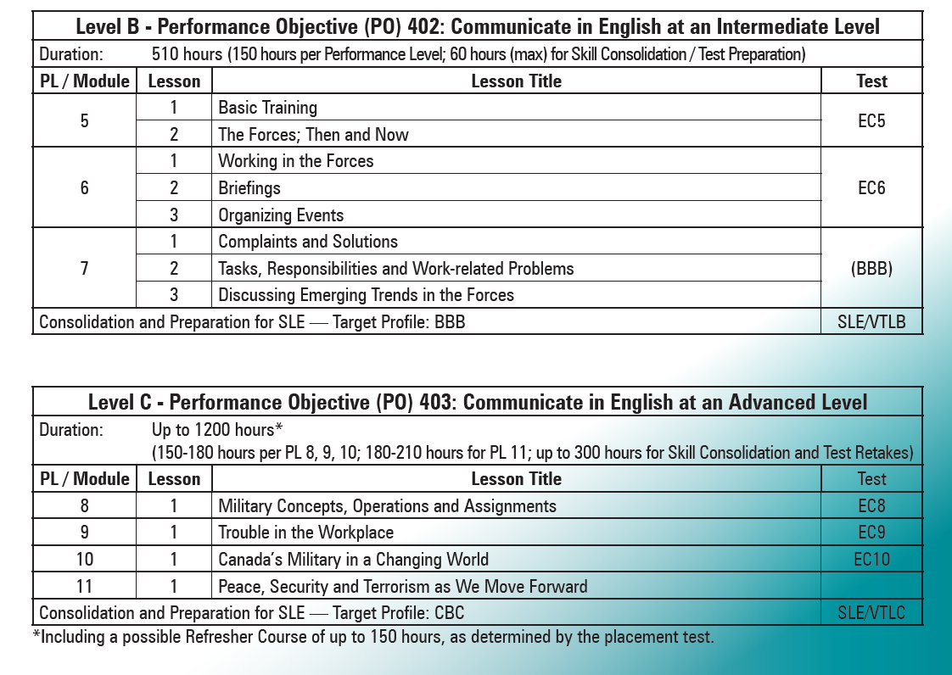

Slide 15
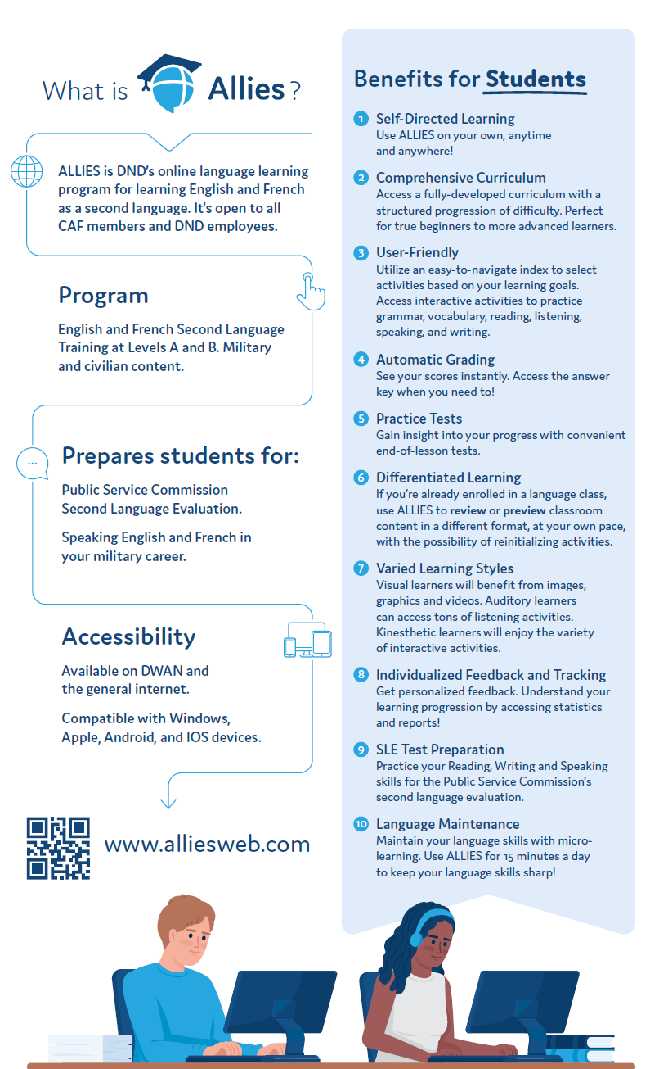
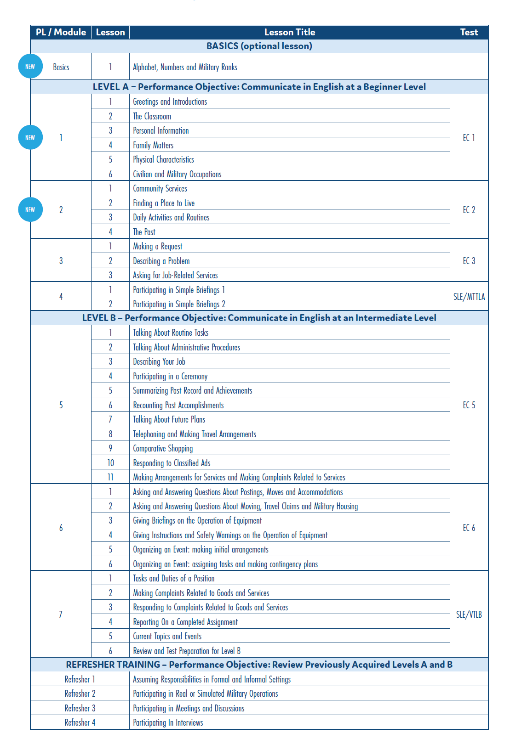

Slide 16
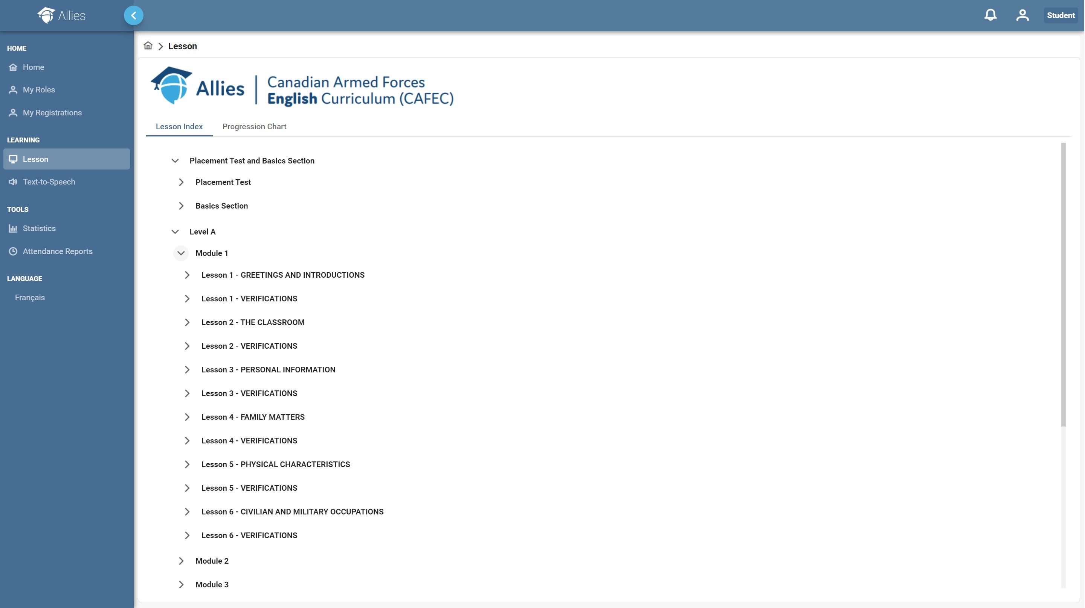

Slide 17
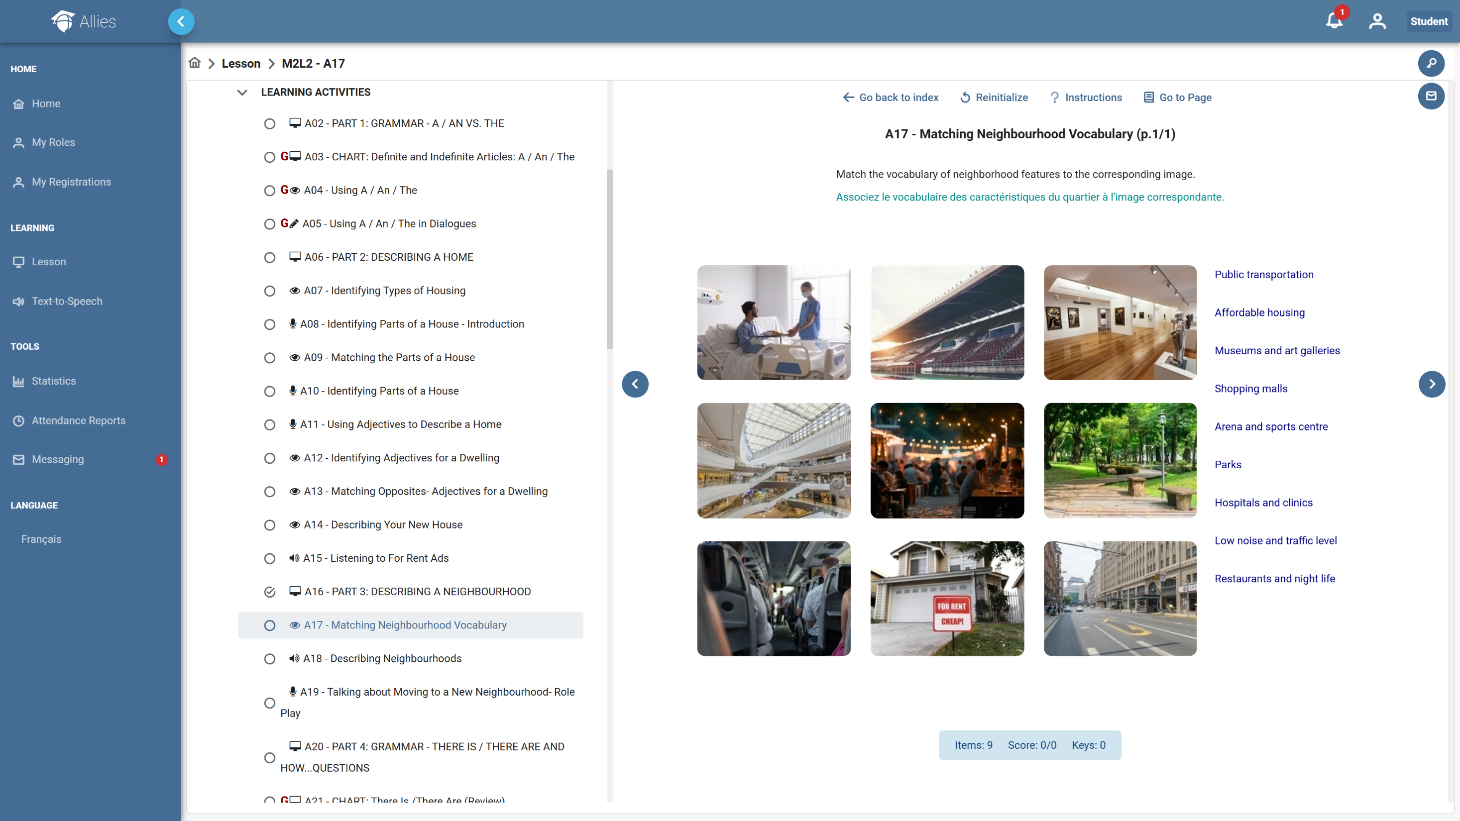

Slide 18
MSLTP Language Course Options
Course Options | Delivery Format
Single progress level (PL) | In-person, virtual, hybrid (approx. 5 weeks)
Back-to-back courses | Block of multiple PLs
Continuous courses | One-year posting (full time)
Distance tutoring (Allies Web) | Student is assigned a teacher (part time)
Autonomous learning (Allies Web) | Self-paced
Specific Skill Courses (R / WR / Oral) | In-person or virtual
Language Retention (individual / group) | In-person or virtual

Slide 19
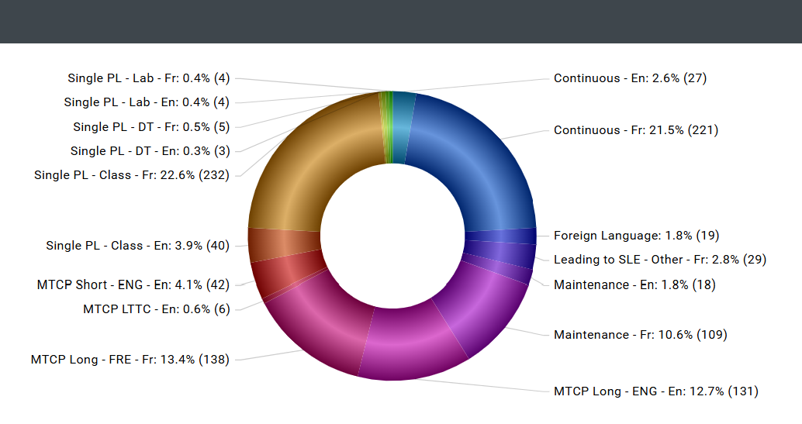
Language Training Integrated Information System (LTIIS)
Manages:
Students
Courses
Registrations
Requests and waiting lists
Waivers
Various workflows

Slide 20
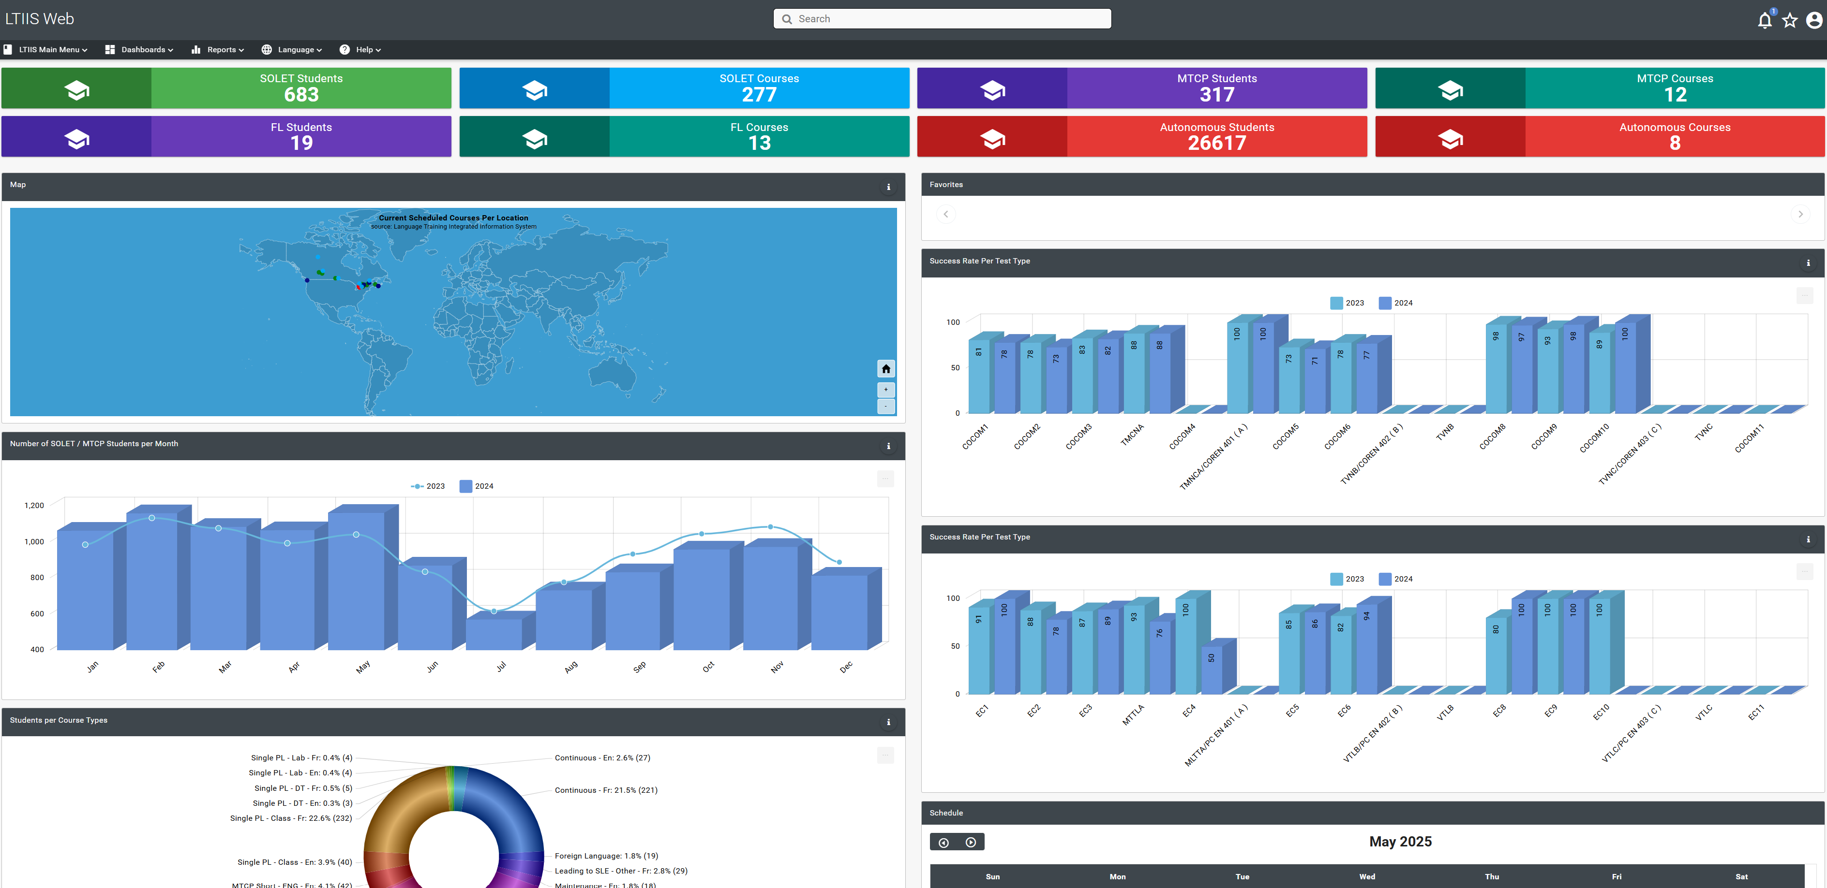
LTIIS Dashboaord

Slide 21
summary
Standardization
flexibility
Centralized Management
Systems Approach to Training
Control documents
Military Second Language Language Programme
Train-the-Trainers and Training Guides
Committees
Staff Assistance Visits
LTIIS
Decentralized Delivery of Training
Course options: single PL, back-to-back, continuous, distance tutoring, autonomous, specific skill, language rentention, accelerated formats
Delivery formats: in-person, hybrid, distance, self-paced, blended, full time, part time
Waiver Requests

