Slide 1
From Paper to Digital Platforms:
Embracing Generative AI Tools and CALT
2025 NATO BILC Conference
25-30 May 2025, Zagreb, Croatia
Tamar Shavlakadze
Head of Foreign Language Testing Division
Training and Military Education Command
MOD Georgia

Slide 2
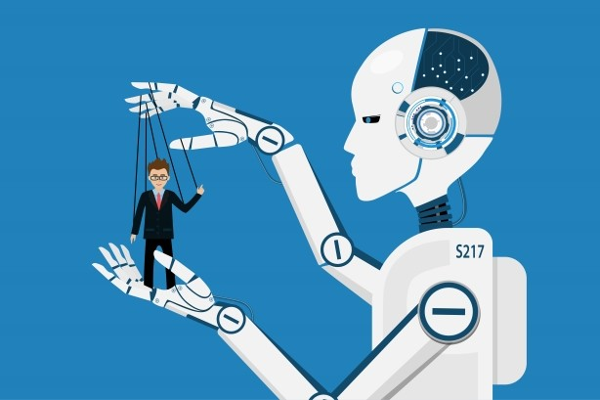

“AI-writing tools in education:
If you can’t beat them, join them”
Tseng and Warschauer (2023)

Slide 3
Merits of Generative AI Tools
Generate detailed instructions that guide different platforms:
Produce specific test components
Evaluate writing performances
Estimate proficiency levels
Provide formative feedback
Generate speeches for listening tests

Slide 4
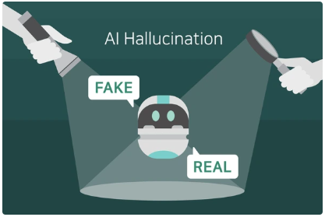
Limitations of Generative AI Tools
Stray from the topic
Produce unsuitable content
“Hallucinate “
generate meaningless content
Mask its limitations

Slide 5
Associated Risks
  Lack of human supervision
  test developers may lose control of the test process
  Lack of the necessary skills to devise prompts

Slide 6

“Tame the beast”

Slide 7
Conclusion
Part 1
AI won’t replace “testers”, but “testers” who use AI will replace those who don’t.

Slide 8
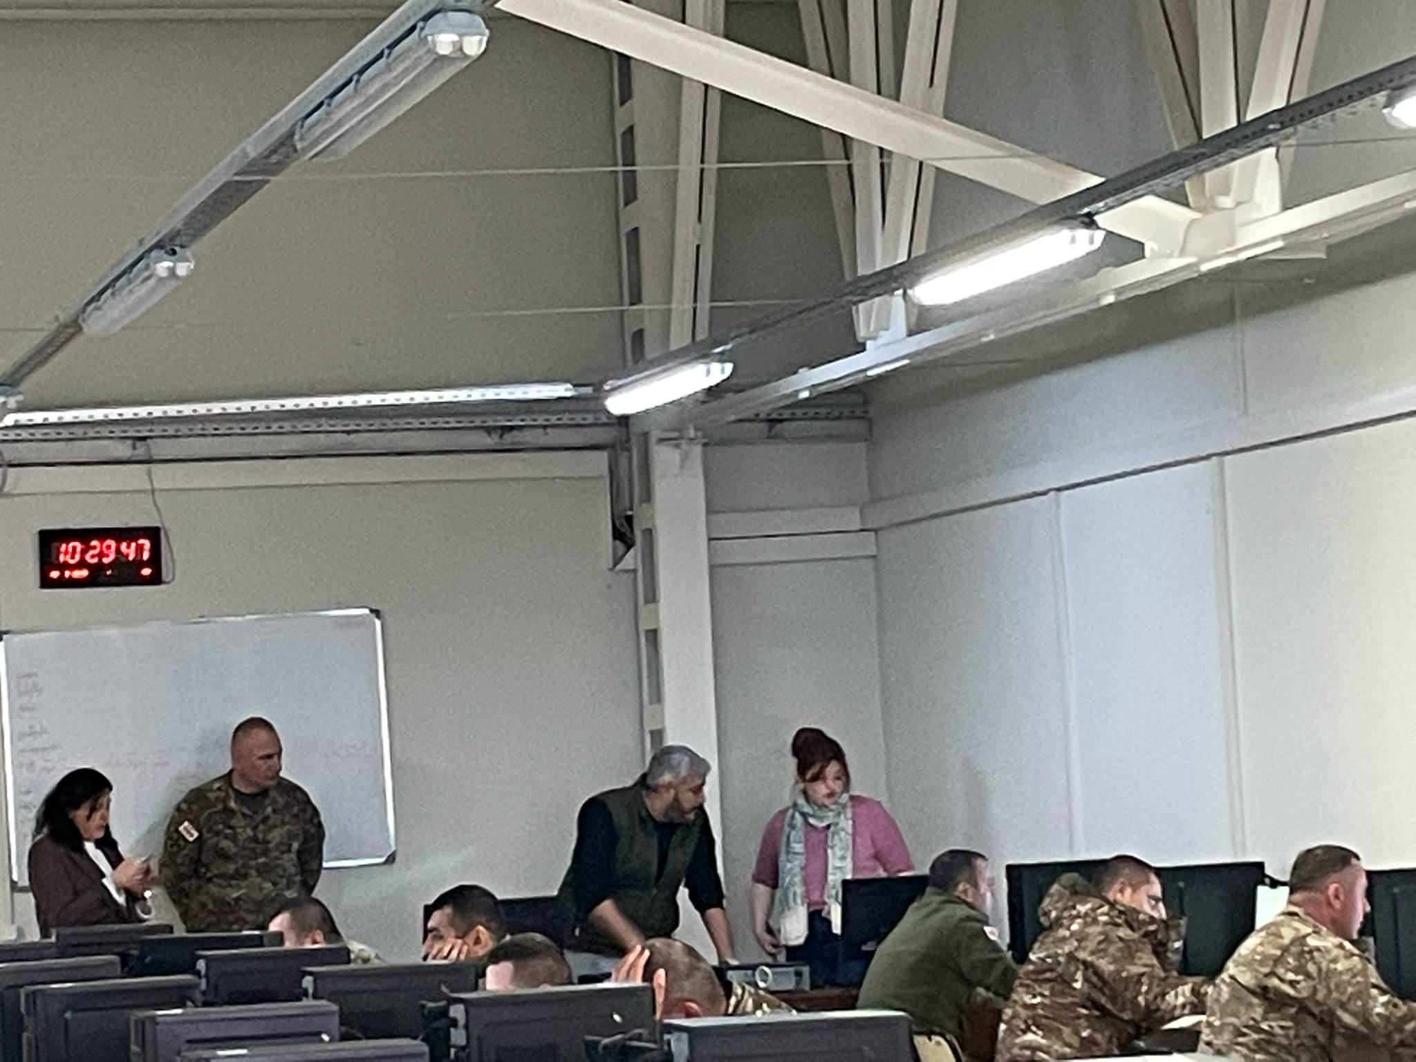
Transition from Paper-based Testing to CALT

Slide 9
Transition from Paper-based Testing to CALT
“Very few facts are able to tell their own story, without comments to bring out their meaning”
John Stuart Mill (1859), cited in Fulcher et al., 2007
Rational for transition
Survey results
Strengths and weaknesses of CALT
A way ahead

Slide 10
The Number of Test Takers by year

Slide 11
Rational for the transition
Advancement of EdTech
Time-cost efficiency
Ease the factor of anxiety
Human error reduction
Conduct researches

Slide 12
Survey results
Quantitative data

Slide 13
Survey results by ranks

Slide 14
Qualitative data
Supporters of CALT:
“As technology has advanced, we should stay up-to-date with these developments. Traditional pen-and-paper methods should be phased out!” (Junker, 21)
Supporters of PBT:
"შეჩვეული ჭირი, ჯობია შეუჩვეველ ჭირს“
"Better the devil you know than the devil you don't."
"Known evils are better than unknown dangers.“ (Captain, 38)

Slide 15
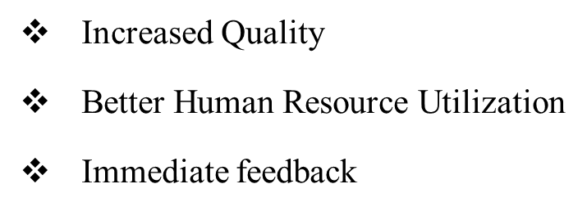
Supporters of CALT
Technological Alignment
Listening Test
Cost and Time Efficiency
Environmental Benefits
Transparency
Precision in Rating
Flexibility of Editing
Better Time management
Word Count and Content Control

Slide 16
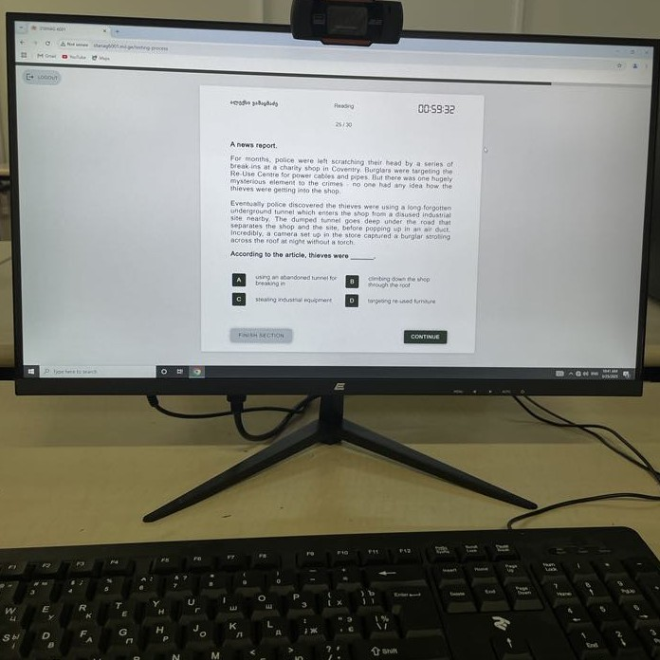
Concerns
Keyboarding skill
Computer familiarity less stressful
Hacking into the system
Eye strain difficulty concentrating
Hardware malfunctions and system glitches
staff downsizing due to automation

Slide 17
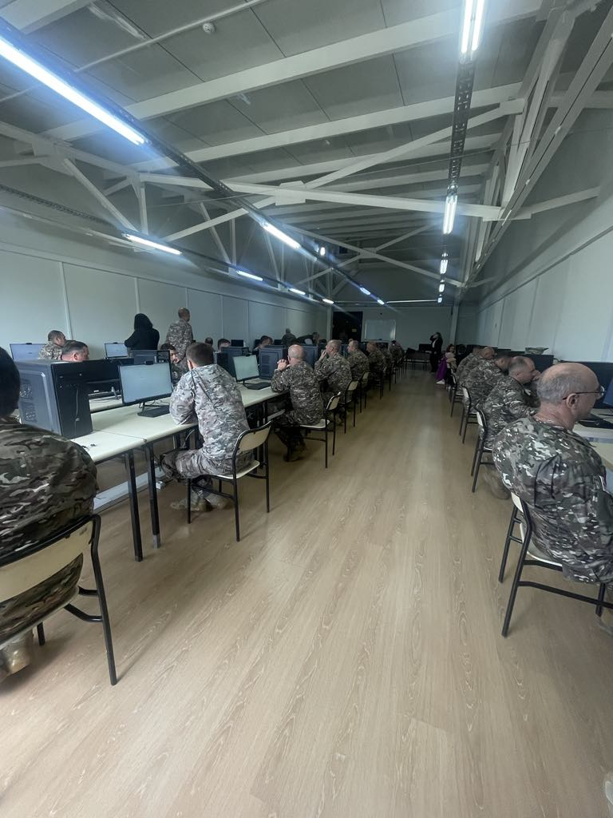
A way ahead
Third round of CALT piloting
Verbal report
Correlation study between PBT &
CALT results
Computer tutorial/FAQ
Continuous evidence collection

Slide 18
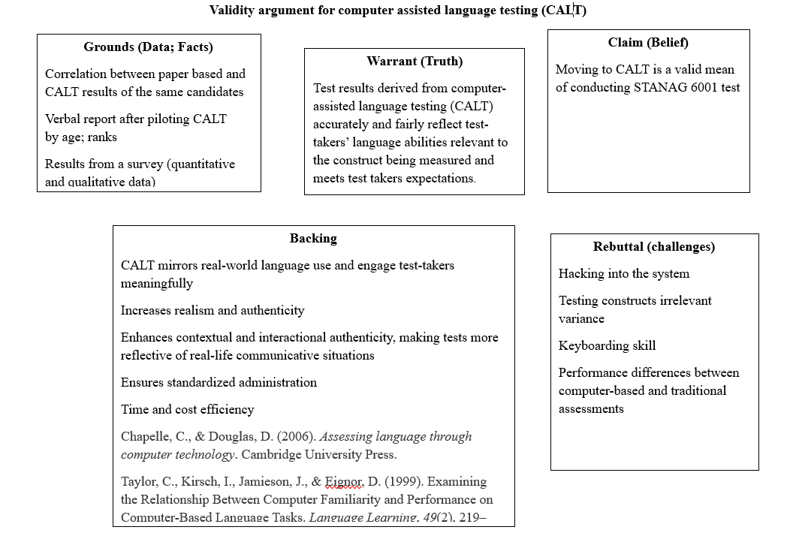
Validity Argument for CALT

Slide 19
Reference
Chapelle, C., & Douglas, D. (2006). Assessing language through computer technology. Cambridge University Press.
Fulcher, G., & Davidson, F. (2007). Arguments and evidence in test validation and use. In Language testing and assessment (pp. 159-178): An advanced resource book. Routledge.
O’Sullivan, B. (2023). Reflections on the Application and Validation of Technology in Language Testing. Language Assessment Quarterly, 20(4–5), 501–511. https://doi.org/10.1080/15434303.2023.2291486
Tseng, W., & Warschauer, M. (2023). AI-writing tools in education: if you can’t beat them, join them. Journal of China Computer-Assisted Language Learning, 3(2), 258–262. https://doi.org/10.1515/jccall-2023-0008
Taylor, C., Kirsch, I., Jamieson, J., & Eignor, D. (1999). Examining the relationship between c
omputer Familiarity and Performance on Computer-Based Language Tasks. Language Learning, 49(2), 219–274. https://doi.org/10.1111/0023-8333.00088
Xi, X., & Sawaki, Y. (2017). Methods of test validation. In E. Shohamy, I. G. Or, & S. May (Eds.), Language testing and assessment (pp. 193-209). Encyclopedia of language and education (3rd ed.). Springer. https://doi.org/10.1007/978-3-319-02261-1_14 .

