Slide 1
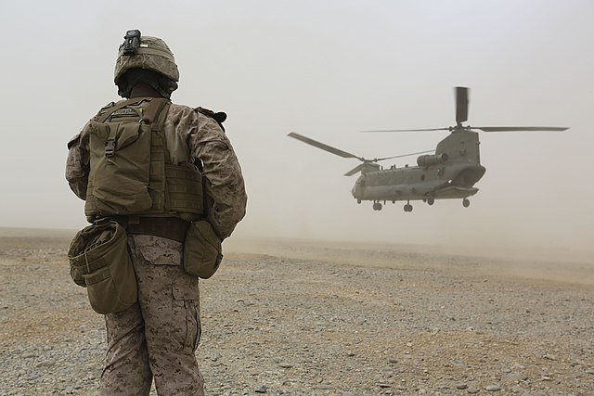

BILC JTAC
Working Group (WG) Update

Slide 2


How is BILC Involved?
JTACs have a language requirement per US Memorandum of Agreement (MOA)
  STANAG 6001 SLP 3332
BILC responded to a request from JTAC stakeholders to
  Analyze the unique JTAC language tasks
  Consider a “more focused test” taking the JTAC environment into account
This Photo by Unknown Author is licensed under CC BY-ND

Slide 3
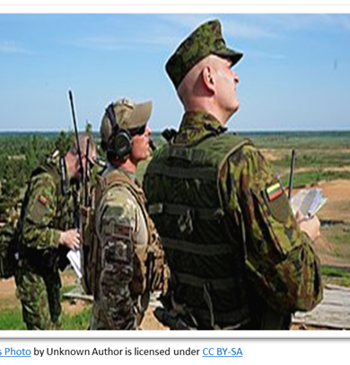
Study Highlights
WG members:
Consulted with JTAC SMEs in Denmark, Norway and Slovenia
Observed a CAS exercise in Denmark, certification training in Norway, and JTAC classroom and simulation training in Slovenia
Observed the Adriatic Strike Exercise with 26 participating nations and conducted semi-structured interviews
Sent survey on critical JTAC language tasks and unique Target Language Use (TLU) factors
  246 responses from JTACs, JTAC evaluators, and
JTAC program managers
The study was published May 2023.

Slide 4
Main takeaway:
Close to total agreement from both NS/NNS on these statements:
  JTACs must be able to take notes in English.
  JTACs must have clear pronunciation
  JTACs must be able to describe terrain features, buildings and structures.
  JTACs must be able to give directions and provide coordinates.
  JTACs must be able to respond readily under time pressure.
  JTACs must be able to understand briefings.
  JTACs must be able to comprehend communications from multiple digital sources, both visual and audio.
  Understanding communications, both face-to-face and on the radio, can be difficult due to different accents.
  Understanding radio communications can be difficult due to interference.
  If JTACs do not know the proper vocabulary terms, they must be able to paraphrase or find other words to explain what they want to say.
  JTACs are expected to use more advanced language during the Operational Planning Phase than during the Execution Phase.
  JTACs should be capable of asking questions when communicating with others during operational planning and other meetings.
  JTACs must be able to read and understand OP ORDS, manuals, and JTAC-related publications.
  JTACs must be able to give short briefings as part of their tasks
  A JTAC-specific English language course would be helpful

Slide 5
Additional comments on JTAC communciations from NS
It is important to:
speak clearly
use standard pronunciation
slow down rate of speech
use correct terminology and brevity terms
avoid slang, use plain language
backbrief or check understanding.

Slide 6

Bureau for International
Language Co-ordination
Unique JTAC linguistic tasks
    Communicating under pressure
    Demonstrating interactional competence in a dynamic multinational environment
    Comprehending multimodal communications from digital and human sources
    Timely responses with clear pronunciation

Slide 7
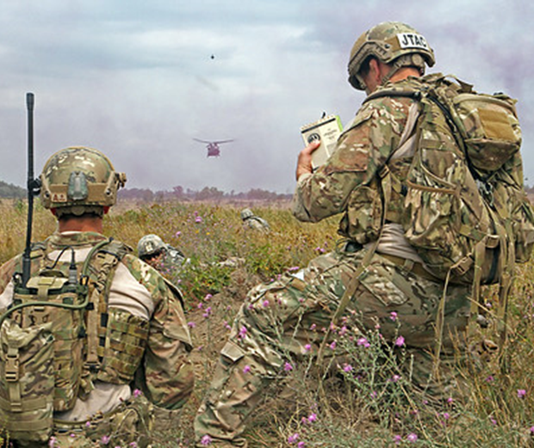
Bureau for International
Language Co-ordination
Findings
There is misalignment between the STANAG 6001 Level 3 General Proficiency test and the actual JTAC language tasks
The WG recommended
A JTAC-specific language test developed by BILC
An interim STANAG 6001 SLP 2+2+2+2
A JTAC-specific language course

Slide 8
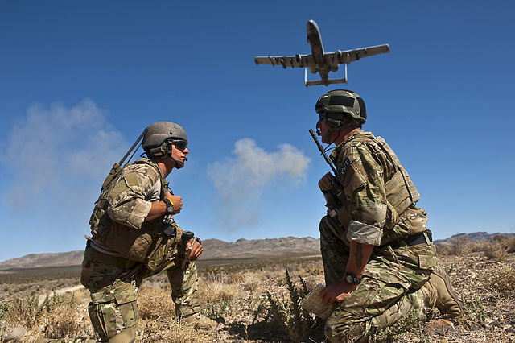



Bureau for International
Language Co-ordination
The WG Recommendations:
A JTAC-specific language test developed by BILC
An interim STANAG 6001 SLP 2+2+2+2
A JTAC-specific language course
JTAC Stakeholders
This Photo by Unknown Author is licensed under CC BY-SA

Slide 9
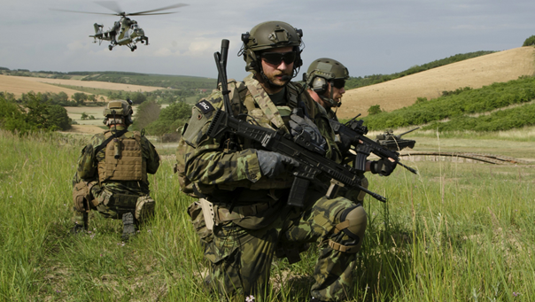
“ NATO CCS have formally tasked BILC to develop a proposition for a JTAC specific language test based on the ICAO structure. When this proposition is mature it will be promulgated for comment.”
            Status: The WG has been piloting integrated skills performance test tasks, considering the ICAO scale for rating purposes.

Slide 10

PLTCE identified a training gap at the NATO Education Training Evaluation and Exercises (ETEE) Annual Discipline Conference in March. JTACs need a tailored language course to develop and practice unique language tasks, not covered in general proficiency courses. This gap falls under the functional area- Language Standards, ESP/military occupational language.
Status: The SG is collecting ideas for
a JTAC-specific language course.

Slide 11






BILC Considered Two Options
The BILC JTAC WG is currently consulting with JTAC SMEs to develop integrated skills performance test tasks, considering the ICAO scale for rating purposes
At the May 2024 BILC Conference, a Study Group recommended
  Consulting with SMEs to develop a JTAC-specific language course based on authentic target language use contexts
  An exit test, considering both ICAO and STANAG 6001 scales
This Photo by Unknown Author is licensed under CC BY-ND

Slide 12






JTAC Language Assessment
WG Meeting, 6-9 May 2025
Eleven language experts from nine nations
Team of Subject Matter Experts (SME)
from NATO Close Air Support (CAS)
Capabilities Section (CS), Ramstein Air Base

Slide 13
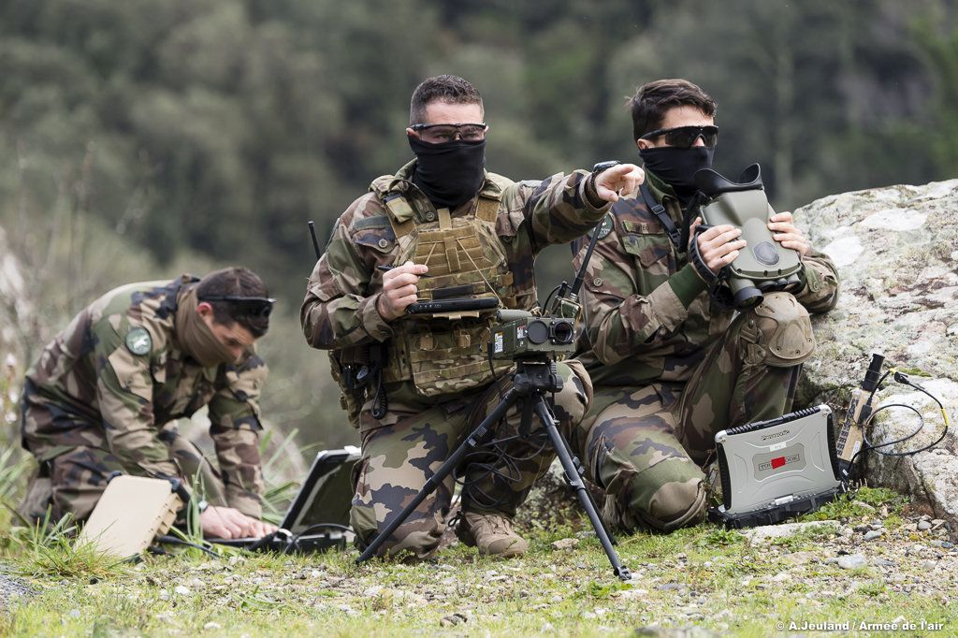
Goal
This Photo by Unknown Author is licensed under CC BY-SA
To determine the way ahead for JTAC-specific language assessment and/or training consistent with the NATO Close Air Support (CAS) Capabilities Section (CS) guidance that it be one solution that can be applied across the nations.

Slide 14


Agenda
National presentations by language experts
International Civil Aviation Organization (ICAO) Language Proficiency Rating (LPR) scale and testing practices
Briefings by NATO CAS CS SMEs
Discussions
Plan the Way Ahead

Slide 15
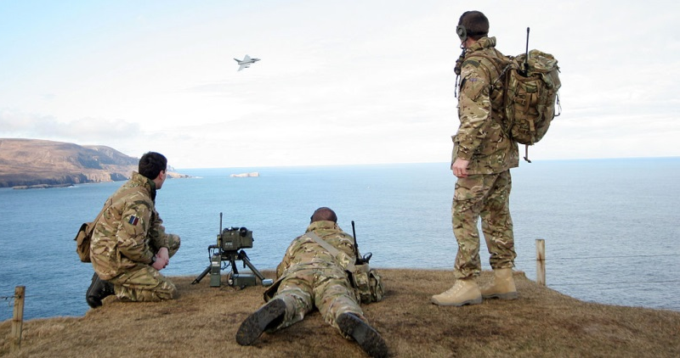
Discussion Highlights
JTACs have the only standardized Air Land Integration/Joint Fires qualifications in NATO
Certification of a JTAC’s operational language skills is not a national responsibility but instead falls under the NATO CAS CS umbrella.

Slide 16

Agreed
The JTAC language assessment will
  serve as a screening tool to determine language readiness for JTAC training
  be the one solution for all nations
  follow an ICAO-inspired approach to the test design and rating practices.

Slide 17

Next Steps
BILC will provide NATO CAS CS with a briefing on the JTAC language assessment project for the Air Operations (AO) WG meeting in September
Project manager:

