Slide 1
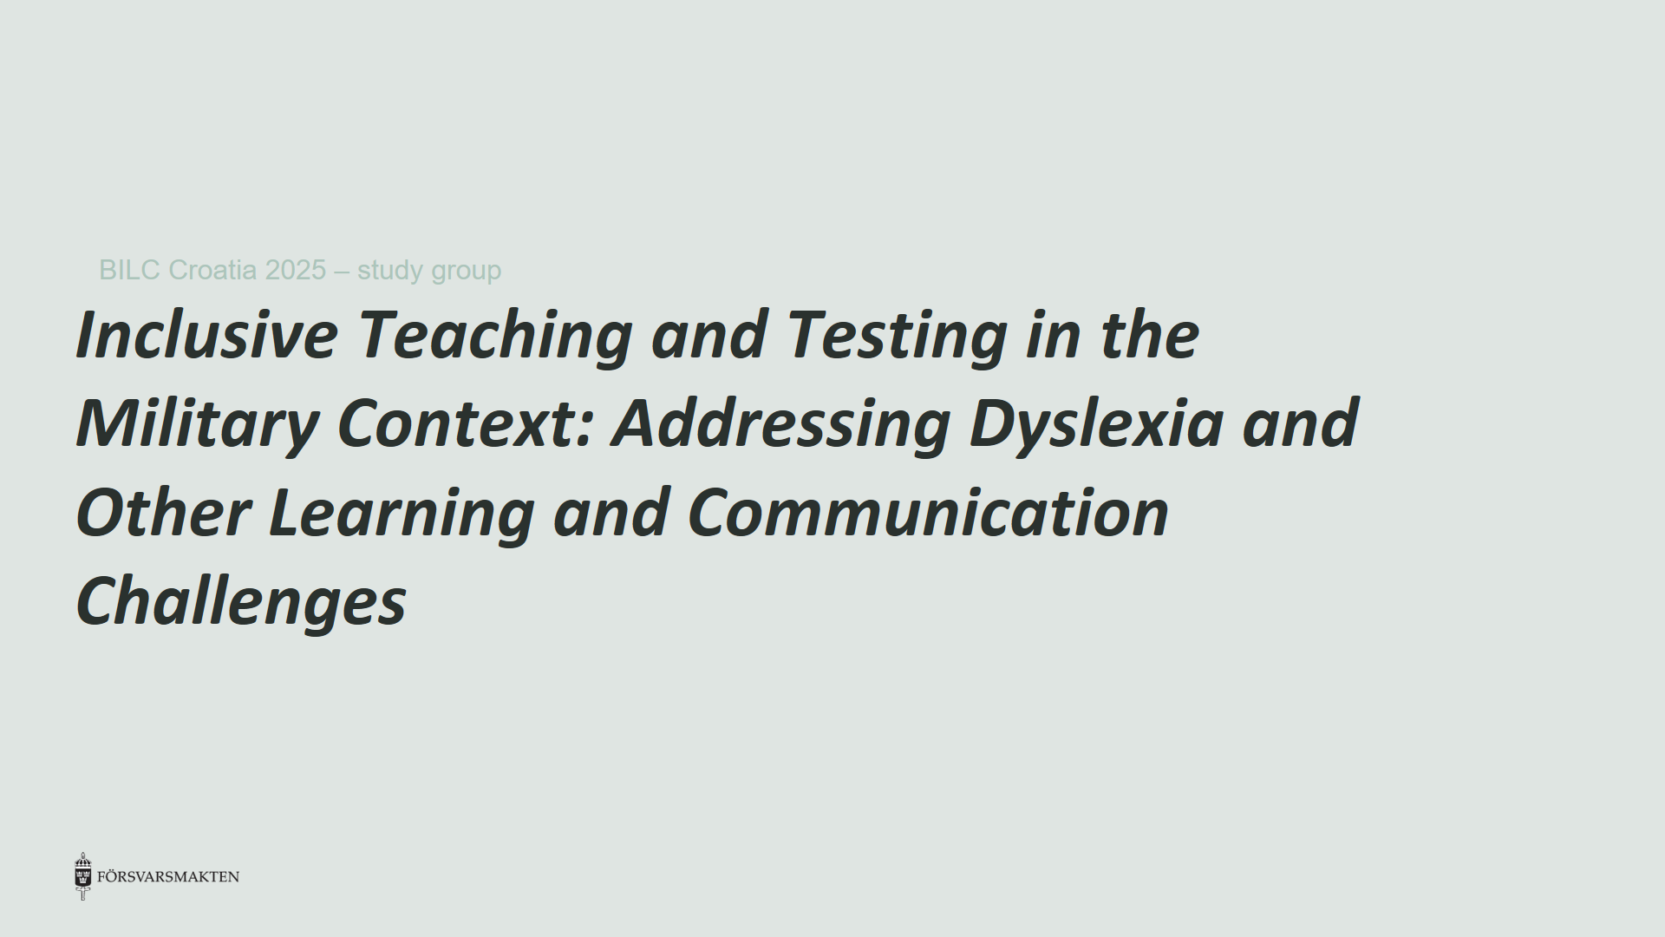
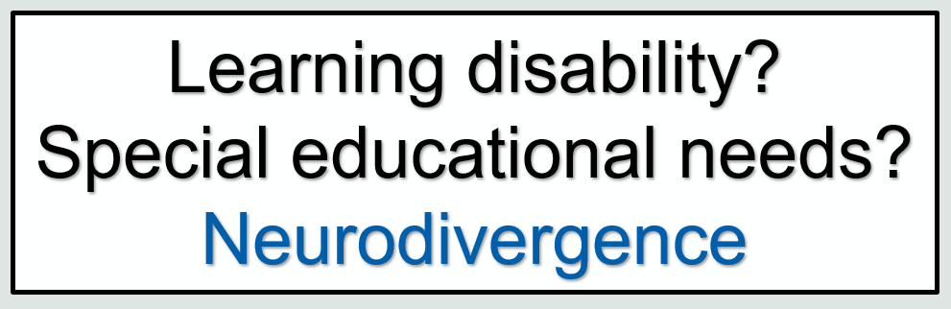
Inclusive Teaching and Testing in the Military Context: Addressing Dyslexia and Other Learning and Communication Challenges
BILC Croatia 2025 – study group
Learning disability?
Special educational needs?
Neurodivergence

Slide 2
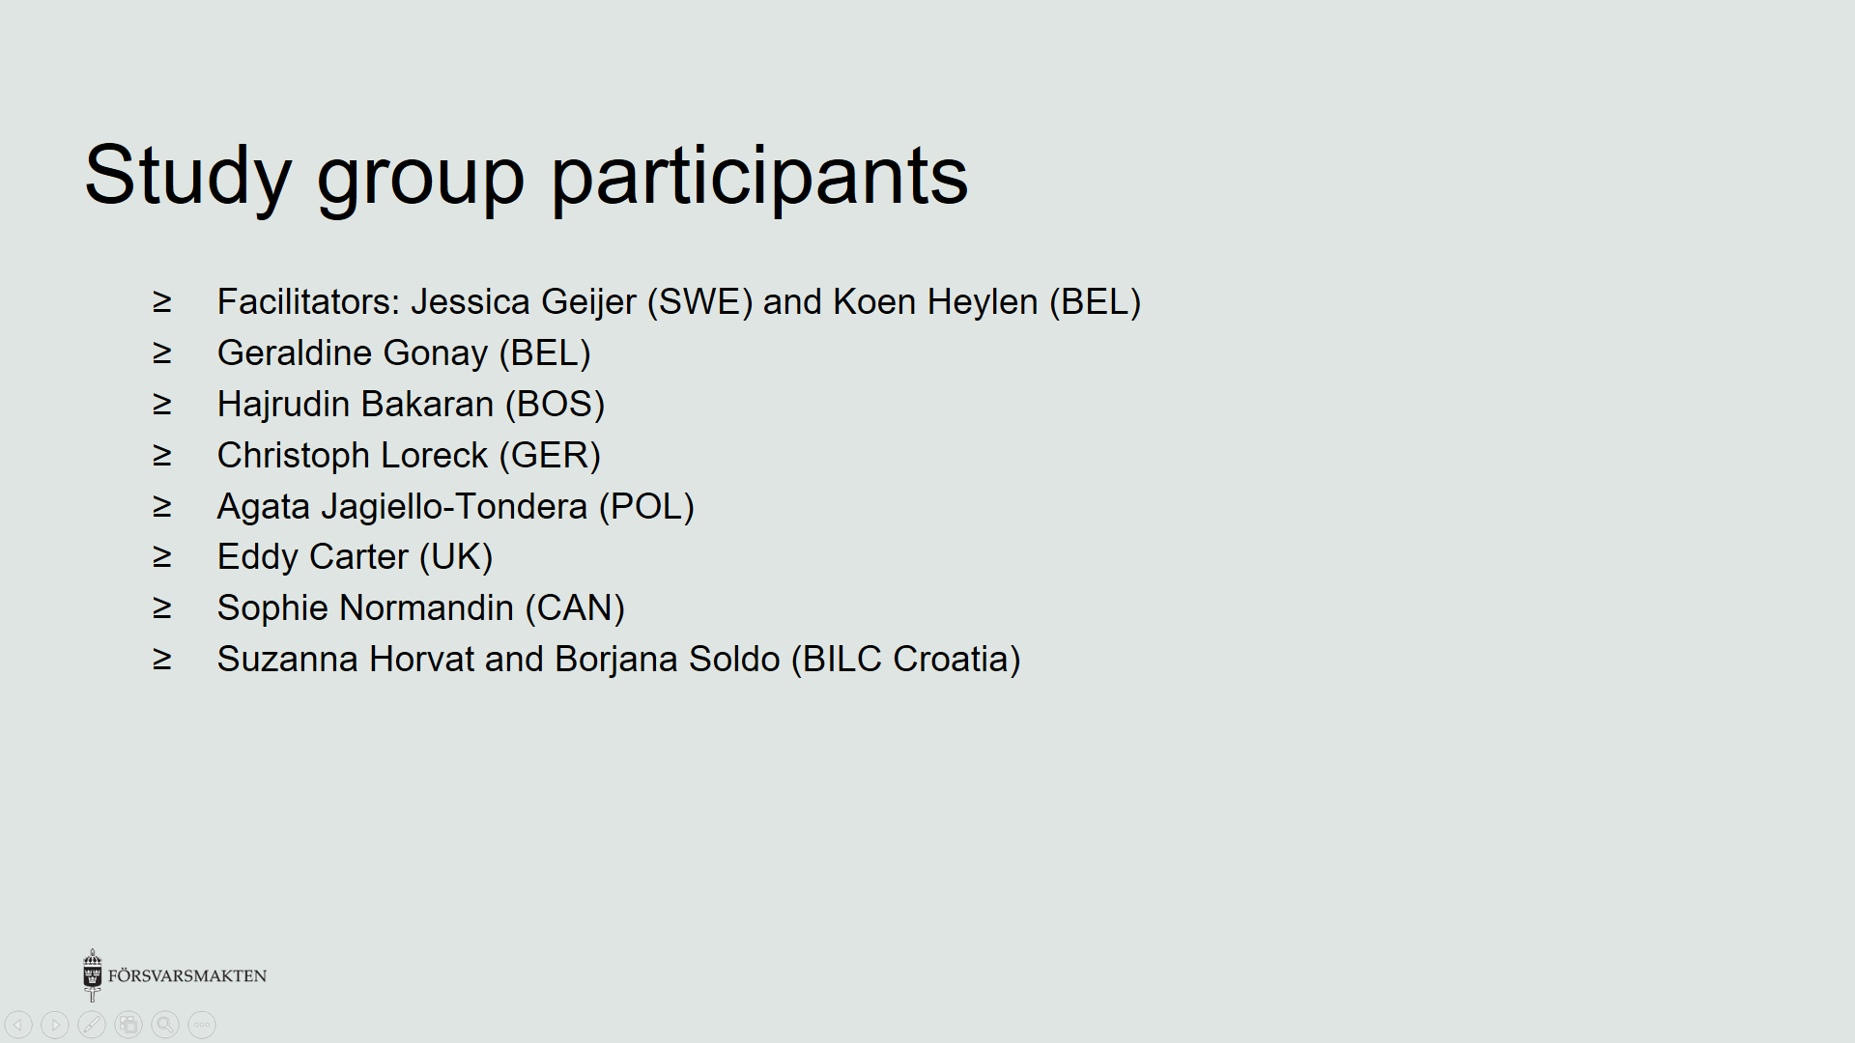
Study group participants
Facilitators: Jessica Geijer (SWE) and Koen Heylen (BEL)
Geraldine Gonay (BEL)
Hajrudin Bakaran (BOS)
Christoph Loreck (GER)
Agata Jagiello-Tondera (POL)
Eddy Carter (UK)
Sophie Normandin (CAN)
Suzanna Horvat and Borjana Soldo (BILC Croatia)

Slide 3
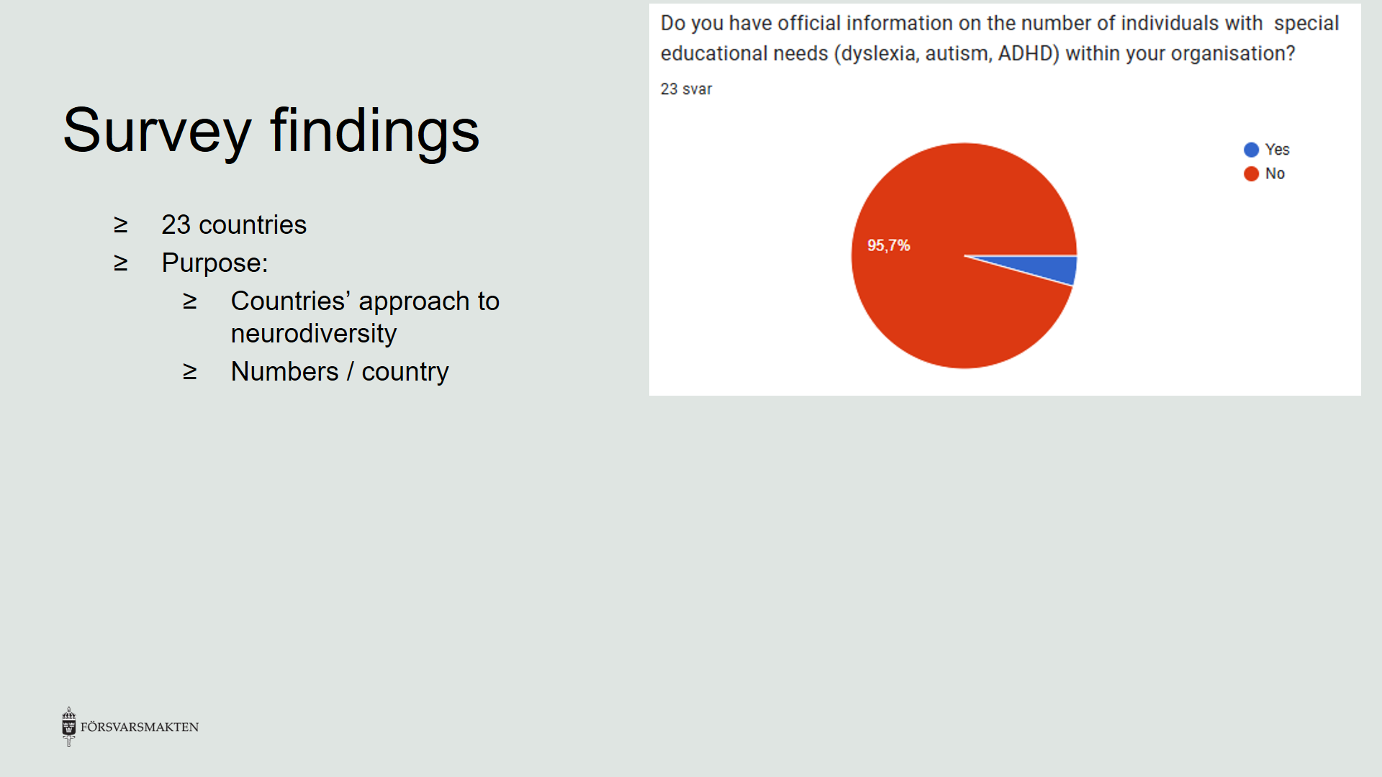
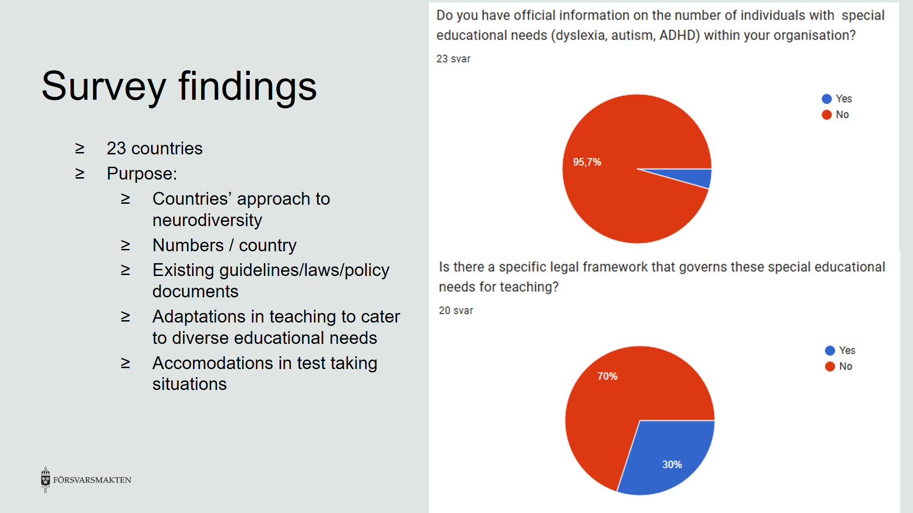

Slide 4
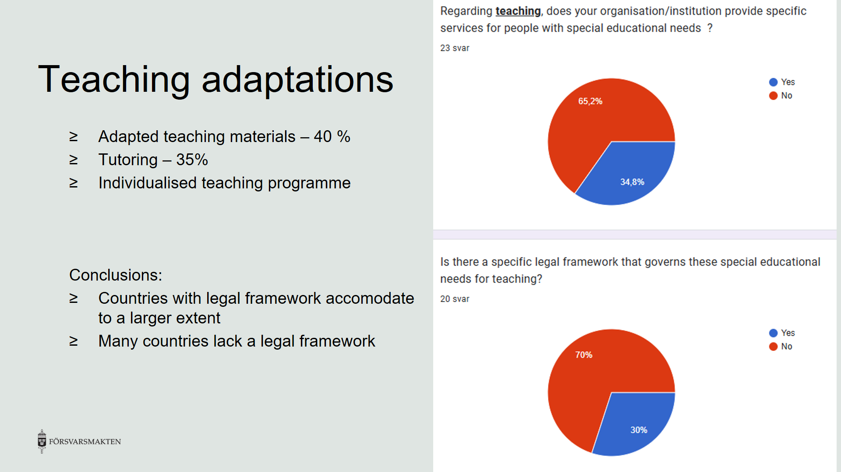

Slide 5
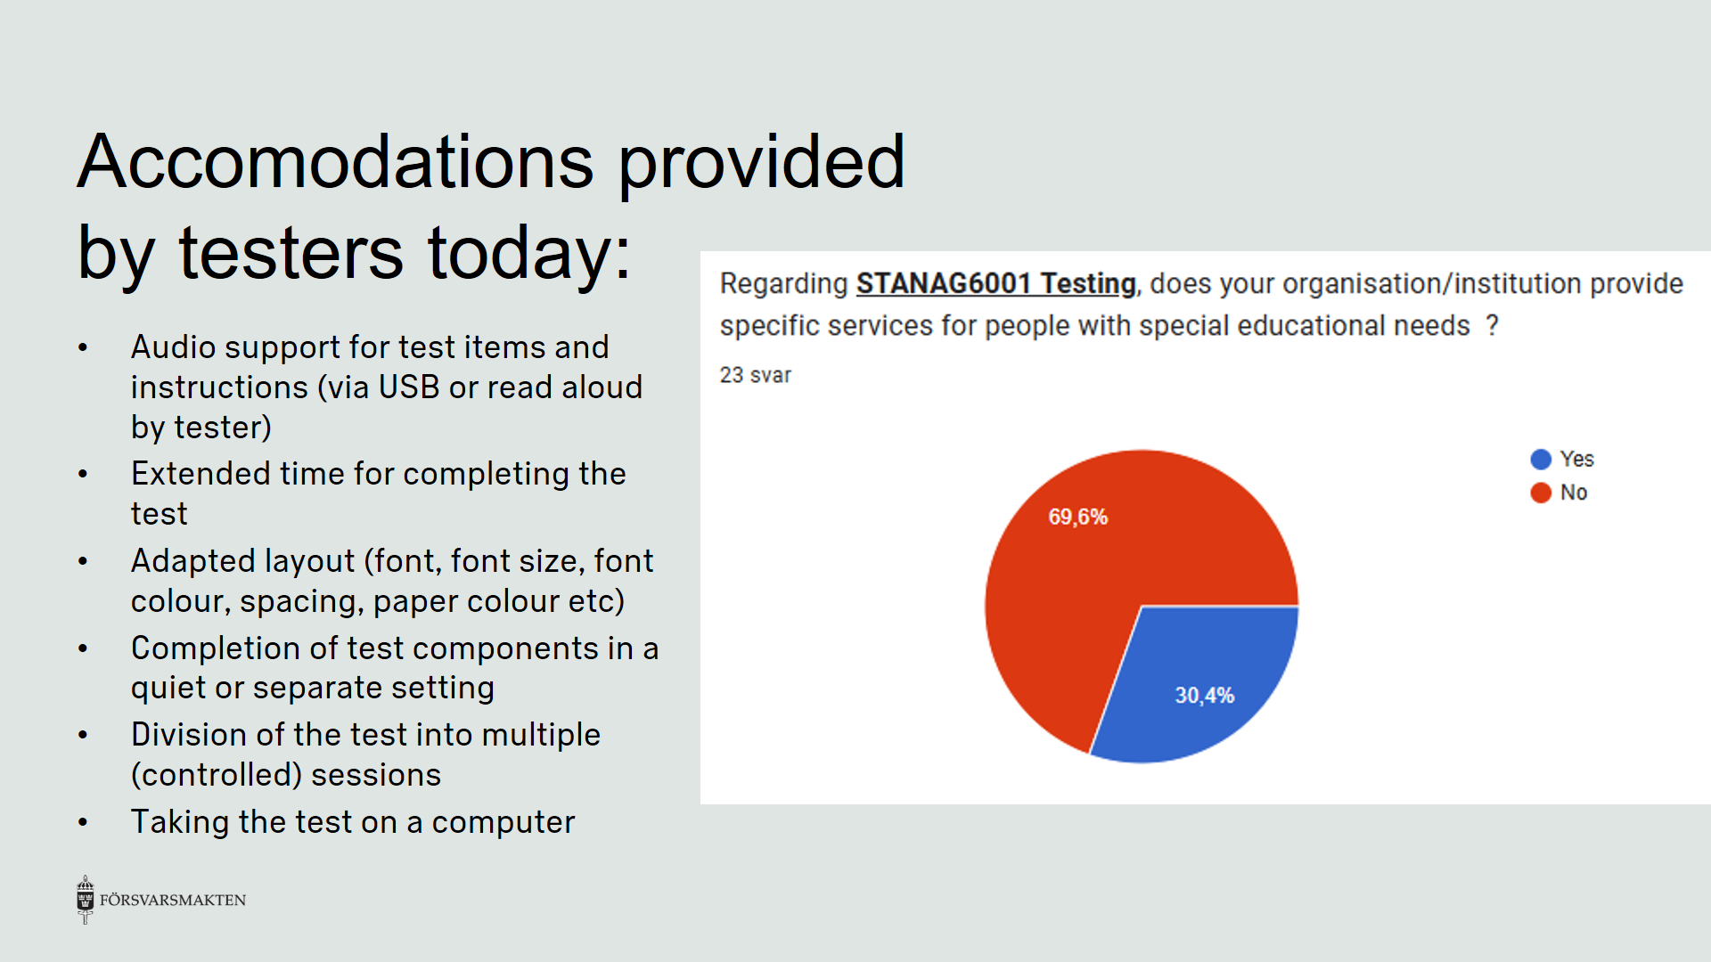

Slide 6
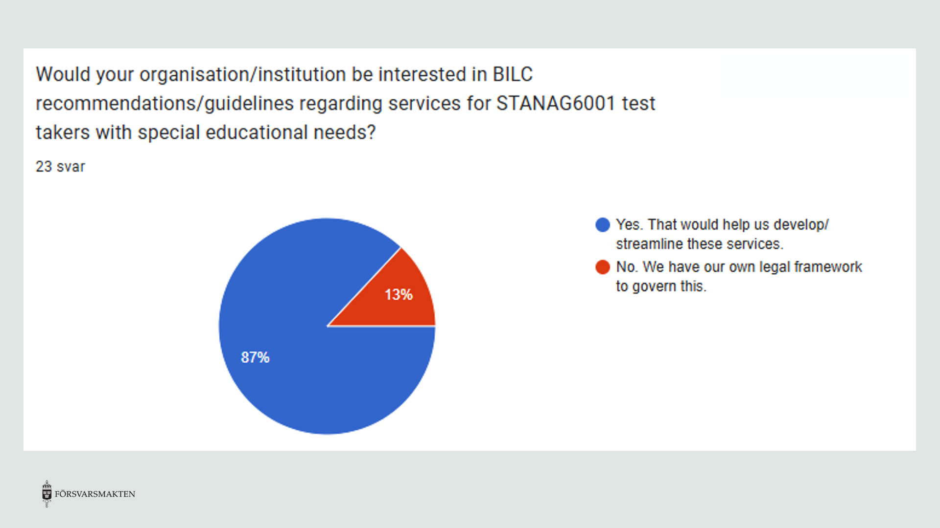

Slide 7
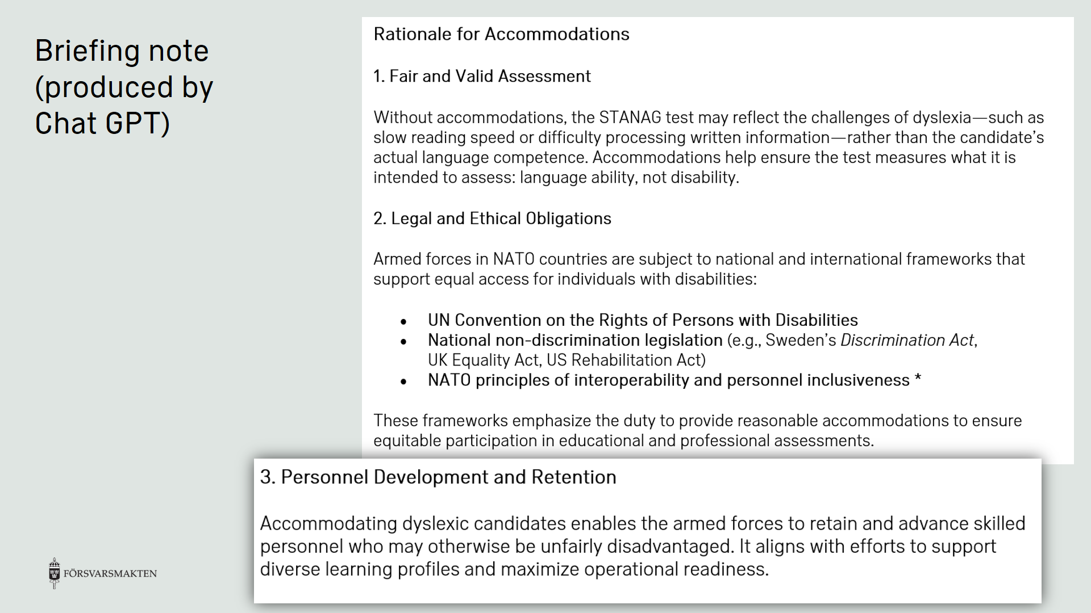

Slide 8
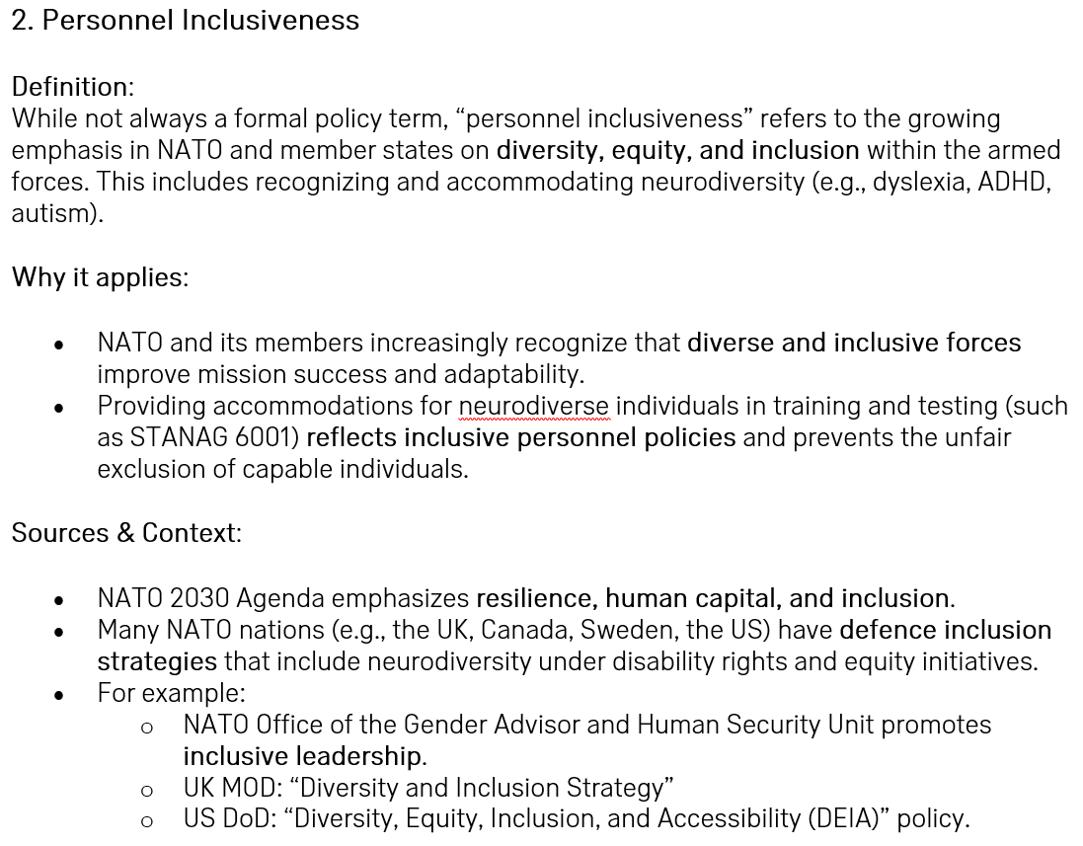

Slide 9
